Slide 1
Lessons Learned and Novel Investigation Techniques in Response to a Large Community Outbreak of HIV-1 infection
Philip J. Peters MD
HIV Testing and Biomedical Interventions Activity Leader,
HIV Epidemiology Branch
Division of HIV/AIDS Prevention
Disclosures: I have no actual or potential conflict of interest in relation to this presentation
The findings and conclusions in this report are those of the authors and do not necessarily represent the official position of the Centers for Disease Control and Prevention.
National Center for HIV/AIDS, Viral Hepatitis, STD, and TB Prevention
Division of HIV/AIDS Prevention

Slide 2
Lessons Learned
Disease Investigation Specialists and Public Health Nurses are Critical to Public Health Prevention and Responses
Hepatitis C Virus Infections indicate Unsafe Injection Drug Use and Vulnerability to HIV Infection in a Community
Emergency Responses are Challenging

Slide 3
Lessons Learned
Disease Investigation Specialists and Public Health Nurses are Critical to Public Health Prevention and Responses
Hepatitis C Virus Infections indicate Unsafe Injection Drug Use and Vulnerability to HIV Infection in a Community
Emergency Responses are Challenging
… Preparedness is also Difficult

Slide 4
Disease Investigation Specialists –
Contact Tracing

Slide 5
Disease Investigation Specialists –
Contact Tracing

Slide 6
Disease Investigation Specialists –
Contact Tracing

Slide 7
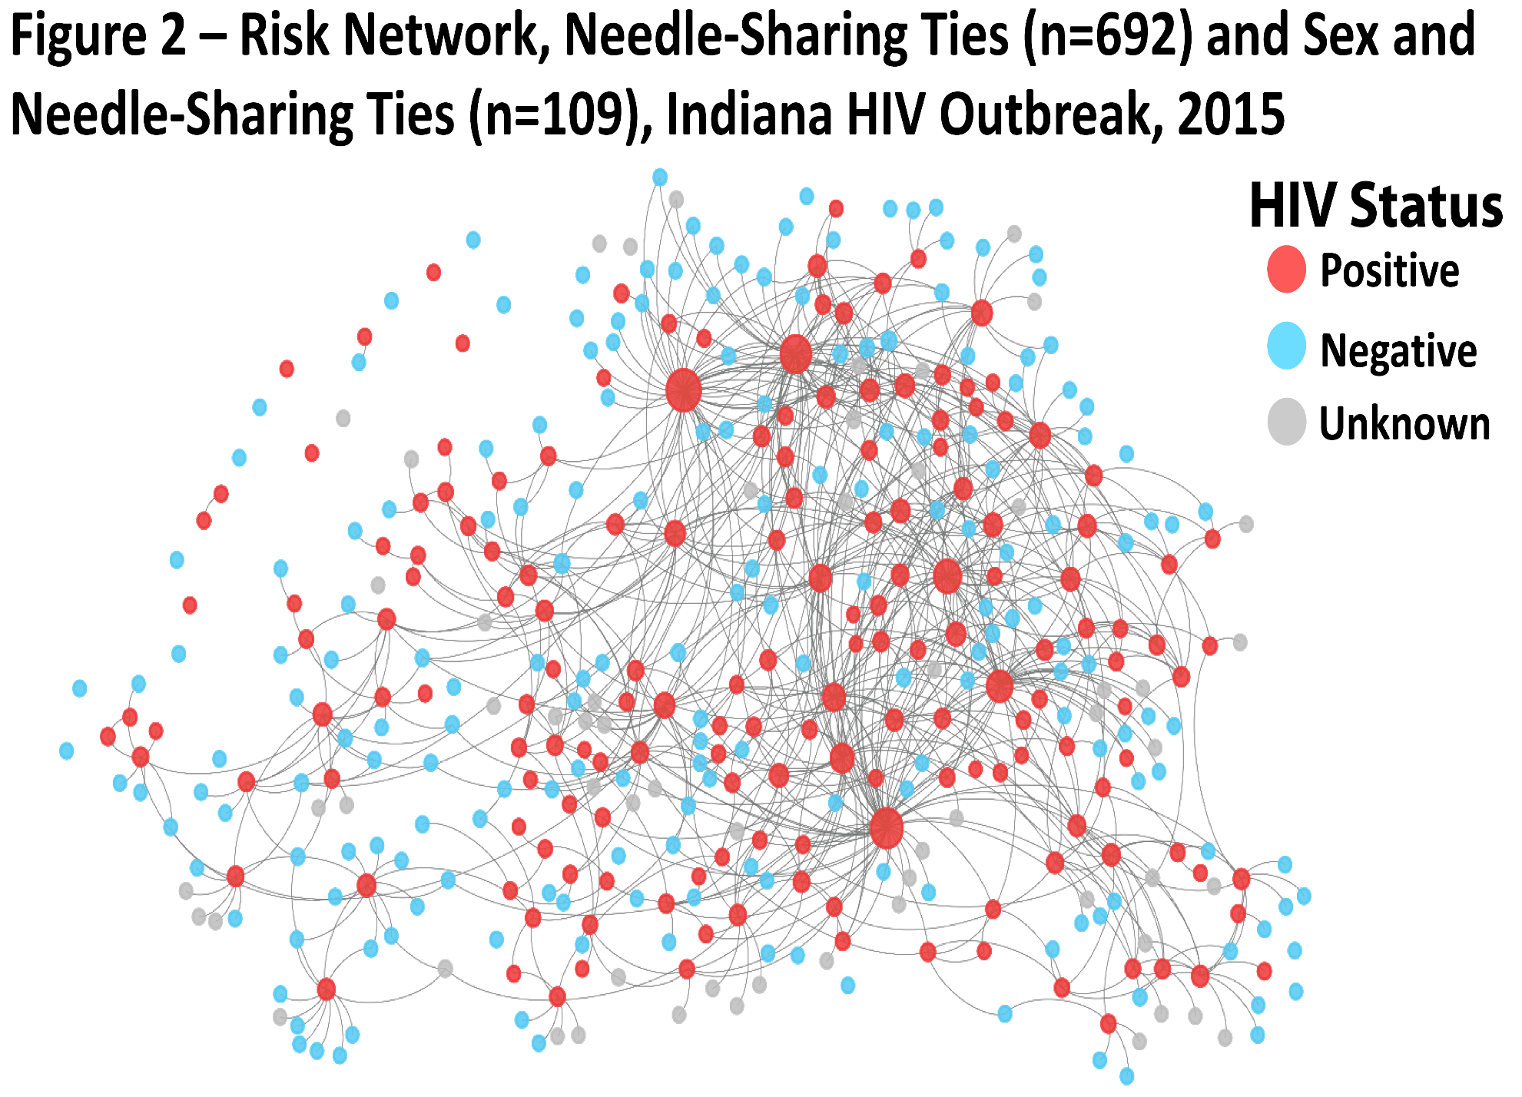

Slide 8
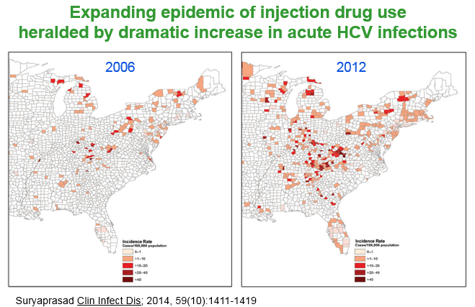
The epidemiology of IDU is changing
The communities affected are not typical of those affected historically by HIV infection or injection drug use

Slide 9
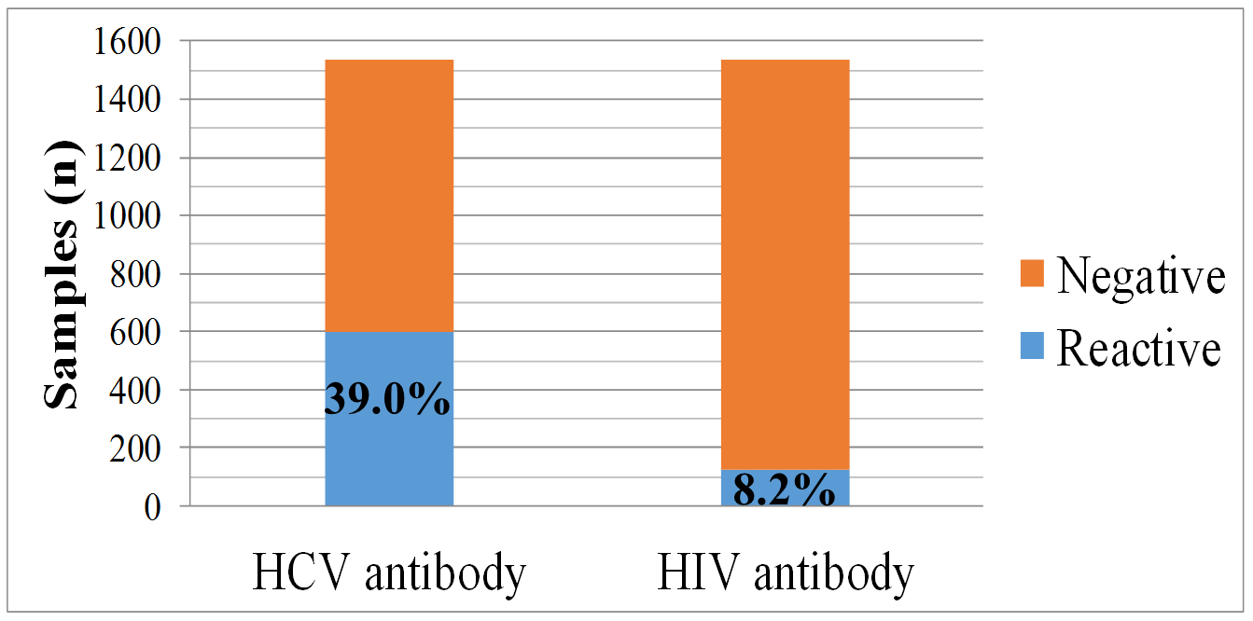
Outbreak-associated specimens tested for HIV and HCV, February - September 2015, n=1,534 specimens
Of HCV reactive specimens,19.4% co-infected with HIV
Ref: SJ Blosser, KA Backfish, M Cross, et al. ID Week 2015

Slide 10
Phylogenetic Analysis – Molecular Epidemiology
Phylogenetics: evolutionary relationships among organisms
  Molecular phylogenetics uses nucleotide sequences
Computational algorithms compare sequences and infer the most likely evolutionary relationship
  Phylogenetic tree displays these evolutionary relationships
  Clusters defined as viruses highly likely in transmission network
  Usually cannot determine directionality of transmission
Despite relevance to HIV and HCV transmission, these analyses are rarely used in real-time to inform interventions

Slide 11
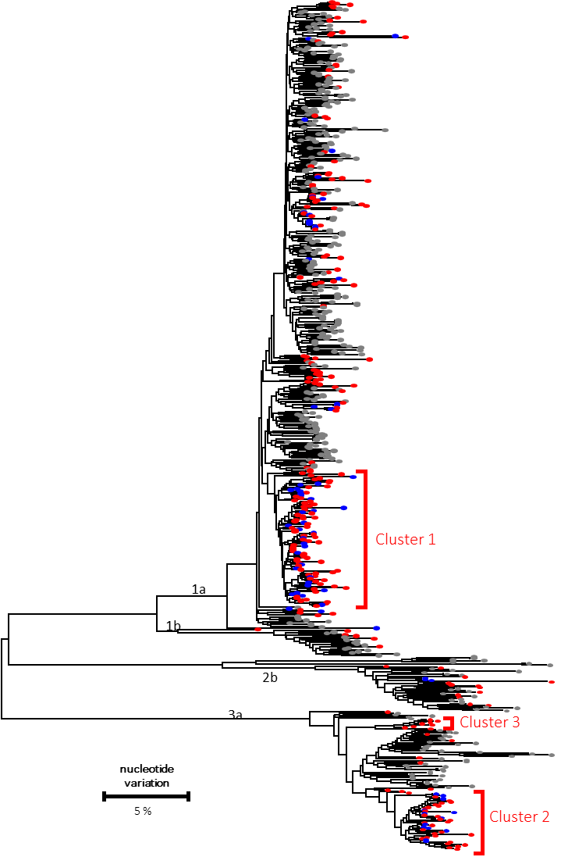
Maximum likelihood phylo-genetic tree of HCV NS5b consensus sequences
HCV mono-infected isolates
HIV/HCV coinfected isolates
North America References
24%
N=70
76%
N=227

Slide 12
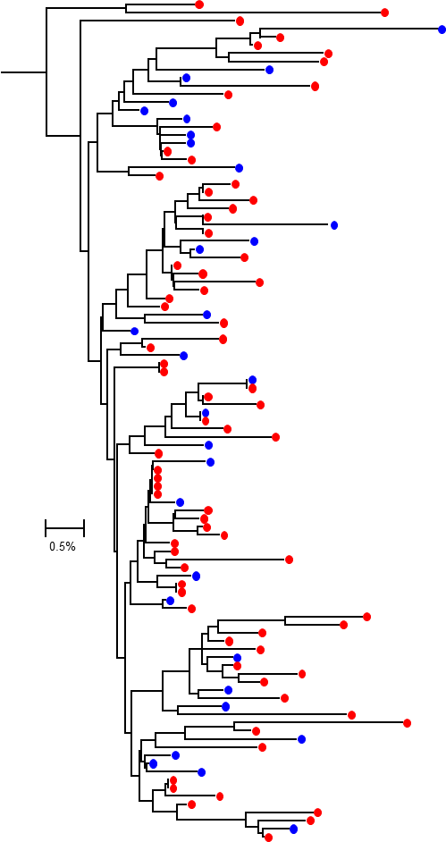
HCV Cluster 1:
Maximum likelihood phylogenetic tree of HCV NS5b consensus sequences
HCV mono-infected isolates
HIV/HCV coinfected isolates
North America References

Slide 13
HCV Phylogenetic Analysis – Molecular Epidemiology
Extensive and Molecularly Diverse Hepatitis C Viruses
  Multiple strains of HCV have been introduced into this network of people who inject drugs (PWID) over a long period of time
  HCV treatment is curative – Treat and Prevent
Large Clusters of Hepatitis C Viruses
  HCV transmission is on-going
  HCV networks involve HIV-infected and HIV-uninfected persons
  Despite high burden of HCV infection – HCV prevention is needed
Novel, Direct HCV Evaluation
  Detect the leading edge of HCV transmissions
  Indications for syringe exchange
  Prioritize contact tracing and HCV curative treatment

Slide 14
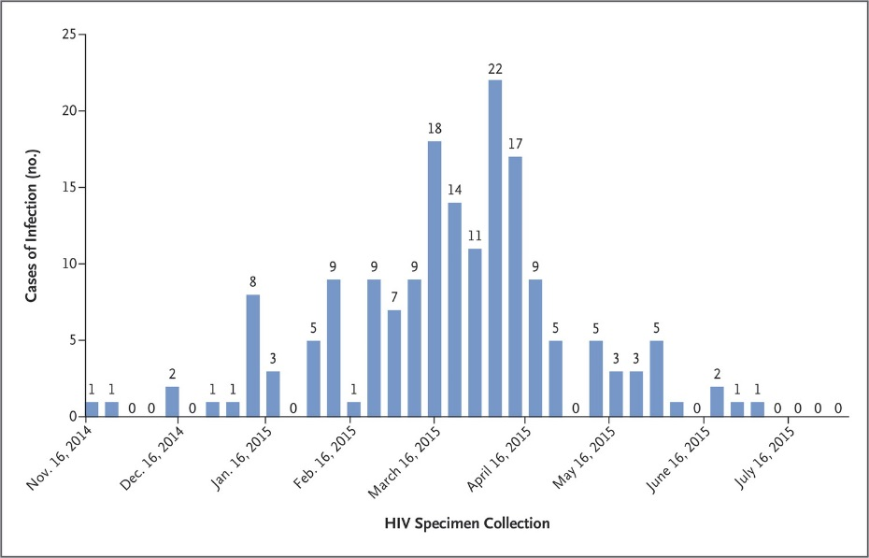
A Sentinel Event has Occurred
Outbreak of 181 HIV infections spread rapidly in a network of people who inject drugs (PWID) in a rural community in Indiana with only five previous HIV infections in the past 10 years
Other U.S. jurisdictions may be at risk for similar event
Unique rural health challenges
  Large populations of PWID (annual testing) without access to testing
  HIV prevention interventions not available (e.g., syringe services)
  Shortage of public health and medical care providers

Slide 15
Preparedness Recommendations
Determine if unsafe injection of drugs is occurring
  Monitoring data sources including acute HCV and overdoses
  Deliverable: dashboard to facilitate on-going monitoring
Enhance testing for HIV and HCV infections
  Providers for persons with substance use disorder
  Jails and prisons
  Emergency departments and in-patient settings
  Metric: HIV and HCV testing
Prepare an action plan for a potential HIV outbreak
  Identify state preparedness partner and develop a response plan
  Metric: HIV health services access

Slide 16
Enhanced PWID HIV Prevention
Access to sterile syringes
  As permitted by federal, state, and local laws
  Communities without operational experience
Provision of pre-exposure prophylaxis (PrEP)
  Nurse mentored program
  Embedded in other services
Expand access to medication assisted therapy (MAT)
  Naloxone, buprenorphine, and methadone

Slide 17
Lessons Learned
Disease Investigation Specialists and Public Health Nurses are Critical to Public Health Prevention and Responses
  Core activity but applied with novel technologies – network analysis
  Can be leveraged for related activities – HCV, overdose
Hepatitis C Virus Infections indicate Unsafe Injection Drug Use and Vulnerability to HIV Infection in a Community
  HIV prevention interventions will also prevent HCV infections
  Need for direct HCV response – treatment, contact tracing
Emergency Responses Challenging; Preparedness Difficult
  Requires resources and local champions
  Necessary after this sentinel event HIV outbreak

Slide 18
Acknowledgements
Scott County Health Department
Clark County Health Department
Indiana State Department of Health
Foundations Family Medicine
Indiana University School of Medicine and Physicians
550 Clinic at University of Louisville
CDC Division of HIV/AIDS Prevention
CDC Division of Viral Hepatitis
CDC Division of STD Prevention
CDC EIS Program Office
Notes:
We would like to acknowledge the many persons who have been integral to the outbreak investigation and response in Indiana. We cannot list everyone by name, but would like to generally acknowledge the Scott County Health Department, Clark County Health Department, Indiana State Department of Health, Foundations Family Medicine, Indiana University School of Medicine and Physicians, The 550 Clinic at University of Louisville and CDC’s Division of Viral Hepatitis, Division of HIV/AID Prevention, Division of STD Prevention, and the EIS Program Office.

Slide 19
HIV Prevention Interventions with Injection Drug Use and Time to Implement
Contact tracing
Antiretroviral therapy
Reduction in risk
of HIV infection
from IDU
Syringe exchange
56%
HIV testing
Opioid substitution therapy
64%
HIV prevention education
Pre-exposure prophylaxis
49%
Immediate
Long-Term
Timeline
Notes:
First, I’ll discuss the comprehensive package of HIV prevention interventions that were implemented as a part of the outbreak response. This diagram shows each of the interventions and I’ll take some time to talk through each one in-depth. No one of these interventions is 100% effective, but together they can help to reduce HIV transmission. Note, that at the onset of the outbreak, these interventions were NOT available in Austin and had to be newly established. Making these interventions available in Austin was essential given that most people in the community don’t have cars or other means to travel outside of the town. Second, I’ll present the findings from an analysis of the early impact of one of these interventions, the syringe exchange program. Third, our end by discussing the next steps for prevention of HIV transmission.

