Slide 1
“Catch me if you Can”
Disclosure:
This speaker has no potential or actual conflicts
of interest to disclose in relation to this presentation.
Rodrigo Garcia APN, MSN, CRNA, MBA, ACIT

Slide 2
“Catch me if you Can”
The Challenge to Survive

Slide 3

Frank Abagnale Jr. Carl Hanratty
Notes:
Briefly describe the true story of “Catch me if you Can”. Focus is on how Frank was able to do it so long and the unselfish way Carl was able to “ask” for help

Slide 4
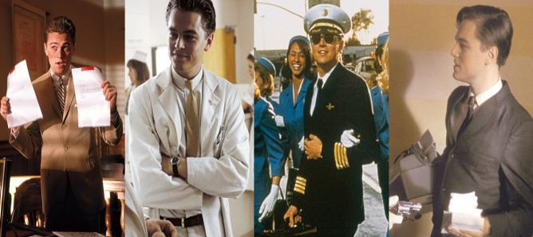
Frank Abagnale Jr.
Notes:
Pilot, Doctor, Lawyer, Millionaire. All before the age of 20

Slide 5

Frank Abagnale Jr.
Character Profile
Accessibility & Necessity
Enabling & ”Misdiagnosed”
Inadequate Intervention
Expert Knowledge
Notes:
Character Profile- What allowed Frank to accomplish all of this?
Smarter “how did you pass the bar exam?”

Slide 6
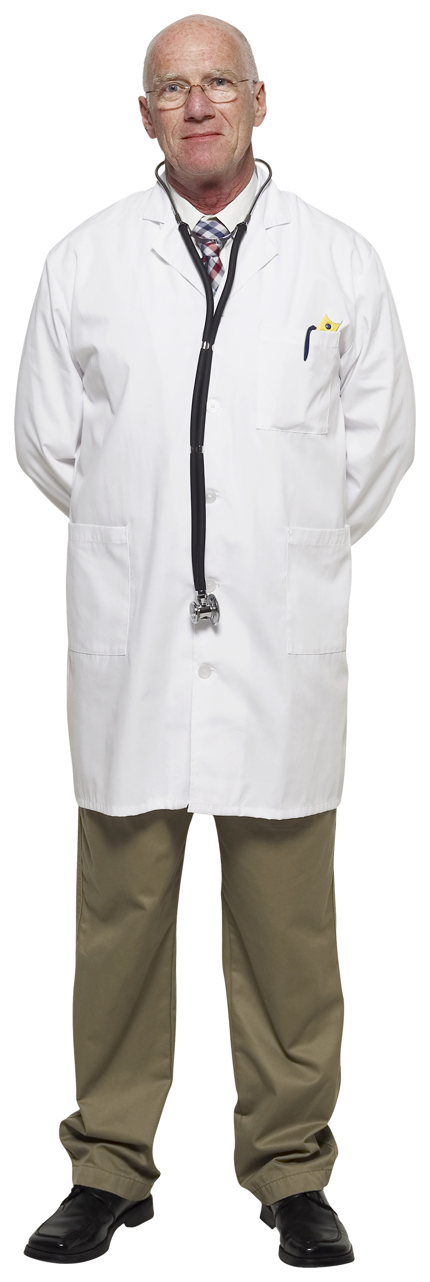
Addicted Professional
Character Profile
Accessibility & Necessity
Enabling & ”Misdiagnosed”
Inadequate Intervention
Expert Knowledge
Notes:
Character Profile- What allows the addict to continue to use? Smarter

Slide 7
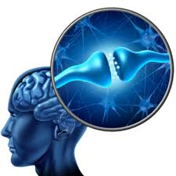
FAQ about Addiction
Is addiction a choice?
Is treatment necessary?
How long can addiction last?
How does it self resolve?
Notes:
Primary- Specific symptoms and prognosis. Not a result or symptom of another disease entity
Progressive- If untreated, it will worsen
Chronic. It can not be cured and requires life long intervention
Fatal- overdose, suicide, MSOF, etc

Slide 8
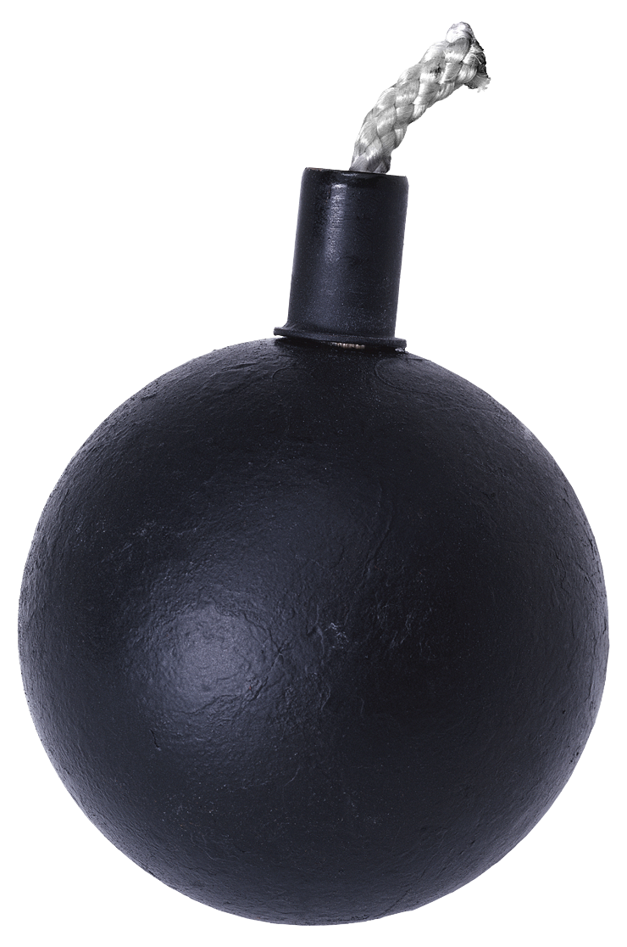






#1 Characteristics
High Accountable Professional (HAP) 10-15%
  Intelligent, top 25% of class
  Well liked and Respected
  Supervisors and Manager
  Advanced Degrees
  Top performers
Notes:
The most common characteristics of the addicted professional

Slide 9
#2 Accessibility & Necessity
Chemical Dependency is estimated to cost U.S. employers $276 billion a year. Three-fourths, or 76 percent, of people with a drug or alcohol problem are currently employed.
Substance Abuse and Mental Health Services Administration (SAMHSA)
Notes:
Includes sick days, workers comp, long term-short term disabilities, lost productivity, litigation costs,

Slide 10
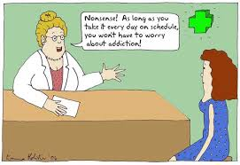
#3 Enabling & Misdiagnosis
“Nonsense! As long as you take it every day on schedule you wont have to worry about addiction!”
Notes:
The difference between dependence and physiological dependence is that physiological dependence often involves craving or a psychological “need” for the substance. It is craved because it causes an enjoyable mental reward. Emotions are changed and perceptions are altered. It is THIS reinforcement that leads to further dependence. Psychological dependence begins after the first trial which a person then becomes satisfied and the satisfaction increases with each use.
The first two criteria, tolerance and withdrawal, are central to “physiological dependence” on a drug. A person can be diagnosed with substance dependence either with or without the “physiological dependence,” although a person is at greater risk of medical problems and relapse if he does not have “physiological dependence.”
Principals of Drugs. 2013. In National Institute on Drug Abuse. Retrieved from http://www.drugabuse.gov/publications/principles-drug-addiction-treatment-research-based-guide-third-edition/frequently-asked-questions/there-difference-between-physical-dependence
Photo Credit. 2013. www.waleto.com

Slide 11
# 4 INADAQUATE INTERVENTION
The Employer
Diagnosis and
Treatment
Professional licensing
Agency
Addict
Monitoring Agency
Law enforcement
Notes:
Our Current System: Should be simple, streamline, and easy.

Slide 12
# 4 INADAQUATE INTERVENTION

Slide 13
July31
NBCRNA
July31
July31
NBCRNA
July31
July31
NBCRNA
October
BON
October
BON
NBCRNA HOURS
ISBON RENEWAL
ISNAP CONTRACT
RESIGNATION VS TERMINATION
AANA REQUIREMENTS
LEGAL

Slide 14
July31
NBCRNA
July31
July31
NBCRNA
July31
July31
NBCRNA
October
BON
October
BON

Slide 15

#5 Expert Knowledge
“ I’m kind of the expert in your field ”
-The Addicted Professional
Notes:
The addicted HAP know the system, policies, rules, and regulations better than the employer.

Slide 16
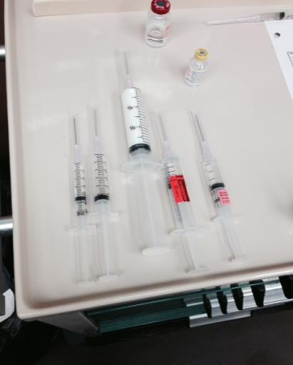
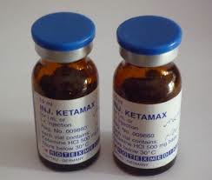
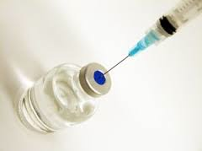
Notes:
Policy and Procedures are essential missing.
Addict knows them better than the Facility

Slide 17
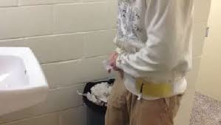
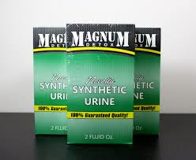
History of the Urinalysis
Dilution
Creatinine
Synthetics
Foreign Substances
Tampering
Notes:
Monitor all urine drug screens.

Slide 18
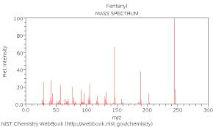
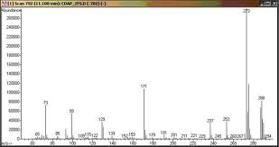
Mass Spectrometry
Notes:
Prefilled concentrated syringes.

Slide 19
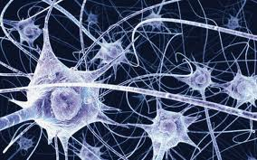
“ Although the initial act of ingestion or participation of use is voluntary, cessation of the habit is not ”
Notes:
Dr. Gabor Matte
Psychiatrist and Addictionologist
Vancover, Canada
****the addict will actually go through GREAT lengths to continue the drug use.

Slide 20
Solutions
Character Profile
Accessibility & Necessity
Enabling & “Misdiagnosed”
Inadequate Intervention
Expert Knowledge
Accept “Different Similarities”
Consider the Compulsion
Utilize Objective Parameter
Oligopolize the Market
Learn More
Notes:
Urine Drug screens are diagnostic, not preventative

Slide 21
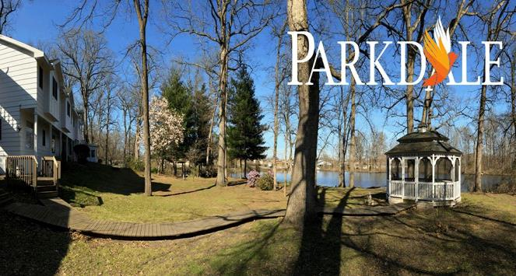
Question?

