Slide 1
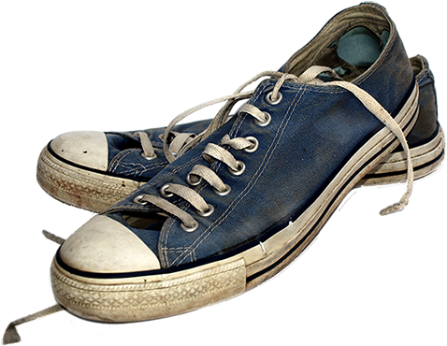

Gently used?

Slide 2
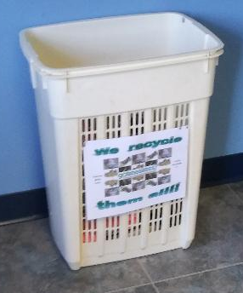
Drop them in this bin → → →

Slide 3
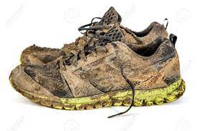
Dirty?

Slide 4
Drop them in this bin → → →

Slide 5
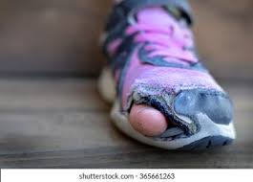
Blow out?

Slide 6
Drop them in this bin → → →

Slide 7
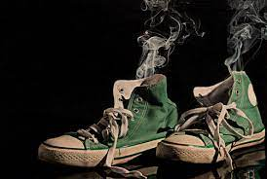
Sole gone?

Slide 8
Drop them in this bin → → →

Slide 9
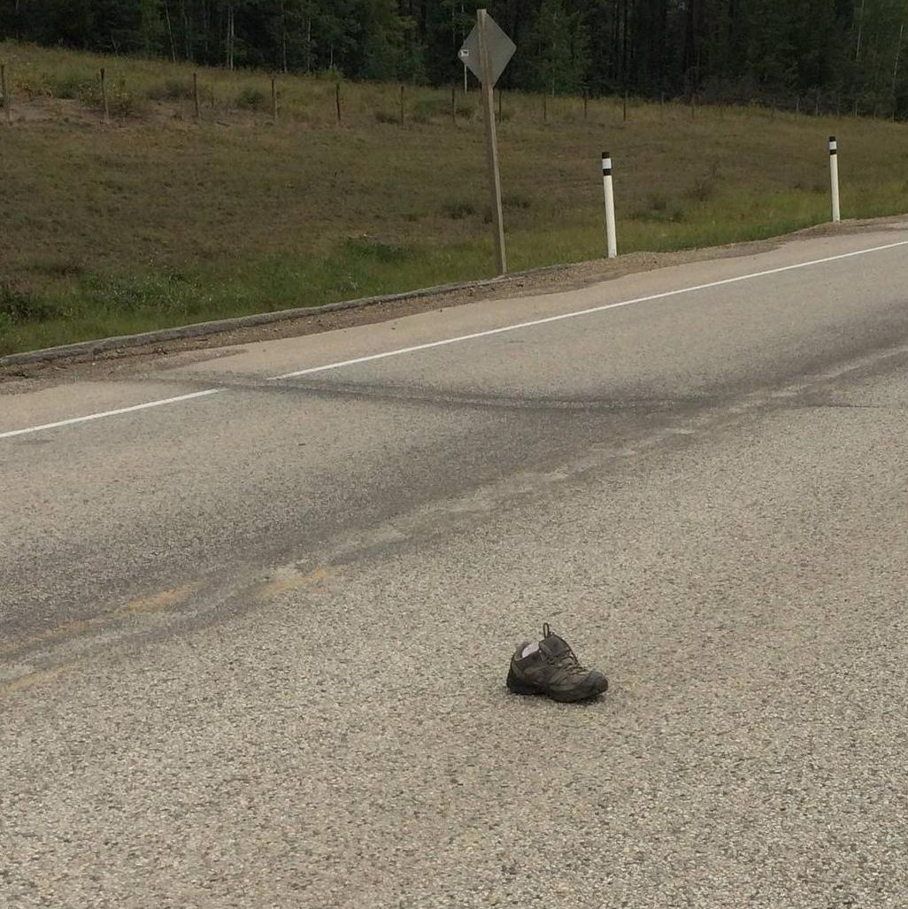
Can’t find the
other one?

Slide 10
Drop it in
this bin
→ → →

Slide 11
From the gently used to the very broke in
Bring them to the Clerk-Treasurer’s Office
And drop them in this bin

Slide 12
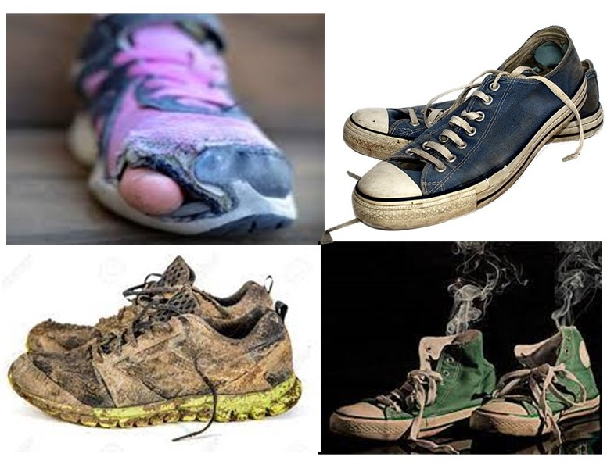
We recycle
them all!!

