Slide 1
State Election Support System
& Who Are Your Elected Officials
indiana.sess.cloud
in.wayeo.us

Slide 2
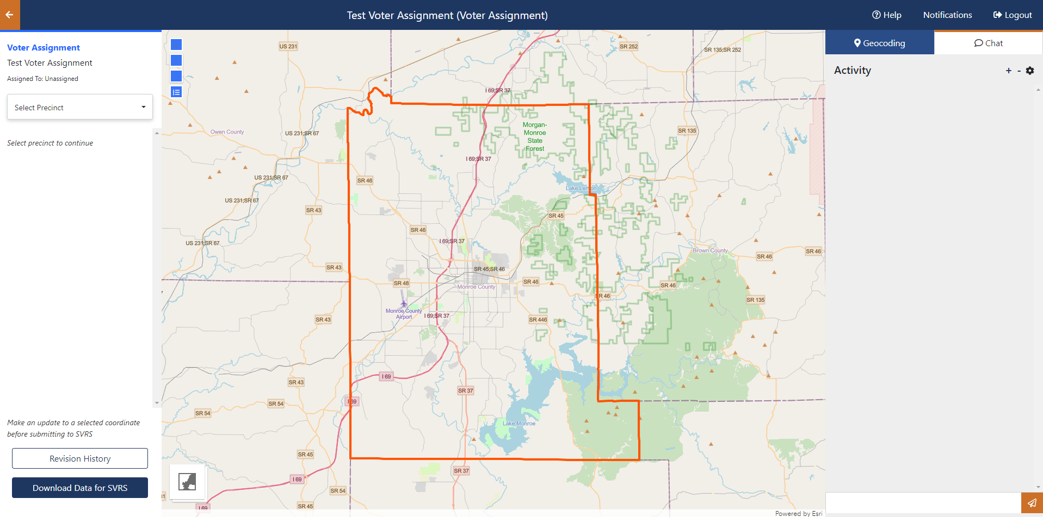
State Election Support System
indiana.sess.cloud

Slide 3
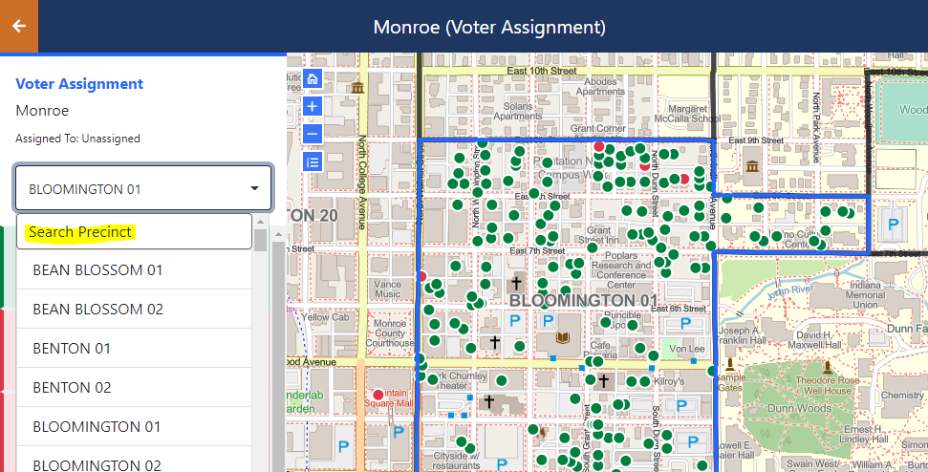
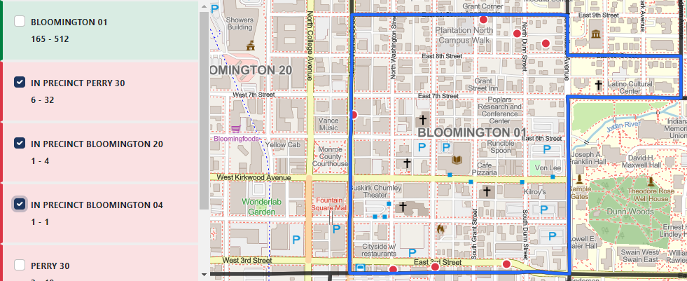
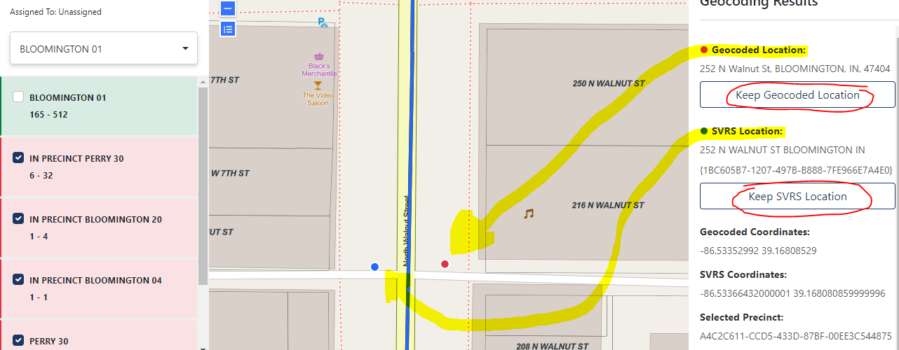
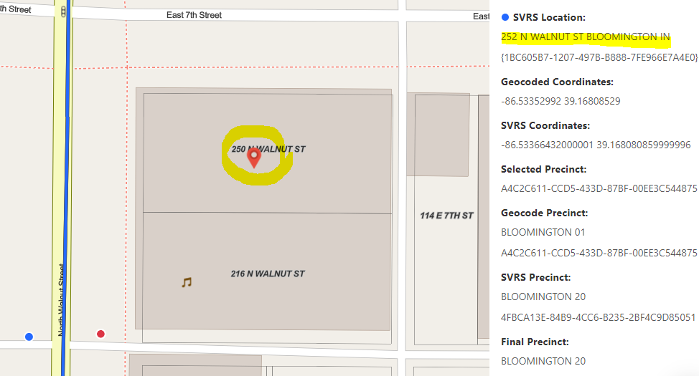
indiana.sess.cloud

Slide 4
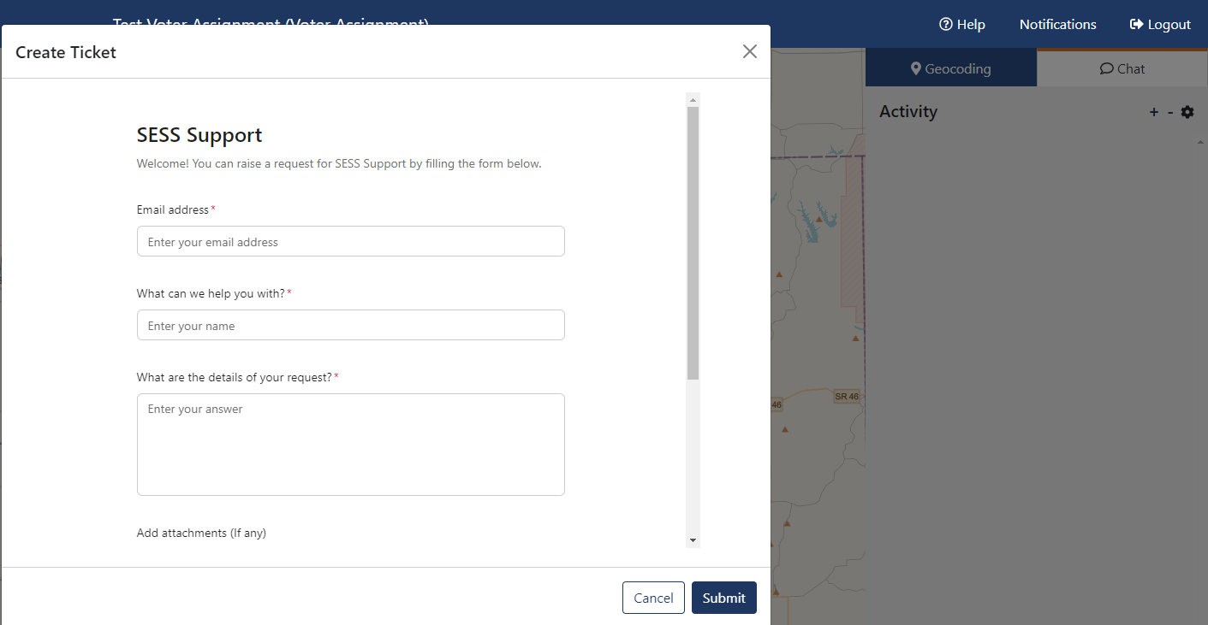
SESS Support Requests
indiana.sess.cloud

Slide 5
SESS Training Dates
Voter Assignment | June 25, 2024
Annexations | June 27, 2024
Reprencincting | September 5, 2024
indiana.sess.cloud

Slide 6
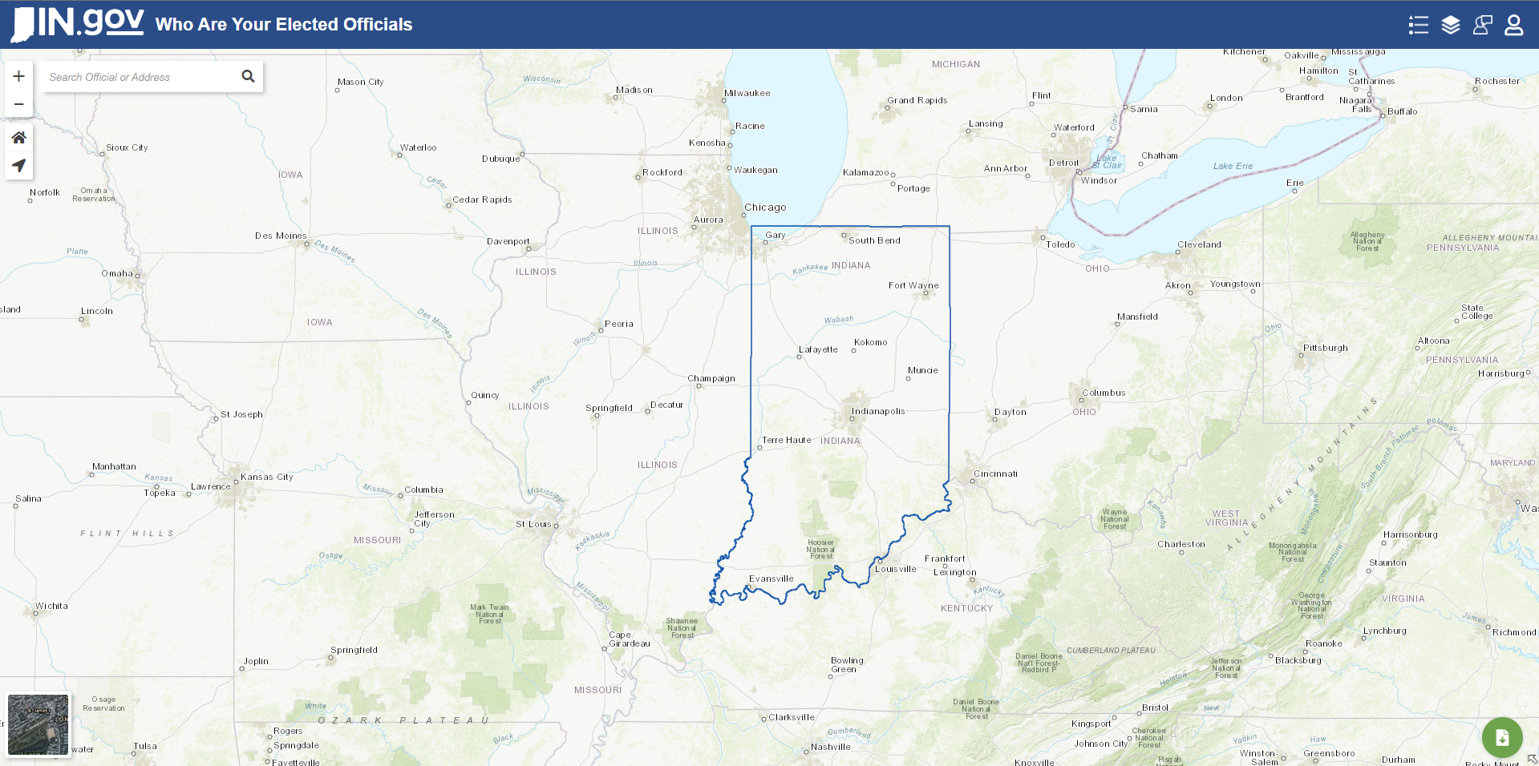
Who Are Your Elected Officials
in.wayeo.us

Slide 7
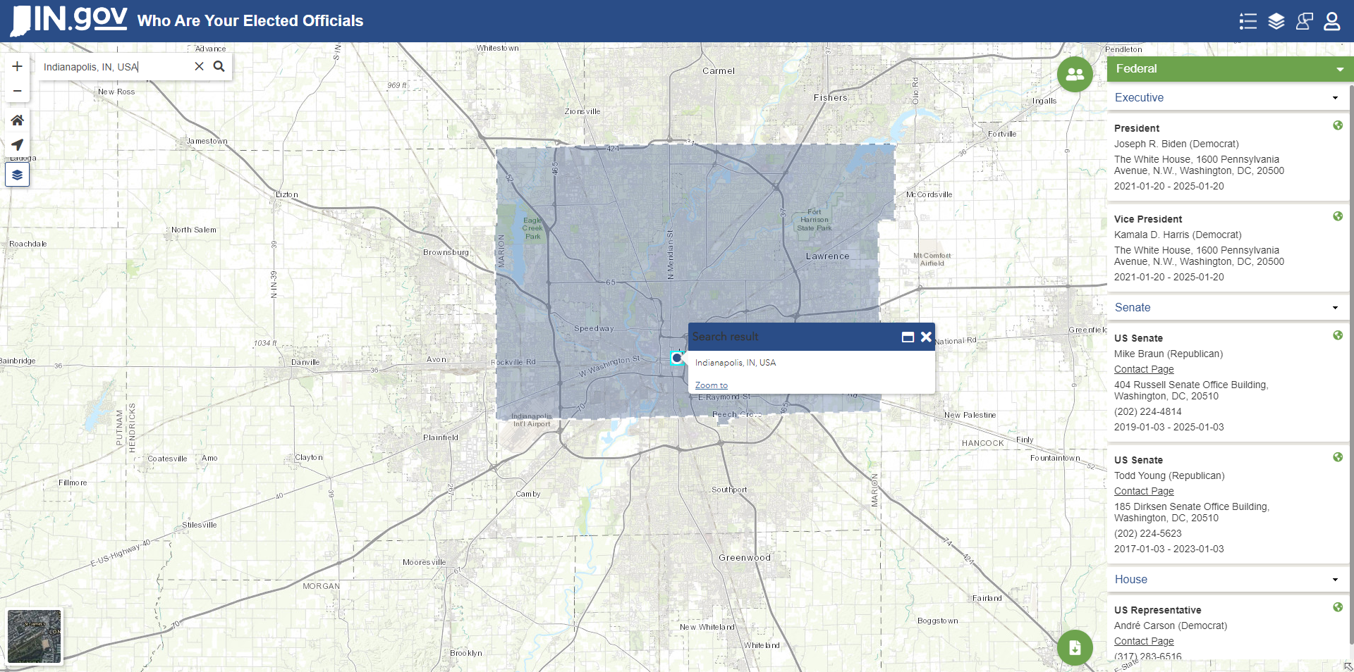
in.wayeo.us

Slide 8
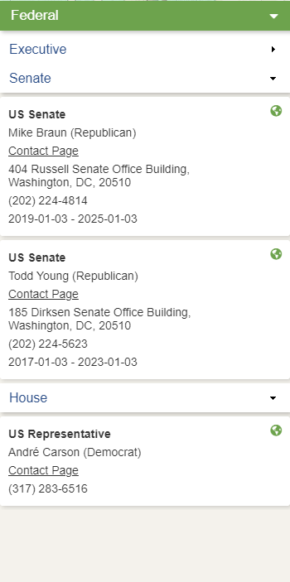
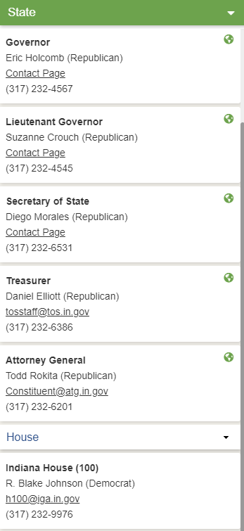
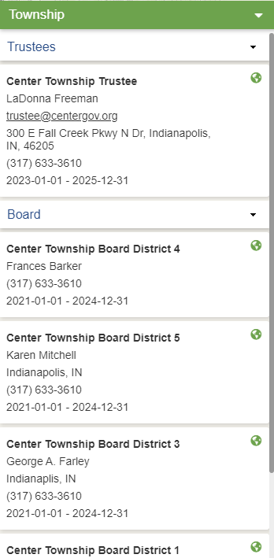
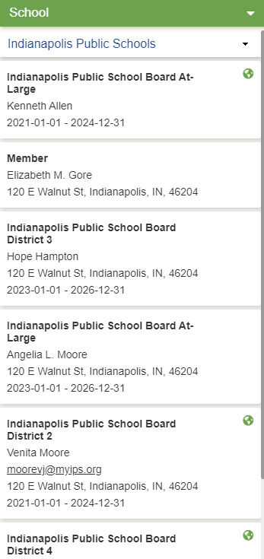
in.wayeo.us

Slide 9
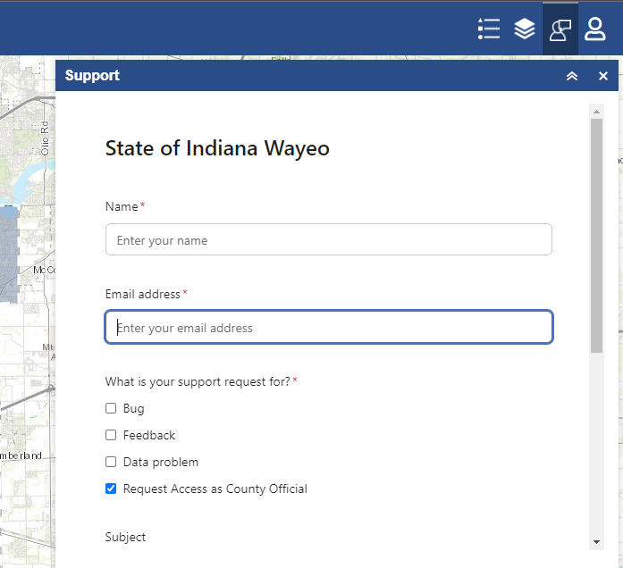
WAYEO Support Requests
in.wayeo.us

Slide 10
Contact Info:
General: info@geoconvergence.com
Paul McBride: paul.m@geoconvergence.com
GIS Director
Sam Armstrong: sam.a@geoconvergence.com
GIS Analyst
indiana.sess.cloud
in.wayeo.us

