Slide 1



Working with State Legislators
Indiana Election Administrator’s Conference, Dec 2025
Katy Owens Hubler, director, Elections & Redistricting
National Conference of State Legislatures (NCSL)

Slide 2



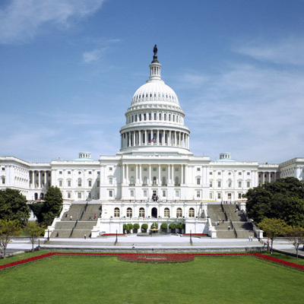

How NCSL Strengthens Legislatures
Policy Research
Connections
Training
State Voice in D.C.
Meetings
Notes:
Research
NCSL tracks more than 1,400 issue areas.
From criminal justice reform, education, health care and transportation to the more obscure issues–chances are we have someone tracking the issue and can provide timely information.
Connections
NCSL brings together legislators and staff from both sides of the aisle to tackle and discuss difficult problems and find reasonable solutions.
Training
NCSL specializes in professional development tailored specifically for legislators and staff, and many of these professional development opportunities are at no cost to you or your state.
State Voice in D.C.
NCSL advocates on Capitol Hill on behalf of all states –fighting against preemption, for the 10th amendment and maintaining federalism. We have eight committees—very similar to your states.
Meetings
NCSL creates regular platforms for leading discussions on some of our nation’s most pressing issues. Many of you may have heard of the Legislative Summit—NCSL’s annual meeting—but this is just one example. We host more than 100 policy-oriented meetings during a typical year.

Slide 3
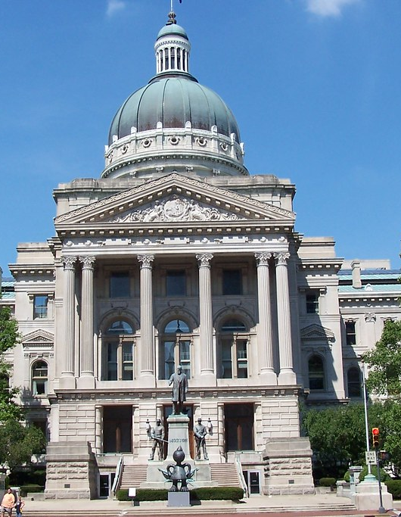
Get to Know Your Legislators
  Chair of the committee that handles election policy.
  Other members of the committee.
  Legislative leaders and how they may impact what bills are heard.
  Legislators who represent your jurisdiction.
  Who else introduces bills or is otherwise interested in election policy?
    Go beyond interacting with those on the committee or your representative. Legislators handle hundreds of bills and dozens of topics, but they like to have a specialty.
This Photo by Unknown Author is licensed under CC BY-NC
Notes:
The first step—and it may seem obvious—is for those who don’t know their legislators to get to know them.
Attend their town halls, invite them for coffee, send an invite to any events you’re planning. Asking multiple times is not a problem—things get lost in the shuffle. Most importantly, invite them to see your operation! Take them on a tour! Seeing how you process absentee ballots or how the tabulation machines work might be very illuminating.

Slide 4

Build Relationships
  Introduce yourself at the capitol or after a committee hearing.
  Attend town halls or other formal gatherings.
  Where can you meet with these legislators informally? Do they show up at county fairs or other events?
  Establish other areas of connection, outside of your mutual interest in election policies.
  Your allies may surprise you.
  Don’t burn bridges – you never know who will chair the committee next.
Notes:
Be open to relationships with anyone in the legislature. Even in a hyperpartisan world, who your potential allies are may surprise you. A legislator of a different political party may be open to your input as an election
administrator, and lawmakers who have not been engaged on election legislation may be inspired to dive in after making a connection with you.
While many local election officials may start with lawmakers from their district because of their shared constituency, you could consider developing relationships with a wider group of legislators to ensure that your expertise reaches the most appropriate decision-makers. That includes legislators who champion election issues, chairs of the legislature’s election committees and even all members of the election committees.
Do your kids go to similar summer camps? Do you share hobbies? Even if there’s a partisan divide, there are ways to establish a human connection.

Slide 5
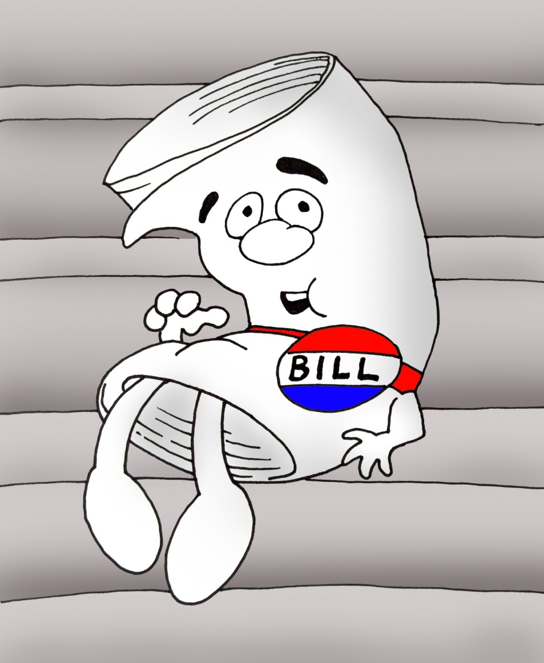
Give Input on Bills
  Keep an eye on the legislative calendar.
  Track relevant bills.
  Give formal testimony on bills during committee hearings.
  Play offense as well as defense.
  Don’t always say no or list the reasons a bill causes difficulties.
    What can you say yes to?
    Have a conversation about the core impetus behind the bill – is there another way to do it that achieves the legislator’s intent?
    Legislators like solutions. What solutions can you provide?
  Use both stories and data.
Notes:
Watch the calendar. When legislators are in session, it’s like you during election season—they focus on the most important, urgent issues at hand and let everything else go until later. So know when your state’s legislature is in session and reach out to your legislators before that session starts—especially if there’s a specific bill or change you’d like to see. They need that lead time. Do not wait until a bill has been passed to share your perspective on it. Instead, during session, pay attention to the election committee’s hearing schedule and which bills will be heard at which hearings. If you have comments on a bill, share those with the relevant committee members before the scheduled hearing. Your input at this stage, especially on technical matters, will allow the bill to be modified or amended before it moves on to possibly become law. In general, the earlier you provide feedback, the easier it is to incorporate into the legislation. Also consider attending committee hearings and testifying (orally, in writing, or both).
Especially when advocating for or against legislation, be prepared to explain the problem and the specific solution you’d like to see. Arm yourself with useful anecdotes, data and financial information (such as how much it costs to run an election and where your funds come from), and take the time to anticipate legislators’ questions (or objections) and have answers at the ready.
While legislators often have widely different priorities, there are a few safe bets when it comes to motivating factors. Financial savings tops the list, and local election officials have unique insight into election costs and potential unfunded mandates—so be prepared to discuss issues such as unexpected costs, how a requested change could save money, now or in the long run, etc. Also consider how the change could help the lawmaker look like a problem solver. Know which issues are particularly important to the legislator and their constituents and make a case for how the change helps them. Bottom line: Election officials will need to do the work to show legislators why they should care.
Some policies are impacted by a national conversation or 50-state comparisons, but often what legislators want to know is what’s happening with their neighbor. Reach out to NCSL, use our legislation tracker and our webpages.

Slide 6

Communicate Strategically
    Reach out multiple times by multiple means (via email, social media, phone calls, texts, letters and in-person conversations).
    Make your pitch:
      Bite size: less than a minute
      Snack: a five-minute chat
      Meal: a 20-minute conversation
    Legislators are busy and multitasking—keep your message focused and relevant.
Notes:
Most legislators, even those who care passionately about elections, only spend a sliver of their attention on elections; they’re also on other committees, sponsoring other bills, serving their constituents, perhaps campaigning again and sometimes holding down another job. They are busy people, and they want to be problem solvers. How you communicate with them must take all this into account
They’re juggling many responsibilities, and to get through to them, you must be clear, concise and direct. Remember that legislators have limited time and want to be problem solvers. So tell them what the problem is, why it matters, and how it can be fixed. They need to know what you want from them, what action you want them to take. Don’t beat around the bush.
Building these relationships takes patience and persistence. Do not be afraid to reach out to legislators multiple times by multiple means (email, phone, social media, in person, etc.) and be willing to play the long game—it’s possible that your offers to “chat elections” may go unheeded until the legislator urgently needs your expertise, but by then they will know you are someone they can consult.

Slide 7
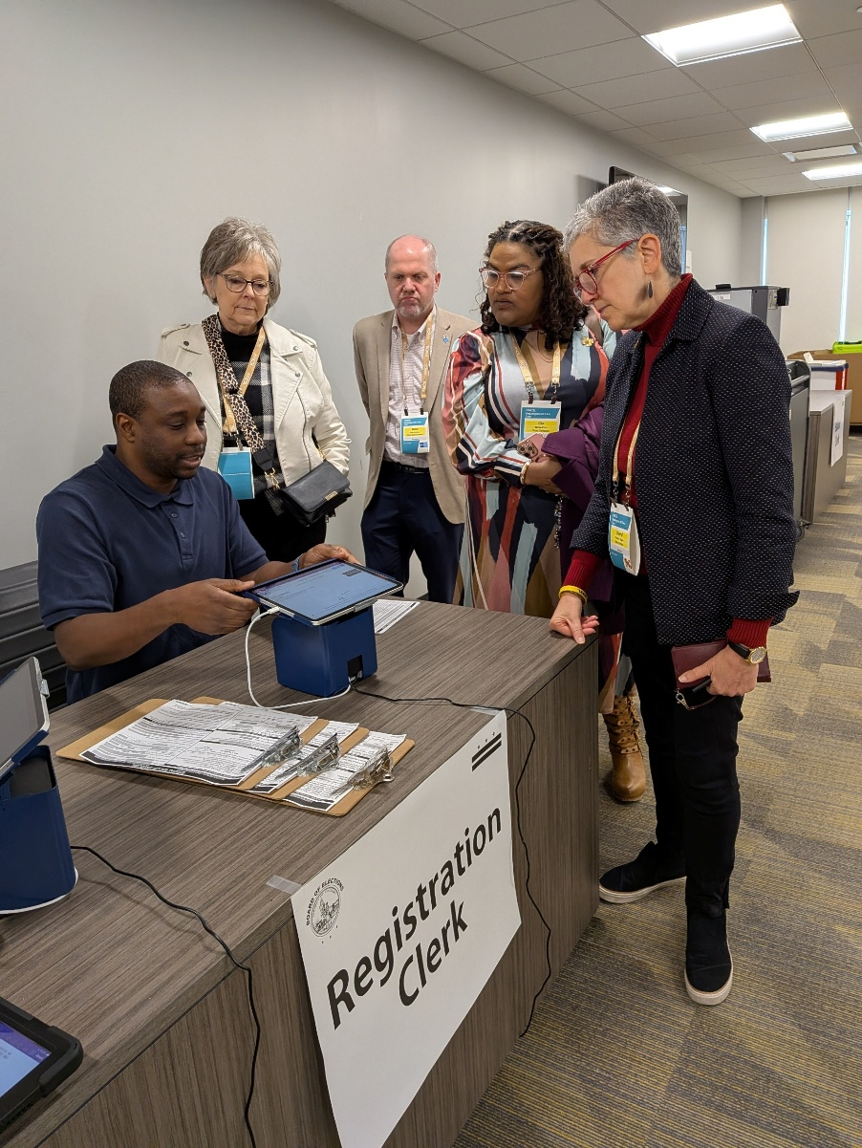
Embrace an Educational Mindset
  Invite legislators on a tour of your election office.
  Offer a community event at your election office, open to the public and with photo ops.
  Keep inviting them to things. Legislators are busy and even if you invited them once (or ten times!) keep trying.
  When talking about a policy or something that affects your work, use stories from the community backed up by facts.
  Cite what is happening in nearby states.

Slide 8

Get to Know Legislative Staff
  Know nonpartisan research staff and committee staff who work on election policies.
    What data or information can you provide that would help them in their work?
  Get to know partisan staff and the role they play that may be different than nonpartisan staff.
  Do legislators have personal staff during session? Do you have their contact information?
  Do you know legal staff? Librarians? Fiscal analysts?
This Photo by Unknown Author is licensed under CC BY-SA-NC

Slide 9

Keep At It
Engage legislators outside of session and have conversations in a less formal context. Try to get ahead of things.
They want to hear from you!
About 20% of legislators are new each session and there can be a steep learning curve.
This Photo by Unknown Author is licensed under CC BY-SA
Notes:
Legislators won their election by reaching out to the community – if the community cares about something they’re more likely to as well. Your jurisdiction could be impacted differently than a smaller or larger one – tell them that.
After every election about 20% of legislators across the county are new. After 2024 we found that 40% of the chairs of election committees were different from the year prior.

Slide 10

Thank you for having me!
Katy Owens Hubler
Director, Elections & Redistricting
Katy.owenshubler@ncsl.org
www.ncsl.org
@NCSLorg
Denver
7700 East First Place,
Denver CO 80230
Washington D.C.
444 North Capitol Street, N.W.
Suite 515,
Washington, D.C. 20001

