Slide 1
Where is that Darn Law?
Valerie Warycha, Co-Counsel
Indiana Election Division

Slide 2
Where is that Darn Law?
State of Indiana
U.S. Code
iga.in.gov
uscode.house.gov

Slide 3
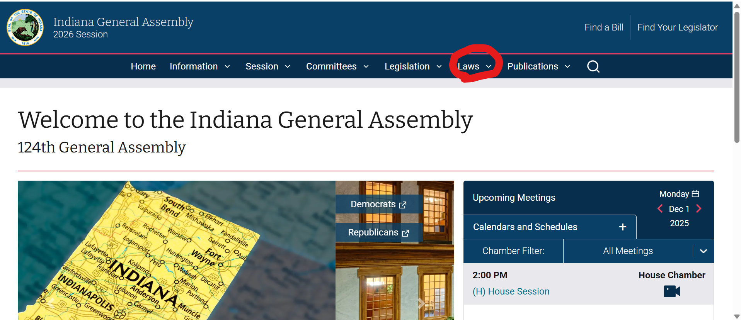
State law, go to iga.in.gov

Slide 4
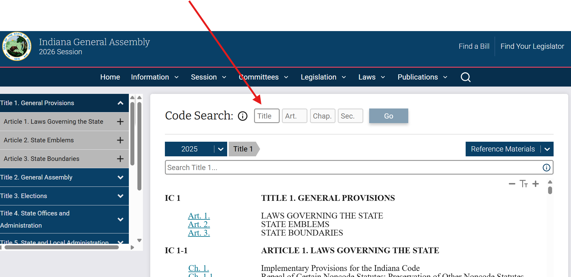
Insert the Code

Slide 5
Step 1 Find the Title Example, Elections will always be IC 3
General Provisions
General Assembly
Elections
State Offices and Administration
State and Local Administration
Taxation
Alcohol and Tobacco
Utilities and Transportation
Motor Vehicles
Public Safety
Corrections
Human Services
Environment
Natural and Cultural Resources
Agriculture and Animals
Health
Repealed
Repealed
Repealed
Education
Higher Education
Labor and Safety
Business and Other Associations
Trade Regulation
Professions and Occupations
Commercial Law
Insurance
Financial Institutions
Probate
Trusts and Fiduciaries
Family law and Juvenile Law
Property
Courts and Court Officers
Civil law and Procedure
Criminal law and Procedure
Local Government

Slide 6
Example Voter Registration IC 3-7
Step 2 Find the Article
Art. 1. REPEALED
Art. 2. REPEALED
Art. 3. CONGRESSIONAL APPORTIONMENT
Art. 4. REPEALED
Art. 5. GENERAL PROVISIONS
Art. 6. POLITICAL PARTY AND ELECTION OFFICERS
Art. 7. VOTER REGISTRATION
Art. 8. CANDIDATES
Art. 9. CAMPAIGNS
Art. 10. PROVISIONS GOVERNING CERTAIN TYPES OF ELECTIONS
Art. 11. VOTING METHODS, SUPPLIES, AND EQUIPMENT
Art. 11.5. COUNTING ABSENTEE BALLOTS
Art. 11.7. PROVISIONAL VOTING
Art. 12. ASCERTAINING RESULTS OF ELECTIONS
Art. 13. VACANCIES
Art. 14. OFFENSES

Slide 7
Example, what’s the law on registering at the BMV? Go to Chapter 14 In article 7, chapters 1-9 have been repealed.
Step 3, Find the Chapter
Ch. 10.General Provisions
Ch. 11.State Administration of Voter Registration
Ch. 12.County Administration of Voter Registration
Ch. 13.Registration and Voting Requirements; General Provisions
Ch. 14.Registration Procedures at License Branches
Ch. 15.Registration Procedures at Public Assistance Agencies
Ch. 16.Registration at Agencies Serving Persons With Disabilities
Ch. 17.Registration at Armed Forces Recruitment Offices
Ch. 18.Registration in Additional Offices; General Provisions
Ch. 19.Registration in Board of Registration Offices
Ch. 20.Repealed
Ch. 20.5.Registration in Unemployment Compensation Offices
Ch. 21.Procedures for Designating Additional Voter Registration Offices; County NVRA Implementation Plans
Ch. 22.Mail Registration
Ch. 23.Repealed
Ch. 24.Distribution Sites for Mail Registration Forms
Ch. 25.Repealed
Ch. 26.Repealed
Ch. 26.3.Statewide Voter Registration List
Ch. 26.4.Statewide Voter Registration Information
Ch. 26.7.Online Voter Registration
Ch. 27.County Voter Registration; Offices and Records Generally
Ch. 28.County Voter Registration; Providing Records to Candidates and Parties
Ch. 29.County Voter Registration; Providing Records to Precinct Inspectors
Ch. 30.Voter Registration Record Confidentiality Requirements and Use Restrictions
Ch. 31.Registration Forms; Content
Ch. 32.Registration Forms; Completion by Voters
Ch. 33.Registration Forms; General Procedures for Processing by Counties

Slide 8
Step 4 Find the Section
IC 3-7-14
Chapter 14. Registration Procedures at License Branches
3-7-14-1Purpose of chapter
3-7-14-2Applicability of definitions
3-7-14-3Bureau of motor vehicles commission as authority
3-7-14-4Application for driver's license or other identification as voter registration application
3-7-14-5Voter registration application form provided with application for driver's license
3-7-14-6Design of registration form
3-7-14-7Requirements of registration form
3-7-14-8Procedures for registration
3-7-14-9Duties of employees providing application; transmittal of completed application
3-7-14-10Duties of employees if applicant registering to vote after twenty-ninth day before primary, general, municipal, or special election
3-7-14-11Written acknowledgment of application; format
3-7-14-12Submission of application; application to be forwarded
3-7-14-12Submission of application; forwarding application or declination to register
3-7-14-13Confidentiality of information
3-7-14-14Updating voter registration record
3-7-14-15Updating voter registration record; exceptions
3-7-14-16Notification to applicant of disposition
3-7-14-17Prohibited acts
Example, What is required of BMV employees when an applicant registers to vote?
IC 3-7-14-9 & IC 3-7-14-10

Slide 9
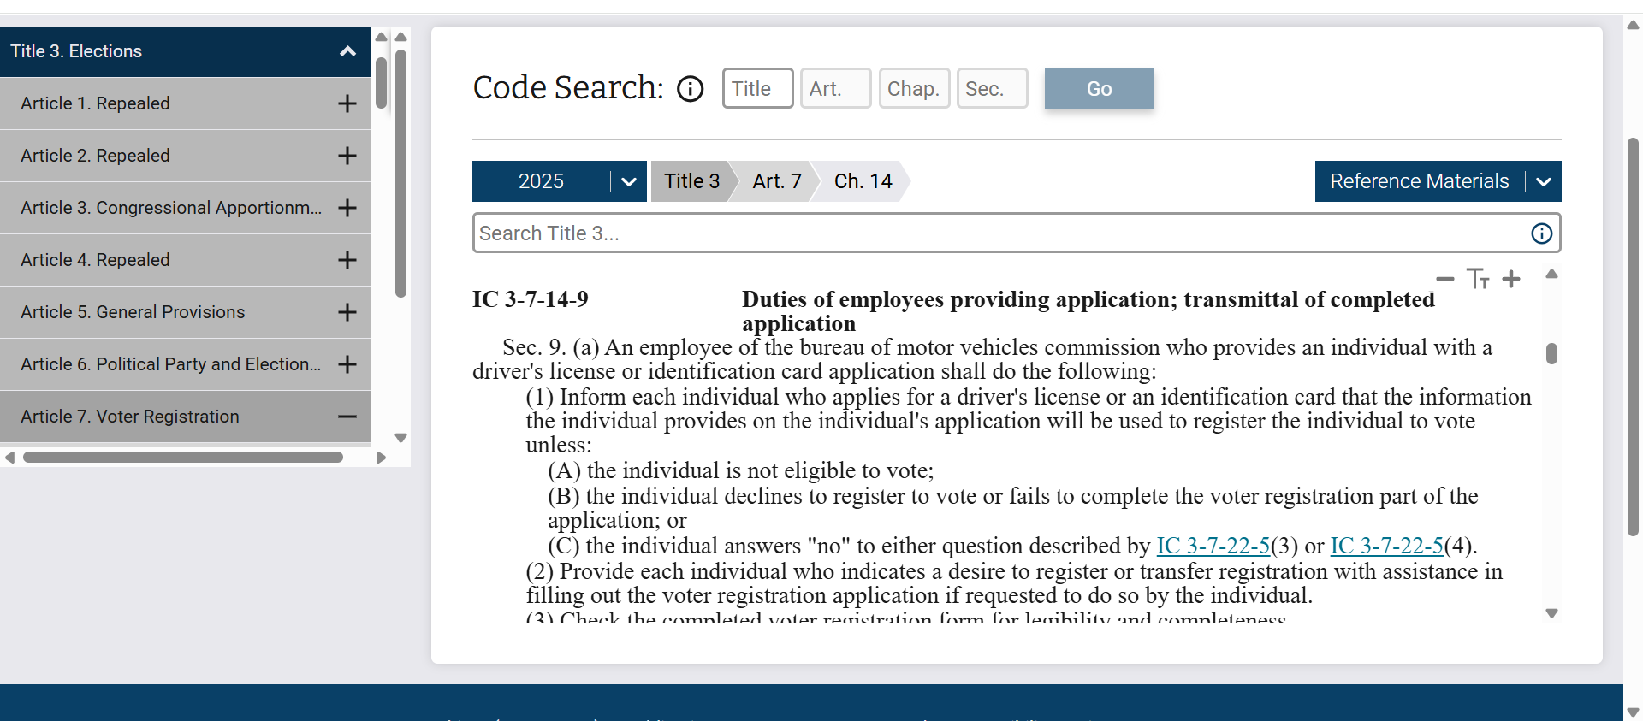
There’s that law!

Slide 10
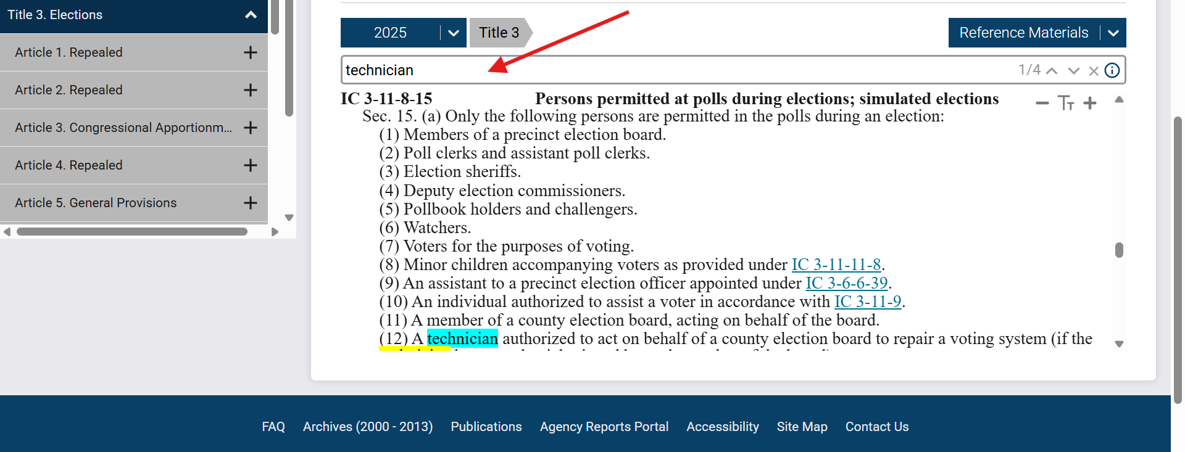
How Can I Search?
You can search the title. Key is to narrow search.

Slide 11
Where do I go for U.S. Code
uscode.house.gov

Slide 12
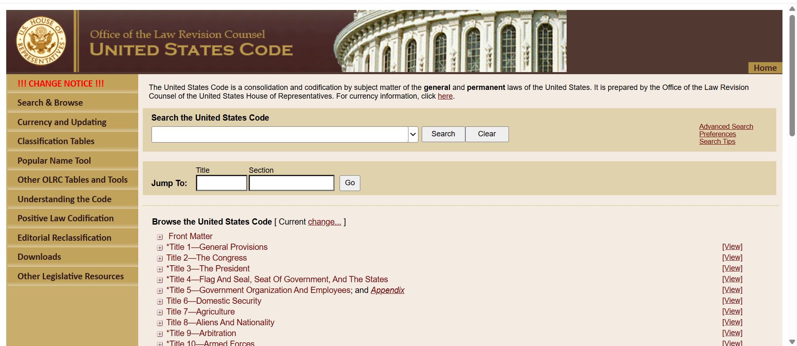
Finding Federal Law
Step 1 go to Title 52 Voting and Elections
Example: Where do I find Motor Voter

Slide 13
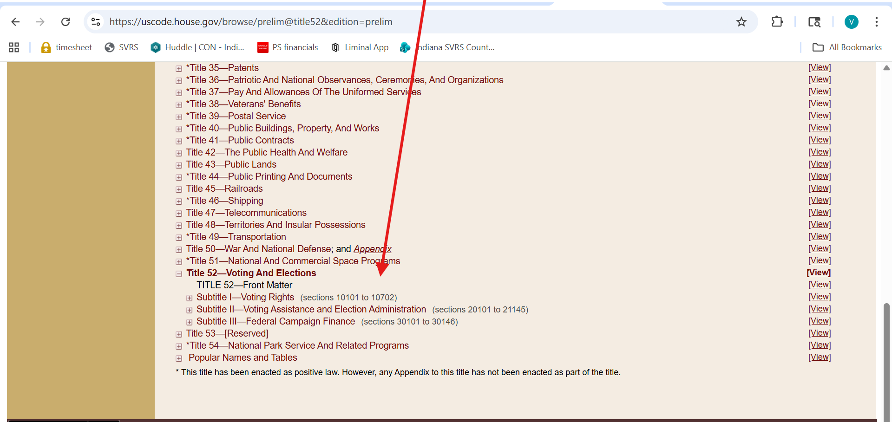
Federal Law
Step 2 go to the subtitle
Example: National Voter Registration Act is in Subtitle II Voting Assistance and Election Administration

Slide 14
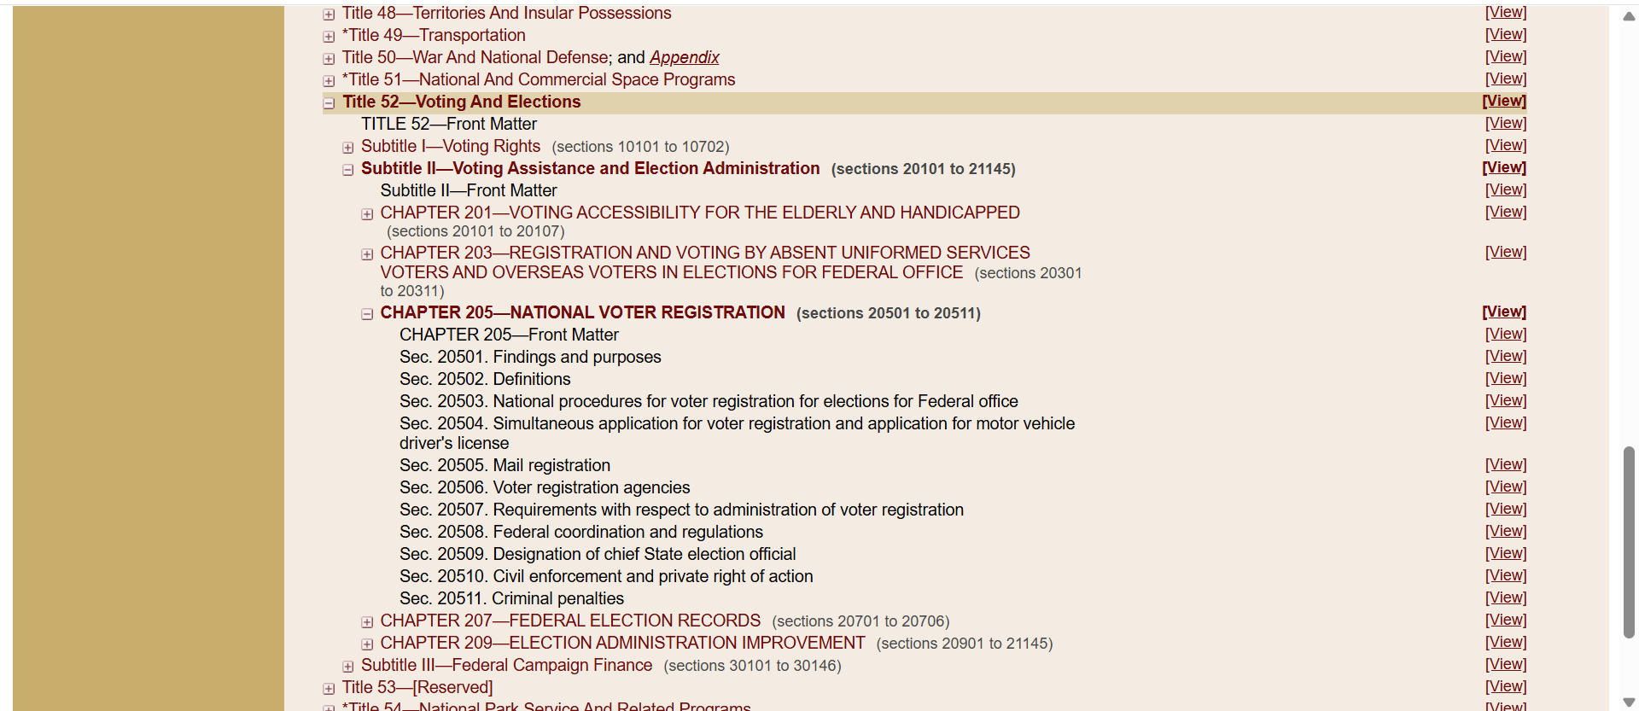
Federal Law
Step 3 go to the chapter
Example: National Voter Registration Act is Chapter 205

Slide 15
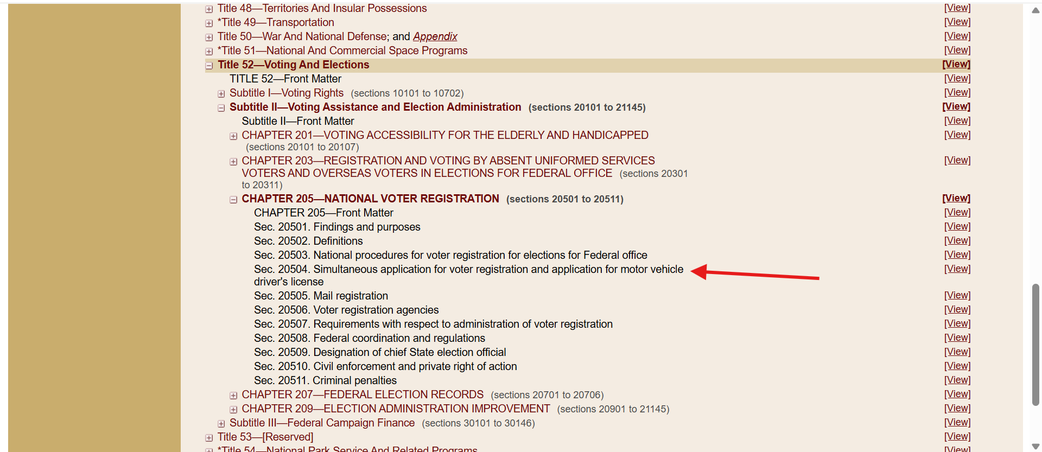
Federal Law
Step 4 go to the chapter
Example: The motor voter law is Section 20504
Motor Voter

Slide 16
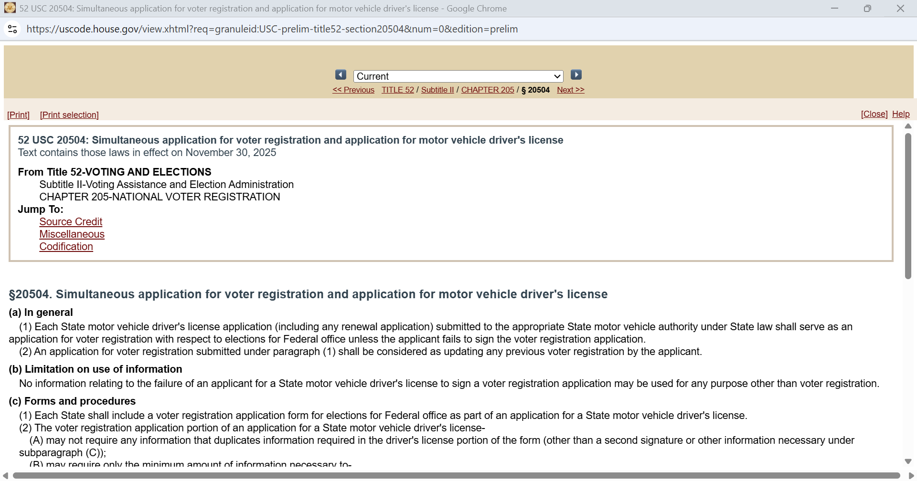
Federal Law
Step 4 go to the chapter
Example: National Voter Registration Act is Chapter 205
Motor Voter

Slide 17
Finding Federal Law
Search Bar

Slide 18
Is there a cheat sheet or a shortcut?
Go to the guidebook
Go to the form
Use Google to get you started and then check the official website

Slide 19
Thank you!

