Slide 1
VACANCY
A County Election Administrator’s Guide to:
Managing Elected Office Vacancies Year-Round
Handling Ballot Vacancies
2023 Election Administrator’s Conference
Presented by Angie Nussmeyer, IED Co-Director
Image by iconicbestiaryon Freepik

Slide 2
Acronyms
BV = Ballot Vacancy
D/R/L = Democratic or Republican or Libertarian
EO = Elected Office
EOV = Elected Office Vacancy
PC = Precinct Committeeman

Slide 3
Elected Office vs. Ballot Vacancies
Elected Office Vacancy
Elected official no longer holds their elected office due to resignation, court order, or death
Person selected assumes the elected office as a pro tempore office holder for remaining term of office
See IC 3-13-3 through IC 3-13-10, generally, for details
Can occur at any time throughout the year
Ballot Vacancy
No Democratic or Republican candidate filed for nomination in primary? Party can fill ballot vacancy for November ballot
See IC 3-13-1 & IC 3-13-2 for details
No Libertarian Candidate nominated at a county convention? Party can fill ballot vacancy for November ballot
See IC 3-13-1 & IC 3-13-2 for details
D/R/L candidates can also fill ballot vacancies if a candidate withdraws from the November election
In 2023, if D/R/L parties do NOT nominate a candidate at a “small town” convention to run for office or a candidate withdraws, then party CANNOT fill ballot vacancy!

Slide 4
EOV: Overview of Clerk Responsibilities
Provide notice to person who has power to fill vacancy
Notice of Resignation
Certify Death
Vacancy Declared by Town Council
Court Order
Receive documentation from person/entity person who filled local office vacancy
CEB-3 (chair appointment, if applicable) or CEB-4 (for caucus), if D/R vacancy
If constitutional officeholder, be sure to send CEB-3, CEB-4 to IED for Governor to send Commission
Notice from school board, other government entity
Send CEB-22 to new office holder
NOTE: No state form for school board vacancies
File paperwork from new officeholder
Oath of office not later than 30-days
CAN-12 or other required statement of economic interest form not later than 60-days

Slide 5
EO Vacancy: Resignation
Elected officials MUST file their resignation, in writing, to:
County Clerk
Non-commissioned countywide & local offices, including school board
Governor
SOS, State Auditor, State Treasurer, Attorney General
State & Local Judicial Officers, including Prosecuting Attorney
Commissioned County Officeholders:
County Clerk, Auditor, Recorder, Treasurer, Sheriff, Coroner, Surveyor
Speaker of the House or President Pro Tempore of the Senate
State Legislators
Clerk/Governor/Speaker/Pres Pro Tem are required to send notice to person who has power to fill the vacancy within 72-hours of receiving resignation notice

Slide 6
EO Vacancy: Death
MUST certify the death of an officeholder, in writing, to the person with power to fill vacancy:
Clerk
All local offices (including prosecuting attorney) except for judge
SOS
State legislative offices
Governor
Statewide offices, judges
Clerk/SOS/Governor must be reasonably satisfied the info obtained about the person’s death is true before sending notice
Information could be obituary, estate notice, death certificate, etc. though statute is not explicit beyond person is “reasonably” satisfied
Must send notice to person who has power to fill vacancy not later than 72-hours after obtaining information

Slide 7
EO Vacancy: Other
Town Council
Members of town council may declare a seat vacant if it is determined by the body that the council member is no longer residing in the district the member was elected to serve
Procedures set forth in IC 5-8-5 to conduct public meeting
If a D/R official is found to no longer reside through this process, then town clerk-treasurer notifies the county clerk, who will give notice to the chair to fill vacancy pursuant to IC 3-13-11 (caucus procedures)

Slide 8
EO Vacancy: Other
Court Order
Once elected & qualified, person holds elected office
Sometimes this is challenged through the courts by filing an “information” (i.e. civil case)
Example: Martin was elected county dogcatcher for Henry County but later moved to Allen County before his term was up. He refuses to resign, so a person with an interest in the office files a civil case to ask court to rule on the matter
Judge’s order sets forth next steps should she decide official is no longer qualified to hold office

Slide 9
Send Notice to Person who Fills EO Vacancy
Local Elected Office Vacancies:
IC 3-13-6 – Judges, Prosecuting Attorney, Clerk
Procedures to fill outlined under each office type, generally
IC 3-13-7 – Other Countywide Offices
IC 3-13-8 – City Offices
IC 3-13-9 – Town Offices
IC 3-13-10 – Township Offices
Section 1 (IC 3-13-7-1, IC 3-13-8-1, et al) points to procedures in IC 3-13-11 (caucus) when D/R officials leave office
Specific office types noted in statute are how to manage vacancy if official is NOT a D/R
However, still important to read those sections as township or town offices allow for another body to fill a D/R EO vacancy if chair/caucus fails to act in 30-days

Slide 10
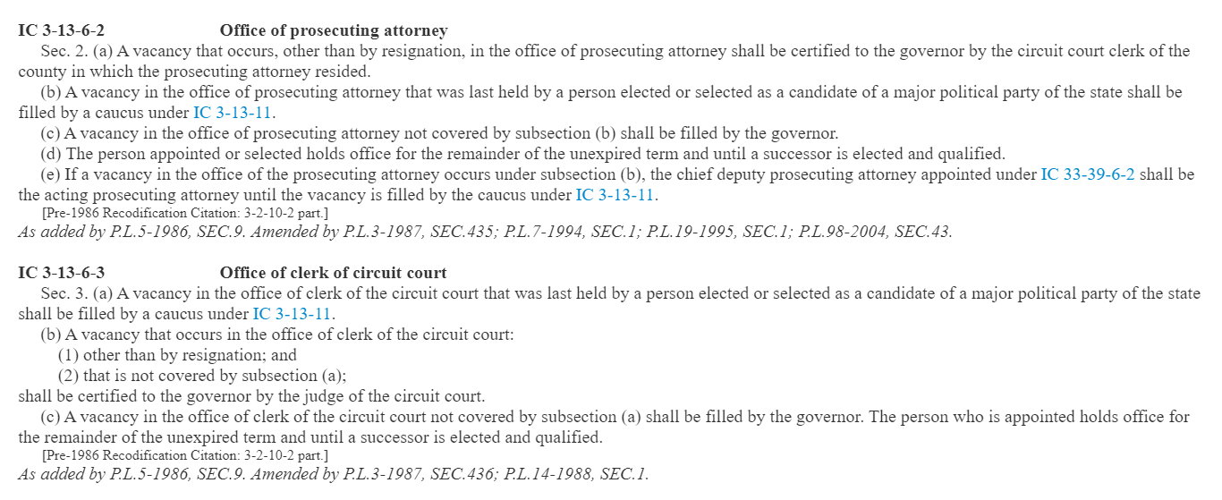
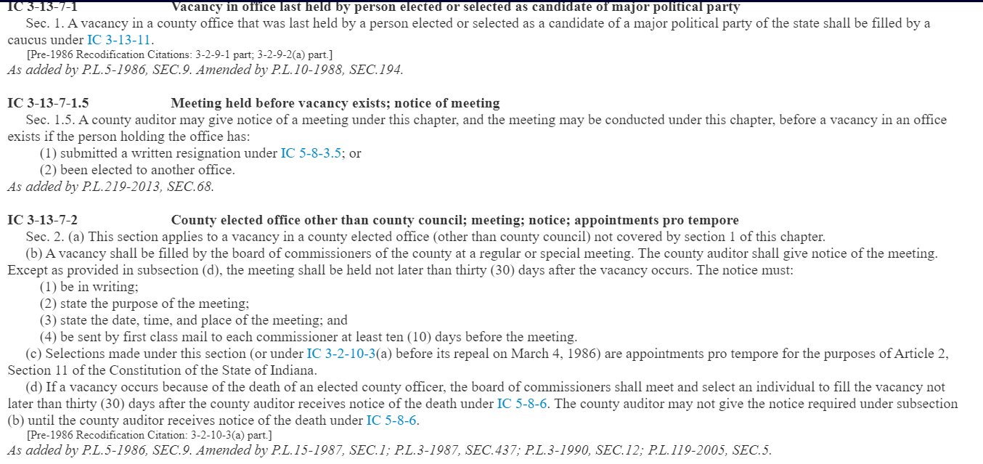
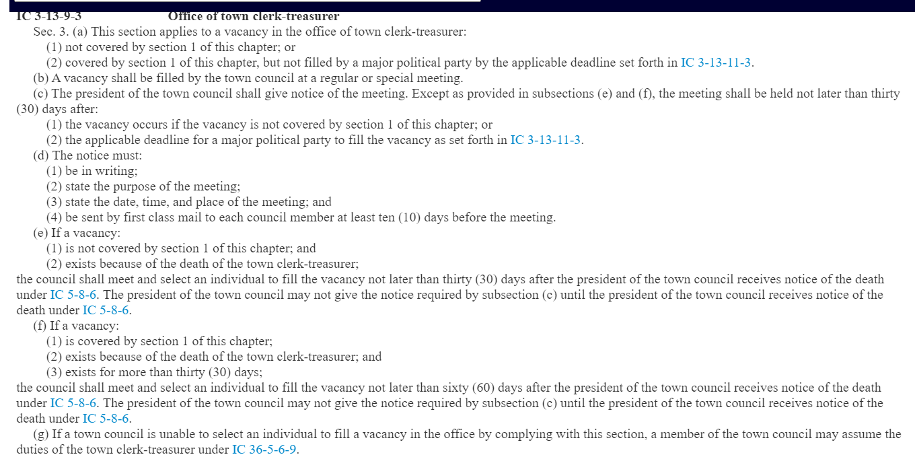

Slide 11
30-Day Clock to Hold Caucus Begins…
Resignation
Assuming chair receives notice within 72-hours…
Future date if specified in the resignation letter
For example, “I resign as dogcatcher on July 1, 2021” but it’s only May 1, 2021
Date of resignation letter, if resignation is specified as “effective immediately”
Assuming chair does NOT receive notice within 72-hours
30-days starts according to the date on the resignation letter BUT
if chair receives notice about the vacancy after the 72-hour period, 30-days starts anew
Death
Date when the person who has power to fill vacancy receives notice from appropriate entity
May NOT hold a caucus until notice under IC 5-8-6 is received!!

Slide 12
Caucus for Local D/R EO Vacancies
Chair (or designee) of the caucus must:
Fill EO vacancy not later than 30-days after the vacancy occurs
Send notice of caucus by first class mail to eligible PCs not later than 10-days after vacancy occurs but at least 10-days before caucus is held
NOTE: No state form but statute lists what info needs to be included; no requirement to file notice of caucus with clerk
Receive CEB-5 candidate filings not later than 72-hours before caucus occurs
NOTE: no requirement to file with clerk
Conduct caucus according to state law & rules established by the caucus
State parties may have sample caucus rules for party chairs to use
Complete caucus paperwork (CEB-3, CEB-4) & file not later than noon, five days after holding caucus
NOTE: Anyone can file the caucus paperwork, as long as it’s notarized

Slide 13
Direct Appointment for D/R EO Vacancies
Direct Appointment for EO Vacancies ONLY in this scenarios:
Only ONE (or NO) eligible PC can participate in the caucus
At caucus, vote ends in a tie & caucus chair may cast deciding vote
At caucus, quorum is not met
Do NOT confuse the approval a chair or county committee may receive from the party organization to make a direct appointment to fill ballot vacancies. The ability to make a direct appointment is one of several procedural differences between filling a ballot vacancy and elected office vacancy.

Slide 14
Effects of Redistricting on Elected Office Vacancies
Cities and towns were required, in most cases, to draw new district boundaries ahead of the 2023 election cycle
Current elected office holders continue to represent voters under the “OLD” district lines – or those lines that the incumbent was last elected.
If incumbent office holder leaves office for whatever reason, the PCs eligible to vote in the caucus are those that represent precincts under the “OLD” district boundaries.
Candidates that want to fill the elected office vacancy must also meet the candidate qualifications, including residency (if applicable) under the “OLD” district boundaries.

Slide 15
When Ballot Vacancies Occur
No D/R candidate ran in the primary election OR no candidate was nominated at the L party convention
Chairs can fill vacancy not later than noon, July 3, 2023
NOTE: This rule does not apply to “small” towns that hold a D/R/L nominating convention
Considered an “early” BV following steps in IC 3-13-1
Candidate withdrawal AFTER nomination
On or before noon, July 17, 2023 – can withdraw for any reason
After noon, July 17, 2023 – can ONLY withdraw for specific reasons
Can be an “early” BV (IC 3-13-1) or if occurring in final 30-days, a “late” BV (IC-3-13-2)
NOTE: July 15 deadline rolls over to noon, July 17, since filing deadline falls on a Saturday in 2023
Independent candidates do not belong to a political party & have no legal way to fill a ballot vacancy; minor party candidates may be able to fill their ballot vacancies. Please reach out to IED with questions.
IC 3-13-1 | IC 3-13-2

Slide 16
Two Ways to Fill a Ballot Vacancy
Caucus of Eligible PCs
Direct Appointment by County Chair
Only one (or no) eligible PC can vote in the caucus
County party organization passes a resolution or make a motion to grant chair the authority to fill BVs by direct appointment
Power can also be delegated to the county central committee made up of the chair, vice chair, secretary and treasurer
No official state form
No state law that sets forth the contents of the resolution or how long its lasts
For example, resolution can be limited to one election cycle or a discrete set of dates, duration of chair’s tenure, or in perpetuity – it’s up to the party organization to decide
Resolutions are easier to manage in terms of filing paperwork BUT a motion can be adopted during a party meeting to give direct appointment authority
Meeting minutes would be used to verify delegation of authority
IC 3-13-1-6 | IC 3-13-1-13

Slide 17
Filling D/R BVs When NO Candidate Nominated
BY CAUCUS when no candidate was nominated in May primary:
Notice of Caucus (CAN-47)
Must be sent by first class mail to all eligible PCs within the election district not later than 10-days before the date caucus is held
Must be filed with the county clerk not later than 10-days before the date the caucus is held
Deadline to hold caucus is noon, July 3, 2023
Declaration of Candidacy & Consent to Fill BV (CAN-48)
Must be filed with the chair of the caucus not later than 72-hours before the date the caucus is held
Must be filed with the county clerk not later than 72-hours before the date the caucus is held
Certificate of Candidate Selection to fill “Early” BV (CAN-49) & Statement of Economic Interests (CAN-12, unless running for judge & use different filing)
Must be filed not later than noon, July 3, 2023
For other types of BV, the CAN-49 is filed not later than noon, 3-days after the caucus but for this specific type of BV where no candidate ran in the primary, the deadline is standardized to July 3, 2023
IC 3-13-1 | IC 3-13-2

Slide 18
Filling D/R BVs When NO Candidate Nominated
BY DIRECT APPOINTMENT when no candidate was nominated in May primary:
Make appointment by noon, July 3, 2023
File following forms with county clerk not later than noon, July 3, 2023:
Declaration of Candidacy & Consent to Fill BV (CAN-48)
Certificate of Candidate Selection to fill “Early” BV (CAN-49)
Copy of Resolution or Meeting Minutes giving direct appointment authority, unless only one eligible PC can vote in caucus
Statement of Economic Interests (CAN-12, unless running for judge & use different filing)
For other types of BV, the CAN-49 is filed not later than noon, 3-days after the caucus but for this specific type of BV where no candidate ran in the primary, the deadline is standardized to July 3, 2023
MUST file a copy of the meeting minutes or resolution to EACH ballot vacancy candidate packet
IC 3-13-1-7 | IC 3-13-1-14 | IC 3-13-1-15

Slide 19
Filling L BVs when NO Candidate Nominated
File notice with county clerk of their intent to fill vacancies where no candidate was nominated for city or town office at convention
No state form
State chair fills ballot vacancies
Must be filed not later than 10-days before filling the vacancy
Deadline to fill vacancy is noon, July 3, 2023
Certificate of Candidate Selection to fill “Early” BV (CAN-32) & Statement of Economic Interests (CAN-12, unless running for judge & use different filing)
Must be filed not later than noon, July 3, 2023
For other types of BV, the CAN-32 is filed not later than noon, 3-days after the caucus but for this specific type of BV where no candidate was nominated at their convention, the deadline is standardized to July 3, 2023
NOTE: this does NOT apply to “small” town nominating conventions, as no party (D/R/L) can fill a vacancy should a candidate not file to run by Aug. 1, 2023
IC 3-13-1-20 | IC 3-13-1-14 | IC 3-13-1-15

Slide 20
Is that a typo? It’s really noon, July 3, 2023, to hold a caucus AND to file final candidate selection form to fill a ballot vacancy?
Correct! State law requires a ballot vacancy where no candidate was nominated in the primary or at a city convention to be filled not later than noon, July 3, 2023 by direct appointment or by caucus AND ALSO for the candidate selection paperwork by filed by noon, July 3, 2023.
Party chairs need to be aware of the competing deadlines & ensure paperwork is in order by noon, July 3, 2023.
Image by wayhomestudio on Freepik

Slide 21
Successful Candidate Challenges
If the CEB determines at a challenge hearing that a candidate is to be removed from the Nov. ballot, the D/R/L parties CAN fill the ballot vacancy
Party chair has 30-days to fill the “early” BV
Clerk does not need to give notice to the chair!
D/R caucus or direct appoint procedures noted on previous slide are used here
BUT the CAN-49 (Candidate Selection) & Statement of Economic Interests must be filed not later than NOON, 3-days after BV is filled
L state chair can fill vacancy as noted in previous slide, though no requirement to give clerk notice of intent to fill vacancy for this scenario
BUT the CAN-32 (Candidate Selection) & Statement of Economic Interests must be filed not later than NOON, 3-days after BV is filled
IC 3-13-1-7(b)

Slide 22
Candidate Withdrawals
ANY candidate can withdraw for ANY reason not later than noon, July 17, 2023
File CAN-46 (Municipal Election Candidate Withdrawal)
Party chair has 30-days to fill the BV
Clerk does not need to give notice to the chair!
D/R caucus or direct appoint procedures noted on previous slide are used here
BUT the CAN-49 (Candidate Selection) & Statement of Economic Interests must be filed not later than NOON, 3-days after BV is filled
L state chair can fill vacancy as noted in previous slide, though no requirement to give clerk notice of intent to fill vacancy for this scenario
BUT the CAN-32 (Candidate Selection) & Statement of Economic Interests must be filed not later than NOON, 3-days after BV is filled
NOTE: July 15, 2023 deadline rolls over to July 17 since it lands on a Saturday
IC 3-13-1-7 | IC 3-13-1-14 | IC 3-13-1-15 | IC 3-13-1-20

Slide 23
Candidate Withdrawals
AFTER noon, July 17, 2023, candidates can only withdraw from November ballot because candidate:
Moves out of election district;
Passes away;
Is convicted of a felony; OR
Judge orders candidate off ballot
Early or Late Ballot Vacancy?
EARLY: Candidate files CAN-46 or candidate passes away not later than October 7, 2023
Follow procedures in IC 3-13-1 to fill BV as noted on previous slides
CAN-49 or CAN-32 & statement of economic interests filed not later than noon, 5-days after filling vacancy
LATE: Candidate files CAN-46 or candidate passes away on or after October 8, 2023
Follow procedures in IC 3-13-2 to fill BV
IC 3-13-1-7 | IC 3-13-2-1

Slide 24
Late Ballot Vacancies
Withdrawal or death on or after October 8, 2023
Candidate files CAN-46, if applicable
Expedited procedures to fill BV
D/R Late Vacancies
All local offices are filled by direct appointment by county chair, AFTER this deadline – even without resolution (IC 3-13-2-5)
File CAN-50 (Certificate of Candidate Selection to fill Late Ballot Vacancy) & statement of economic interests with clerk not later than noon, 3-days after filling the BV or Election Day, whichever is sooner
Libertarian Late Vacancies
State central committee selects candidate and state chair still uses CAN-32
Files CAN-32 & statement of economic interests with clerk not later than noon, 3-days after filling the BV or Election Day, whichever is sooner
NOTE: The CEB may have to reprint the ballot in these scenarios, up to the final 5-days before the election. Consult the 2023 Election Administrator’s Manual or contact IED with questions.
IC 3-13-2

Slide 25
Only eligible PCs within election district can vote in the caucus
Elected PCs automatically qualify, if in election district
Appointed PCs must have been appointed to a precinct within election district not later than 30-days before date vacancy occurred
Vice PCs DO NOT VOTE!
MAY be proxy for PC
If vice to elected PC, then must be appointed not later than 5-days before caucus
If vice to appointment PC, then must be appointed not later than 30-days from date vacancy occurred
Secret ballot required if more than one candidate files
Chair of caucus breaks tie votes or makes direct appointment if quorum is not met
General Caucus Reminders for Party Officials
Image by pvproductions on Freepik

Slide 26
VACANCY
QUESTIONS?
Image by iconicbestiaryon Freepik

