Slide 1

Post-Election (Risk Limiting) Audits Overview
Indiana Election Administrator's Conference
December 13, 2023 Presented by the Voting System Technical Oversight Program

Slide 2

The VSTOP Team
Dr. Jay Bagga
VSTOP Co-Director,
BSU Professor of Computer Science
Dr. Chad Kinsella
VSTOP Co-Director,
Managing Director of Bowen Center for Public Affairs,
BSU Associate Professor of Political Science
Marc Chatot
VSTOP Manager
Austin Bilbrey
VSTOP Logistics Specialist
Duncan Klemm
VSTOP IT Specialist
Matt Housley
VSTOP Audit Specialist
Alisa Gray
VSTOP Training and Assessment Specialist
Ethan Rice
VSTOP Graduate Assistant for Post-Election Audits

Slide 3
As Defined by Indiana Election Code
"Post-election audit means an audit protocol that makes use of statistical methods and is designed to limit to acceptable levels the risk of certifying a preliminary election outcome that constitutes an incorrect outcome"
IC 3-12-13-3
Notes:
Dr. Kinsella

Slide 4
In Simpler Terms
"A post-election audit checks that the equipment and procedures used to count votes during an election worked properly and that the election yielded the correct outcome."
National Conference of State Legislatures (NCSL)
Notes:
Dr. Kinsella

Slide 5
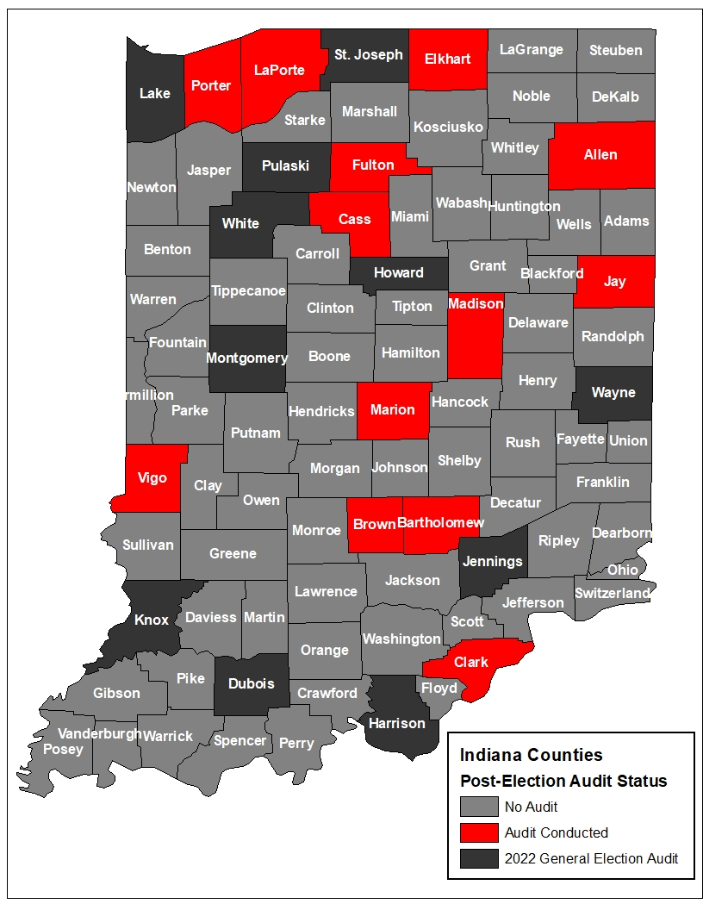
History of Post-Election Audits in Indiana
Indiana post-election audits are governed by Indiana Code IC 3-12-13.
VSTOP has been conducting post-election audits in Indiana since the pilot program began in Marion County in 2018.
Indiana’s post-election audit procedures are based on various state models, including California, Colorado, Rhode Island, and Virginia.
x2
Notes:
Dr. Kinsella

Slide 6
What does a post-election audit entail?
Post-election audits check paper ballots or voter-verifiable records in search of strong evidence that the reported election outcome was correct.
A post-election audit can stop as soon as it finds strong confidence that the reported outcome was correct (closer elections generally entail checking more ballots).
Generally, the audit team works with confidence levels of 90-95%.
A post-election audit is NOT a recount – we will only sample a fraction of the total votes. This audit is another tool used to provide confidence in the vote outcome.
Notes:
Dr. Kinsella

Slide 7

But why should we conduct these audits?
Provide evidence that the outcome was correct
Provide evidence that a counting error or malicious attack did not change the outcome
Restore public confidence
Improve voter turnout
Notes:
Liz

Slide 8
Audit Preparation
Before the Audit
County personnel will submit County Election Board Resolution.
VSTOP works with county personnel to review the process.
VSTOP works with county personnel to select races to audit.
County personnel will fill out a questionnaire for audit preparation. Some questions to expect:
    Vendor used?
    Ballot images available? (Y/N)
    Central scanner used? (Y/N)
    Precincts or vote centers?
    Predicted # of participants & names, if known?
    Audit location?
    Election results?
County personnel will prepare the ballot manifest, with VSTOP’s assistance.
VSTOP will enter the contest information into the Stark Audit Tool to determine how many ballots to initially sample.
Notes:
Liz

Slide 9
Ballot Manifest Preparation
IC 3-11-18.1-14Separation of ballots at vote center by precinct; exception for Marion County; reports of anomaly with poll book
Sec. 14. (a) The precinct election board administering an election at a vote center shall keep the ballots cast in each precinct separate from the ballots cast in any other precinct whose election is administered at the vote center, so that the votes cast for each candidate and on each public question in each of the precincts administered by the board may be determined and included on the statement required by IC 3-12-4-9.
A Ballot Manifest is a list that indicates how the ballots in an election are organized and stored. This should include number of precincts and number of ballots voted in each precinct.
Notes:
Liz

Slide 10
Post-Election Audit Testimonial
Has your perception of post-election audits changed now that you have participated in an audit?
If so, how?
What are your recommendations for future counties who intend to participate in Indiana post-election audits?
Notes:
County Responses to Questions Proposed by VSTOP
We sent three questions to our panelists from Elkhart, Jay and Marion, and asked them to share their experience. We will now take one question at a time and invite our panelists to respond.
Question #1
Please provided a brief description of your experience with risk-limiting audits, including your experiences with RLA training, the RLA audit tool(s), and the RLA process.
Question #2
What are your recommendations for future counties who intend to participate in the RLA process?
Question #3
What thoughts do you have on the value of risk-limiting audits for your county?

Slide 11
Questions?
Voting System Technical Oversight Program
Muncie, Indiana
vstop@bsu.edu
765-285-8784
If you are interested in being designated as a Post-Election Audit County for the 2024 Primary or General Election or are interested in learning more about the post-election audit process in Indiana, please find Matt Housley at the end of this presentation or contact the Team via the information on this slide.
Informational packets & pamphlets are available upon request.
Notes:
Liz

Slide 12
Thank You!
Notes:
Closing Remarks
Some closing remarks from VSTOP, time permitting.

