Slide 1

Ballot & Office Vacancies Presentation
BALLOT & OFFICE VACANCIES
Presented by:
Matthew Kochevar
Co-General Counsel
Election Administrators’ Conference
December 16, 2025

Slide 2
OFFICE VACANCY CAUCUS PROCEDURES
Elected Official Resigns
Most local offices file resignation with county clerk
  County constitutional officeholders file with governor
    County judges, prosecuting attorneys, clerks, auditors, recorders, treasurers, sheriffs, coroners, and surveyors
    Resigning elected officials are encouraged to contact IED with questions on where to file resignation
Clerk (or governor) must give notice to county chair of party elected official was elected or appointed under within 72-hours of receiving the resignation
Elected Official Dies
“Information” must be given to the county clerk that the elected official is deceased that clerk believes is true
Clerk must give notice to county chair within 72-hours of receiving information about the death
  CANNOT fill the vacancy until notice is given to the chair about the officeholder’s death!
NOT to be confused with ballot vacancies, where no candidate ran for an office in the May primary election. This will be covered in the future. You can read more in the 2026 Candidate Guide or 2026 Election Administrator’s Manual.
IC 3-13-11, generally | IC 5-8-3.5-1 | IC 5-8-6-3
OFFICE VACANCIES ARE ALMOST ALWAYS FILLED BY A CAUCUS OF ELIGIBLE PCs!

Slide 3
OFFICE VACANCY CAUCUS PROCEDURES
Office must be filled not later than 30-days after the date the vacancy occurred
  If official files notice with a resignation date in the future, the chair can fill the position before the office becomes vacant but the 30-day clock does not start until the office is vacated
  In some limited circumstances, if the county party fails to fill an elected office vacancy within the 30-day period, then other officials are entitled to fill the open position
Chair must determine eligible PCs to vote in caucus
  Elected PCs must live in the election district to vote
  Appointed PCs must represent a precinct within the election district AND be appointed at least 30-days before the date the vacancy occurred to vote
    Vice PCs do NOT vote in an elected office vacancy caucus
    CAN be proxy for their PC
      Vice of an elected PC must be appointed at least 5-days before the date of the caucus
      Vice of an appointed PC must be appointed at least 30-days before the date of the caucus
NOT to be confused with ballot vacancies, where no candidate ran for an office in the May primary election. This will be covered in the future. You can read more in the 2026 Candidate Guide or 2026 Election Administrator’s Manual.
IC 3-13-11, generally

Slide 4
OFFICE VACANCY CAUCUS PROCEDURES
Chair must send written notice of the caucus by first-class mail to all eligible PCs
  No special state form
  Notice must include the purpose of the caucus, date, location, and name of chair
  Must be mailed at least 10-days before the date of the caucus
Candidates must file CEB-5 declaration of candidacy with chair of the caucus at least 72-hours before the caucus is held
  Must meet the same qualifications to fill an office vacancy that you would need to run for the office
  NEW! The last two primary elections in Indiana in which the candidate voted must have been the Democratic (or Republican) primary
    Candidate can seek written certification from chair, however, to waive this requirement
  NEW! The county chair or caucus can disqualify a candidate from a caucus if he or she learns the individual does not meet the qualifications to run for or hold the office
NOT to be confused with ballot vacancies, where no candidate ran for an office in the May primary election. This will be covered in the future. You can read more in the 2026 Candidate Guide or 2026 Election Administrator’s Manual.
Neither the clerk or CEB has authority to deny office vacancy on these qualification matters!

Slide 5
OFFICE VACANCY CAUCUS PROCEDURES
Caucus Procedures
  Caucus adopts rules
    State law requires….
      a secret ballot be used when there is more than one candidate
      tie votes to be broken by the county chair
      direct appointment made by chair if there is not a quorum (quorum is established in the rules of the caucus by the caucus participants)
  NEW! If only one candidate files to fill the office vacancy, the chair can, at the caucus, directly appoint the candidate to fill the vacancy
    Note: A caucus vote does not need to be held if there is only one or no eligible PC to vote in the caucus; chair makes a direct appointment in this case
Filings
  Not later than noon, 5-days after the caucus is held, the CEB-4 form must be filed
    If a direct appointment is made under the limited circumstances found in state law, the CEB-3 form must be filed not later than noon, 5-days after the appointment is made
  CAN-12 statement of economic interests must be filed by noon, 60-days after assuming office
  Oath of Office must be filed by noon, 30-days after being selected
NOT to be confused with ballot vacancies, where no candidate ran for an office in the May primary election. This will be covered in the future. You can read more in the 2026 Candidate Guide or 2026 Election Administrator’s Manual.
IC 3-13-11, generally

Slide 6

ELECTED OFFICE VACANCIES
NEW! Any candidate seeking to fill an elected office vacancy must, in the last two primary elections in Indiana in which they voted, have voted in the primary of the political party filling the vacancy
  Candidate can seek written approval from chair, however, to waive this requirement
NEW! The county chair or caucus can disqualify a candidate from an elected office vacancy caucus if he or she learns the individual does not meet the qualifications to run for or hold the office
  Each political party is responsible for setting their own rules on how these “challenges” are to be handled
New! If only one candidate files to fill the office vacancy, the chair can cancel the caucus and directly appoint the candidate to fill the vacancy
  NOTE: These rules do not apply to ballot vacancies where no one filed to run in the primary election!
IC 3-8-1-5.7 | IC 3-13-11-10

Slide 7

LOCAL OFFICE VACANCY IN CODE
    Procedures to fill outlined under each office type, generally:
  IC 3-13-6 – Judges, Prosecuting Attorney, Clerk
  IC 3-13-7 – Other Countywide Offices
  IC 3-13-8 – City Offices
  IC 3-13-9 – Town Offices
  IC 3-13-10 – Township Offices
    Section 1 (IC 3-13-7-1, IC 3-13-8-1, et al) points to procedures in IC 3-13-11 (caucus) when D/R officials leave office
    Specific office types noted in statute are how to manage vacancy if official is NOT a D/R
      However, still important to read those sections as some positions allow for another body to fill a D/R EO vacancy if chair/caucus fails to act in 30-days

Slide 8
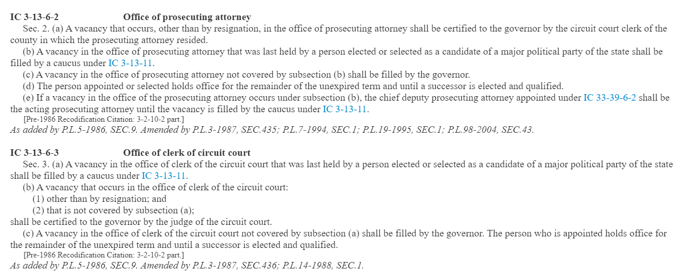
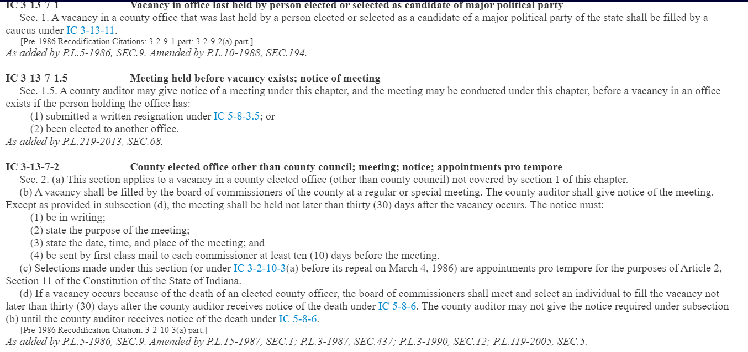
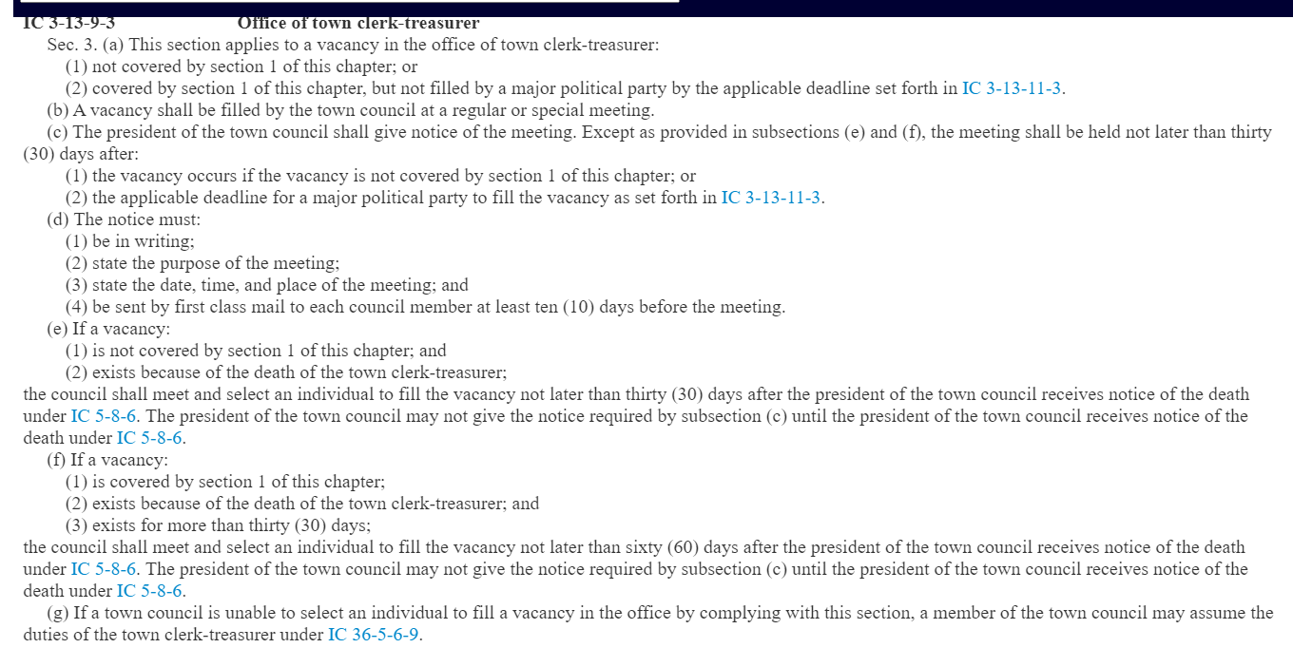
Illustration in Title 3 of Indiana Code

Slide 9
LOCAL OFFICE BALLOT VACANCIES
  Two Distinct Deadlines:
No D or R candidate ran for an office in the primary election (or no L candidate ran for an office at convention)
  Must hold caucus by July 3, 2026 & file selection paperwork by noon, July 6, 2026
    L Party must file “notice of intent” to fill ballot vacancies (See slide 16)
ANY candidate withdraws from the general election (Nov.) ballot
  ALL Candidates can withdraw for ANY reason until noon, July 15, 2026
  After noon, July 15, 2026, may only withdraw if:
    Convicted of a crime; Removed by court order; Moved out of the election district; Died; Violated the Hatch Act/Judicial Canon/IN Dept. Homeland Security
  If permitted, must fill ballot vacancy not later than 30-days by the date the vacancy occurred & file selection paperwork not later than noon, THREE days after making decision
    “Late” ballot vacancies occur in final 30-days before election & process is streamlined; contact IED staff for details
      See IC 3-13-2 for late vacancy procedures; IC 3-13-1 for all ballot vacancy procedures up to final 30 days

Slide 10
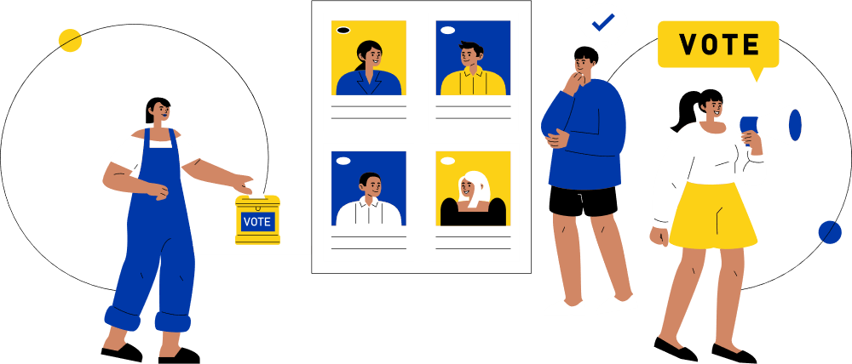
WHO FILLS A BALLOT VACANCY?
There are two ways to fill all local office ballot vacancies:
By a caucus of eligible PCs of the political party with the ballot vacancy
Direct Appointment by the county party chair or county central committee (the county chair, vice chair, secretary, and treasurer)
  But only have if direct appointment power is given by the county party committee made up of party PCs and Vice PCs
  NOTE: State legislative ballot vacancies can only be filled by caucus led by state chair or his designee
  NEW! Cannot fill a ballot vacancy where no candidate ran for an office on the ballot in the May primary until May 8!

Slide 11
BALLOT VACANCY: CAUCUS
Chair of Caucus (or designee) must:
Manage Notice of Caucus (CAN-30)
  Must be sent by first class mail to ALL eligible PCs not later than 10-days before the date the caucus is held AND
  File an original, signed CAN-30 with the county clerk not later than NOON, 10-days before the caucus is held
Receive Candidate’s Declaration of Candidacy (CAN-31)
  Candidates must file CAN-31 with chair of caucus AND an original signed CAN-31 with county clerk not later than 72-hours before caucus is held
    Note: There is NO requirement that a candidate filling a ballot vacancy for the D/R party comply with the two primary rule
      Only applies to those running in the primary election OR seeking to fill an elected office vacancy
IC 3-13-1-9 | IC 3-13-1-10.5

Slide 12
BALLOT VACANCY: CAUCUS
Chair of Caucus (or designee) must:
Hold Caucus
  More than one candidate filed? MUST conduct election by secret ballot
  Tie vote? Chair of caucus makes final decision
  Quorum not met? Chair makes direct appointment
File CAN-29 Certificate of Candidate Selection & CAN-12 Statement of Economic Interests
    Original, signed copies of CAN-29 & CAN-12 must be filed not later than:
        NOON, July 6, 2026, for ballot vacancies where no D or R candidate ran in primary OR
        NOON, 3-days after caucus is held for ballot vacancies where D or R candidate withdrew
IC 3-13-1-9 | IC 3-13-1-10.5

Slide 13
BALLOT VACANCY: APPOINTMENT
Party organization MUST pass a resolution or make a motion to give county chair or central committee (chair, vice, secretary, treasurer) the power to fill a ballot vacancy
  No official state form
  Resolution or motion sets forth any limitations, if desired
    NEW! Direct appointment authorization for ballot vacancies expires on the date of the primary election held to
    elect the D/R PCs
      IN D Party: Direct appointment authority expires on 5/5/26, unless otherwise stipulated before this deadline
        County party authorize direct appointment to fill ballot vacancies for a period of no more than four years, ending on the date of the 2030 primary election
      IN R Party: Direct appointment authority expires on 5/7/28, unless otherwise stipulated before this deadline
        County party would authorize direct appointment to fill ballot vacancies ending not later than 2032 primary election
Paperwork Packet:
  CAN-31 (candidate’s declaration of candidacy)
  CAN-29 (certificate of candidate selection)
  CAN-12 (statement of economic interests
  Copy of the resolution or, if a motion is made, the party’s meeting minutes
    MUST file resolution/minutes with EACH set of ballot vacancy paperwork filed
IC 3-13-1-8

Slide 14
Direct Appointment Exceptions
Only one or no PC eligible to vote in the caucus?
  Direct appointment required (IC 3-13-1-13)
  File following paperwork:
    CAN-31 (candidate’s declaration of candidacy)
    CAN-29 (certificate of candidate selection)
    CAN-12 (statement of economic interests
Tie vote at caucus? Not a quorum attending the caucus?
  Direct appointment required (IC 3-13-1-12)
  File following paperwork:
    CAN-29 (certificate of candidate selection)
    CAN-12 (statement of economic interests

Slide 15
Judicial Office Vacancies
Similar process with a few key differences
  Most paperwork filed with Indiana Election Division in Indianapolis
  Statement of economic interests filed earlier AND with a different form filed with Commission on Judicial Qualifications
Caucus
  CAN-30 notice must be mailed to eligible PCs AND filed with IED by NOON, 10-days before the caucus
  Candidate files CAN-31 declaration & file-stamped copy of statement of economic interests with chair of caucus AND IED not later than 72-hours before the caucus is held
    This is NOT the CAN-12!
    Commission on Judicial Qualifications creates the form & it is filed online through their website
    Can take a few days to get a file-stamped copy back through their online portal
  CAN-29 certificate of selection must be filed with IED, NOT the county clerk
Direct Appointment
  On or before deadline to fill ballot vacancy, must file CAN-31, file-stamped copy of statement of economic interests, CAN-29, AND copy of resolution or meeting minutes giving chair authority to fill by direct appointment
IC 3-13-1-9 | IC 3-13-1-10.5

Slide 16
Libertarian Party Ballot Vacancies
Libertarian State Party Forms to Fill Ballot Vacancies
To notify IED or CEB that ballot vacancies from party convention will be filled:
No State Form; Usually Submitted on State Party Letterhead
Libertarian Party Certification to Fill Local Ballot Vacancy to Clerk:
CAN-32 Certificate of Candidate Selection
CAN-12 Statement of Economic Interests for Local Office Candidate
Libertarian Party Certification to Fill Federal, State, State Legislative, or Judicial Ballot Vacancy to Clerk:
CAN-33 Certificate of Candidate Selection
Requisite statement of economic interests required to be filed by candidate
If Libertarian Party does not nominate candidate at state or county convention, then the Libertarian State Party not later than July 3, 2026
  State Chair must give notice the state committee will fill ballot vacancies to state or county, depending on where candidacy paperwork is filed, not later than 10 days before the committee meets to fill the ballot vacancy
      Final paperwork due not later than noon, July 6, 2026
        Exception: Rules for withdrawing from a “small” town office as described above have a different deadline
  Candidate paperwork filing will be at IED
    for federal, state, state legislative, and judicial filings (including prosecuting attorney)
  Candidate paperwork filing will be at CEB
    for all other local office vacancies (county, township, municipal)

Slide 17
Questions?
10

