Slide 1

“Specialized” ABS Voting Categories:
UOCAVA
VPD
AG Program
Travel Board
2026 Election Administrators’ Conference
Angie Nussmeyer, Co-Director
Images by freepik

Slide 2

Acronyms
ABS = absentee
AG = Attorney General
CEB = county election board
FPCA = Federal Post Card Application
FVAP = Federal Voting Assistance Program (US DOD)
FWAB = Federal Write-In Absentee Ballot
IEC = Indiana Election Commission
IED = Indiana Election Division
MOVE Act = Military & Overseas Voters Empowerment Act
UOCAVA = Uniformed & Overseas Citizens Absentee Voting Act of 1986
VPD = voters with print disabilities
VR = voter registration

Slide 3
Federal Post Card Application (FPCA)
FPCA: Dual Purpose Form for Military & Overseas Voters
Voter Registration Application
  Confirm person is registered at the address indicated
    Special residency exceptions for overseas voters
  Special VR deadlines for military & overseas voters
    Monday, April 27, 2026, Primary Election VR Deadline
    Monday, October 26, 2026, General Election VR Deadline
      In limited cases, special rules for late VR registration after these stated deadlines
Absentee Application
  Covers elections held in 1 calendar year – Jan. 1 to Dec. 31
    Must include a party choice on the FPCA to receive an absentee for the primary
  Allows absentee ballot to be sent by mail, fax, or email
    Request for MAILED ABS: Same as civilian ABS application deadline (12-days before election day)
    Request for FAXED or EMAILED ABS: Noon, day before election day
IC 3-5-5 | IC 3-7-36-14 | IC 3-11-4-3

Slide 4
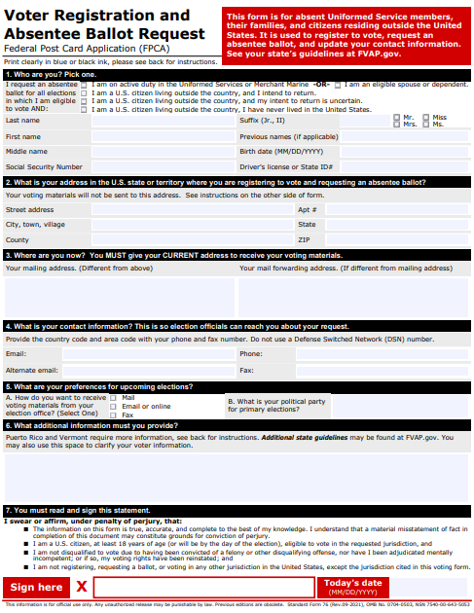
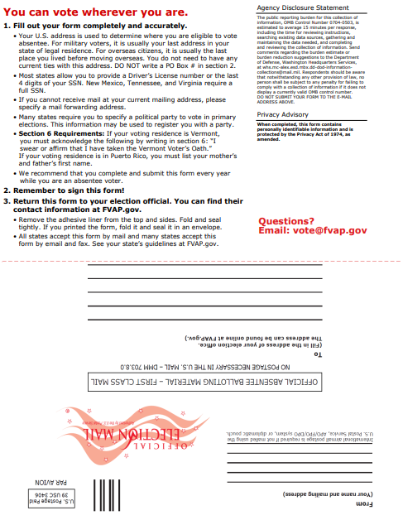
FPCA Images

Slide 5

Military Voters
Active-duty member of the Uniformed Services, Merchant Marine, or National Guard
  “Uniformed Services” means:
    The armed forces (Army, Navy, Air Force, Marine Corps, Space Force & Coast Guard);
    Commissioned corps of the NOAA; and
    Commissioned corps of the Public Health Service.
Spouse or dependent of an active-duty member of the Uniformed Services, Merchant Marine, or National Guard
  NOTE: IN National Guard members must be deployed outside of Indiana to use the FPCA
IC 3-5-2.1-64 | IC 3-5-2.1-75 | IC 3-5-2.1-100

Slide 6
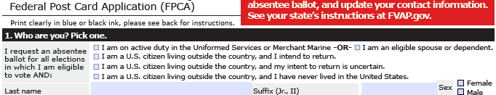
Member of Military and Eligible Spouse or Dependent
Must be registered to vote at last Indiana residence address before deployment
  Person may not be returning to this address, but it’s the location where they last lived in the US and, in Indiana, must have lived at the address for at least 30-days before departing
  NEW! Spouse of a member of the military may use the member’s last US address before departing overseas as their last residence address to register to vote, even if the spouse never resided there
Receives regular “FULL” ballot, if otherwise eligible
  Don’t forget the extended VR period for voters using the FPCA, so it may be possible to update a registration before sending out the absentee depending on the timing in the election calendar
IC 3-11-4-3 | IC 3-11-4-6 | IC 3-7-36-15

Slide 7

Overseas Voters
Reside in any locale in the world that is not the U.S. or its territories
  Canada and Mexico, for example, are “overseas” as is Australia
Defined in state law:
  A person who resides outside the US and is qualified to vote in the last place in which the person was domiciled before leaving the US
  A person who resides outside of the US and, but for such
  residence, would be qualified to vote in the last place
  in which the person was domiciled before leaving the US
    NOTE: In Indiana, the state Constitution requires an individual
    to be a resident of their precinct at least 30 days; therefore,
    an overseas voter must have lived in Indiana for at least
    30 days before departing overseas.
IC 3-5-2.1-75
Image by pch.vector on Freepik

Slide 8
Overseas U.S. Citizen WHO INTENDS TO RETURN TO U.S.
Must be registered to vote at last Indiana residence address
  Person may not be returning to this address, but it’s the location where they last lived in the US and in Indiana, must have lived at the address for at least 30-days before departing
Receives regular “FULL” ballot, if otherwise eligible
  Don’t forget the extended VR period for voters using the FPCA, so it may be possible to update a registration before sending out the absentee depending on the timing in the election calendar
IC 3-11-4-3 | IC 3-11-4-6 | IC 3-11-4-8

Slide 9
Overseas U.S. Citizen WHOSE RETURN TO U.S. IS UNCERTAIN
Include address where person last resided in Indiana
  Person may not be returning to this address, but it’s the location where they last lived in Indiana before departing overseas
In Indiana, registered to vote in the PRECINCT of COUNTY VR OFFICE
  Counties traditionally use the address of the voter registration office
Receives FEDERAL ONLY ballot, if otherwise eligible
  Federal Only ballot contains only federal offices; no state, local, party offices or public questions
    In 2026, only candidates for the voter’s US House district will be on the federal only ballot
  Don’t forget the extended VR period for voters using the FPCA, so it may be possible to update a registration before sending out the absentee depending on the timing in the election calendar
IC 3-11-4-3 | IC 3-11-4-6 | IC 3-11-4-8

Slide 10
Federal Only Ballot Style
Federal Only ballot style is ONLY used for this small universe of ABS voters: U.S. citizens whose return to the U.S. is not certain
  Do NOT give this ballot to any other group of voters!
  Should NOT be included with Election Day materials
    Used in absentee voting ONLY
Every county must have an absentee ballot that ONLY includes federal offices:
  U.S. President, when applicable
  U.S. House of Representatives, every election cycle
  U.S. Senate, when applicable
November General Election Ballot would also include…
  “Write-in” line for each federal office, even if there are no declared write-in candidates for those offices
  Straight party device certified to counties by IED
IC 3-11-2-6 | IC 3-11-2-10 | IC 3-11-13-11 | IC 3-11-14-3.5

Slide 11
Overseas U.S. Citizen WHO NEVER LIVED IN INDIANA
Indiana county election officials must reject the application
  Indiana constitution does not permit a person who has never lived in Indiana for at least 30-days to vote in the state
Art. 2, Sec. 2 Ind. Const.

Slide 12

FPCA Processing Reminders
UOCAVA Voters & Voter ID
  Must comply with state law to provide voter ID number OR copy of valid photo ID on ABS applications
  Voter can include this info in section 6 (additional information) or in section 1
Emailed or Faxed ABS Ballots
  County must send ABS-9 form, generated in SVRS; voter must return it with their faxed/emailed ballot by deadline to confirm consent to
  waive right to secrecy
  FVAP produced cover sheet does NOT replace the ABS-9
MOVE Information Sheet
  Must be included in ballot packet to voter
    See 2026 Election Administrator’s Manual for details
Image by freepik
IC 3-11-4-6 | IC 3-11-4-2 | IC 3-11-10-1

Slide 13
Federal Write-In Absentee Ballot (FWAB)
“Back-Up” ballot in case original ABS ballot sent by mail, fax or email was not received by the voter or received by the county by ABS ballot deadline
How to use the FWAB in Indiana:
  Voter MUST FILE FPCA before applicable deadlines
    County MUST use FPCA to register voter, if applicable, and process ABS application to send the ABS ballot to the voter
  Voter MAY also submit FWAB, but not required
    FWAB must be received not later than 6PM, Election Day, in Indiana
    FWAB may be mailed, faxed, or emailed
  If FWAB timely filed, CEB attaches it to FPCA
    FWAB should remain sealed (If mistakenly opened, re-seal!)
  If voter’s original ABS ballot is not received by deadline, then CEB directs bi-partisan remake team to use the FWAB to complete an ABS optical scan ballot card
    Don’t forget to use same serial numbers on FWAB and optical scan ballot card!
IC 3-11-4-12.5 | IC 3-12-1-18 | IC 3-12-1-19

Slide 14
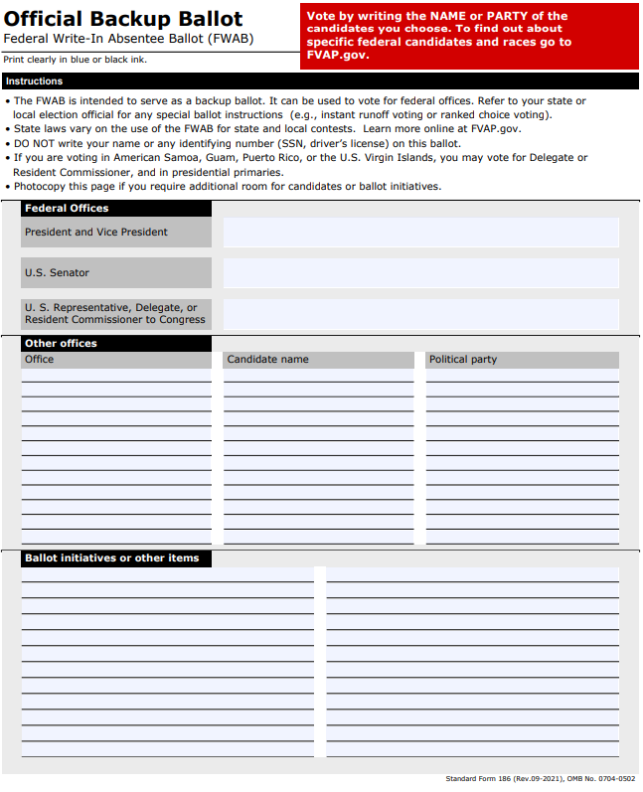
PRIMARY ELECTION
FPCA establishes which party’s primary the voter is voting
  NOTE: may indicate non-partisan, if local public question is on ballot
FWAB is void if…
  Voter does not indicate the office the candidate is running for on the FWAB
  Voter votes for a candidate of a differing political party than indicated on the FPCA
  Voter votes for a D candidate and R candidate on the same FWAB
FWAB is NOT void if…
  Voter votes for only candidates of the same political party as indicated on the FPCA
Voter is required to indicate the office and candidate’s name
  Voter does not need to spell candidate’s name perfectly
Voter does not need to vote in every office or ballot question
IC 3-12-1-18

Slide 15
GENERAL ELECTION
Voter is required to indicate the office and candidate’s name
  Voter does not need to spell candidate’s name perfectly
  Voter does not need to provide a political party
However, voter may indicate a political party anywhere on the FWAB
  This is considered using the straight party device
Voter may provide only one name for the ticket of…
  President & Vice President
  Governor & Lt. Governor
Voter does not need to vote in every office or ballot question
IC 3-12-1-19 | IC 3-12-1-1.7

Slide 16
Key UOCAVA Deadlines for May 5, 2026 Primary
March 21, 2026 (SATURDAY): Deadline to send ABS ballots to voters with approve apps to comply with MOVE Act
  DOES NOT ROLL OVER TO MONDAY!
  Ballot Ready Date in SVRS set to 3/21/26; counties can file a CAF to move up ballot sent date
April 23, 2026 (11:59PM): Deadline for county to receive FPCA requesting a MAIL ABS ballot
April 27, 2026 (11:59PM): Deadline for most UOCAVA voters to register to vote using the FPCA
May 4, 2026 (NOON): Deadline for county to receive FPCA requesting FAX/EMAIL ABS ballot
May 5, 2026 (6PM): Deadline for CEB to receive fax/emailed ABS ballot & ABS-9
May 5, 2026 (6PM): Deadline for CEB to receive stateside military voters’ ABS ballots by mail
May 15, 2026 (NOON): Deadline for CEB to receive overseas military & overseas voters mailed ABS ballots
  ABS Ballot must be counted if the voter is otherwise eligible and the security envelope is postmarked on or before May 5, 2026

Slide 17
UOCAVA Resources
MOVE Information Sheet
  Available on the INSVRS County Portal
  Be certain to include document with all absentee ballots being sent to UOCAVA voters
Federal Voting Assistance Program (FVAP)
  www.FVAP.gov
    Forms
    Guides & FAQs
    Contact Information
Indiana’s Military & Overseas Voters Guide (2026)
  Available on in.gov/sos/elections
  Hard copies available through HAVA Administrator (Scott Zarazee)

Slide 18

Voters with Print Disabilities (VPD)
Voters who cannot independently mark a paper ballot due to:
  Blindness or low vision
  Physical disability that prevents the reliable use of their hands
Special “Combined” Form: ABS-VPD
  Allows voter to register to vote & request ABS ballot
    ABS ballot can be sent by mail, fax, email
  ABS application good for one calendar year
    Must indicate a party preference for primary election
  Same VR & ABS deadlines
    VR: 29 days before election day
    ABS Application: 11:59PM, 12 days before election day
    ABS Ballot Return: 6PM on Election Day
IC 3-5-2.1- 107 | IC 3-11-4-3 | IC 3-11-4-6

Slide 19
VPD Processing Reminders
IF CEB learns voter does not meet VPD definition…
  Process the VR portion, if voter is otherwise qualified & form timely filed
  Reject ABS application
    Notice of disposition sent to voter & voter can re-apply using ABS-Mail or other ABS methods
Emailed or Faxed ABS- VPD Ballots
  County must send ABS-25 form, generated in SVRS; voter must return it with their faxed/emailed ballot by deadline to confirm consent to waive right to secrecy
    If using Democracy Live OmniBallot portal, the ABS-25 is part of the online packet & no need to print SVRS-produced ABS-25
Electronic Signatures
  Voter must be able to affix signature or mark to ABS-25 secrecy waiver or ballot security envelope
    Can be done using ink or pencil, but also using a computer mouse or finger on a touch sensitive device

Slide 20
VPD Processing Reminders
Faxed/Emailed Ballot Return
  Like UOCAVA voters using FPCA, store returned emailed/faxed ballot in ABS-10B envelope (or, if using up old stock, ABS-10)
  Mark the ABS-10B to indicate voter returned ballot by fax/email
  Attach voter’s application & ABS-25 secrecy waiver to envelope
Follow General Remake Procedures on Faxed/Emailed Ballots
  MUST be remade on paper ballot or ballot card; NOT DRE
  Serialize original ballot & new ballot card with same number
IC 3-12-1, generally | IC 3-12-3-5

Slide 21

Traveling Board
Used by voters who:
  Believe their polling place is inaccessible
  due to voter’s disability
  Are confined to their residence
  Cannot personally mark their own ABS
  ballot
  Are the caregiver of someone who is
  confined to their home
ABS-Traveling Board Application Period:
  Filed as early as 12/1/25 for May 2026
  primary & as late as noon, day before
  election day (5/4/26)
IC 3-11-10-25

Slide 22
Traveling Board
ABS-Traveling Board Appointments:
  Appointments to vote start no earlier than 19 days before each election & must end day before election day
    Exception: CEB may deploy travel board, by unanimous consent, if voter is hospitalized after noon, day before election day
  Must be set at a mutually agreeable time between voter & CEB
    Out of county travel request? CEB must unanimously agree to send travel board team outside of county
  May bring DRE or BMD to appointment
    Requires CEB to unanimously consent to its use; not automatic!
  Only Bi-Partisan ABS board can assist voter to complete their ABS ballot
    Voter may make their mark or sign the affidavit on the ballot security envelope OR
    ABS team can mark affidavit to indicate voter has a disability and unable to sign their name on the affidavit
IC 3-11-10-25 | IC 3-11-10-26.2

Slide 23
AG Address Confidentiality Program
NO “Special” VR form BUT there IS a “Special” ABS form. Voter must:
Complete the state or federal VR form that includes their physical residence address, if voter is not already registered to vote at that address
  Mailing address MUST be their PO Box noted on the letter
Submit “Notice to Government Entity of Address Confidentiality Program Participant” letter from AG office
  Sample letter is Appendix of 2026 Indiana Voter Registration Guidebook
If proper paperwork filed, VR official will mark the voter’s record with a “protected voter” flag in SVRS
  Flag remains on the record for a period of four full years, ending on June 30. Examples:
    Record marked confidential on 8/9/23; Flag removed on 6/30/28
      8/9/23 to 6/30/24 is not a full year, so four-year countdown starts on 7/1/24
    Record marked confidential on 5/1/23; flag removed on 6/30/27
      5/1/23 to 6/20/23 is not a full year, so four-year countdown starts on 7/1/23
IC 3-7-31-5 | IC 5-26.5-2-5 : IC 5-26.5-5-2.5

Slide 24

AG Address Confidentiality Program
ABS Application: ABS-Attorney General
  Good for one calendar year (Jan. 1 to Dec. 31)
    ABS application would need to be filed at least 12-days before each election to be considered “timely” for CEB to review & send ABS ballot
  Must indicate a party preference to receive partisan primary ballot
  Must comply with voter ID law when submitting ABS app
  Mail ballot to voter’s PO Box as indicated on the app
VR record & ABS-Attorney General application are CONFIDENTIAL
May NOT share in any public records request to ensure privacy
& safety of its participants, this includes any voter ID documentation
supplied with the voter’s ABS-AG application
IC 3-11-4-6 | IC 5-26.5 | IC 5-14-3-4(a)(1)

