Slide 1
Understanding Generative AI: Risks, Benefits and Best Practices
Indiana Elections in The Age of AI

Slide 2
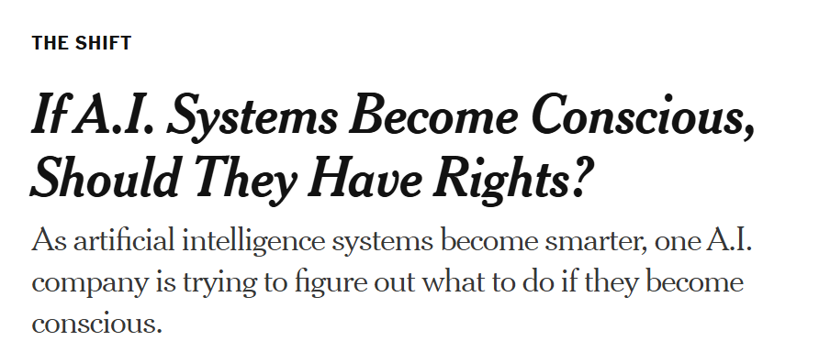
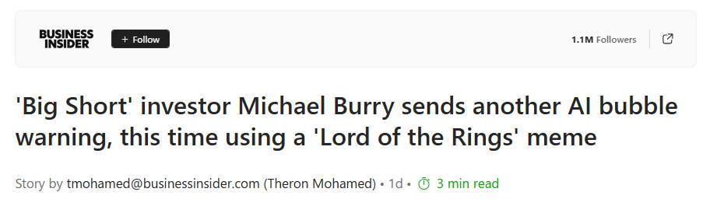
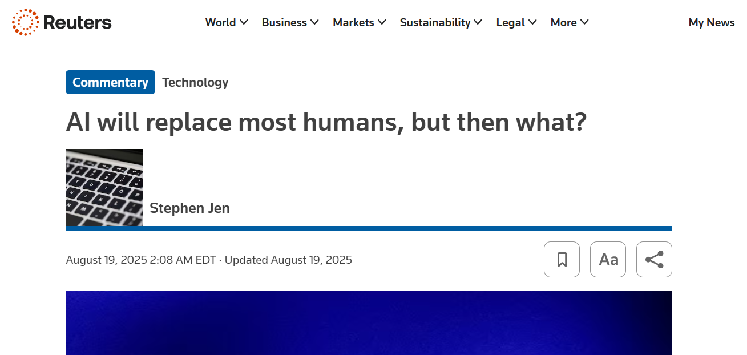
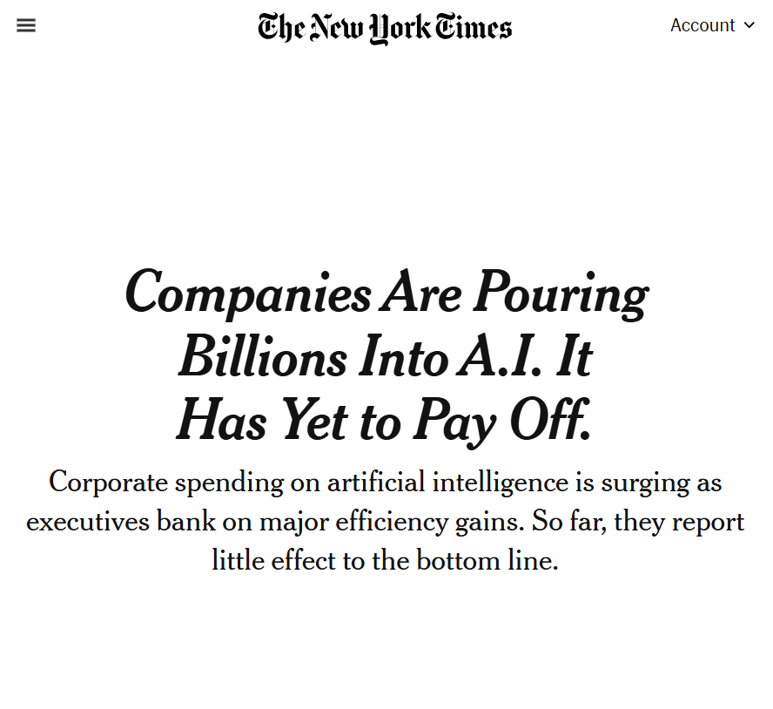
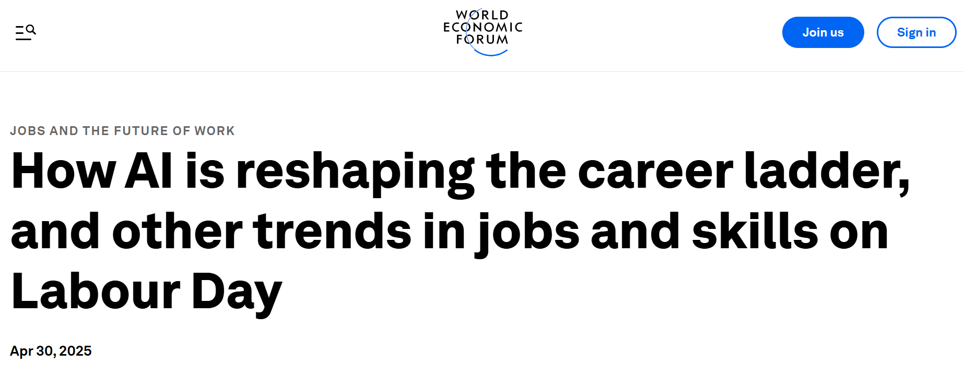
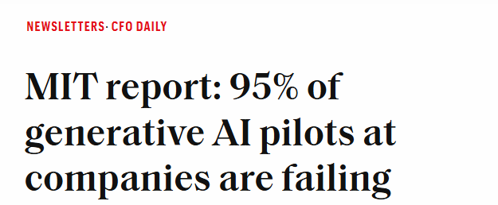
AI headlines
AI Headlines
Notes:
Speaker:
Ai is everywhere. It’s on our phones, it’s in the news, its in conversation – it’s still hype. And no doubt about it, it’s an awesome tool…because like a tool, GenAI is only as good as it’s user.
So today, we’re just going to take it back to realism and focus on how all of us can start to use GenAi today and some practical use cases that can come of it.

Slide 3
Agenda
Defining Generative AI and AI Fluency
Using Generative AI Securely
Examples of Generative AI Impacting Elections
Indiana’s Current Legal & Regulatory Response
How to Prepare for AI
Next Steps

Slide 4














Generative AI is Another Efficiency Tool
Generative AI FLUENCY
Artificial Intelligence
READ Natural Language Processing
SEE Computer Vision
PREDICT Predictive Analytics
LEARN Machine Learning
CREATE Generative AI
TEXT
VIDEOS
MUSIC
VOICE
CODE
IMAGES
Notes:
Speaker: Jessica Carius
Exponential Growth of GenAI – for reference, Netflix took just over 3 years to hit 1 million users, Instagram – 2 months, ChatGPT – 5days.
It is so important to break through the hype to understand what GenAI is, and what it is not.
Speaker Notes:
Before we dive deeper into the topic, let’s start by answering a fundamental question: What is Generative AI?
If you are an AI expert feel free to either zone out for 2 minutes or take this as an opportunity to take away a new approach to educating your teams.
At its core, we can define Artificial Intelligence (AI) as computer systems designed to perform tasks that typically require human intelligence—tasks like understanding speech (Natural Language Processing, or NLP), seeing and interpreting images (Computer Vision), recognizing patterns (Predictive Analytics), and now… creating. This creative ability is what we call Generative AI.
Generative AI represents an evolution in AI technology. It combines traditional AI techniques like machine learning, computer vision, NLP, and predictive analytics into one powerful model.
And thus, these models, often referred to as Large Language Models (LLMs), are trained on vast amounts of data—text, images, videos, and sounds—giving them the ability to generate (or, predict) entirely new and original content.
The hype has lied in the exponential Growth of GenAI – for reference, Netflix took just over 3 years to hit 1 million users, Instagram – 2 months, ChatGPT – 5days.
It is so important to break through the hype to understand what GenAI is, and what it is not.
Machine Learning Foundation: Generative AI heavily relies on advanced machine learning techniques, particularly deep learning and neural networks, to analyze patterns in large datasets
Predictive Analytics Integration: While generative AI focuses on content creation, it incorporates predictive capabilities to generate coherent and contextually relevant outputs
Computer Vision Techniques: For image and video generation tasks, generative AI employs computer vision algorithms to understand and create visual content
NLP Capabilities: In text generation and language understanding tasks, generative AI leverages NLP techniques to process and generate human-like text

Slide 5
What is Generative AI?
Generative AI FLUENCY
What Generative AI is
What Generative AI is not
A conversational participant
A search engine
A new content generator
A database of memorized facts
A language analyst
A replacement for human judgement or creativity
Notes:
Speaker: Jessica Carius
But what is AI fluency?
Fluency is understanding the potential and, arguably more importantly, the limitations of this technology. Understanding the limitations provides a safe-guard against risks. Understanding the potential can provide new ideas for applications.
GenAI is a new way to think about doing work and solving business problems.
We our motto is that Fluency is the foundation for any success when it comes to using these tools. A car isn’t going to get you anywhere safely if you don’t know how to drive or what you should do to stay safe.
Gen AI is a PARTICIPANT across our teams.

Slide 6
Generative AI as a participant in Business Processes
Generative AI FLUENCY
Value of Co-Intelligence
Human
Attention
Generative AI Participation
Expanded Intelligence:
AI scales human expertise, allowing humans to focus on high-value decisions.
Notes:
Speaker: Jessica Carius
And so with this in mind, it’s important to think of Generative AI as a participant in your business processes.
The true value of this tool comes when it’s augmenting the capabilities of the human using it. We refer to this augmentation as “Expanded Intelligence”
MIT links careless ChatGPT use to lower engagement, yet a Swiss follow-up-coach study raised exam scores fifteen percentile points when students thought first and prompted second. [Swiss study]
AI is an ingredient. You’re still the chef. Automation without aspiration is just autopilot.
GenAI is a new way to think about doing work and solving business problems.
We our motto is that Fluency is the foundation for any success when it comes to using these tools. A car isn’t going to get you anywhere safely if you don’t know how to drive or what you should do to stay safe.
Gen AI is a PARTICIPANT across our teams.

Slide 7
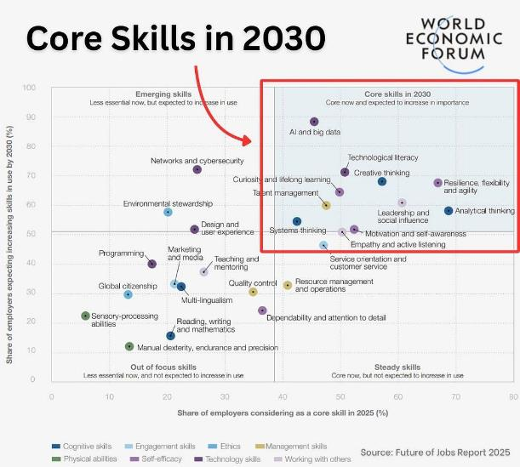
AI Literacy as important as Critical Thinking
Generative AI FLUENCY
Notes:
Speaker: Jessica Carius
Notes:
Critical thinking and being comfortable working alongside technology is so important.
This WEF report listed those 2 skills, alongside AI in the Core skills of 2030
As we use AI more, our ability to think critically about its outputs becomes even more essential, not less
Critical questions we must always ask: Is this output accurate? Is it appropriate for this context? What biases might be embedded? What am I not seeing?
Humans provide the critical oversight and judgment that ensures we use these powerful tools responsibly and effectively Without critical thinking, AI literacy is incomplete and potentially dangerous

Slide 8

Myth: Transformation means All or Nothing
Generative AI FLUENCY
AI Fluency
Agent
AI fully takes over repetitive or rule-based tasks
AI Maturity An organization's readiness to integrate AI into its core operations.
Augment
AI enhances human decision-making and workflows
Assist
AI support tasks by providing insights and reducing manual effort
Scale of AI Use Cases The technological sophistication of AI deployments across all parts of the organization.
Notes:
Speaker: Jessica Carius [update talk track to be more applicable to individual use cases >> start with small tasks and build. Have a post it note approach]
A lot of executives are getting analysis paralysis thinking about bringing AI in as an ‘All or Nothing’ endeavor
We need to all take a step back and think about how genai can augment the way we work, versus automating - Start small.
An assist, augment, agent approach is more achievable for a stream of organizational wins
AI Maturity is an organisations ability to leverage AI effectively, or derive business value from AI. Scale of AI Usecases are the applications of AI being scaled across the enterprise.
As your AI Fluency increases, you will see incremental steps forward in your AI Maturity and Scale of AI use cases. When they’re early in the curve, all that’s in the context window is “write an email”….then they become more advanced (loading the context window multiple times) > look at your overall task at hand. The more specific and defined the prompt, the less likely you’ll get a hallucination. So when you look at a big task, structure the prompt to make it every time a very specific task (narrow).
Ideation > if you think of a more complex task, AI fluency will help you break that task down.
Risk > understanding where data goes and the leak. (Slide …input slide, loop “taking history of the conversation and feedback in but it’s not learning, it’s providing context). More of a business thing > understand the data flow and guard against it. Cyber risk.

Slide 9
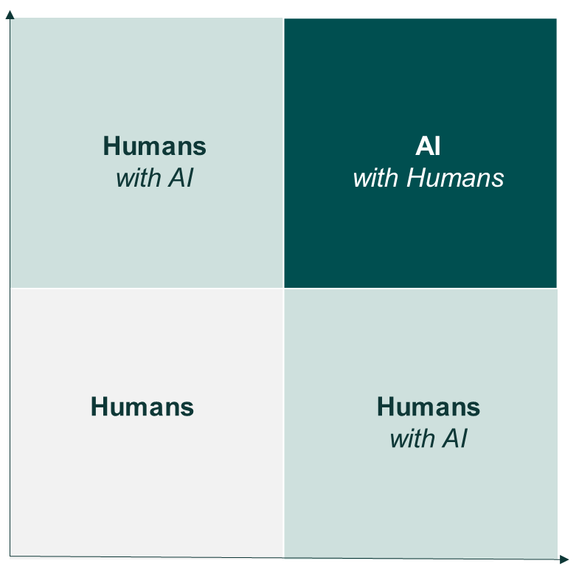

Just because Generative AI can, doesn’t mean it should.
USING GENERATIVE AI SECURELY
Does it make sense?
How are you accountable?
Task | GenAI | Human
Idea
Generate
Review
Action / Decision
Keep it Human: AI Adds Little Value
Human-Directed AI: Expert Oversight
Human Knowledge of Task
Gen AI-Assisted Learning: Research-Supported
Proceed with Caution: Critical Thinking Required
AI assists. Humans always authorize.
Effort to Complete Task
Notes:
Speaker: Jessica Carius
In our work, we see a lot of businesses who want “GenAI” and they pick a use application and it sinks. And this is because, sometimes while GenAI can do something, sometimes good old fashioned automation is the way to go.
Yes, Gen AI can rewrite your report with a different name, but you can also just Ctrl-F Replace too.
So when you go to use Gen Ai, think about your application on a quadrant of Human Expertise (or validation effort) versus effort to complete that task.
But here's the critical question we need to ask before any AI implementation…should we be using GenAI?
Bottom left – tasks with quick decisions or that are easy. This can be routine automation. GenAi works but it’s overkill and probably costs more than the value it adds. Like hiring a consultant to tie your shoes – possible. But unnecessary.
Humans with AI bottom right- - high-volume, routine tasks. perfect for tasks like generating routine reports or processing warranty claims. You lead – telling Ai what to do, and the AI augments your work. This can also be applied when you’re learning something new.
Humans with AI top left – expert decisions that don’t take long. They have the expertise to interpret ai insights quickly and make the call. AI augments their knowledge. Ai can highlight patterns or draft summaries, but you’re driving the analysis and making the decisions.
Bottom right and top left: you're in control, AI helps. Top right: AI drives, you guide and validate."
Top right – complex tasks requiring both expertise and massive effort.

Slide 10
Understand the data risks when using Generative AI.
USING GENERATIVE AI SECURELY
Prompt Injection
Tricking an AI System by typing misleading or harmful instructions, causing it to do things it wasn’t meant to do.
Data Leakage
Information you give to an AI system can accidentally be revealed to others if the system is not handled carefully.
Training Data Exposure
If your information is used to “teach” an AI system, pieces of it might show up later in what the AI says.
Compliance
Laws and rules about how information must be handled can be broken if an AI system uses or stores data in the wrong way.
Before you prompt…
1
If your data leaks, is it annoying, or devastating?
2
What type of data does your use case require as context?
3
Do we have the right capabilities to securely manage our data?
4
What regulatory or compliance requirements apply to our data?
Notes:
Speaker: Jessica Carius (bring up transcription use case here**)
**Add in talking points on AI Guardrails for bad actors / prompt injections /
One of the most important concepts to grasp is the difference between training and a context window..
I want to take a moment to clarify this idea of “Training” the model too. It’s a common misconception that the “AI is leaning about me” when you interact and that’s not necessarily the case.
There is this line in the workflow between Training and Context windows.
Training: How the AI Learns
On the left side, you see the word Training. This is where the LLM is taught—it’s exposed to massive amounts of training data text from books, articles, websites, and more. It uses reinforcement learning (computationally intense learning mode…process to teach. The process teaches, the model doesn’t learn, it gets taught)
If we think back to the last slide, During training, is where the model learns those patterns, grammar, facts, and even some reasoning by analyzing how words and sentences fit together.
Once the model is trained, it doesn’t keep learning from new data unless it’s retrained. The knowledge it has is ‘frozen’ at the time of training.
Context: How the AI Understands You Now
On the right side, we have Context. This is everything the AI model knows about your current session—your prompts, the system’s instructions, and sometimes even previous conversations if “user memory” is enabled.
Context is temporary and only lasts for your current interaction or session. It’s like the notes you pass to the AI during your conversation.
So, you personally are not training a LLM every time you use generative AI. You are however, providing consent for the provider to use your “User Memory” to train a future model with your stored conversations.
When deciding what use cases you want to use GenAI for, it’s important to understand your data risks. Is it annoying or devastating if something gets leaked? If it’s devastating, don’t use ChatGPT or Claude, set up an internal environment. Is it annoying? Ok, maybe an API connector is fine.Make sure you understand the data in your context. This is cyber and data governance 101 – and the more you scale, the more important it becomes.
a) training, where it goes in circles with a question/preferred answer – reinforcement learning (computationally intense learning mode…process to teach. The process teaches, the model doesn’t learn, it gets taught) and then b) inference – where you put something in the context window and it generates output but there’s no learning. However, data goes in and can get stored.
Data goes in a gets stored on one side …. if it leaks it pushes to the other side
GenAI isn’t LEARNING as you have a conversation with it. It is however, using your system prompt, your user prompt, and, in OpenAI or ChatGPT’s case, all the stored data associated with your account which provides it the best context as to how it responds to you.
So “How do you keep it from leaking” > get contracts with model providers to say they won’t and you have to. API stores data but contractually says they don’t train on that data. Every provider will have their own terms.
“This is the not the only place they are getting data! It’s cyber 101… you’re putting data out there all the time” It’s just good old fashioned cyber security. And there’s way to mitigate it through contractual > companies have to decide, if it did leak, is it annoying or devastating. If devastating – don’t let it leave the premises. So will amp up processing power to run model internally in network and there are costs. But you don’t have to run everything on prem.
ENVIRONMENTAL NOTES:
All the models out there have a carbon rating on them (i.e. what’s the carbon footprint per number of tokens). None of it really matters unless its comperative i.e. if you run the carbon footprint of the model, you’re running a carbon footprint of X hours of processing at that carbon rate. The comparative of that is having a person commute to their job for a month and then the delay in getting a job done. So if you’re comparing task to task, that’s one way to look at the carbon footprint of the model. That said, when people are writing their emails using this, it’s probably using more carbon footprint … the other interesting metric that we’re finding around this is, if you look at what we do as consultants, 85% is work that wouldn’t be done in an automated way anyway. But we use a couple of hours of carbon footprint to do that, but then it made other peoples lives easier. But that would never have happened unless there was a tool that could get it done. Someone has to do it, but no one would have built an automated process to get it done. If you look at knowledge bases, it’s the same category … and so people are stuck in their way and you have to figure out your carbon footprint on that. If there was an example of helping a telecom client … if you save 1 truck roll a year (i.e. going out to fix a router) , if you avoided one of those trips you could pay for all your carbon footprint.
Look at the comparative – IF YOU DIDN’T USE IT WHATWOULD YOUR FOOTPRINT BE.

Slide 11

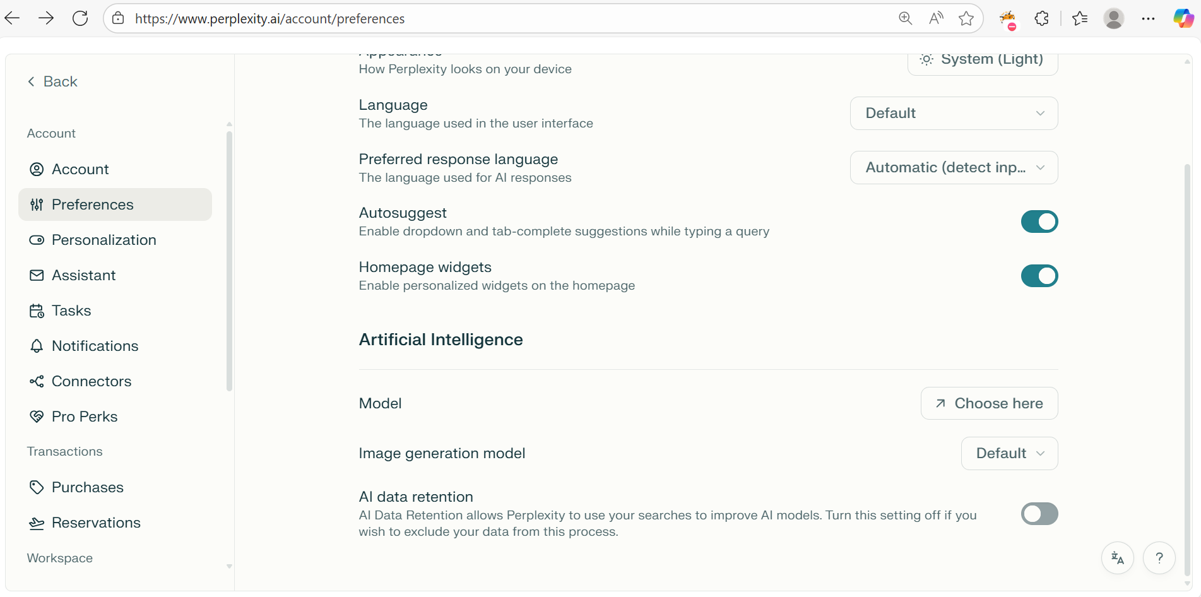
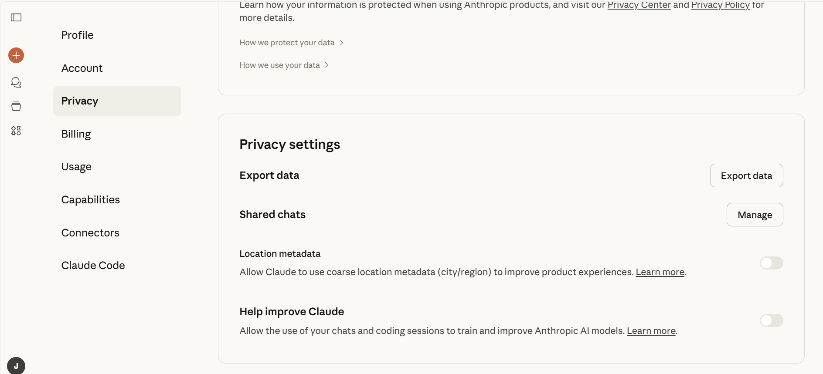
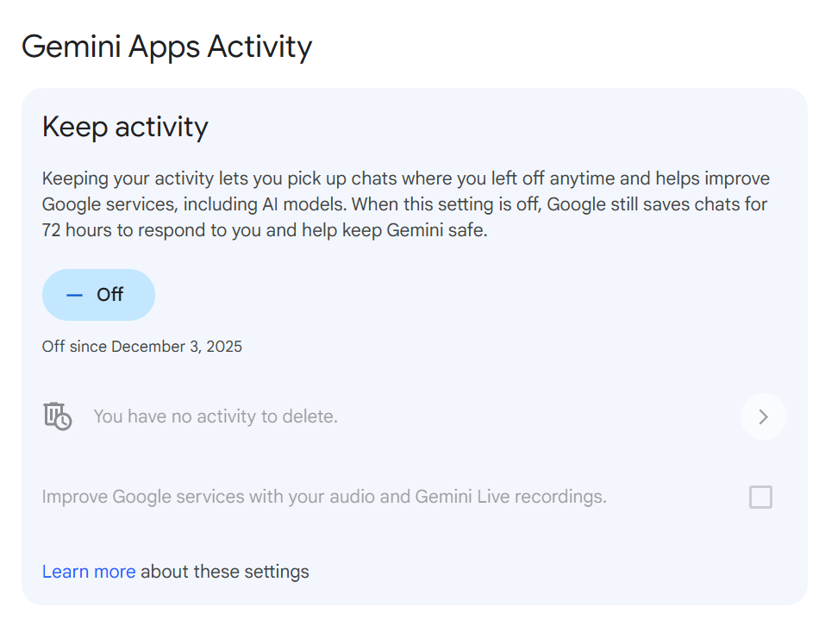
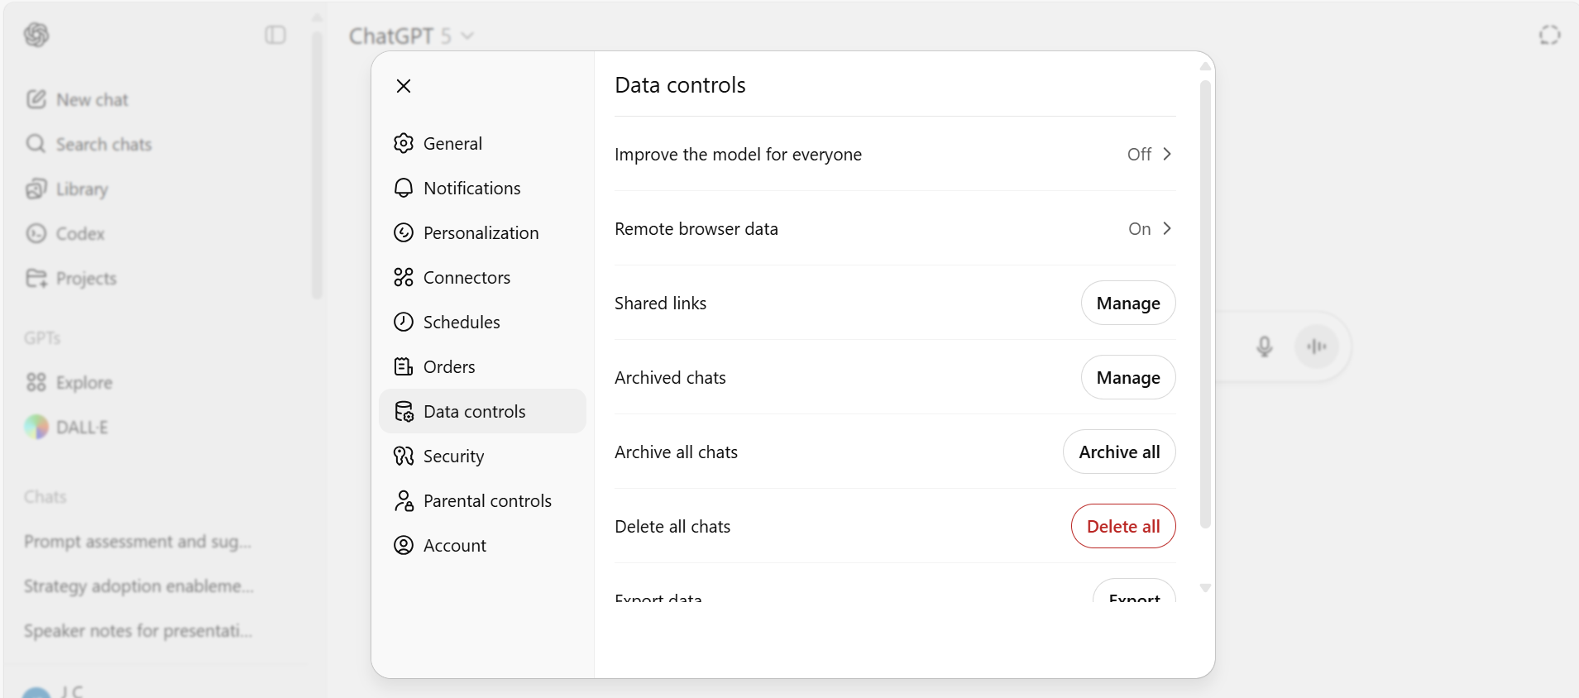
Setting Up External Sites for Security
USING GENERATIVE AI SECURELY
Perplexity
Claude
Gemini
ChatGPT
Notes:
Speaker: Jessica Carius

Slide 12
Examples of AI impacting elections
AI IN Elections
Chat Bots Influencing Voters
In testing, a pro-Harris AI chatbot shifted likely Trump voters nearly 4 points toward Harris after a short conversation, and similar chatbots moved voters in Canada and Poland by about 10 percentage points¹
Deep Fakes
In Slovakia’s 2023 parliamentary election, a fabricated audio recording appeared days before voting and went viral across platforms, falsely presenting an opposition leader as discussing vote‑buying and manipulation.²
Targeted Persuasion
Firms reported using AI models to create hundreds to thousands of “audience segments” based on detailed behavioral and demographic data, then delivering tailored streaming‑TV and digital ads to those segments. ³
Advanced Cyber Threats
This July, Microsoft identified more than 200 instances of foreign adversaries using AI to create fake content online, more than double the number from July 2024 and more than ten times the number seen in 2023.⁴
https://news.cornell.edu/stories/2025/12/ai-chatbots-can-effectively-sway-voters-either-direction
The Role of AI in the 2024 Elections – Ash Center
Reaching the Disengaged: How Campaigns Win by Engaging Overlooked Voters
Microsoft: Russia, China increasingly using AI to escalate cyberattacks on the U.S.

Slide 13
Indiana’s Current Legal & Regulatory Response
AI IN INDIANA Elections
House Bill 1133
State of Indiana AI Policy
National Institute of Standards and Technology (NIST) AI Risk Management Framework
Enacted in 2024. Law requires that political advertising which uses GenAI must depict a disclaimer.
State of Indiana Artificial Intelligence Policy adopts NIST AI RMF as the risk management framework for AI models
Govern | Policies, processes, procedures and practices across the organization related to the mapping, measuring and managing of AI risks are in place.
Map | Context is established and understood.
Measure | Appropriate methods and metrics are identified and applied.
Manage | AI risks based on as output from the Map and Measure functions are prioritized, responded to, and managed.
State of Indiana AI Standard
The Standard outlines the requirement for the submission of a Readiness Assessment Questionnaire prior to implementation or use of an AI tool or system.
Sources: Indiana law regulating AI usage in elections takes effect - The Indiana Lawyer, MPH: State of Indiana AI Policy and Guidance

Slide 14
How to Prepare for AI
AI IN INDIANA ELECTIONS
Consider conducting a risk assessment of internal systems even if not currently required by law to understand if/when AI could help (or pose risk) for voter-list management, communication, or operations.
Create a plan to respond to deepfakes or other synthetic media that could affect election integrity
Train staff on proper use of AI; spotting and reporting impersonation, synthetic media, or misinformation
Provide support to answer questions or respond to concerns
Take control of your online presence (.gov domain, verified social channels)

Slide 15




Next Steps
GETTING STARTED
GET STARTED
Provide a secure environment for your teams to start experimenting with Generative AI
PROMOTE FLUENCY
Provide resources to engage and teach your teams how to use Generative AI responsibly and efficiently
ENDORSE champions
Empower champion users to lead the way with use case ideation and innovation, and fluency.
start small & learn Quickly
Identify your pain points in business processes and select a small-scale project to start.
Notes:
Speaker: Jessica Carius
Note: champions will come naturally over time.
Assuming you've avoided these pitfalls and identified the right opportunity, you're facing the final strategic decision: how do you actually execute?
The key takeaway: GenAI success isn't about the technology - it's about the process. Start with business problems, assess systematically, avoid common traps, and choose your execution path deliberately.

Slide 16
Questions?
Baker Tilly Advisory Group, LP and Baker Tilly US, LLP, trading as Baker Tilly, operate under an alternative practice structure and are members of the global network of Baker Tilly International Ltd., the members of which are separate and independent legal entities. Baker Tilly US, LLP is a licensed CPA firm that provides assurance services to its clients. Baker Tilly Advisory Group, LP and its subsidiary entities provide tax and consulting services to their clients and are not licensed CPA firms. The name Baker Tilly and its associated logo is used under license from Baker Tilly International limited. The information provided here is of a general nature and is not intended to address the specific circumstances of any individual or entity. In specific circumstances, the services of a professional should be sought. © 2025 Baker Tilly Advisory Group, LP

Slide 17


Jordan Anderson, AIGP
DIRECTOR
E: jordan.anderson@bakertilly.com
Jessica Carius
MANAGER
E: jessica.carius@bakertilly.com

