Slide 1
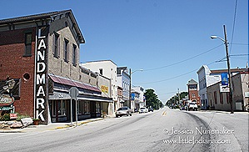
A Small Town Election
2011 Election Administrator’s Conference
Reproduced with permission of Jessica Nunemaker littleindiana.com

Slide 2
A Small Town Election
What do we mean by “Small Town?”
    Small Towns are towns with a population of less than 3,500
    Large Towns are towns with a population of 3,500 or more whose elections are governed by the same laws applicable to Cities

Slide 3
A Small Town Election
YOU SHOULD KNOW THE ANSWERS TO THESE QUESTIONS:
Who is responsible for conducting the election in a small town?
How are candidates nominated?
What are the election procedures and forms used in small town elections?
Who Pays and How much?

Slide 4
A Small Town Election
Does the county election board
or does a town election board conduct the election
in a small town?

Slide 5
A Small Town Election
Who Conducts Election in a Small Town?
County Election Board will conduct the election in a small town unless the town council adopts a resolution establishing a Town Election Board on or before Monday August 8, 2011
The Town Clerk-Treasurer must file the resolution with the circuit court clerk by noon Monday August 22, 2011 and the resolution, if adopted, expires December 31, 2011
(IC 3-10-7-5.5)

Slide 6
A Small Town Election
Who is on the Town Election Board?
If a town council adopts a resolution establishing a town board, the town board is made up of:
  The Democratic and Republican Party Town Chairmen (voters of the town who does not hold town office appointed by County Chairmen)
  The Town-Clerk Treasurer who serves as secretary of the board
  (IC 3-10-7-7)

Slide 7
A Small Town Election
Powers of Town Election Board
If a town election board is established then the town election board, the town executive (president of town board), and the town clerk-treasurer have the same rights, powers, and duties as a county election board, county executive, and circuit court clerk
(IC 3-10-7-21)

Slide 8
A Small Town Election
Nomination of Major Party Candidates
The Rule: Democrats and Republicans (major political parties) nominate candidates in town conventions held by each party
  The Exception: Small towns may adopt an ordinance providing for a primary for Ds and Rs held May 3, 2011 with all other city and large town candidates nominated at the primary with same forms (CAN-42) and deadlines (Jan. 19–noon Feb 18, 2011) as other primary candidates (IC 3-8-5-2)

Slide 9
A Small Town Election
BALLOT ACCESS: OTHER CANDIDATES
Small town candidates may also run as:
Minor Party and Independents are nominated by petition (CAN-44 and CAN-45; Petitions may be filed for certification from Jan. 3-noon June 30, 2011); or
Write-in candidates
  Candidate forms and filing deadlines for petition and write-in candidates are the same for all cities, large towns, and small towns (CAN 51 may be filed from Jan. 3–noon July 5, 2011)

Slide 10
Town Convention
Town Convention for Democratic, Republican and Libertarian Parties
If a small town does not adopt an ordinance for a primary election then Democratic and Republican Parties will nominate candidates by town convention (IC 3-8-5-2)
In a small town the Libertarian Party always nominates candidates by town convention (IC 3-8-5-17)

Slide 11
Town Convention
Who Runs a Town Convention?
Town Chairmen are voters of the town appointed by the County Chairman of each major party (same person who serves on town election board, if established)
  Note: Town Chairman may not be a town office holder (IC 3-8-5-3)
Town Chairman appoints a voter of the town as Secretary to help run convention
Town Chairman “calls” convention, posts notices, conducts convention, and certifies convention results to the circuit court clerk

Slide 12
Town Convention
Pre-Convention Deadlines and Forms
Ds, Rs, or Ls must file Declaration (CAN-16) with the circuit court clerk in the county that contains the greatest percentage of population of the town
  Filing Begins January 3, 2011 and the filing DEADLINE is Noon Monday August 1
  Withdrawal by Noon August 1 (CAN-46)
  Don’t Confuse CAN-42 with CAN-16!!!

Slide 13
Town Convention
Is a Town Convention Always Required?
No convention for a party is necessary if there are no contests within that party
  Uncontested candidates are considered nominated for the November ballot for their party
Single seats: A contest is when you have two declarations filed by different candidates in the same party for the same office where only one candidate may be elected
At-large seats: 3 candidates of same party for 3 at-large seats does not create a convention contest but 4 candidates for 3 at-large seats does

Slide 14
Town Convention
Certification of Candidates for Convention
After filing on August 1 the circuit court clerk shall:
  Complete CAN-17 certification and mark unopposed candidates considered nominated with an asterisk*
  Post CAN-17 in a prominent place in the clerk’s office
  If a Town Election Board has been established circuit court clerk sends CAN-17 and copies of declarations (CAN-16) to town clerk-treasurer
  (IC 3-8-5-10.5(e))

Slide 15
Town Convention
Calling Town Convention
If Town Convention is necessary because of opposition within a party, the Town Chairman must do the following:
  Post notice of town convention (CAN-15) at least 3 days before convention in 3 prominent places (including clerk-treasurer’s office);
  File a copy of the notice with the circuit court clerk;
    Note: Deadline to conduct the town convention is Saturday August 20, 2011
    (IC 3-8-5-10)

Slide 16
Town Convention
Pollbook for Town Convention
County voter registration office must furnish the Town Secretary of the town convention a list of the town voters
    Note: This voter list must show date of registration for voters who registered in 2011 since parties determine registration closing date for town conventions
    (IC 3-8-5-11(b))

Slide 17
Town Convention
Conducting the Convention
Town Chairman for party makes initial determination regarding a voter’s party qualification
  Voter can appeal Town Chairman’s decision to the undisputed voters at convention
Proxy voting, absentee voting, and voting in more than one convention are not allowed
Voting at town convention of more than one party is a crime

Slide 18
Town Convention
Town Convention Rules
In addition to statutory requirements, parties have Model Rules that cover:
  Registration Deadline
  Voting Procedures
  Resolving Tie Votes
    Note: Model Rules are in Town Election Guidebook and available from Election Division

Slide 19
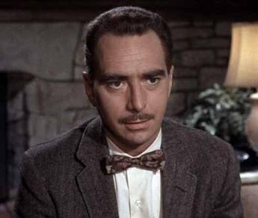
Town Convention
Convention Adjourned!!!
Anyone up for a Haircut at Floyd’s?

Slide 20
Town Convention
Certification of Convention Results
Town Chairman and Secretary certify candidates selected at convention (CAN-18) and file it with the circuit court clerk no later than Noon Monday August 29, 2011
Circuit Court Clerk must file a copy of the CAN-18 with town clerk-treasurer along with the CAN-16 of nominated candidates no later than Noon Tuesday September 6, 2011

Slide 21
A Small Town Election
Who Determines Candidate Challenges in a Small Town?
Challenges to small town convention candidates are determined by the town election board if one has been established, if not, then they are determined by the county election board
Even if there is a town election board, any voter of the town may appeal a decision of the town election board to the county election board (IC 3-10-7-34)

Slide 22
A Small Town Election
Challenge Issues
Failure to Properly Certify Ballot Vacancy
Candidate Qualification Issues (Residence, prior felony conviction, sore loser)
  Note: A petition candidate can appeal clerk’s denial of certification of petition for failure to obtained sufficient signatures

Slide 23
A Small Town Election
Challenge Deadlines
Small Towns: Challenge Filing deadline is Noon Tuesday September 6, 2011 for town convention and petition candidates
  CEB (or town election board) must rule by Noon Tuesday September 13 (IC 3-8-5-14.7)
Write-In Candidates: Filing deadline is Noon Friday August 26
  CEB must rule by Friday Noon September 2
  (IC 3-8-2-14(c); 3-8-5-14.7)

Slide 24
A Small Town Election
Necessity of Holding a Town Election
If all candidates for town office are unopposed (including write-in candidates) then a town election may not be held (IC 3-8-5-14.3)
Unopposed candidates are certified as elected (IC 3-12-5-3)
If no candidate even filed for a particular town office then the person currently holding that office will “holdover” in office for another term

Slide 25
A Small Town Election
Partial Election
General Rule: If at least one contest for one office then all nominees for each office must be on the ballot
  The Exception If:
    1) There is a contest in a single-member district less than the whole town and only voters in the district vote; and
    2) There is no contest where all voters in the town vote (town-clerk treasurer, for example); and
    3) The election board, by unanimous vote, adopts a resolution to have an election only in the contested district
Then Town may have an election only in the district
  (IC 3-10-7-6)

Slide 26
A Small Town Election
POST-ELECTION CERTIFICATION
Initial canvass of votes election evening then provisional ballots if any processed by noon Friday November 18, 2010 (noon 10 days following election)
Officially certify election by Monday November 21
File Post-election report (CEB-9) with the Indiana election division by Tuesday November 22
Certificates of election beginning noon Nov. 28- town clerk treasurer (CEB-32), town council (CEB-33), town judge receives a commission from the governor

Slide 27
A Small Town Election
  Keeping Election Records
If a Town Election Board conducts the town election then the board must immediately file election records and forms with the circuit court clerk after the town election completes counting all the votes
All election records must be preserved for at least 22 months
(IC 3-10-7-33(b))

Slide 28
A Small Town Election
  Who Pays?
Small Town pays if election is run by Town Election Board (but town may contract with county for supplies)
If County Election Board conducts election then County pays up front but town pays either:
  An amount specified in contract between county and town entered into no later than September 21, 2011 (IC 3-10-7-4); OR
  A combination of direct costs for town expenses and a percentage of county’s general expenses (IC 3-5-3)
  (See County Election Board Worksheet)

Slide 29
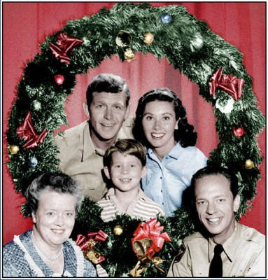
A Small Town Election
Merry Christmas from Mayberry!

