Slide 1

What is “Legal Residence”
Presented by: Brad King, Co-Director
Indiana Election Division

Slide 2
“Residence”- always fact-sensitive and can be complicated in some cases.

Slide 3

State law defines term: IC 3-5-2.1-90:
"Residence" means the place:
(1) where a person has the person's true, fixed, and permanent home and principal establishment; and
(2) to which the person has, whenever absent, the intention of returning.

Slide 4




State law (IC 3-5-5-1) applies definition of “Residence” to:
(1) A voter or a person applying to be a voter,
(2) A candidate, and
(3) A person holding elective office.

Slide 5

Basic starting point to determine residence: IC 3-5-5-2; A person's residence may be established by: (1) origin or birth; (2) intent and conduct taken to implement the intent; or (3) operation of law.
An individual BORN in Star City, Indiana, has established residence there (even if infant cannot yet have intent or engage in conduct to do so.)
An individual moves to Mars Hill, Indiana from Kentucky. Can establish legal residence in Mars Hill if: (1) intent to do so; and (2) engages in conduct to implement this intent.
An individual from Pluto Water, Indiana is elected to Congress, and spends almost all her time in Washington, DC for the next 10 years. But by “operation of law”, retains her Pluto Water residence while in DC “on the business of the United States”.

Slide 6
IC 3-5-5-4 Abandonment of residence A person who has a residence in a precinct retains residency in that precinct until the person abandons the residence by: (1) Having the intent to abandon the residence; (2) Having the intent to establish a new residence; and (3) Acting to establish residence in new precinct.
Basic starting point to determine residence:

Slide 7
An individual cannot be a resident of more than one location AT THE SAME TIME:
- Cannot be a resident of more than one precinct in Indiana at same time. - Cannot be a resident of both Indiana and another state, such as Ohio, at same time. IC 3-5-5-3.

Slide 8

Basic starting point to determine residence:
IC 3-5-5-4 Abandonment of residence
A person who has a residence in a precinct retains residency in that precinct until the person abandons the residence by:
(1) having the intent to abandon the residence;
(2) having the intent to establish a new residence; and
(3) acting to establish residence in new precinct.

Slide 9
Although we cannot easily determine an individual’s INTENT to establish or abandon a residence, we can rely on ACTIONS taken by that individual.
Individual statement made under the penalties for perjury (such as signing a poll list, homestead credit, tax returns, etc.) is presumed to reside at that address as of DATE that statement made. RISK of CONTRADICTION.
IC 3-5-5-6(b)

Slide 10
Likewise, the law establishes PRESUMPTIONS that can be the starting point for our analysis, but can be REBUTED by the individual if his or her case is not TYPICAL.

Slide 11
PRESUMPTIONS; Out-of-State:
A person who is physically present in another state outside of Indiana WITH INTENT to make the other state legal residence, even if the individual INTENDS to move back to Indiana at a later date, the person LOSES residence in Indiana.
IC 3-5-5-8 and 3-5-5-9

Slide 12
PRESUMPTIONS; Out-of-Precinct:
Same rule: If person physically outside of precinct WITH INTENT to make the other precinct the person’s residence, then the person LOSES residence in former precinct.
IC 3-5-5-10

Slide 13
PRESUMPTIONS; Transitional Situations:
- Temporary employment
- Preparing to purchase or occupy a residence
IC 3-5-5-7

Slide 14
PRESUMPTIONS; “IMMEDIATE FAMILY”:
"Immediate family": An individual's "immediate family" includes the spouse, children, stepchildren, parents, or grandparents of the individual (IC 3-5-5-0.5).
Residence of person’s “immediate family” is residence of person, UNLESS residence is transient for person or person’s family.
Person doing business in another place away from immediate family, person’s residence is presumed to be with immediate family UNLESS the person INTENDS to not return to family residence.
If married person does not live in same residence as spouse and INTENDS for different residence to be that person’s legal residence, then married person does not have same legal residence as spouse.
Unmarried person who does NOT have immediate family presumed to reside “where the person usually sleeps” UNLESS intent is different.
IC 3-5-5-11, 12, 13, 14, and 15

Slide 15
PRESUMPTIONS; Students:
- Physical presence in Indiana for educational purposes is presumed NOT enough, by itself, to establish residence.
- HOWEVER, if student chooses can state the EITHER address where person attends higher educational institution OR address where student lives when not attending school is legal residence.
IC 3-5-5-7

Slide 16
Special Cases:
Veterans home: Resident of veterans home presumed to reside at that home. IC 3-5-5-16
Mentally ill confined persons: Can choose residence at institution where confined OR at address where person lives when not committed to institution. IC 3-5-5-17
Nursing home: Not special statute, but person’s INTENT is what matters, whether or not family, doctors, or nursing home staff think return to that address is likely or possible.

Slide 17
Homeless/mobile persons: “Persons with a non-traditional address”
Individual with a nontraditional residence means a person who:
(1) does not reside in a private residential dwelling or an institutional structure; and
(2) maintains a mobile residence or usually sleeps in a shelter, public area, or public right-of-way.
Individual with “nontraditional residence” can have legal residence in a precinct.
IC 3-5-5-18 and IC 3-5-2.1-54

Slide 18
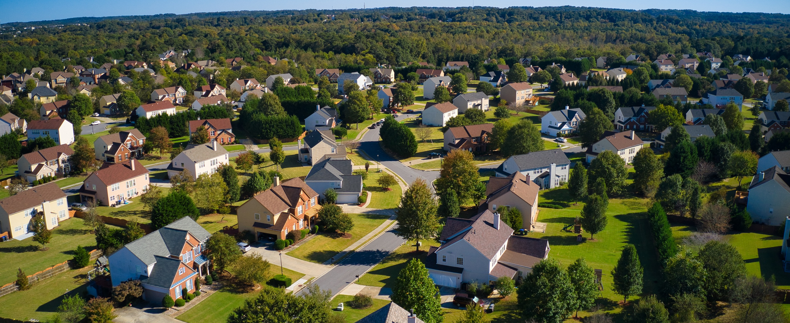
Questions?

