Slide 1
SVRS: New ABS Module Validation Features
Anola Gallion & Jason Jacobs, Proficiency Management, Civix

Slide 2
Step-by-Steps to Review:
Absentee Application Overview
Absentee Cure Process
ABS-VPD
FPCA Absentee Process
Processing Absentee Requests from Public Site
Processing Records from DLN/SSN Corrections Hopper and ID Updates Hopper

Slide 3
ABS Validation Processes
ID Validation in the ABS Module
Online ABS – DLN/SSN Corrections Hopper
Online ABS – ID Updates Hopper
Paper ABS – Validating ID information
Paper ABS – Photo ID Provided
Upcoming Enhancements
Notes:
SVRS menus are laid out logically by their function
We will begin with Voter

Slide 4
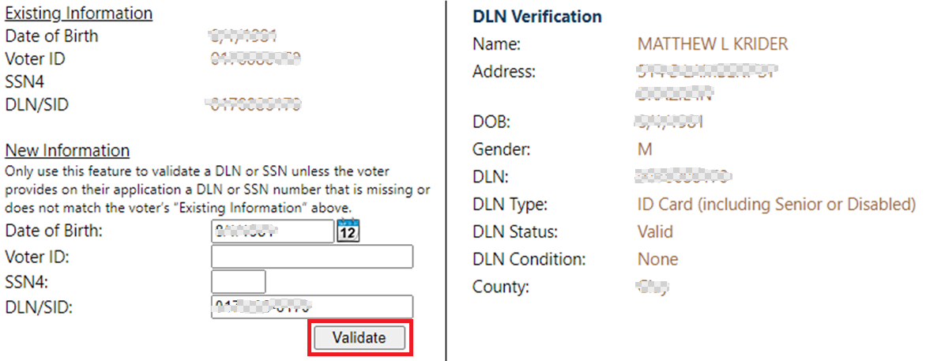
ID Validation in the ABS Module
ABS Applications submitted via IndianaVoters.com
Voter must include either their DLN, SSN4 or Unique Voter ID number when submitting an Online Absentee Application.
More than one ID may be provided on the application itself.
ID information will populate in the Validation section of the ABS Module.
Validate button must be selected to verify information entered by the voter prior to approving or rejecting the application.
Notes:
SVRS menus are laid out logically by their function
We will begin with Voter

Slide 5
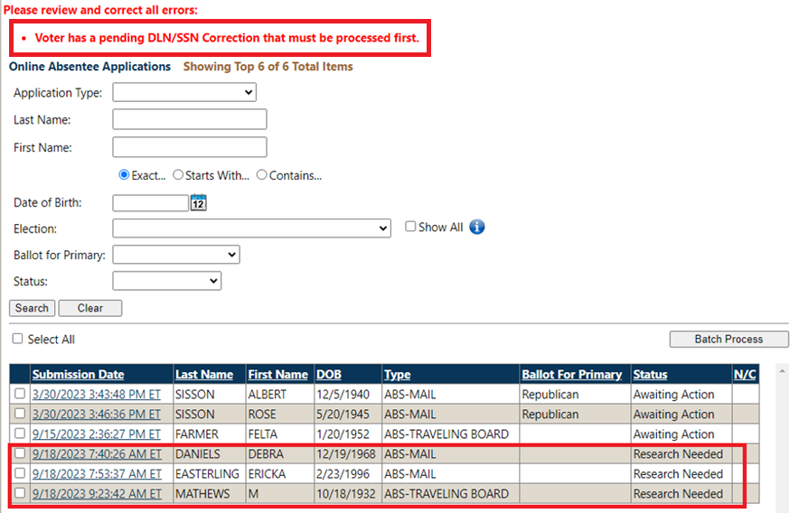
Online ABS – DLN/SSN Corrections Hopper
Record must be processed from hopper BEFORE processing ABS Application
Voter adds an ID on IV.com not on their current SVRS profile to access and complete the ABS Application.
Record populates in both the Online ABS Application Hopper and DLN/SSN Corrections Hopper.
When selecting record in Online ABS Application Hopper, a message will appear informing SVRS User to process record from DLN/SSN Corrections Hopper first.
ABS Application will be in Research Needed status
Notes:
SVRS menus are laid out logically by their function
We will begin with Voter

Slide 6
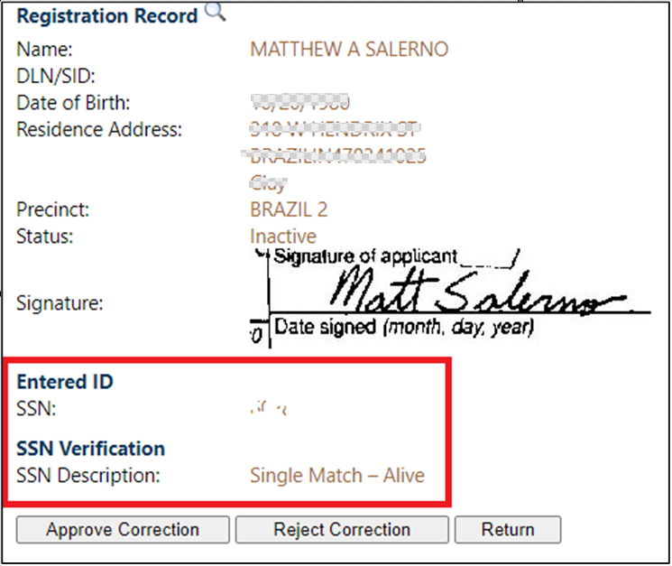
Online ABS – ID Updates Hopper
Record enters hopper created AFTER processing ABS Application
Voter accesses ABS Application on IV.com with an ID that exists on SVRS profile, then adds additional ID information on the application.
SVRS User selects “Validate” in the ABS Module, then approves or rejects the application.
Additional ID information goes into ID Updates Hopper for potential approval.
If approved, ID is added to the voter profile.
Comment added to voter profile if ID is approved or rejected.
Notes:
SVRS menus are laid out logically by their function
We will begin with Voter

Slide 7
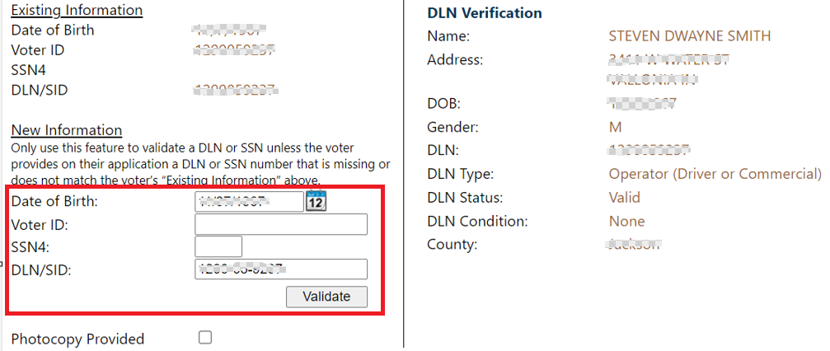
Paper ABS – Validating ID Information
Through Request App or Add Application functionality following Absentee Search
For Paper ABS Applications, SVRS Users may enter the DOB and any ID information provided on the paper form.
If additional IDs are included on the paper form, an entry will populate in the ID Updates Hopper for consideration
Notes:
SVRS menus are laid out logically by their function
We will begin with Voter

Slide 8
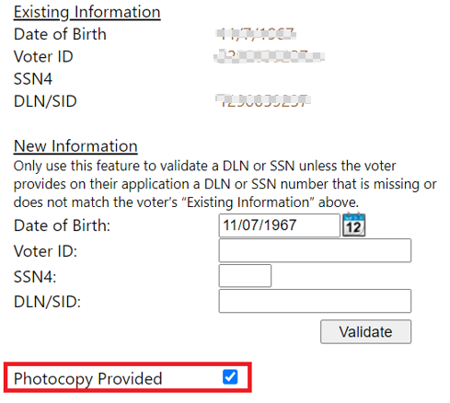
Paper ABS – Photo ID Provided
Voters may provide a photocopy of their Identification with their Absentee Application.
SVRS users should enter DOB and checkmark the box for “Photocopy Provided” and will not need to enter other ID information.
If a county wishes to keep the photocopy provided on file, it may be scanned and attached to the Documents section of the voter’s profile.
Notes:
SVRS menus are laid out logically by their function
We will begin with Voter

Slide 9
Upcoming Enhancements
The following are System Service Requests (SSR) currently in development and will be implemented in a future build as enhancements to SVRS.

Slide 10
Upcoming SVRS Enhancements
SSR 2206: Update Verbiage from "New Information" Section Paper Process
Instructions under “New Information” section during the “Add Application” process to be updated to match requirements for Paper Absentee forms
SSR 2207: Update Validation Requirement and Warning Message for Paper Process
Existing warning message of “New Identification Information Must Be Validated” to be updated to accurately reflect requirements when reviewing a Paper Absentee Application.
SSR 2211: Add a Warning Message in DLN/SSN Correction Hopper if No Match
If there is no match for the voter-provided DLN/SSN, an additional warning message will display at the top of the page with instructions for the SVRS User.
Notes:
SVRS menus are laid out logically by their function
We will begin with Voter

Slide 11
Related Web Trainings:
All times EST and subject to change
ABS-VPD Overview
2/20/24 at 1:00 p.m. & 2/22/24 at 11:00 a.m.
Absentee FPCA Overview
2/27/24 at 1:00 p.m. & 2/29/24 at 11:00 a.m.
Absentee & Cure Process Overview
3/19/24 at 1:00 p.m. & 3/21/24 at 11:00 a.m.

Slide 12
Contact Us
HelpDesk Contact:
888-467-8771
INSVRSHelpDesk@gocivix.com

Slide 13
Questions

