Slide 1

Voter List Maintenance Programs
Matthew Kochevar, Co-General Counsel
Valerie Warycha, Co-General Counsel
2026 Election Administrators’ Conference
Image on Freepik.

Slide 2

ACRONYMS
ABS: absentee
BMV: Indiana Bureau of Motor Vehicles
DL: driver’s license
IDOH: Indiana Department of Health
IED: Indiana Election Division
MOU: memorandum of understanding
SAMC: statewide address mailing confirmation notice
SOS: secretary of state
SSA: Social Security Administration
SSN: Social Security Number
SVRS: statewide voter registration system
VLM: voter list maintenance
VR: voter registration

Slide 3
VOTER LIST MAINTENANCE (VLM)
Ongoing maintenance of each county’s voter registration rolls, following state and federal laws
Specific “freeze” periods where counties CANNOT:
  Move a registration to “inactive” status in SVRS OR
  Send a Statewide Address Mailing Confirmation (SAMC) Notice
Must complete VLM work to update voter status to “inactive” based on approved VLM data sources not later than:
  90-days before a federal election (even-numbered years)
  29-days before a municipal or special election (odd-numbered years)
During “freeze” period, counties CAN:
  Update registrations & process new registrations
  Act on death record or disenfranchisement information
  Move a registration to “cancelled” on the written request of the voter
IC 3-7-38.2-2 | IC 3-7-38.2-14 | IC 3-7-38.2-15

Slide 4
48 HOUR DEADLINE TO COMPLETE VLM TASK
A county voter registration office must conduct voter list maintenance activity within forty-eight (48) hours of receiving information that a voter has:
  died
  moved outside the county
  failed to respond to voter list maintenance mailings
  was disfranchised due to imprisonment following criminal conviction; OR
  did not reply to a proof of citizenship notice
Counties CANNOT move a voter’s status to “inactive” during freeze periods and must wait until vote history is applied from the last election to confirm voter did not vote making the record ineligible for a status change to “inactive”.
IC 3-7-26.3-11 | IC 3-7-38.2-2

Slide 5
Confidence Factor
Data Matching in SVRS relies on a “confidence factor” to assist counties with decision-making
Full SSN: 40 points
SSN4: 10 points
IN DLN/ID Card Number: 50 points
DOB: 25 points
Last Name: 15 points
First Name: 15 points
Middle Name: 5 points
Suffix: 5 points
Street Address 1: 10 points
Zip Code (first five): 5 points
MAXIMUM POSSIBLE POINTS: 180
Most SVRS hoppers are designed to only show potential matches where confidence factor is 75 points or more
If 75 points or more, the greater likelihood of an accurate match
Counties must still carefully review proposed system match before accepting a match to avoid downstream issues
IC 3-7-38.2-5.5

Slide 6
VLM DATA: DEATH RECORD SOURCES
SVRS Death Records Hopper
  Contains death record info from IDOH, SSA Death Master File & State & Territorial Exchange of Vital Events (STEVE)
  Outside agency data is matched to SVRS records using a confidence factor; counties review to determine if the match is accurate and move status to “cancelled”
115-Year-Old Program
  At least once a year, counties must review SVRS report containing registered voters SVRS calculates are 115 years old or older or identifies as having a missing birth date on their VR record
  Review information to perform VLM work by finding obit of voter publish in newspaper or on license funeral home website OR find notice of estate administration
“Outside SVRS” Resources
  Death certificates, obituaries published in the newspaper or licensed funeral home website, notice of estate administration published in paper
  County Dept. of Health must file quarterly death notice paperwork with county auditor and county VR official of all deaths that occurred during the previous three months
    County DOH must provide records to county VR office not later than January 31, April 30, July 31, and October 31 of each year
      Previously only filed with the County Auditor and county VR official had to request county death record information
IC 3-7-45-2.1 | IC 16-37-3-9

Slide 7
VLM DATA: DISENFRANCHISEMENT
In Indiana, when a person is currently imprisoned following conviction of a crime:
  Registration record moved to “cancelled” status in SVRS
    Notice of Disposition sent to voter at their last mailing address, if county determines voter’s registration should be “cancelled”
  Cannot register to vote
    When released, may register to vote even if on probation, parole, or enrolled in community corrections programs
SVRS DOC Hopper
  Loaded with records from the IN Department of Correction
“Outside SVRS” Sources
  Quarterly reports from county sheriff for manual review and entry, if applicable
  US Attorney data sent to counties from IED time-to-time for manual review and entry, if applicable
IC 3-7-13-4 | IC 3-7-46-1 | IC 3-7-46-2 | IC 3-7-46-3 | IC 3-7-46-6 | IC 3-7-46-7

Slide 8
VLM DATA: CANCEL AT WRITTEN REQUEST OF VOTER
Various forms used for voter to authorize cancellation at their last Indiana address:
  VRG-14: authorize to cancel Indiana registration
  Statewide Address Mailing Confirmation (SAMC) notice & Voter Response Card (VRC) used in bi-annual statewide VLM project
    One option allows voter to cancel Indiana registration, but voter needs to sign form
Permissible for voter to send in their own letter, though must have an original “wet” signature
  Forms or letter must be mailed or hand-delivered
MUST be signed & authorized by the voter NOT a family member or friend or even a person with the voter’s POA!
IC 3-7-43-2 | IC 3-7-38.2-2 | IC 3-7-38.2-17

Slide 9
SAMC & VLM DATA SOURCES
Statewide Address Mailing Confirmation (SAMC) notice must be sent by forwardable first-class US mail to the voter’s most recent mailing address in SVRS AND contain pre-paid postage on the return portion of the notice
  Cannot be sent during the “freeze” period; may resume day after election until next “freeze”
Voter must be given at least 30-days to respond to the mailing based on the date the SAMC is mailed to:
  Confirm their Indiana registration address
  Cancel their Indiana registration for a move out of county
  Update their Indiana registration for a move within the county
Must be signed by the voter and if updating their registration, voter must answer age and citizenship questions
If voter fails to respond during the notice period OR SAMC is returned as undeliverable by USPS, then voter’s status is moved to “inactive”
  ONLY reason to move registration status to “inactive” under state or federal law
  Cannot change to “inactive” status during freeze period; must wait until after election day AND after applying vote history from the election
IC 3-7-38.2-2

Slide 10
APPROVED VLM DATA SOURCES TO SEND SAMC
The USPS National Change of Address Service
A jury duty notices returned because of an unknown or insufficient address
The return of a mailing sent by the county voter registration office to all active voters in the county because of an unknown or insufficient address
Notice from the BMV concerning the surrender of a voter's Indiana license for the operation of a motor vehicle to another jurisdiction
The return of a voter acknowledgement card, after the 7-day pending period, because of an unknown or insufficient address
The return of a mailing sent to voters of a precinct advising voters of a change of precinct boundary or the precinct polling place because of an unknown or insufficient address, if the county sends a similar mailing to the voters of each precinct when a boundary or polling place is changed
Information received from the election division from the national change of address service or return of federal jury summons
A declination to register by the voter stating that the voter resides at an address different from the address on the voter's registration record
Information received from the election division as a result of a comparison between a voter registration address and commercially available data, such as data from a credit agency
IC 3-7-38.2-2

Slide 11
APPROVED VLM DATA SOURCES TO SEND SAMC
New Sources to Send SAMC (2025 Legislative Session)
Information received by any person that an individual has moved out of state
  Also requires county to send VRG-14 (Cancellation Request by Voter) to their out-of-state address, if known. Otherwise, send to voter’s mailing address on IN voter record
Returned absentee ballot envelope because of an unknown or insufficient address as defined in IC 3-5-2.1-102
Voter has not voted in the last two general elections
  General elections are those held in November in even-numbered years, NOT the municipal (or city/town) elections held in odd-numbered years
  Must apply vote history from the election before moving forward with SAMC
  Civix & state working on SVRS functionality to streamline this effort
IC 3-7-38.2-2 | IC 3-7-38.2-2.4 [NEW]

Slide 12
VLM DATA: MULTI STATE INFORMATION
SOS may enter into MOU with other states for registration comparison
Information received from such a program must be used to send a SAMC to the voter
  Note: Kansas Crosscheck Program officially repealed from state law; IGA removed Indiana from the program several years ago and instituted IDEA, which remains in effect
IC 3-7-38.2-2 | IC 3-7-38.2-19 [NEW]

Slide 13
VLM DATA: US DISTRICT COURT DATA
US District Court Data
  By January 31, 2026, IED will request from Indiana’s US District Court information concerning:
    Jury services notices returned as undeliverable by USPS; and
    Individual disqualified from jury service due to citizenship status
  On or before 28 days after the 2026 primary (June 2, 2026) IED will provide to each county with information for any registered voter who:
    Had a federal jury service notice returned as undeliverable by USPS
    Is disqualified or potentially disqualified from jury service because voter is not a US citizen
  On or before 42 days after the 2026 primary (June 16, 2026) county VR official must:
    Determine if there is an approved resource to confirm a voter is deceased to move their registration to cancelled (if not, send a SAMC);
    Send a SAMC to each voter, at the voter’s mailing address on their VR record, who had a jury service notice returned; or
    Send a VRG-26 proof of citizenship notice to each voter identified as being disqualified from jury service because of citizenship
IC 3-7-38.2-2 | IC 3-7-38.2-16

Slide 14
VLM DATA: STATEWIDE VLM MAILING
Statewide VLM Mailing
  In 2027 IED will conduct another statewide VLM mailing program
  Each active registered voter in the state will be sent a mailing (First Mailing)
    If a voter’s first mailing is returned as undeliverable to IED then IED will send the voter a statewide SAMC card (second mailing)
    Second mailing is very similar to SAMC cards you produce out of SVRS and send to voters as part of other county VLM activities
IC 3-7-38.2-2 | IC 3-7-38.2-16.1 | IC 3-7-38.2-17

Slide 15

SAMC & NON-RESIDENTIAL ADDRESSES
VR officials MAY NOT enter a nonresidential address in SVRS as a voter’s registration address
VR applicants MAY NOT list a PO box or commercial mailing address as their residence address
  Application is considered incomplete under IC 3-7-34 if it does
Not later than August 1 of each year, VR officials must identify potential nonresidential addresses in SVRS
  If counties identify a non-residential match, then follow IC 3-7-38.2-7.4 and send a SAMC to the voter.
This change does NOT impact existing requirements for a VR official to investigate and determine whether a commercial or nonresidential address is
being used as a non-traditional address by an application or an error in the designation
made by SmartyStreets.
See IC 3-7-33-5.7 for details.
Image on Freepik.
IC 3-7-32-2.5[NEW] | IC 3-7-34-1.5 | IC 3-7-33-5.7 | IC 3-7-38.2-7.4

Slide 16
“OUT OF STATE” INFORMATION
IED, or sometimes counties directly, receive information from other states that indicate an Indiana voter might have moved out-of-state
CANNOT use this alone to base cancellation of Indiana record; instead, assuming voter registered in new state after being registered in Indiana:
  Ask out-of-state jurisdiction for a copy of the voter’s registration in the NEW state to look for “authorize to cancel registration” language on the form
    If out-of-state form has the “cancellation” language, then IN registration may be cancelled
    If not, county is to send a SAMC to their last IN mailing address AND (New!) VRG-14 to their new state’s registration address
  If county cannot get a copy of the out-of-state registration, then send SAMC to voter to their last Indiana mailing address
Can you use information provided by other states to cancel
an Indiana voter’s registration? It depends!
IC 3-7-38.2-5.5(d) – (f)

Slide 17
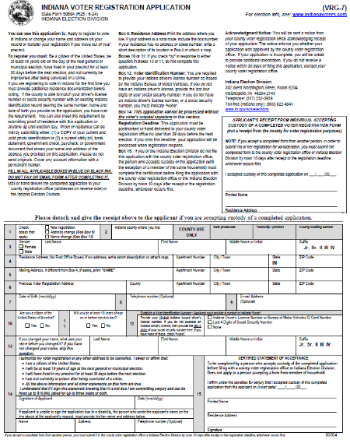
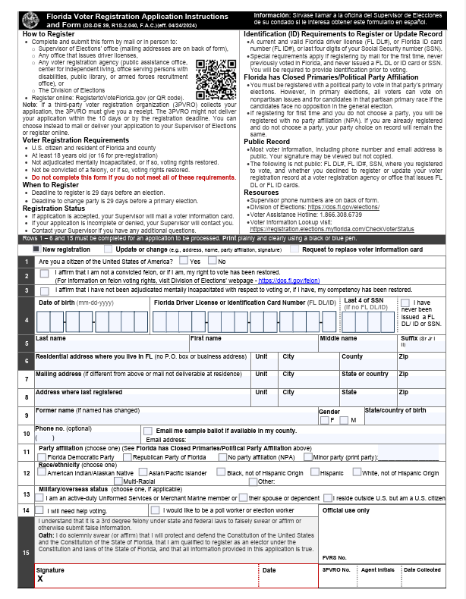

FL VR form does NOT appear to have “magic words” to cancel registration at another address.
IN VR form DOES have “magic words” to cancel at another address

Slide 18
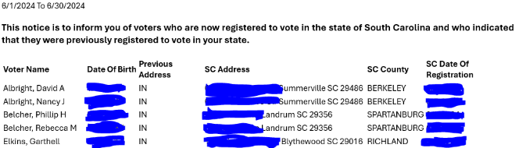
OUT OF STATE VOTER INFORMATION
Example 1: Sample Out of State Notice (SC)
Analysis: Does it contain the voter’s registration in South Carolina with the voter’s signature AND a statement noting the person authorizes cancellation at a previous address? NO!
Next Steps: If NEW state registration occurred AFTER their Indiana registration date:
1) Must send a SAMC to the voter to the mailing address on their IN registration record, when outside of the freeze period
Voter can update, cancel or confirm IN
residence address
If no response after given 30 days’ notice
(or SAMC is returned as undeliverable), move
voter to “inactive” status, if not in a
freeze period
2) Must send a VRG-14 for voter to cancel their IN registration to the voter’s address in their new state, which can happen any time
  NOTE: Cannot use undeliverable VRG-14 for VLM purposes to move a registration to inactive or to send a SAMC

Slide 19
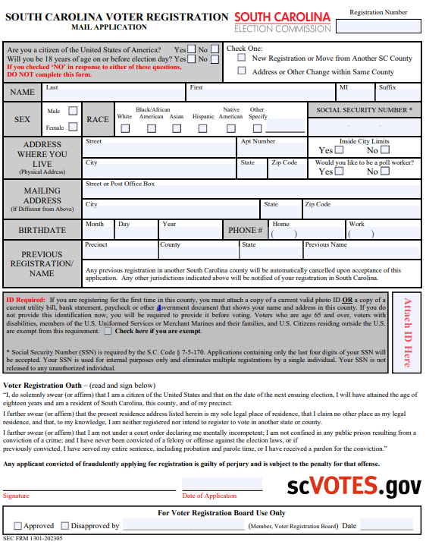
OUT OF STATE VOTER INFORMATION
Example 2: Sample Signed SC Voter Registration Form
  Analysis: Assuming the SC VR form is signed by the voter, can you use it to cancel the voter’s IN registration? Maybe. “Magic words” to look for on the form will authorize cancellation at a previous address
Next Steps: If NEW state registration occurred AFTER their Indiana registration date:
County VR official must decide if language on SC form authorizes cancellation at a previous out-of-state address
If decision is “yes,” then voter’s status can be moved to cancelled
If decision is “no” or “not sure,” then county can use this information to send a SAMC AND VRG-14 to the voter

Slide 20
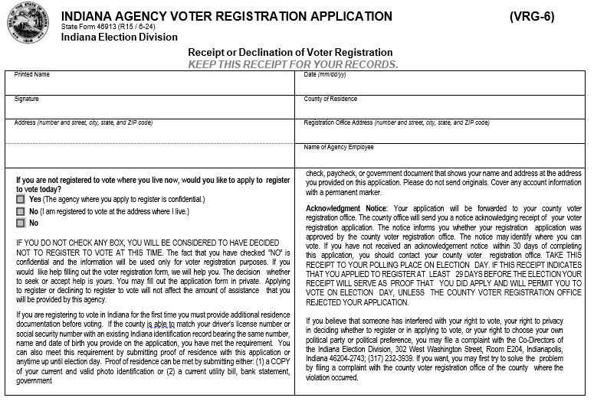
SAMC & VRG-6 DECLINATIONS
For ALL full-service agencies EXCEPT BMV….
  Agency files paper VRG-6 forms & declinations with county VR official not later than 5 days after receiving form from voter
    VRG-9 cover sheet is used
  VR official provides VRG-8 form to agency confirming receipt of VRG-6 forms & declinations
BMV VRG-6 & declinations are sent electronically to SVRS
  No need to use the VRG-8 & VRG-9 forms
Process voter registration portion the same as any other VR form
  BMV registrations come through the SVRS BMV Hopper
  All other full-service agency registrations are on paper
Image is the top half of VRG-6 form; lower half is similar to state VR form

Slide 21
SAMC & VRG-6 DECLINATIONS
Does ADDRESS ON DECLINATION match the residence address on their current registration record?
  If a MATCH, cannot be used for list maintenance
    Minor variations in the address are OK (missing “Drive” or “St.”, for example)
  If NOT a match, a statewide address mailing confirmation (SAMC) notice is sent to the voter
    Generated in SVRS
    Allows voter to confirm current registration address, update it within their county, or cancel it
    If voter fails to respond after 30-days or the SAMC is returned as undeliverable, then voter’s status is changed to inactive (assuming not in a freeze period)
DO NOT SEND A SAMC if the only difference between the records is that the voter’s name does not match!
County may wish to follow-up with the voter, though name changes can be handled in multiple ways through the voting process without major impact to voter
IC 3-7-38.2-2(e)(8)

