Slide 1

Ballot access: Candidate Qualifications candidate filing Petition Filing
Presented by:
Brad King & Angie Nussmeyer, Co-Directors
Indiana Election Division
2026 Election Administrators’ Conference
Image by macrovector on Freepik

Slide 2

Acronyms
ABS = absentee
CEB = County Election Board
D/R/L = Democratic, Republican or Libertarian Parties
DLN = driver’s license number
IED = Indiana Election Division
SEI = Statement of Economic Interests
SOS = Secretary of State
SSN = social security number
VR = voter registration

Slide 3


NOT THE CANDIDATE POLICE!
ONLY REJECT CANDIDATE FILINGS WHEN:
Presented AFTER deadline for filing
Missing CAN-12 (or statement of economic interests filing receipt) from declaration of candidacy form
Filed on old version of form
Filed in wrong office (ex: form filed with CEB that should be filed with IED)
For ballot vacancies, call to caucus (CAN-30) or candidate declaration (CAN-31) was not timely filed before the candidate selection form (CAN-29)
Petition carrier on the petition of nomination is not completed before petition filing deadline
MUST deny a petition for minor party/independent candidates or school board candidates that have an insufficient number of signatures
IC 3-5-4-1.9 | IC 3-8-9-6 | IC 3-5-4-8 | IC 3-5-4-1.2 | IC 3-13-1-21 |IC 3-6-12-8 | IC 3-8-6-12(d)

Slide 4
Candidate Challenges: CAN-1
Who can challenge a candidate based on not being qualified to seek office?
Voter in the election district OR county chair, in a county that is part of the election district.
When can a challenge be filed?
It depends. For a primary election, a CAN-1 must be filed by noon, one week after the filing deadline or noon, Feb. 13, 2026.
How is a challenge managed? Hearing of the county election board (more on this topic later in the conference) where both parties must be given notice to present their facts and evidence to the board.
Can a candidate using the petition process file a challenge to dispute a clerk’s decision to deny ballot access to them?
Yes. See the current version of the Election Calendar: Election Administrator’s Edition for the 2026 deadlines.

Slide 5

candidate QUALIFICATIONS
Are there durational residency requirements?
Some offices require you to reside in the election district (and often the jurisdiction such as the county) for a specific period before the November election
Am I registered to vote in the election district?
Nearly all elected offices require you to be a registered voter of the election district in order to run for the office
Do I meet the vote history requirements to run in the D or R Primary in May?
State law requires that the last TWO primary elections in Indiana in which you voted must be of the same political party you seek nomination in the May primary
If your voting history does not meet this requirement, you can seek certification from the county chair where you reside
Note: This is NOT a requirement to fill a ballot vacancy after the May primary election through a party caucus or chair appointment
Am I old enough to hold office if elected?
A few offices require a person to be of a certain age to hold office, if elected in November
Party Offices (Delegate, Precinct Committeeman)
Qualifications are set by party rules, not state law!
IC 3-8-1 | IC 3-8-2-7(a)(4)

Slide 6

Other QUALIFICATIONS
Government Employment & Holding Office
State law does not permit a person to hold local office AND be employed by the same unit of government
Can run for office, but are considered to have resigned from after taking oath and assuming elected office
Specialized Training
County Assessor requires a person, ONCE ELECTED, to achieve Level 2 certification before assuming office in their first term
Must achieve level 3 certification before assuming a second term, if elected again
Prosecuting Attorneys and most Judges need to be a member of the Indiana Bar, in good standing
Felony Conviction
A person who has been convicted of a felony is disqualified from being a candidate
for an elected office (except a federal office) or assuming an office
Felony means a conviction of a crime where a person can be imprisoned for more than 1 year
If the felony conviction is pardoned, vacated, expunged, or otherwise reversed then the person is no longer disqualified from being a candidate for elected office (but not when felony reduced to misdemeanor as part of plea)
IC 3-5-9 | IC 3-8-1 | IC 3-8-1-5

Slide 7

LOOKING AHEAD TO 2026 ElectionS
Primary Election Day: May 5, 2026
Voters must pick a Democratic or Republican Party Ballot
If public question on the ballot, then counties must create a:
non-partisan “public question only” ballot AND a special 17-year old ballot to eliminate the public question from partisan D/R ballot
Note: Not as likely given the change in state law to move the most common public questions to the Nov. ballot in an even-numbered year.
IN Secretary of State, Comptroller (Auditor) & Treasurer are NOT on the May ballot
Selected at state party convention
General Election Day: November 3, 2026
All candidates on the same ballot to determine who serves the term of office
If a school-related public question is on the ballot, then a “no public question” ballot must be created for those voters who moved out of the school corporation boundaries 30 days or more before the election & did not update their registration. (Similar to the 17-year-old ballot style in the primary.)
Don’t Forget about the “Federal Only” Ballot for certain military & overseas voters – more to come later!
IC 3-5-1-2 | IC 3-7-13-3 | IC 3-8-4-2

Slide 8
What’s on the Ballot IN 2026
Federal Offices
US House
IN does not have US Senate on the ballot, since it’s the “off-year” in the six-year cycle
State Offices
Secretary of State
State Comptroller (Auditor)
Treasurer of State
State Legislative (IN House, IN Senate)
Party Offices
Dem Party: PC, Delegate
Rep Party: Delegate
Local Offices
Circuit & Superior Court Judges
County Prosecuting Attorney
County Assessor & Sheriff (in all counties)
County Auditor, Clerk, Coroner, Recorder, Surveyor & Treasurer (in some counties)
County Commissioner & County Council
Township Trustee & Board
Town Judge (in some municipalities only)
Town Council (in some municipalities)
Town Clerk-Treasurer (in some municipalities)
School Board (NEW! can affiliate with a party)
IC 3-8-1 | IC 3-10-2

Slide 9

Ballot access: D & r candidates
Primary Election: Filing starts Jan. 7 and ends at NOON, Feb. 6, 2026
State Legislative Offices
File with IED: CAN-2 declaration of candidacy + Receipt showing SEI filed
Senate: File SEI with secretary of the Senate (NOT the CAN-12; form available at iga.in.gov)
House: File SEI with clerk of the House (NOT the CAN-12; form available at iga.in.gov)
Judicial Offices & Prosecuting Attorneys
File with IED: CAN-2 declaration of candidacy + Receipt showing SEI filed with Office of Judicial & Attorney Regulation
SEI is NOT the CAN-12; form available at in.gov/courts/ojar/judicial-resources/forms/
Local Offices
File with CEB: CAN-2 declaration of candidacy & CAN-12 Statement of Economic Interests
Party Offices
File with CEB: CAN-37 filed with County Election Board (no CAN-12 – statement of economic interests – required)
If D/R lacks primary voting history, the chair’s certification would also be included with their filing. This is NOT a state form, but a sample form is available to counties.
IC 3-8-2-5 | IC 3-8-2-6 | IC 3-8-2-11 | IC 3-8-9

Slide 10
After the Primary election…
D & R Ballot Vacancies for Local Office
If no person ran in the D or R primary for an office, then party can fill vacancy up to noon, July 3 using one of two options:
Caucus of eligible PCs to fill ballot vacancy held on or before noon, July 3; HOWEVER, final paperwork must be filed on or before noon, July 6, 2026
July 3, 2026, is a state holiday so party must take ACTION to fill vacancy by this date, but paperwork filing date rolls to noon, July 6, 2026, or next time office is open
Direct appointment by county chair, if the party organization has given him or her that authority OR there is only one or no eligible PC to vote in a caucus
If a person nominated in the D or R primary withdraws not later than noon, July 15, then party can fill vacancy within 30-days
After noon, July 15, a D or R candidate may only withdraw if they move out of election district, die, are convicted of a felony (for state & local offices only), becomes otherwise disqualified under IC 3-8-1-5, or ordered off the ballot by a judge under IC 3-8-7-29
If this occurs, then party can fill vacancy within 30-days
NOTE: Ballot vacancies to fill statewide or legislative vacancies use slightly different procedures
IC 3-8-7-28 | IC 3-13-1-2 | IC 3-13-1-6 | IC 3-13-1-7

Slide 11

Ballot access: D & R Party Offices
IC 3-5-2.1-34 "Elected office"
"Elected office" means a federal office, state office, legislative office, school board office, or local office. Political party offices (such as precinct committeeman and state convention delegate) are not considered to be elected offices.
Democratic Party (2026)
Elect Precinct Committeemen
Elect State Convention Delegates
Democratic Party (2028)
Elect State Convention Delegates
Republican Party (2026)
Elect State Convention Delegates
Republican Party (2026)
Elect Precinct Committeemen
Elect State Convention Delegates
Image by pikisuperstar on Freepik
File CAN-37 (NO CAN-12 Needed) for each party office individual wants to run
OK for candidates for elected office to file CAN-2/CAN-12 AND CAN-37(s) for party office (not dual lucrative)
Qualifications for party office determined by state party rules

Slide 12

BALLOT ACCESS: libertarian party CANDIDATES
Nominated at a state or county convention
Nomination paperwork due by noon, July 15
Exception: If a “small” town (less than 3500 persons) holds their town elections in 2026, then the filing procedures for town offices are different and a Libertarian Party town convention may need to be held and final nominating paperwork filed with the county clerk by noon, Aug, 28, 2026
Note: Does NOT apply to D/R candidates in “small” towns in even-numbered year; instead, D/R candidates file for the primary election or fill a ballot vacancy, if applicable
May fill ballot vacancies
State Chair must give notice the state committee will fill ballot vacancies to state or county, depending on where candidacy paperwork is filed, not later than 10 days before the committee meets to fill the ballot vacancy
Final paperwork due not later than noon, July 3
Exception: Rules for withdrawing from a “small” town office as described above have a different deadline
Candidate filing may be done at IED or CEB, depending on the office sought
IC 3-8-4-10 | IC 3-8-5-17 | IC 3-10-2-15 | IC 3-13-1-20

Slide 13

BALLOT ACCESS: Ind. Or minor party CANDIDATES
File CAN-3 to be a write-in candidate
Due by noon, July 3, 2026 (Filing deadline rolls to noon, July 6, 2026, due to state holiday)
Name is NOT printed on the ballot
File petitions to have name printed on ballot
Use CAN-19 (federal, state, judicial) / CAN-21 (local office), depending on office sought
Must collect signatures of registered voters totaling at least 2% of total vote cast among all candidates for SOS in 2022 in the precincts making up the election district
Petitions due by noon, June 30, 2026, for certification
Must also file statement of economic interests & candidate consent (CAN-20)
For local office candidates, the CAN-12 is filed with the petitions and consent is filed by noon, July 15
Exception: for counties with separate VR board (Allen, Marion, Madison, Vigo, Vanderburgh), the CAN-12 is filed with the CEB at the time certified petitions are filed
For state candidates, the petitions are filed by June 30 and the certified petitions along with statement of economic interests & consent are filed with IED by noon, July 15
Write in
Joe Jones 4 Dogcatcher!
IC 3-8-2-2.5 | IC 3-8-6-3 | IC 3-8-6-10 | IC 3-8-9

Slide 14

BALLOT ACCESS FOR School Board CANDIDATES
NEW! Party Affiliation Allowed to Appear on Ballot!
D/R/L or other minor party
Independent
“Blank”
To have name printed on the ballot:
File with CEB: CAN-34 petition & candidate’s consent + CAN-12 SEI
Filing begins on May 19 and ends at NOON, June 18, 2026
For MOST school districts, need signatures of 10 registered voters within the election district
To be a write-in candidate (name NOT printed on the ballot)
File with CEB: CAN-26 + CAN-12 statement of economic interests
No signature gathering requirement
Filing begins August 5 and ends at NOON, August 21, 2026
Image by macrovector on Freepik
IC 3-8-2.5-2 | IC 3-8-2.5-2.5 | IC 3-8-2.5-4

Slide 15
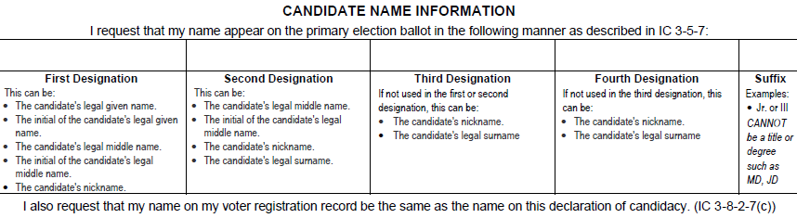
Candidate Name Designations
1 First Designation
Candidate’s legal given name OR initial of candidate’s legal given name OR
Candidate’s legal middle name OR initial of candidate’s legal given name OR
Candidate’s nickname
Primary Ballot Candidate Order: Listed ALPHABETICALLY BY SURNAME
Form design requires candidates to list their designation to take guess work out for county officials
All NICKNAMES must go in (PARENTHESES) on the ballot
Parentheses not required when nickname is used in first designation
Must be a nickname candidate is commonly known
Limited to 20 characters
Cannot use Title or Degree
Candidate Name does NOT have to match registration
Instead, registration updated to reflect candidate name
2 Second Designation, if not used in the first designation…
Candidate’s legal middle name OR initial of candidate’s legal given name OR
Candidate’s nickname OR
Candidate’s surname
3 Third Designation, if not used in the first or second designation
Candidate’s nickname OR
Candidate’s legal surname
4 Fourth Designation, if not used in the first or second or third designation
Candidate’s nickname OR
Candidate’s legal surname
5 Fifth Designation: Suffix Only
Suffix
15

Slide 16
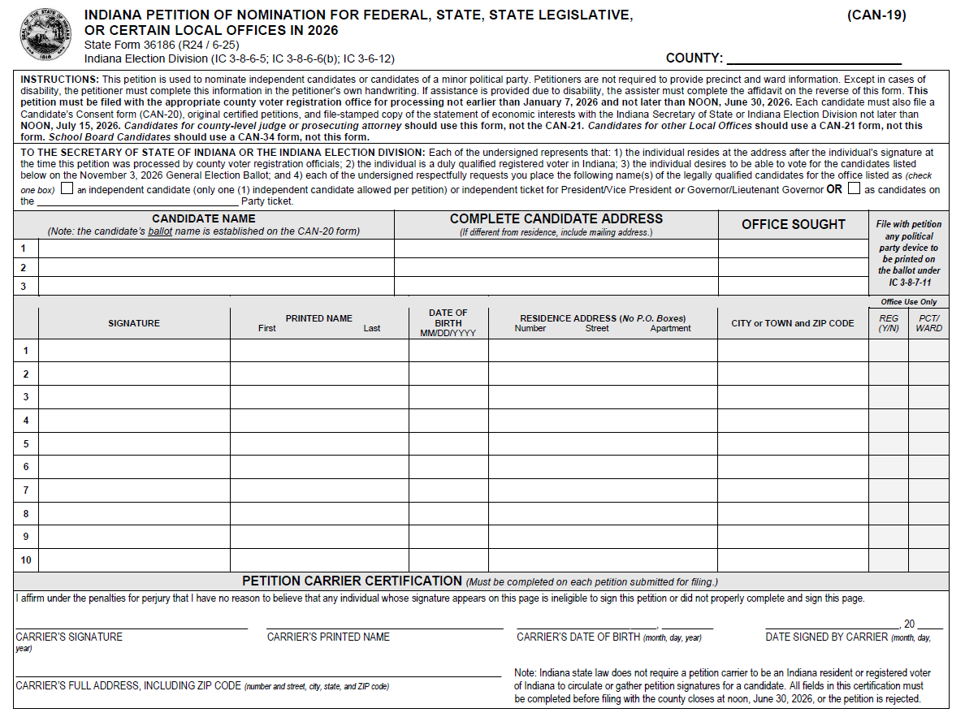
Petition Processing
2026 CAN-19 Example

Slide 17
Petition processing: Filing
Independent/Minor Party Candidates (CAN-19/CAN-21)
Collect signatures of registered voters within election district
File with county VR official where voter is registered
If election district is more than one county, county VR official may ONLY certify signatures of voters in their own county!
Petition filing period for county review is Jan. 7 to noon, June 30, 2026
Deadline to file certified petitions & candidate consent (CAN-20) is noon, July 15, 2026
Statement of economic interest for local offices (CAN-12) is filed with petitions by June 30, 2026, in almost all Indiana counties (see earlier slide)
School Board Candidates (CAN-34)
Collect signatures of registered voters within election district
In most cases, the entire school corporation. NOTE: exceptions for schools if only voters within an election district vote for a school board seat, for example.
File with county VR official where the largest percentage of voters of the school corporation reside
“Large” county processes all petitions; different than CAN-19/CAN-21 procedures!
CAN-34 includes candidate’s consent (on back of form)
Filing period: May 19 to noon, June 18, 2026
Statement of economic interest (CAN-12) must be filed with petitions at time of county review in almost all Indiana counties (see earlier slide)
Certified petitions must be filed by noon, June 18, 2026, so candidates running in counties with a separate VR office should file petitions early!

Slide 18

REQUIRED PETITION ELEMENTS: REview
Minor Party Candidates Using CAN-19/CAN-21
Candidate Name(s)
Up to three individuals from the same minor political party may circulate the same petitions & those tallies apply to each candidate
Name(s) do not have to match registration; CAN-20 consent establishes ballot name
D/R/L candidates are NOT eligible to use these forms!
Candidate(s) Address(es) & Office(s) sought
Independent Candidates Using CAN-19/CAN-21
Candidate Name, Address & Office sought
Only ONE independent candidate may be included on a petition as “independent” is NOT a political party, not even a “minor” one!
IC 3-8-1-33 | IC 3-8-9-5

Slide 19
REQUIRED PETITION ELEMENTS: Review (CONTINUED)
Voter’s Signature
Must reasonably conform to the registration record
Check for voter assistance affidavit on back of form to see if voter had assistance with signing their name
Voter’s Printed First & Last Name
Name should reasonably conform to the registration record
Voter’s Residence Address
MUST be registered to vote at the address indicated on the petition at the time the petition is reviewed by county VR officials
Minor variations may be OK; see IC 3-5-6-4 and IC 3-5-6-5 for discussion on major/minor variations
IC 3-5-6-4 | IC 3-5-6-5 | IC 3-5-6-6

Slide 20
Other PETITION ELEMENTS: REview
Voter’s Date of Birth
NOT required; not a reason to reject name – helpful to identify voter in SVRS
Petition Carrier Affidavit
All petition carriers (including candidates!) must complete the affidavit found on the bottom of each petition
All elements must be present; any missing information results in form being “incomplete”
County VR official MUST contact petition carrier to request that the affidavit be completed before deadline to file petitions for initial certification
If carrier completes affidavit by deadline (noon, June 30, 2026, for CAN-19/CAN-21, for example), then county may review and process it
If carries does NOT complete affidavit by deadline, then petition is rejected
“For Office Use Only” Columns
Voter does NOT complete this information; do NOT reject if not present
Instead, counties should use to confirm if voter was registered to vote and their precinct/ward
Do NOT mark through petition rows – use the “yes/no” column to indicate if voter was registered!
IC 3-5-6-6 | IC 3-6-12-7 | IC 3-6-12-8 | IC 3-6-12-9

Slide 21

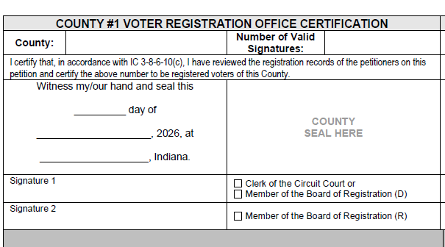
Petition Certification
Certify Each Petition
Certification boxes found on the back of each form
Two boxes available in case more than one county needs to certify signatures
MUST be completed by county VR official or employee, including number of valid signatures on petition
More than one signature line in each box in case a board of registration is certifying
Using a seal is optional
ONLY certification that matters – SVRS reports are helpful, but original physical document with county VR certification is “official” count!
IC 3-11-10-26

