Slide 1

Campaign Finance
Presented by: Abbey Taylor and Michelle Thompson
Campaign Finance Directors, Indiana Election Division
2026 Election Administrators’ Conference
December 15-17, 2025| Indianapolis, Indiana
Image by blossomstar on Freepik

Slide 2
Acronyms
CEB = County Election Board
CFA = Indiana Campaign Finance Act (IC 3-9, generally)
CFA-1 = Statement of Organization (Candidate’s Committee)
CFA-2 = Statement of Organization (Political Action Committee)
CFA-3 = Statement of Organization (Regular Party Committee)
CFA-4 = Report of Receipts & Expenditures (Used by ALL committees)
CFA-11 = Large Contribution Report (Used ONLY by candidate committees)
D/R/L = Democratic, Republican or Libertarian Parties in Indiana
IED = Indiana Election Division

Slide 3

Offices Paying MORE THAN $5K
For offices paying $5,000 OR MORE in a calendar year:
In 2026, candidates running for office in 2026 must open a campaign finance committee (whichever comes first):
by noon, ten days after raising or spending more than $100 toward running for office; OR
by noon, seven days after the filing deadline to put their name on the ballot
Example: Sue files to run for an elected office on the Democratic Party primary ballot on the last day – February 6, 2026. The office pays $5,000 or more. Therefore, she must file CFA-1 by noon, February 13, 2026.
Image available on Freepik
IC 3-9-1-3 | IC 3-9-1-5
<a href="https://www.freepik.com/free-vector/regular-money-transfer-cash-transaction-planned-payment-online-banking-remittance-personal-account-management-money-addresser-cartoon-character-vector-isolated-concept-metaphor-illustration_12083651.htm#from_view=detail_alsolike">Image by vectorjuice</a> on Freepik

Slide 4

Offices Paying LESS THAN $5K
For offices paying LESS THAN $5,000 in a calendar year
File CFA-1 by noon, ten days after raising or spending more than $500 toward running for office.
“More than” is $500.01+
No “triggering” event when filing a declaration of candidacy
This rule also applies to school board candidates, regardless of the salary income received.
NOTE: Candidates running for party office (PC & delegate) DO NOT need to open a campaign finance committee.
IC 3-9-1-3 | IC 3-9-1-5 | IC 3-9-1-5.5
Image available on Freepik

Slide 5
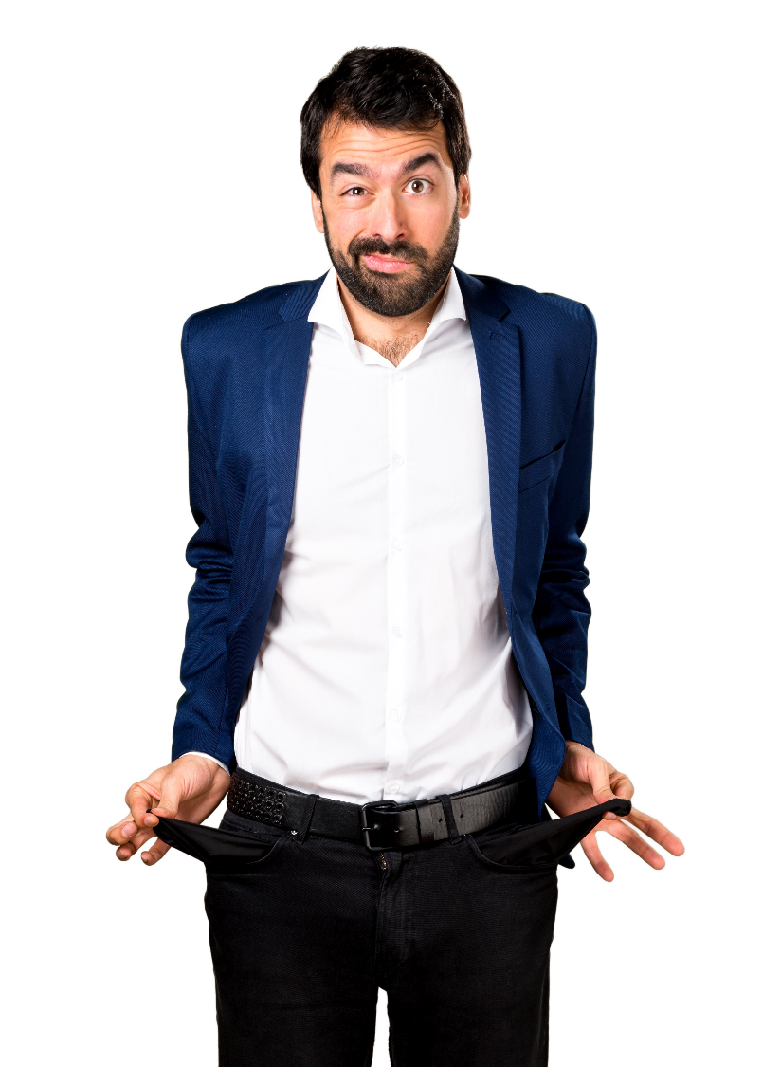
But I’m not going to raise or spend any money? Do I need to file a CFA-1 or campaign finance reports?
If the office pays $5,000 or more in a calendar year and you filed to be on this year’s ballot, YES!
The CFA-1 needs to be filed AND all applicable CFA-4 reports such as pre-primary, pre-election & annual, until committee is disbanded.
Didn’t raise or spend money? Report zeroes on CFA-4 Summary Page.
Image by luis_molinero on Freepik

Slide 6
When to File a CFA-1: CEB Administratively Open
What happens when candidate required to open a committee does not?
CEB MUST open a campaign finance committee for delinquent candidates by noon, fourteen days after the filing deadline
For D&R primary candidates, the CEB must act to administratively open a committee not later than noon, February 20, 2026
File a CFA-1 on the candidate’s behalf:
Use contact information from CAN-2 to complete the top portion
Enter office sought
Name the candidate as treasurer AND chairperson of the committee
No signature required
Might write a note in the “Office Only” space the committee was administratively opened on <INSERT DATE>
IC 3-8-1-1.6 | IC 3-9-1-6

Slide 7
CFA-4 Reporting
Local Office Candidates on the Ballot in 2026 (including judge, prosecuting attorney)
On D/R primary ballot? Pre-Primary Report
D/R/L candidate filling a ballot vacancy in the summer? Vacancy Report
L candidate seeking nomination at convention? Pre- OR Post-Convention Report
Hinges on whether candidate files a CFA-1 25 days or more before convention or less than 25 days before convention
Independent/Minor Party Candidate OR Write-In Candidate? Petition Report or Write-In Report
Independent/minor party candidates & write-in candidates owe report covering time from they became a candidate to 14 days after the deadline to file to get on the ballot
On general election ballot? Pre-General Report
Includes write-in candidates or Independent/minor party candidates who are certified to be on the ballot
Keeping committee open? Annual Report
At minimum, will have an annual report due each January until such a time the person seeks another elected office OR is no longer a candidate/holding elected office and can file final/disbands report
Regular Party Committees & Political Action Committees
Three reports due most years: Pre-Primary, Pre-General, Annual Reports
Only Annual Report due the year following the presidential election
IC 3-9-5-6

Slide 8
Where to File CFA Forms
Statewide & State Legislative Office:
Candidates file only with the Indiana Election Division
County, City, Town or Township Office (INCLUDES JUDGES AND PROSECUTING ATTORNEYS):
Candidates file with the County Election Board
School Board Candidates:
Candidates file with EACH County Election Board in the school district
PACs and Legislative Caucus Committees:
Support Statewide or State Legislative Candidates or Public Questions
File with the Election Division
Support County, City, Town or Township Candidates or Public Questions
File with County Election Board
Supporting more than one of these categories
File with the Election Division
IC 3-9-5-2 | IC 3-9-5-3 | IC 3-9-5-4

Slide 9
2026 Reporting Deadlines
2025 Annual Report Wednesday, January 21, 2026 (NOON)
ALL Candidates and PACs
Regular Party Committees Monday, March 2, 2026 (NOON)
Pre-Primary Report Friday, April 17, 2026 (NOON)
Candidates on the ballot for reporting period ending Friday, April 10, 2026
PACs and Party Committees
Pre-General Report Friday, October 16, 2026 (NOON)
Candidates on the ballot for reporting period ending Friday,
PACs and Party Committees October 9, 2026
2026 Annual Report Wednesday, January 20, 2027 (NOON)
ALL Candidates and PACs for reporting ending December 31, 2026
Regular Party Committees Monday, March 1, 2027 (NOON)
IC 3-9-5-6 | IC 3-9-5-10

Slide 10

All OPEN committees are responsible for TIMELY FILING campaign finance reports, according to the state’s schedule, UNTIL the committee is eligible to file a final/disbands report.
NEW! ALL elected officeholders must maintain an open campaign finance committee until they no longer hold elected office and are no longer a candidate.
Image by luis_molinero on Freepik

Slide 11
Resources
2026 Indiana Campaign Finance Manual
Available on IED website under “Election Administrator’s Portal”
Campaignfinance.in.gov
State website for candidates and committees required to file with IED
Helpful to search for party committees, if CEB is unsure if the regular party committee is supposed to file with county or state
Party committees only required to file CFA-4 reports in location where they opened their committee
CEBs lack authority to fine committees that file with IED; IED lacks authority to fine committees that file with CEB

