Slide 1

MILITARY & OVERSEAS VOTERS
Background photo created by freepik - www.freepik.com
Presented by Angie Nussmeyer, Co-Director
Indiana Election Division
2024 Election Administrators’ Conference

Slide 2
Why do military & overseas have special forms & deadlines?
Uniformed & Overseas Citizens Voting Act of 1986 (UOCAVA)
  Allowed military & overseas voters to register and vote absentee in elections for federal offices
  Created the Federal Post Card Application (FPCA) & Federal Write-In Absentee Ballot (FWAB)
  Created the federal only ballot
Military & Overseas Voters’ Act of 2009 (MOVE)
  Expanded UOCAVA services
  Required states to begin transmitting absentee ballots not later than 45-days before the election
    March 23, 2024 for May 7 Primary Election
    September 21, 2024 for November General Election

Slide 3
Federal Partners
Federal Voting Assistance Program (FVAP)
  Program of the U.S. Department of Defense (DOD)
  Assists military & overseas citizens exercise their right to vote
    Voting Assistance Officers provide non-partisan voting information to military
  Assists state in complying with relevant federal law
  Reduces obstacles to military & overseas voters
    www.FVAP.org
      Fillable forms, form “wizards” to assist in completing applications

Slide 4
Federal Post Card Application (FPCA)
Dual Purpose Form for Military & Overseas Voters
  Voter Registration Application
    Confirm person is registered at the address indicated
      Special exceptions for overseas voters
    Special VR deadlines for military & overseas voters
      Monday, April 29, 2024, Primary Election VR Deadline
      Monday, October 28, 2024, General Election VR Deadline
        In limited cases, special rules for late VR registration after these stated deadlines
  Absentee Application
    Covers elections held in 1 calendar year – Jan. 1 to Dec. 31
    Allows absentee ballot to be sent by mail, fax, or email
IC 3-7-36-14 | IC 3-11-4-3 | IC 3-11-4-3

Slide 5
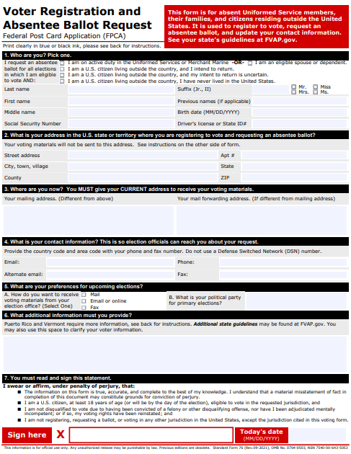
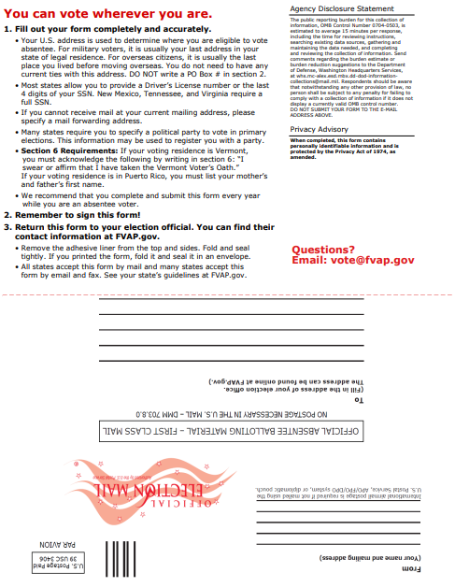

Slide 6


Who can use the FPCA?
Overseas Voters
  Reside in any locale in the world that is not the U.S. or its territories
  Defined in state law:
    An absent uniformed services voter who, by reason of active duty or service, is absent from the US on the date of the election
    A person who resides outside the US and is qualified to vote in the last place in which the person was domiciled before leaving the US
    A person who resides outside of the US and, but for such residence, would be qualified to vote in the last place in which the person was domiciled before leaving the US
      NOTE: In Indiana, the state Constitution requires an individual to be a resident of their precinct at least
      30-days
IC 3-5-2-34.5

Slide 7

Who can use the FPCA?
Military Voters
  Active duty member of the Uniformed Services, Merchant Marine, or National Guard
    “Uniformed Services” means:
      The armed forces (Army, Navy, Air Force, Marine Corps, Space Force & Coast Guard);
      Commissioned corps of the NOAA; and
      Commissioned corps of the Public Health Service.
  Spouse or dependent of an active duty member of the Uniformed Services, Merchant Marine, or National Guard
    NOTE: National Guard members must be deployed outside of Indiana to use the FPCA
IC 3-5-2-1.5

Slide 8
Who can use the FPCA?
Military Voters
  Military voter and spouse/dependent may not always be an “overseas” voter
    Can be stationed in the US and its territories and use the FPCA
      Mailed, emailed & faxed absentee ballots must be received not later than noon, Election Day
    Can be stationed “overseas” and use the FPCA
      For emailed & faxed absentee ballots, the ballot return deadline is noon, Election Day
      For mailed absentee ballots, ballot may be received up to noon, ten-days after Election Day and counted, if the postmark is on or before the date of the election
IC 3-11.5-4-10 | IC 3-12-1-17

Slide 9
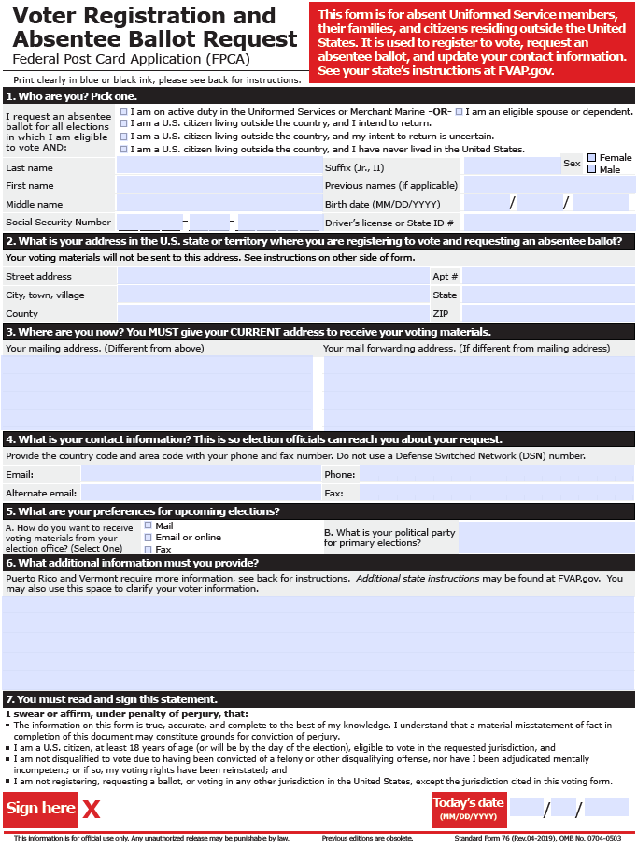
What does section 1 of the FPCA mean?
1
2
Active duty uniformed services members, Merchant Marine or their eligible spouse or dependent
Mark box 1 or 2
Registered to vote at last Indiana residence address
  Person may not be returning to this address, but it’s the location where they last lived in Indiana
  Don’t forget extended VR deadline when using FPCA!
Receives regular ballot, if otherwise eligible
  Absentee by mail request must be received not later than 12-days
  before election pursuant to Indiana law
  Absentee by fax/email request must be received
  not later than noon, the day before election day
IC 3-11-4-3 | IC 3-11-4-6

Slide 10
What does section 1 of the FPCA mean?
3
U.S. Citizen WHO INTENDS TO RETURN TO U.S.
Mark box 3
Registered to vote at last Indiana residence address
  Person may not be returning to this address, but it’s the location where they last lived in Indiana
Receives regular ballot, if otherwise eligible
  Absentee by mail request must be received not later than 11:59 PM,
  12-days before election pursuant to Indiana law
  Absentee by fax/email request must be received not later
  than noon, the day before election day
IC 3-11-4-3 | IC 3-11-4-6

Slide 11
What does section 1 of the FPCA mean?
4
U.S. Citizen WHOSE RETURN TO U.S. IS UNCERTAIN
Mark box 4
Include address where person last resided in Indiana
  Person may not be returning to this address, but it’s the location where they last lived in Indiana
In Indiana, registered to vote at the ADDRESS OF COUNTY VR OFFICE
Receives FEDERAL ONLY ballot, if otherwise eligible
  Absentee by mail request must be received not later than 11:59PM, 12-days
  before election pursuant to Indiana law
  Absentee by fax/email request must be received not later than
  noon, the day before election day
IC 3-11-4-3 | IC 3-11-4-6 | IC 3-11-4-8

Slide 12
What is a Federal Only Ballot?
Federal Only ballot style is ONLY used for the small universe of absentee voters who are U.S. citizens and their return to the U.S. is not certain
  Do NOT give this ballot to any other group of voters!
  Should NOT be included with Election Day materials
    Used in absentee voting ONLY
Every county must have an absentee ballot that ONLY includes federal offices:
  U.S. President
  U.S. House of Representatives
  U.S. Senate, when applicable
November General Election Ballot would also include…
  “write-in” line for each federal office, even if there are no declared write-in candidates for those offices
  Straight party device certified to counties by IED
IC 3-11-2-6 | IC 3-11-2-10 | IC 3-11-13-11 | IC 3-11-14-3.5

Slide 13
What does section 1 of the FPCA mean?
5
U.S. Citizen WHO NEVER LIVED IN INDIANA
Mark box 5
Indiana county election officials must reject the application
  Indiana constitution does not permit a person who has never lived in Indiana for at least 30-days to vote in the state
Art. 2, Sec. 2 Ind. Const.

Slide 14
How can FPCA voters receive ABS ballots?
Section 5b
  Political Party or Public Question Only must be included for the FPCA voter to receive a May primary ABS Ballot
Section 5a
  ABS sent by MAIL
    Mail to address in box 3 or 4, depending on how voter completes the FPCA
    Use ABS-10A Security Envelope to differentiate overseas and overseas
    military voters from stateside civilian or military voters
    Don’t forget ABS Voter Bill of Rights & MOVE information sheet!

Slide 15
How can FPCA voters receive ABS ballots?
Section 5a
  Email/Fax
    Must include email or fax number in section 4
    County must send ABS Voter Bill of Rights & MOVE Information Sheet
    County must send to voter the ABS-9 secrecy waiver with image of absentee optical scan ballot card
      ABS-9 secrecy waiver is generated in SVRS. Requires person to waive their right to secret ballot, if the voter chooses to vote by fax or email and MUST be returned with faced/emailed ABS ballot!
      Be certain the scanned image of absentee ballot has bi-partisan initials of CEB or ABS voter board!
      When returned by voter, print image of completed ballot and seal in ABS-10B ballot security envelope
        Attach FPCA, ABS-9 to envelope
        Complete information found on ABS-10B & attach label from SVRS
      If voter is found eligible to cast ABS ballot, then bi-partisan remake team MUST remake faxed/emailed ballot on optical scan ballot card on Election Day
        Don’t forget to use the same serial numbers on returned
        ballot image AND remade optical scan ballot
IC 3-11-10-1 | IC 3-11-4-6 | IC 3-12-2-7.5 | IC 3-12-3-5

Slide 16
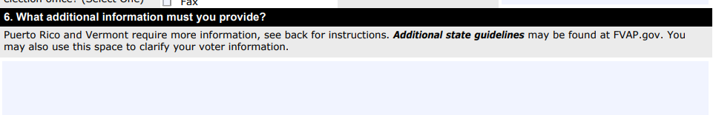
Do UOCAVA voters need voter ID on FPCA?
YES! New as of July 1, 2023
Can attach photocopy of valid photo ID to FPCA
  OK to email or fax image of ID
Can provide voter ID number to match or validate
  Section 6: Additional Information
    Indiana specific instructions in the FPCA packet note the voter is to provide their IN DLN/State ID card number OR last four of SSN OR unique SVRS ID
  Section 1: “Who Are You” Voter Information
    If voter provides one of the required voter ID information in this section, counties may use it to process absentee application
IC 3-11-4-2(h)

Slide 17
So, what’s the deal with the FWAB?
Federal Write-In Absentee Ballot (FWAB)
  “Back-Up” ballot in case original ABS ballot sent by mail, fax or email was not received by the voter or received by the county by prescribed ABS ballot deadline
  How to use FWAB:
    Voter MUST FILE FPCA before applicable deadlines
    Voter MAY also submit FWAB, but not required
      FWAB must be received not later than 6PM, Election Day, in Indiana
      FWAB may be mailed, faxed, or emailed
    If timely filed, CEB attaches FWAB to FPCA
      FWAB should remain sealed
        If mistakenly opened, re-seal!
    If voter’s original ABS ballot is not received by deadline, then CEB directs bi-partisan remake team to use the FWAB to complete an ABS optical scan ballot card
      Don’t forget to use same serial numbers on FWAB and optical
      scan ballot card!
IC 3-11-10-1(b) | IC 3-11.5-4-5

Slide 18
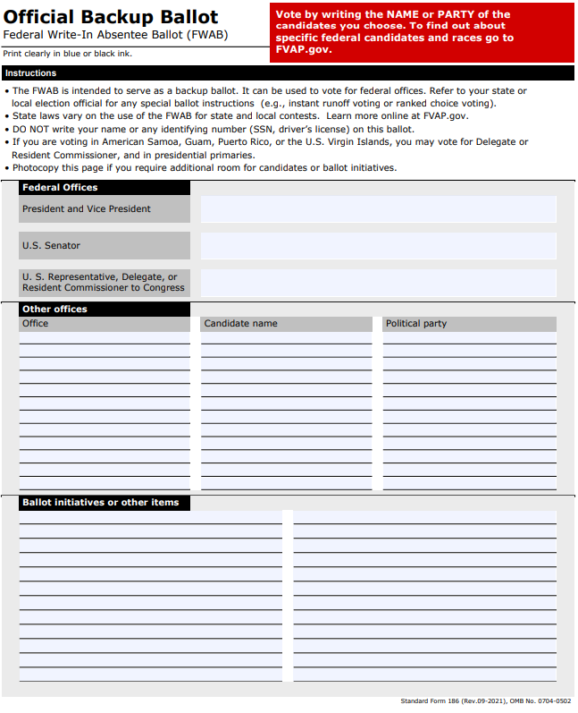
PRIMARY ELECTION
FPCA establishes which party’s primary the voter is voting
  NOTE: may indicate non-partisan, if local public question on ballot
FWAB is void if…
  Voter does not indicate the office the candidate is running for on the FWAB
  Voter votes for a candidate of a differing political party than indicated on the FPCA
  Voter votes for a D candidate and R candidate on the same FWAB
FWAB is NOT void if…
  Voter votes for only candidates of the same political party as indicated on the FPCA
Voter is required to indicate the office and candidate’s name
  Voter does not need to spell candidate’s name perfectly
Voter does not need to vote in every office
IC 3-12-1-18

Slide 19
GENERAL ELECTION
Voter is required to indicate the office and candidate’s name
  Voter does not need to spell candidate’s name perfectly
  Voter does not need to provide a political party
However, voter may indicate a political party anywhere on the FWAB
  This is considered using the straight party device
Voter may provide only one name for the ticket of…
  president & vice-president
  governor & lt. governor
Voter does not need to vote in every office
IC 3-12-1-19

Slide 20
What if…
…the voter doesn’t include or sign the “waiver of right to secret ballot” document created by FVAP & included in their packet to the voter?
  The FVAP document does NOT replace the state’s ABS-9 secrecy waiver form for faxed/emailed absentee ballot
  Voter MUST sign the ABS-9 secrecy waiver and return it with their faxed/emailed absentee ballot
    ABS-9 secrecy waiver form generated in SVRS
    Counties are to include the ABS-9 secrecy waiver with the ABS ballot image emailed or faxed to voter
    Voter must return signed ABS-9 secrecy waiver with their completed ballot image by 6PM on Election Day for emailed/faxed ABS ballot to be counted
  NOTE: a voter voting using the FWAB is not required to sign and return the ABS-9 secrecy waiver
IC 3-11-4-6(h) | IC 3-11-4-12.5(c)

Slide 21
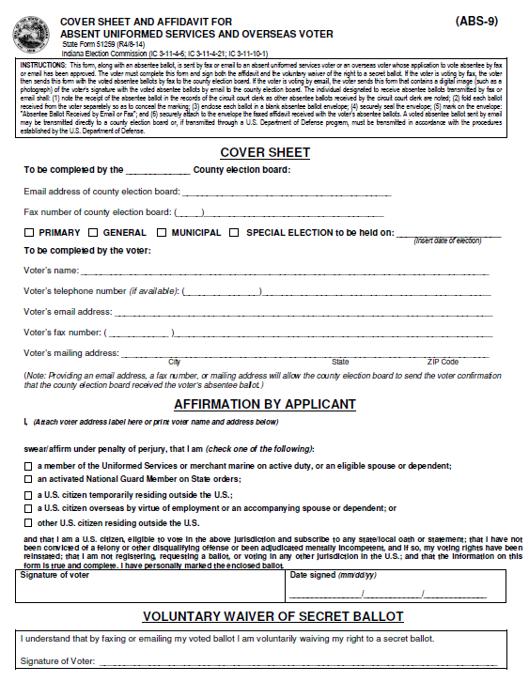
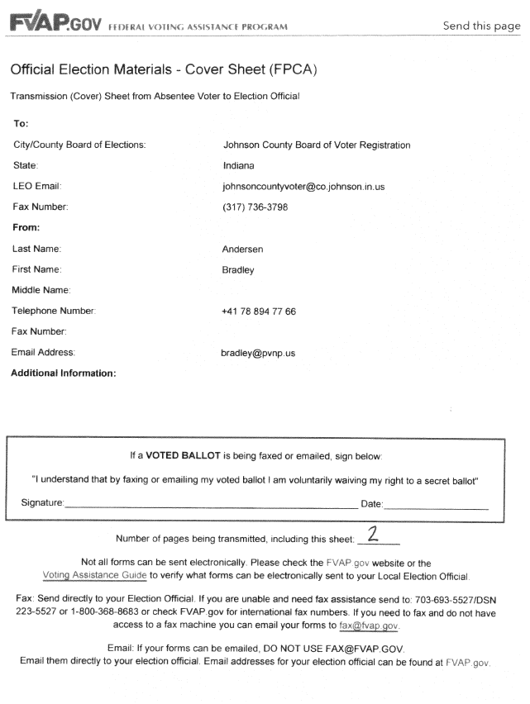

Slide 22
What if…
…a military or overseas voter uses the state’s ABS-Mail application?
  Any eligible Indiana voter can use the ABS-Mail form, though the protections military and overseas voters gain by using the FPCA do not apply to the state’s absentee ballot applications
    ABS-Mail cannot be used to update a voter’s registration, unless the move is within the voter’s precinct
    ABS-Mail is only good for the election it’s intended (May primary or November general election)
    Cannot receive ballot by fax/email when using the ABS-Mail application
    ABS Ballot is due not later than 6PM, Election Day
    FWAB cannot be used as a back-up ballot when requesting an absentee using ABS-Mail
  Counties must mail the ballot to the overseas address, if the mailing address provided is overseas
IC 3-11-10-24

Slide 23
What if…
…the deadline to mail absentee ballots falls on a Saturday, like March 23, 2024? Does it roll over to the following Monday?
  NO!
  This is NOT a deadline that rolls over to Monday because it falls on a weekend.
    The 45-day deadline to send absentee ballots will always fall on a Saturday, unless state or federal law changes.
    IC 3-5-4-1.2 extends deadlines for certain filings, and sending ABS ballots is not a filing
  March 23, 2024, is the absolute last day to send absentee ballots for the May 2024 primary election for those individuals with approved absentee ballot applications, including the FPCA.
    You can send ballots earlier than this date, but you cannot send the
    first batch of ballots out any later than this deadline.

Slide 24
Key UOCAVA Dates for 2024 Primary
March 23, 2024: Deadline to send ABS ballots to comply with MOVE Act
April 25, 2024 (11:59PM): Deadline for UOCAVA voters to file FPCA if they want to vote absentee by MAIL
April 29, 2024 (11:59PM): Deadline for most UOCAVA voters to register to vote using the FPCA
May 6, 2024 (NOON): Deadline to receive FPCA to request FAX/EMAIL absentee ballot
May 7, 2024 (6PM): Deadline for CEB to receive fax/emailed absentee ballot & ABS-9
May 7, 2024 (6PM): Deadline for CEB to receive stateside military voters’ ballots by mail
May 17, 2024 (NOON): Deadline for CEB to receive overseas military & overseas voters mailed absentee ballots
  ABS Ballot must be counted if the voter is otherwise eligible and the security
  envelope is postmarked on or before May 7, 2024

Slide 25
Resources
MOVE Information Sheet
  Available on the INSVRS County Portal
  Be certain to include document with all absentee ballots being sent to UOCAVA voters
Federal Voting Assistance Program (FVAP)
  www.FVAP.gov
    Forms
    Guides & FAQs
    Contact Information
Indiana’s Military & Overseas Voters Guide (2024)
  Available on in.gov/sos/elections
  Hard copies available through HAVA Administrator

