Slide 1
U.S. Election Assistance Commission
2023 Indiana Election Administrator's Conference
December 12, 2022
Commissioner Donald Palmer
Notes:
Good afternoon and thank you for inviting the EAC to share information about our organization and the resources that we have for Indiana clerks at this year’s 2023 Election Administrator's Conference.
One of the benefits of my role as a Commissioner is speaking at conferences like this and sharing the work of the EAC, but also hearing from you all so the EAC can continue to improve the assistance the EAC provides election officials across the country.

Slide 2
EAC Mission
The U.S. Election Assistance Commission helps election officials improve the administration of elections and helps Americans participate in the voting process.
Notes:
In case you are unfamiliar with the U.S. Election Assistance Commission, the EAC is the only federal agency solely focused on election administration. Our mission is to help election officials improve the administration of elections and to help Americans vote.

Slide 3
Help America Vote Act
Established the EAC
Improved voting system and access issues identified following the contested 2000 presidential election
Created new mandates for states to follow in several key areas of election administration
Notes:
The 20th anniversary of the signing of the Help America Vote Act was October 29 of this year.
In addition to establishing the EAC, HAVA made sweeping reforms to the nation's voting process that are still making an impact today
This included:
Improving voting system and access issues
Creating new mandates for states to follow in several key areas of election administration and
Providing funding to help states meet these new standards and continue to evolve by replacing voting systems, improve voter education and poll worker training, expand provisional voting, and expand accessibility offerings at polling places

Slide 4
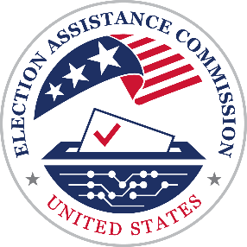
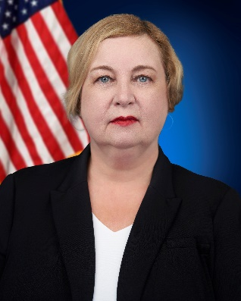
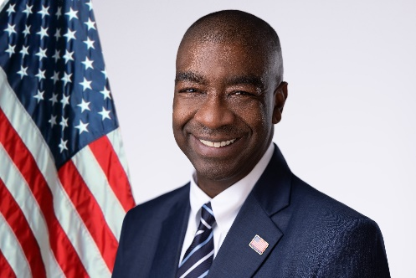
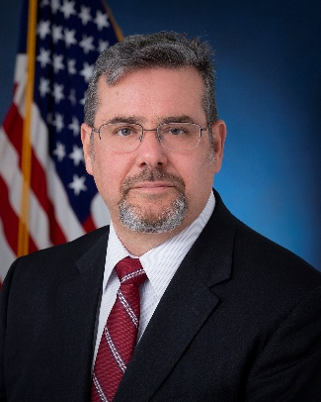
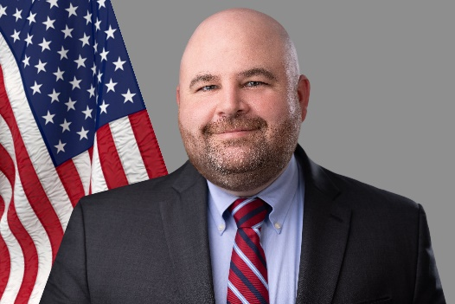
EAC Commissioners
Bipartisan
Selected by Congressional leaders of the majority and minority parties
Appointed by the President
Confirmed by the U.S. Senate
Chairman
Thomas Hicks
Vice Chair
Christy McCormick
Commissioner
Ben Hovland
Commissioner
Donald Palmer

Slide 5
EAC Advisory Boards
Indiana Representation
Local Leadership Council
Jessica Bailey, Porter County Clerk
Shelly Septer, Huntington County Clerk
Standards Board
J. Bradley King, Co-Director of the Indiana Election Division
Nicole Browne, Monroe County Clerk
Notes:
The EAC has four boards that provide valuable feedback and advise the agency.
Indiana election officials are represented on the Local Leadership Council and the Standards Board.

Slide 6
Voluntary Voting System Guidelines (VVSG)
Notes:
The EAC also certifies voting systems.
Every aspect of voting systems certified by the EAC undergo a substantial amount of testing by accredited laboratories, in order to determine they are compliant to the Voluntary Voting System Guidelines, or VVSG.

Slide 7
Voluntary Voting System Guidelines
Voting Systems undergo a full suite of tests for conformance to the standards adopted.​​
Certification requires:
Source Code Review → no malicious or malfunctioning code
Functional Testing → operates as intended with accurate results
Security Testing → measures to prevent unauthorized access and alterations
Hardware Testing → user safety and system integrity between storage, transportation, and when in use
U.S. Election Assistance Commission | www.eac.gov
7
Notes:
During the testing process, labs will perform a series of tests that cover every applicable requirement.
These tests are broken up into four major categories:
Software testing and Source Code Review ensure that there are no vulnerabilities in the source code including malicious code, malfunctioning code, or any code not currently aligned with industry standards.
Functional testing of the equipment checks all functional features of the system establishing the voting system is operating as intended. This includes Accuracy and Usability.
Security testing consists of both a hardware and software checks ensuring that any unauthorized access will not be granted to the system.
Hardware testing verifies that equipment is safe for voters to use, and that the system will not experience a malfunction or data loss from environmental conditions.
If any non-conformances or discrepancies are discovered during testing, they are reported to the EAC and the manufacturer for remedial action.
All non-conformances and critical discrepancies must be fully addressed prior to the EAC granting certification of the system.

Slide 8
Voluntary Voting System Guidelines
VVSG 1.0 adopted in 2005
VVSG 1.1 adopted in 2015
VVSG 2.0 adopted in 2021
When standards introduce new competencies, accreditation of the VSTLs is necessary
VVSG 2.0 is now fully implemented
U.S. Election Assistance Commission | www.eac.gov
8
Notes:
VVSG 1.0 adopted in 2005
VVSG 1.1 adopted in 2015
VVSG 2.0 adopted in 2021
When standards introduce new competencies, as VVSG 2.0 has, accreditation of the VSTLs is necessary.
Until recently, two Voting System Test Labs, or VSTLs, maintained accreditation to test VVSG 1.0 and 1.1; Pro V&V and SLI Compliance.
This past summer, assessments for both VSTLs were initiated by the EAC and NIST's National Voluntary Laboratory Accreditation Program to add 2.0 to their scope.

Slide 9
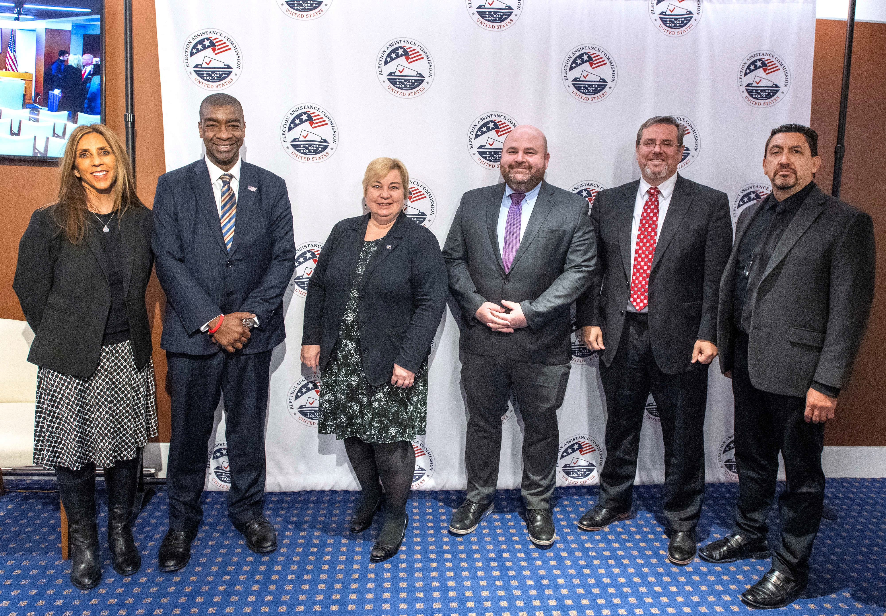
First VSTL accredited to test voting systems to VVSG 2.0
EAC Commissioners unanimously voted during a November 15, 2022, public hearing to accredit SLI Compliance as the first Voting System Testing Lab (VSTL) able to test voting systems to VVSG 2.0.
The EAC is now prepared to accept applications to test and certify equipment to the new standard.
Modifications to systems certified to VVSG 1.0 will continue to be accepted through November 15, 2023.
From left to right: Traci Mapps, Vice President of SLI Compliance; Chairman Hicks; Vice Chair McCormick; Commissioner Hovland; Commissioner Palmer; Michael Santos, Director of SLI Compliance
U.S. Election Assistance Commission | www.eac.gov
9
Notes:
EAC Commissioners unanimously voted during a November 15 public hearing to accredit SLI Compliance as the first Voting System Testing Lab (VSTL) able to test voting systems to VVSG 2.0.
Accreditation of a VSTL to test systems against VVSG 2.0 means the EAC is now prepared to accept applications to test and certify equipment to the new standard.
Modifications to systems certified to VVSG 1.0 will continue to be accepted through November 15, 2023.

Slide 10
Voluntary Voting System Guidelines 2.0
VVSG 2.0 expands and improves upon the VVSG 1.0 requirements in all areas, including:
Cybersecurity
Interoperability Testing
Accessibility
Improved Auditability
Penetration Testing
U.S. Election Assistance Commission | www.eac.gov
10
Notes:
The VVSG 2.0 requirements represent a significant advancement in Federal voting system standards.
Major updates were made to all areas including:
Cybersecurity, interoperability, accessibility, auditability, and inclusion of penetration testing
Security of voting system has never been more important. VVSG 2.0 has updated many aspects of security from the prior standard.
Interoperability introduces common data formats and allows for the importing and exporting of data in those formats.
Accessibility has been improved to enhance many aspects of the voting experience for voters with disabilities.
The auditability of the devices ensures that the voting system cannot cause an undetected change to the election results and produces resilient records.
Penetration testing is a preliminary set of security tests that will be performed by a VTSL upon the submission of a system to the program.

Slide 11
Voting System Accuracy
VVSG 1.0 requires the system accurately read over 1.5 million votes without error.
VVSG 2.0 requires the system accurately read 10 million votes without error.
U.S. Election Assistance Commission | www.eac.gov
11
Notes:
An example of an updated requirement is the change in accuracy testing.
With VVSG 1.0, a system must accurately read over 1.5 million votes, across all of its devices, without any error.
The difference for VVSG 2.0, is that a system must accurately read 10 million votes without any error.

Slide 12
Voluntary Electronic Poll Book Pilot Program (EPB)
Notes:
In other exciting news, we also have an update for you on the EAC's Voluntary Electronic Pollbook Pilot Program.

Slide 13
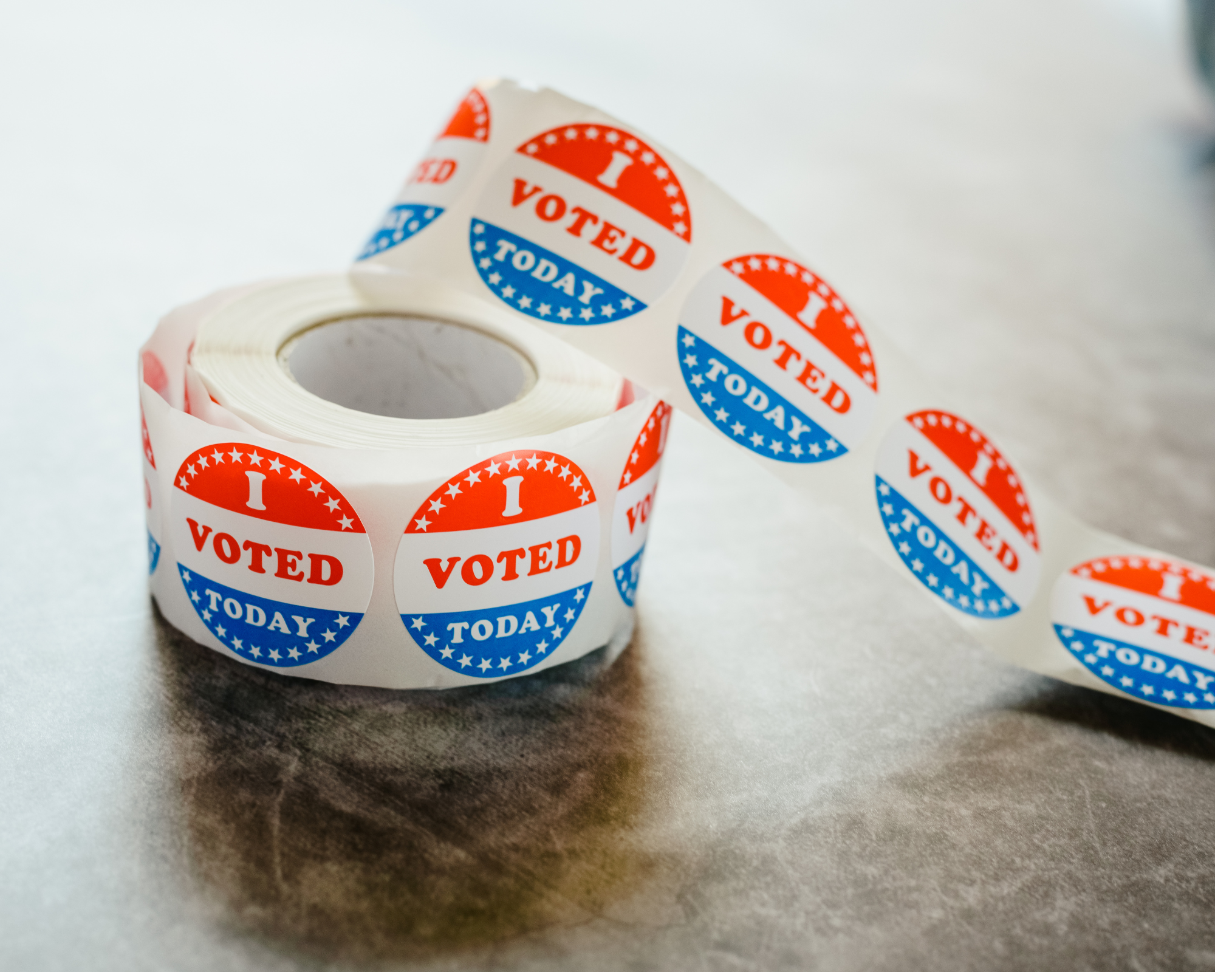
Voluntary Electronic Pollbook Pilot Program
Initial set of EPB pilot testing requirements have been developed addressing security, accessibility, and usability.
These requirements are currently in the late stages of review by stakeholders.
Notes:
The EAC is moving forward with its e-poll book testing pilot program.
The goal of this program is to help alleviate some of the burden currently shouldered by states in developing and maintaining EPB standards as well as conducting testing of broadly applicable functionality such as security, accessibility, and usability.
As there is a wide range of functional and interoperability requirements that are jurisdiction-specific, the EAC is not currently developing these sorts of requirements but would like to add any areas with wide applicability that should be considered “baseline” functionality.
An initial set of requirements has been developed by the EAC and NIST and has been circulated to various stakeholders including labs and our advisory boards for feedback.
Our goal at this stage is to ensure we have a comprehensive set of testable requirements that will allow us to obtain feedback on the testing procedures and readiness of both manufacturers and labs to participate in this type of testing.
After the pilot, the EAC will go through a more formal standards development process similar to how VVSG is vetted with public comment periods and full review by all stakeholders.
The EAC has also been in discussions with the Center for Internet Security on how we may integrate their RABET-V security testing methodology into our pilot program.
We are considering conducting more “traditional” system testing in parallel with CIS’s more specialized security testing to be able to compare both approaches and their appropriateness for future testing efforts.

Slide 14
Voluntary Electronic Pollbook Pilot Program
The EAC will recruit a representative sample of EPB systems for pilot testing in early 2023.
The information gathered during the pilot will be compiled, analyzed, and shared with stakeholders after testing is completed.
Stakeholders will be included in this process to ensure our program receives feedback before moving forward.
Notes:
As we wrap up the requirements work, we are drafting participant agreements and moving into an active recruitment phase to obtain a representative sample of systems for pilot testing.
Our goal is to begin testing of 2 to 3 systems by the end of the first quarter of 2023.
Our primary risks at this stage are related to receiving our full year appropriations and obtaining voluntary participation from EPB manufacturers within this timeframe.
So far, the EPB manufacturers have been enthusiastic about participation and we’re hoping that continues.
When testing is complete, the EAC will analyze the test data as well as feedback received from participants and the labs to determine our best course forward in addressing standards for this critical election technology.
Part of this will be determining whether certification of the tested functionality is appropriate or whether some other form of reporting better suits the needs of stakeholders.
Additionally, whether we are able to run RABET-V testing in parallel or use results they’ve already obtained against the same systems to conduct comparative analysis, we plan to evaluate the feasibility and value of incorporating RABET-V into our future efforts.
Finally, the EAC is committed to providing value to you as our primary stakeholders in this effort and welcomes any feedback throughout this process on how the program can best serve you.
The EAC understands how burdensome (time and resources) EPB testing can be. The goal is to help alleviate this burden on states and increase confidence in our elections by offering EPB standards and, possibly, certification.

Slide 15
Latest EAC Resources and Programs

Slide 16
Clearinghouse Division
Notes:
As part of the EAC's effort to provide election officials with valuable work product we recently established a Clearinghouse Division.
This division includes former election officials and experts with specialized knowledge in election law, audits, Native American tribal voting, and more.

Slide 17
Clearinghouse Resources
Accessibility
Audits
Election Security
In-Person Voting
Language Access
Results, Canvass, and Certification
Toolkits
Voter Information and Communications
Voting Technology
https://www.eac.gov/election-officials
Notes:
The EAC has a centralized webpage that lists all of the latest resources for election officials.

Slide 18
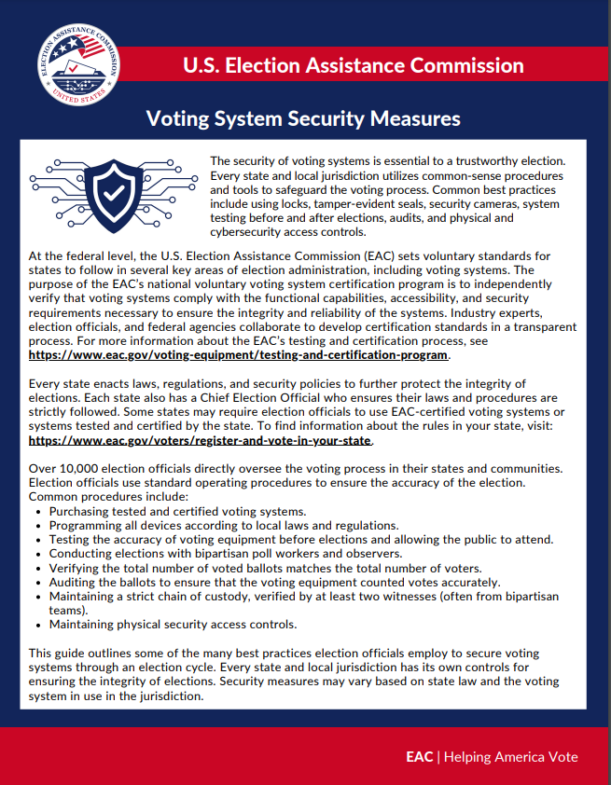
Latest EAC Resources
Voting System Security Measures Guide
Broad list of common security measures, best practices and procedures to protect the integrity of an election
Notes:
We released the Voting System Security Measures Guide earlier this year.
This resource is written not only for voters so they can better understand how voting systems are secured and the safeguards in place, but also for election officials as they communicate with the public about the security of elections in their communities.
This guide outlines some of the many best practices local election officials follow to secure voting systems through an election cycle.
It's important to note this is a broad list of common security measures and procedures to protect the integrity of an election.
The types of security measures may vary based on the voting systems in use in state and local jurisdictions.

Slide 19
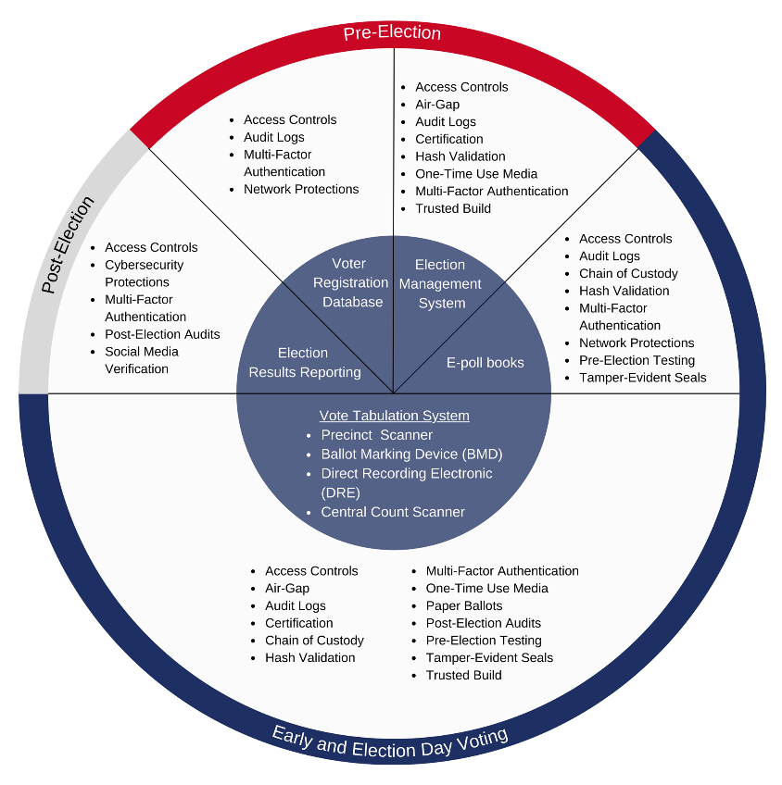
Latest EAC Resources
Election Technology Security
Highlights security features that are used to protect election technology
Includes an icon library
Notes:
This document can be used by election officials to inform the public about the types of security measures local election officials use to protect their election technology.
There is also an icon library of the security measures referenced throughout this report, that anyone can download and use in their own messaging to the public

Slide 20
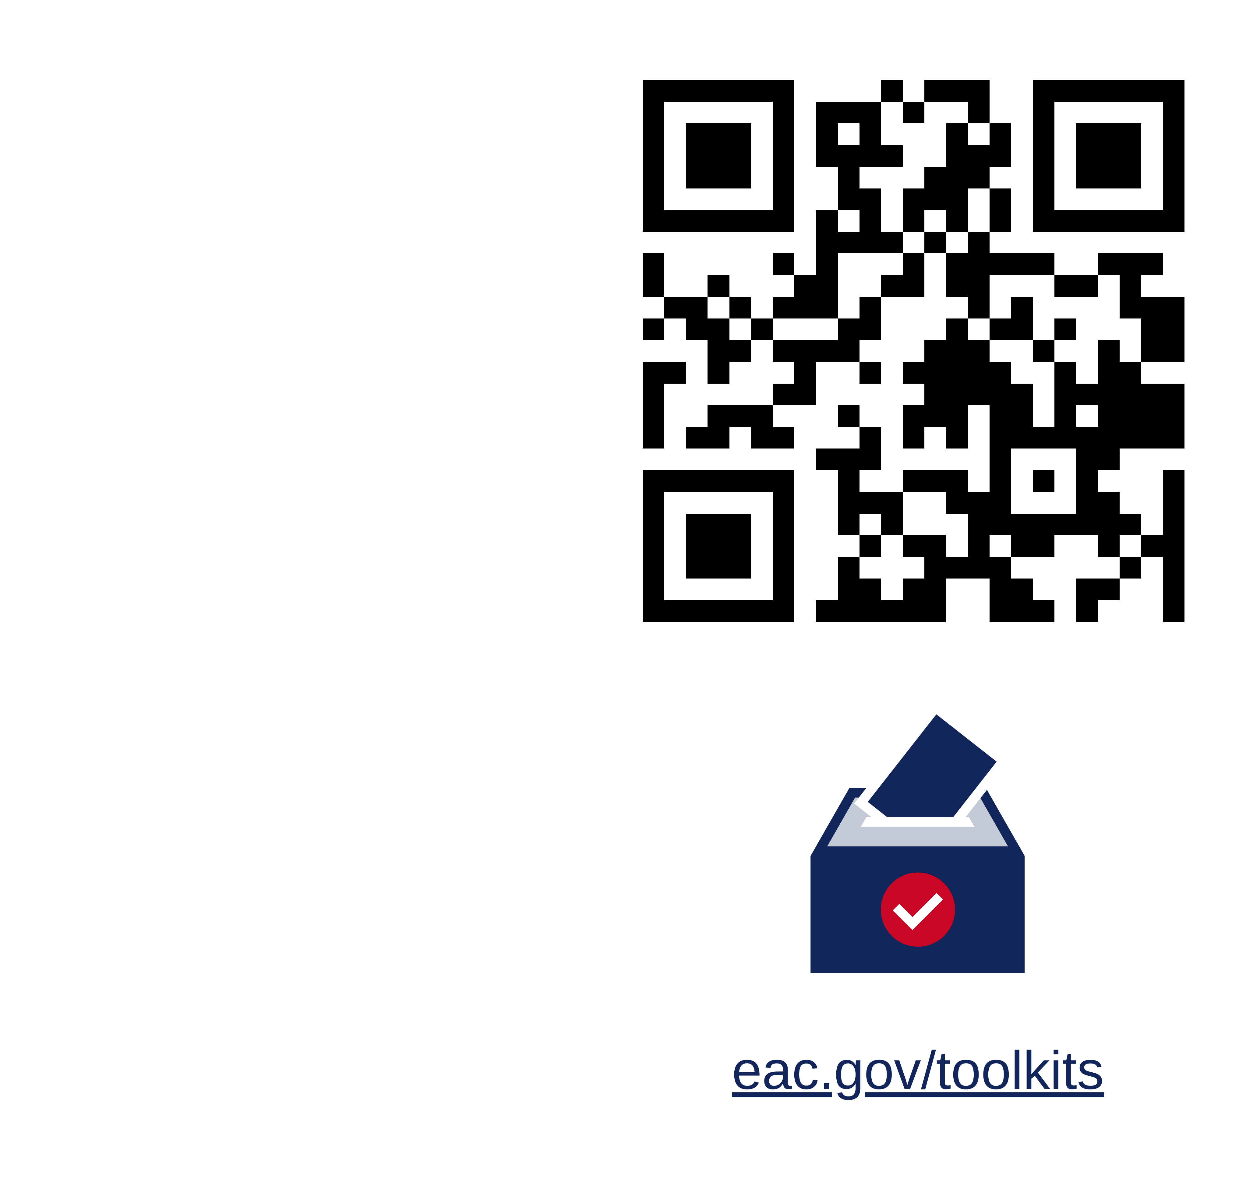
EAC Toolkits
Best Practices: FAQs for Election Officials
National Poll Worker Recruitment Day Toolkit
Other Federal Agency Toolkits
Notes:
There are several EAC toolkits that are fully customizable, with graphics, social media content and example messages for the public. Some of the toolkits include:
The FAQs Toolkit, which has resources to proactively provide accurate and timely information for voters. This toolkit provides guidance, infographic fact sheets, social media graphics, social media text, and example Questions and Answers
The National Poll Worker Recruitment Day toolkit, which has a variety of resources to help recruit poll workers, including social media graphics, videos and more.
We also have links on our website to other federal resources, such as de-escalation techniques and cybersecurity tools and resources that are offered by the Cybersecurity and Infrastructure Security Agency (CISA), at no cost to local elections offices

Slide 21
Coming Soon from the EAC

Slide 22
Upcoming Resources
Election Management Guidelines
Alternative Voting Methods Report
Resources on:
Accessibility for Voters with Disabilities
How to Work with Your Legislators Guide
Communications Toolkit
Notes:
As you can see we have a number of upcoming resources we are working on for voters as well as election officials. These include:
Election Management Guidelines – which is a 200 page textbook that gives an overview of the entire election process. New Election Clerks can review the Chapters of interest to quickly understand the election process by subject matter.
Alternative Voting Methods Report, which gives a high-level explanation of the different voting systems used in the US.
Resources on:
Accessibility for voters with disabilities – early next year we will be publishing a series of webinars that will explain how to make documents, videos and other communications 508 compliant.
A guide for how to work with your legislators, with best practices and tips for communicating with policy makers about election administration.
A guide for election officials to successfully communicate with the public about election administration.

Slide 23
Election Administrator Portal
Online web portal for election officials
Compare and analyze data​
Find relevant information ​
Peer-to-peer
Receive timely alerts​
Notes:
I also wanted to share a new exciting resource that the EAC plans to have available this year: the Election Administrator Portal.
Election administration is a challenging field. Election officials are expected to coordinate tasks across a wide range of skill sets, including logistics, IT, human resources, and public relations, and many other core competencies. ​
With so many responsibilities, relevant information can provide critical support to election officials.
The Portal will be online and election officials will be able to log into a personalized account to access detailed information and policies about your jurisdictions and other jurisdictions across the nation.
The EAC also hopes to be able to share helpful information, such as when new resources are published and other networking opportunities.
Membership is free.

Slide 24
Key Features of the Portal
Jurisdiction Pages
EAC, State, and Local pages
Follow feature
Query function (size, voting equipment, voting procedures, etc.)
Document Management System
Ability to share documents and data
Message Board Feature
Ability to network and communicate by topic
Notes:
The portal will include several key features, including the tools that were discussed above.

Slide 25
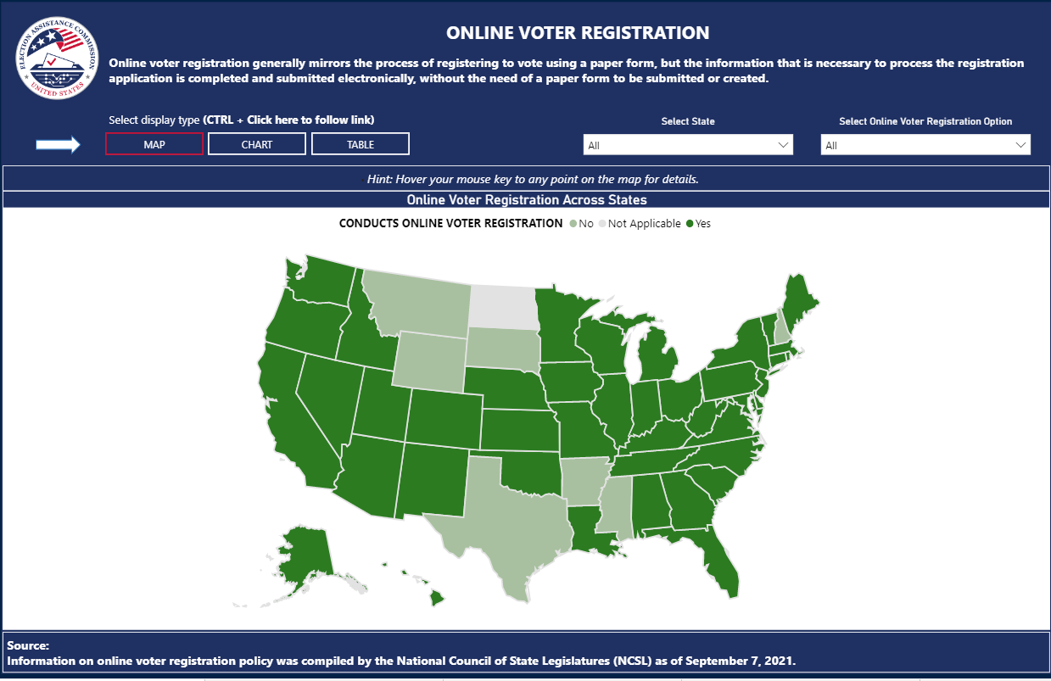
Portal Data Visualizations
Notes:
Users will be able to interact with data through data visualizations to more easily find states and jurisdictions with similar policies.

Slide 26
EAC Administered Grants
Notes:
One of the EAC’s most important responsibilities is administering federal grants to the state authorities who administer elections.

Slide 27
HAVA Election Security Funds
Consolidated Appropriations Act of 2022: $75 million in Election Security grant funds
Total Election Security grant funds to date
$380 million (2018)
$425 million (2020)
$75 million (2022)
$880 million Total
52% expended for the 2018 and 2020 funds as of June 1, 2022
Notes:
In 2018 and 2020, for the first time since 2010, EAC received grant funds under the authority of Section 101 to provide grants to states with an emphasis on election security.
I also want to touch on HAVA grant funding and the recent spending package that Congress authorized for FY 2022 and that the President signed in mid-March
Though it arrived halfway through the fiscal year, it’s better late than never and it appropriates $75 million for the HAVA Election Security Grant Program.
The 2022 funds are consistent with recent years.
As always, the EAC grants staff are available to answer questions you may have about the new grants and previous HAVA grants.
As of June 1, 2022, the states collectively reported spending roughly 52% of the $805 million distributed in 2018 and 2020.
The Election Security grant narratives, budgets and reports can be found at EAC.gov

Slide 28
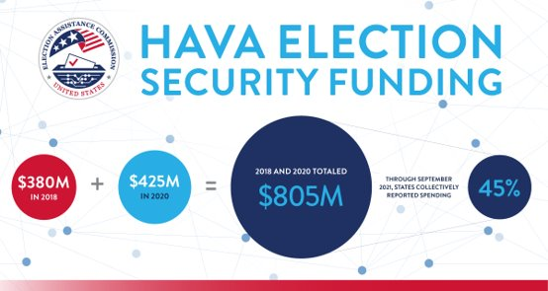
HAVA Election Security Funds
Indiana received about $16 million in 2018 and 2020 combined and as of March 31, has spent 101% of those funds
Indiana was allocated $1.3 million in the Consolidated Appropriations Act of 2022.
Notes:
HAVA Election Security Grant are formula grants, so each state and territory receives a pre-determined amount based on a statutory formula.
Indiana received about $16 million in 2018 and 2020 combined and as of March 31, has spent 101% of those funds.
This (spending 101%) is possible because total federal expenditures for the state includes federal grant funds and federal interest earned.
Indiana was allocated $1.3 million in the Consolidated Appropriations Act of 2022.
The Election Security grant narratives, budgets and reports can be found at EAC.gov

Slide 29
National Clearinghouse Awards ("Clearies")

Slide 30
Indiana Awarded Two 2021 "Clearies"
Indiana Secretary of State won for Outstanding Innovations in Elections
Indiana Election Division and the Indiana Clerks Association won for Outstanding Election Official Association Program
Notes:
The EAC presents the Clearinghouse Awards, also known as the “Clearie” Awards, annually across the U.S. for best practices in election administration. Now in its seventh year, this program celebrates the leadership, hard work, and enterprising spirit of election officials across the U.S.
Congratulations to everyone responsible for the two Clearie Awards Indiana won last year!
The first was awarded to the Indiana Secretary of State for the Outstanding Innovations in Elections for the Certificate in Election Administration, Technology, and Security Program (CEATS) that is conducted by the Voting System Technical Oversight Program (VSTOP).
The second was awarded to the Indiana Election Division and the Indiana Clerks Association for the Outstanding Election Official Association Program for last year's Election Administrators Conference, which set a record for attendance. It was attended by 450 county clerks, election administrators, and county election board members.

Slide 31
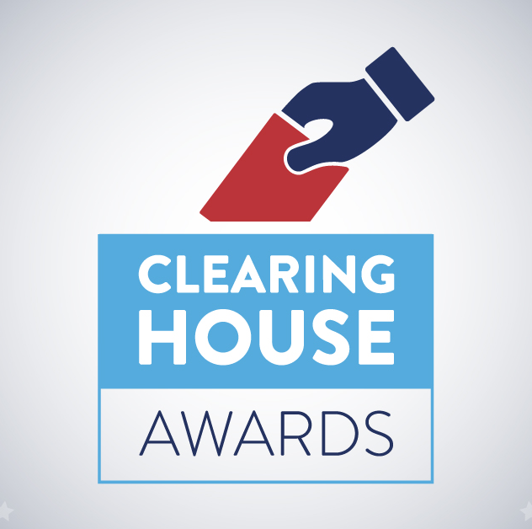
2022 Clearinghouse Awards
In January, the EAC will open the submission period for the 2022 National Clearinghouse Awards
Stay tuned for more information on EAC.gov/clearies
Notes:
In January, the EAC will open the submission period for the 2022 National Clearinghouse Awards
Stay tuned for more information on EAC.gov

Slide 32
Learn more about the EAC

Slide 33
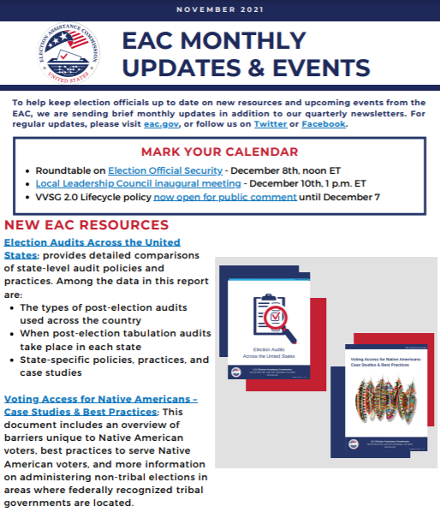
Sharing EAC News
Monthly newsletter
www.eac.gov/newsletter
Notes:
I want to make you aware the EAC has a monthly newsletter that includes upcoming events, new resources, and any other relevant information to assist you
This is a good way to keep up with what is happening at the EAC.
If you don't you don't already receive the newsletter, you can go to this link and sign up.

Slide 34
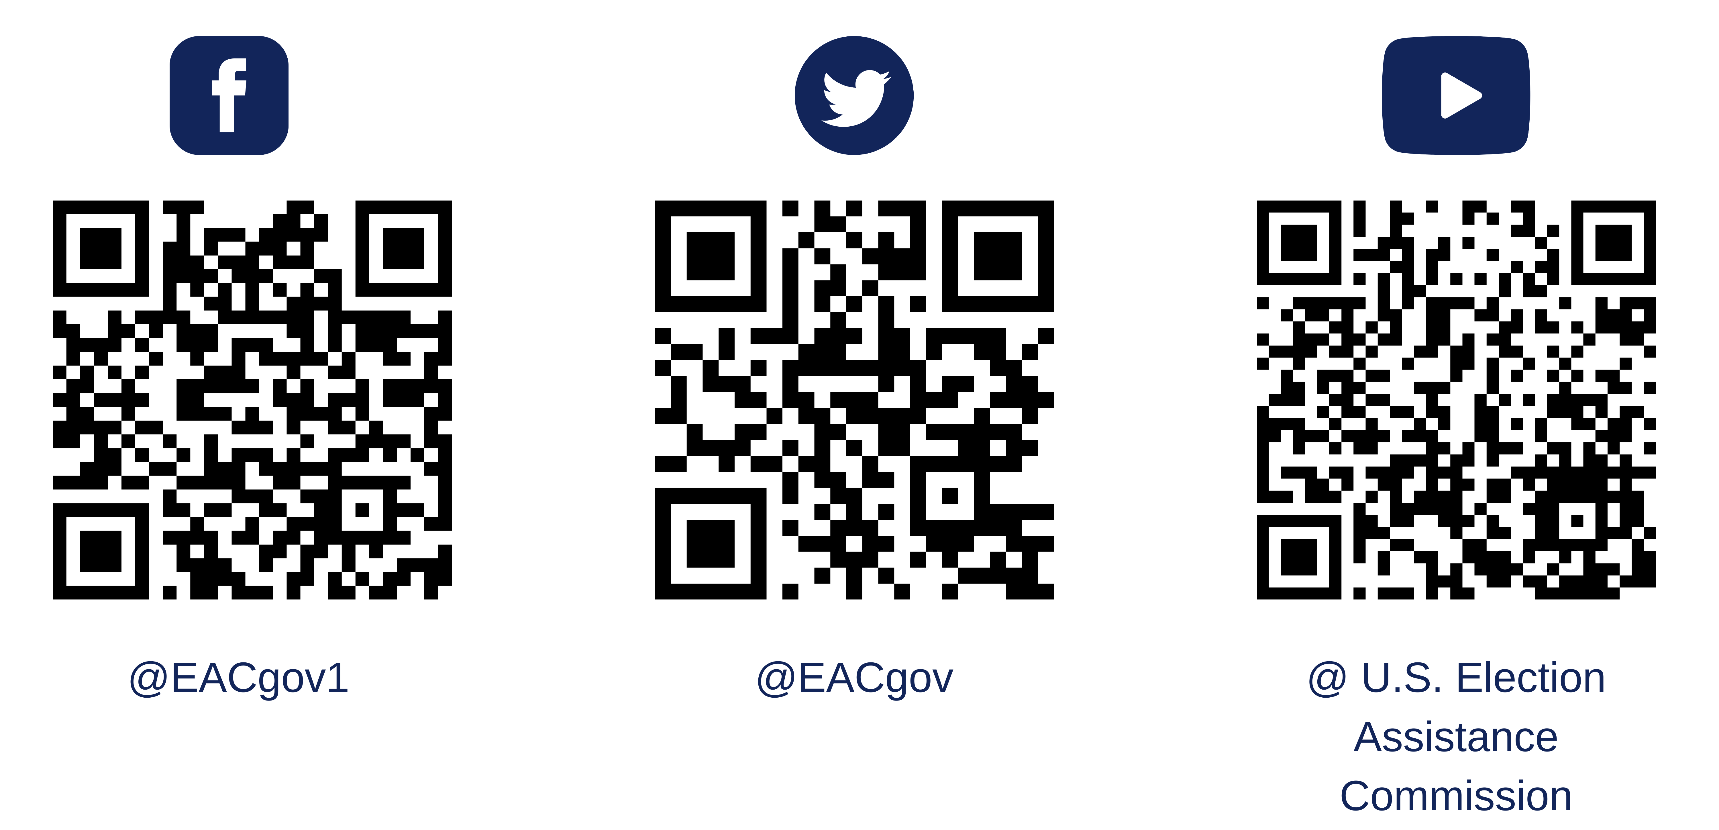
Sharing EAC News
Follow us on Social Media
Notes:
I want to make you aware the EAC has a monthly newsletter that includes upcoming events, new resources, and any other relevant information to assist you
This is a good way to keep up with what is happening at the EAC.
If you don't you don't already receive the newsletter, you can go to this link and sign up.

Slide 35
Contact
Commissioner Donald Palmer
Email: dpalmer@eac.gov
Twitter: @votingguy

Slide 36
Questions?

