Slide 1




Indiana Voter Registration Association
2024 Summer Conference
Brad King, Republican Co-Director
&
Valerie Warycha, Republican Co-Counsel

Slide 2


Temporary Credential Flag
In 2023, HEA 1334 required the state to include a temporary credential flag on SVRS records.
Temporary credentials are issued to certain non-citizens by the BMV.
While the individual may not have been a citizen when the credential was issued, the individual may have become a citizen after receiving the credential.
A temporary credential flag in SVRS, indicates research must be done to determine if the individual is a citizen and eligible to register to vote or to receive an absentee ballot.
SVRS Module Updates
ABS Module was updated in fall 2023 to show the temporary credential flag when voter provides BMV credential number as their voter ID number used for identity confirmation on ABS applications.
VR Module was updated in June 2024 Build to show the temporary credential flag when voter uses IN credential number to update their current registration or to file a new registration.
IC 3-11-4-2.2

Slide 3

Proof of Citizenship
Beginning July 1, 2025 (HEA 1264), the statewide voter file of existing voters will be run against the BMV database to identify those who are currently registered to vote with a temporary credential flag
The county will then send a notice to the voter asking if the voter is eligible to be registered to vote. (State will create a notice counties can generate out of SVRS.)
The individual who receives the notice will have 30 days to respond.
If the individual does not respond and provide proof of citizenship, the voter’s registration status will be moved to cancelled.
IC 3-7-38.2-7.3

Slide 4
Proof of Citizenship
“Proof of Citizenship” means any of the following documents or a copy:
Birth Certificates
U.S. Passport
U.S. Naturalization Documents
Certificate of Naturalization Number
Any other proof of citizenship document or method of proof of citizenship under the Immigration Reform and Control Act of 1986.

Slide 5

Proof of Citizenship
An individual who is unable to provide proof of citizenship may request a hearing before the county election board.
Appeal request may be made by mail or in-person.
County election board must conduct a hearing, make a finding concerning the individual’s citizenship status.
A copy of the decision goes to the voter registration office so changes may be made to the voter’s registration record if necessary.
IC 3-7-38.2-7.3
Starts July 1, 2025

Slide 6


Tsunami Warning
3rd party organizations will be registering people in large numbers.
Your office may register people to vote at fairs and festivals.
Do not use government property to register voters at party booths.
IC 3-14-1-17

Slide 7
Q & A
Q. Will there be changes to ABS envelopes?
A. No, the templates are complete and can be found on the county portal.
Q. When can we enter ABS applications into SVRS?
A. Voters may not send ABS applications when voter registration is closed after the primary or prior to December 1 the year before the election. When voter registration is open, you may enter the application into SVRS the day it is processed. (IC 3-7-13-10)
Q. What can I do if I am on the ballot?
A. Clerks, deputies and staff who are on the ballot are not restricted from performing their duties.

Slide 8
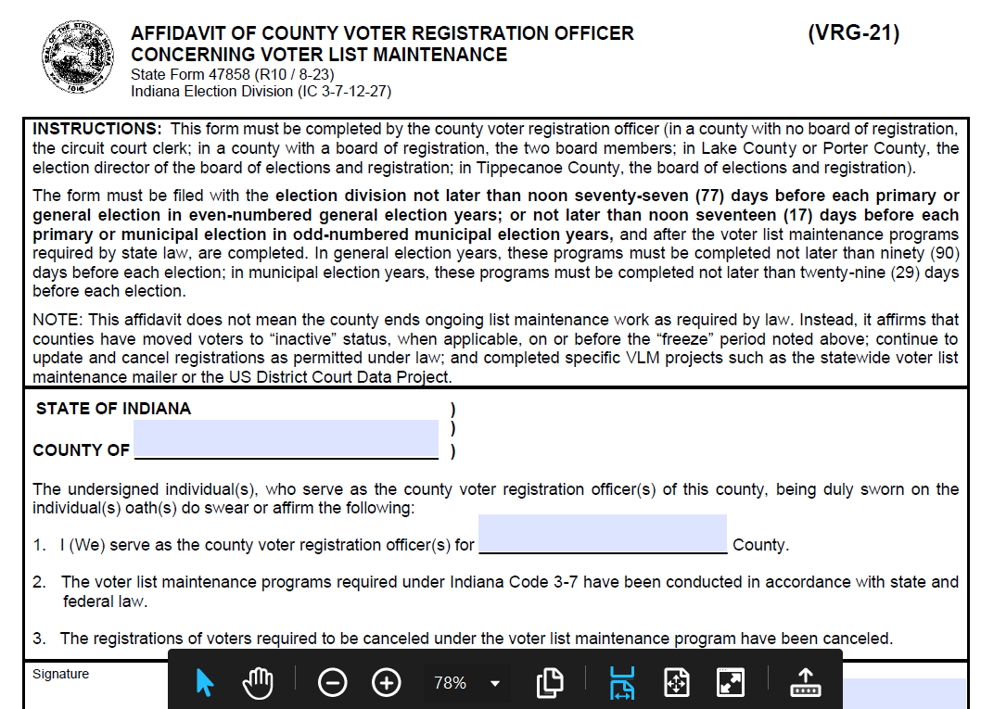
*Reminder
Deadline to file VRG-21 is
August 20, 2024

Slide 9

Redistricting Amnesty
A local government that did not redistrict or recertify election districts following the 2020 census must redistrict after January 1, 2025 and before November 1, 2025.
For election districts where offices are not on the ballot in
2024, redistricting must be done before November 1, 2025.
A member of a local government redistricting authority
who fails to redistrict or recertify current districts will
not be entitled to receive a salary until they comply.
IC 3-5-10-7, IC 3-5-10-7.1

Slide 10


Redistricting Amnesty
Not sure where to start?
Step 1. The unit of local government needs to work with their attorney.
Step 2. Get 2020 Census Data. Katie Springer with the state
library is prepared to help.
Email kspringer@library.in.gov
Phone 317-232-3732

Slide 11

Redistricting & Annexations
If redistricting or annexations take place, you may have voter records that will need to be altered to reflect any change in a voter’s election district.
Reprecincting may be required.
Example, if the county council redistricts, district boundaries may not cross a precinct boundary. IC 36-2-3-4

Slide 12



Where is that Law?
General Provisions
General Assembly
Elections
State Offices and Administration
State and Local Administration
Taxation
Alcohol and Tobacco
Utilities and Transportation
Motor Vehicles
Public Safety
Corrections
Human Services
Environment
Natural and Cultural Resources
Agriculture and Animals
Health
Repealed
Repealed
Repealed
Education
Higher Education
Labor and Safety
Business and Other Associations
Trade Regulation
Professions and Occupations
Commercial Law
Insurance
Financial Institutions
Probate
Trusts and Fiduciaries
Family law and Juvenile Law
Property
Courts and Court Officers
Civil law and Procedure
Criminal law and Procedure
Local Government
Step 1. Find the article
Example, Election law is title 3.
Criminal Law is title 35

Slide 13



Where is that Law?
Title 3. Elections
Art. 1. REPEALED
Art. 2. REPEALED
Art. 3. CONGRESSIONAL APPORTIONMENT
Art. 4. REPEALED
Art. 5. GENERAL PROVISIONS
Art. 6. POLITICAL PARTY AND ELECTION OFFICERS
Art. 7. VOTER REGISTRATION
Art. 8. CANDIDATES
Art. 9. CAMPAIGNS
Art. 10. PROVISIONS GOVERNING CERTAIN TYPES OF ELECTIONS
Art. 11. VOTING METHODS, SUPPLIES, AND EQUIPMENT
Art. 11.5. COUNTING ABSENTEE BALLOTS
Art. 11.7. PROVISIONAL VOTING
Art. 12. ASCERTAINING RESULTS OF ELECTIONS
Art. 13. VACANCIES
Art. 14. OFFENSES
Step 2 Find the article.
Example, Voter Registration will always be IC 3-7
.

Slide 14
Where is that Law?
Ch. 10.General Provisions
Ch. 11.State Administration of Voter Registration
Ch. 12.County Administration of Voter Registration
Ch. 13.Registration and Voting Requirements; General Provisions
Ch. 14.Registration Procedures at License Branches
Ch. 15.Registration Procedures at Public Assistance Agencies
Ch. 16.Registration at Agencies Serving Persons With Disabilities
Ch. 17.Registration at Armed Forces Recruitment Offices
Ch. 18.Registration in Additional Offices; General Provisions
Ch. 19.Registration in Board of Registration Offices
Ch. 20.Repealed
Ch. 20.5.Registration in Unemployment Compensation Offices
Ch. 21.Procedures for Designating Additional Voter Registration Offices; County NVRA Implementation Plans
Ch. 22.Mail Registration
Ch. 23.Repealed
Ch. 24.Distribution Sites for Mail Registration Forms
Ch. 25.Repealed
Ch. 26.Repealed
Ch. 26.3.Statewide Voter Registration List
Ch. 26.4.Statewide Voter Registration Information
Ch. 26.7.Online Voter Registration
Ch. 27.County Voter Registration; Offices and Records Generally
Ch. 28.County Voter Registration; Providing Records to Candidates and Parties
Ch. 29.County Voter Registration; Providing Records to Precinct Inspectors
Ch. 30.Voter Registration Record Confidentiality Requirements and Use Restrictions
Ch. 31.Registration Forms; Content
Ch. 32.Registration Forms; Completion by Voters
Ch. 33.Registration Forms; General Procedures for Processing by Counties
Step 3 ,find the chapter.
Example, what’s the law on registering at the BMV? Go to Chapter 14.
In IC 3-7, chapters 1-9 have been repealed.

Slide 15
Where is that Law?
IC 3-7-14Chapter 14. Registration Procedures at License Branches
3-7-14-1Purpose of chapter
3-7-14-2Applicability of definitions
3-7-14-3Bureau of motor vehicles commission as authority
3-7-14-4Application for driver's license or other identification as voter registration application
3-7-14-5Voter registration application form provided with application for driver's license
3-7-14-6Design of registration form
3-7-14-7Requirements of registration form
3-7-14-8Procedures for registration
3-7-14-9Duties of employees providing application; transmittal of completed application
3-7-14-10Duties of employees if applicant registering to vote after twenty-ninth day before primary, general, municipal, or special election
3-7-14-11Written acknowledgment of application; format
3-7-14-12Submission of application; application to be forwarded
3-7-14-12Submission of application; forwarding application or declination to register
3-7-14-13Confidentiality of information
3-7-14-14Updating voter registration record
3-7-14-15Updating voter registration record; exceptions
3-7-14-16Notification to applicant of disposition
3-7-14-17Prohibited acts
Step 4 Find the section.
Example, What is required of BMV employees when an applicant registers to vote? IC 3-7-14-9 and IC 3-7-14-10

Slide 16
Where is that Law?
IC 3-7-14-9Duties of employees providing application; transmittal of completed application
Sec. 9. (a) An employee of the bureau of motor vehicles commission who provides an individual with a driver's license or identification card application shall do the following:
(1) Inform each individual who applies for a driver's license or an identification card that the information the individual provides on the individual's application will be used to register the individual to vote unless:
(A) the individual is not eligible to vote;
(B) the individual declines to register to vote or fails to complete the voter registration part of the application; or
(C) the individual answers "no" to either question described by IC 3-7-22-5(3) or IC 3-7-22-5(4).
(2) Provide each individual who indicates a desire to register or transfer registration with assistance in filling out the voter registration application if requested to do so by the individual.
(3) Check the completed voter registration form for legibility and completeness.
(4) Inform the individual that the individual will receive a mailing from the county voter registration office of the county where the individual resides concerning the disposition of the voter registration application.
(5) Inform each individual who submits a change of address for a driver's license or identification card that the information serves as notice of a change of address for voter registration unless the applicant states in writing on the form that the change of address is not for voter registration purposes.
(b) The bureau of motor vehicles commission shall transmit a voter registration form to the election division for transmittal to the appropriate county voter registration office in accordance with IC 3-7-26.3.

Slide 17

Thank You
Your time and attention
are greatly appreciated.

Slide 18

Credits
This presentation template is free for everyone to use thanks to the following:
for the presentation template
Pexels, Pixabay
for the photos
Happy designing!

