Slide 1

Running for School Board Office in the 2026 Election Cycle
ISBA Webinar, March 3, 2026
Presented by the Indiana Election Division
Brad King, Co-Director
Angie Nussmeyer, Co-Director
elections@iec.in.gov | in.gov/sos/elections
Images by freepik

Slide 2

ACRONYMS
CAN = Candidate (used on some form designations)
CEB = County Election Board
CFA = Indiana’s Campaign Finance Act (IC 3-9, generally)
D/R/L = Democratic, Republican, Libertarian Parties
IED = Indiana Election Division
SB = School Board
SVRS = Statewide Voter Registration System
VR = Voter Registration

Slide 3

Running for School Board Office
Qualifications to Run | Forms & Filing Periods
Breakdown of CAN-34 Petition & Consent | Petition Processing
Write-In Candidates | Candidate Withdrawal | Challenges

Slide 4

candidate QUALIFICATIONS (1)
Are there durational residency requirements?
Yes. Candidates for school board must reside in the school corporation (or, if applicable, an election district that consists of an area smaller than the entire school corporation boundaries) for at least one year before the election (meaning, one year before the November 3, 2026, general election).
Am I registered to vote in the election district?
You must be a registered voter of the election district not later than the deadline to file the candidate’s consent on the CAN-34 form.
Am I old enough to hold a school board office if elected?
Must be at least 18 years of age and otherwise eligible to assume office, if elected
[NEW IN 2025: FORMERLY at least 21 years of age…]
IC 3-8-1-1 | IC 3-8-1-34 | IC 3-8-2-7(a)(4) | IC 20-26-4-9

Slide 5
candidate QUALIFICATIONS (2)
Do I meet the vote history requirements to run as the D or R candidate?
State law requires that you cast a ballot in the last TWO primary elections in Indiana in which you voted must be of the same political party you are seeking to represent on the November ballot
This does not mean only the last two primary elections held in your precinct; rather, you must look back at your entire primary vote history
Example 1: John pulled a D primary ballot in 2024 and a D primary ballot in 2008 and voted in no other primary elections in between 2008 and 2024. He meets the party affiliation standard in state law.
Example 2: Sue pulled an R primary ballot in 2024 and a D primary ballot in 2022; there was no primary election in her precinct in 2023. She does NOT meet the party affiliation standard in state law.
Example 3: William pulled an R primary ballot in 2022, and the county recorded his primary ballot choice as “PQ” or public question only in 2020. He does NOT meet the party affiliation standard in state law.
Example 4: Mary pulled an R primary ballot in 2024 and an R ballot in Virginia in 2022. She does NOT meet the party affiliation standard in state law.
If your voting history does not meet this requirement, you can seek certification from the county chair where you reside
No official state form for the certification, but IED and CEB have a template that can be shared
Not running as a D or R candidate? Then this requirement does not apply to you.
IC 3-8-1-1 | IC 3-8-1-34 | IC 3-8-2-7(a)(4) | IC 20-26-4-6

Slide 6

Other QUALIFICATIONS
Can a teacher or non-certified employee hold a school board position in the same school corporation for which they are employed?
No. State law does not permit a teacher or non-certified employee (as defined in IC 20-29-2-11) to be a member of the governing body of the same school corporation they are employed.
Can I run for elected office with a felony conviction?
A person who has been convicted of a felony is disqualified from being a candidate
for an elected office (except a federal office) or assuming an office
Felony means a conviction of a crime where a person can be imprisoned for more than 1 year
IC 20-26-4-9 | IC 20-26-4-11 | IC 3-8-1-5

Slide 7
Filing Timeline & CAN-34 Petition Overview
NOW: Collect signatures of registered voters within election district using the CAN-34 Petition Form
School board members elected at-large
All voters of the election district vote on the race and can vote for more than one person to serve on the school board
Signatures can come from any registered voter within the school corporation boundaries
School board members are elected by district BUT voted on in the “at-large” style
Generally, the district is created for residency/geographic balance purposes though all voters within the school corporation boundaries vote on the school board seats
Signatures can come from any registered voter within the school corporation boundaries
School board members are elected by district and only by voters in their district
Signature can only come from a registered voter within the “smaller’ internal election district

Slide 8
Filing Timeline & CAN-34 Petition Overview (1)
Most school board candidates need 10 certified signatures of registered voters in the election district as described in the previous slide. A few school corporations use different guidelines (mostly in Lake County) and the signature count differs.
School Corporation Plan is the definitive resource to confirm how each school board seat is elected.
May 19 to June 18, 2026 (NOON): CAN-34, CAN-12 Filing Period
Complete the consent on the back of the CAN-34 on at least one petition
File CAN-34 petitions with county VR official where the largest percentage of voters based on the 2020 census population of the school corporation reside
“Largest” county processes all CAN-34 petitions (Note: This is different than other types of petitions used to gain ballot access)
File the CAN-12 Statement of Economic Interests at the same time as the CAN-34 petition (in most counties*)
CAN-12 reflects the previous year’s (2025) financial activity, not the year in which the report is filed (2026).
*Six counties (Allen, LaPorte, Madison, Marion, Vanderburgh & Vigo) have a separate board of registration. In these counties, you must first file the CAN-34 with the VR office. Once the petitions are certified, then you must take the VR certified CAN-34 petitions to the county election board or clerk to officially file to run for office. This requires the CAN-12 to be filed with the CAN-34 petitions/consent.

Slide 9
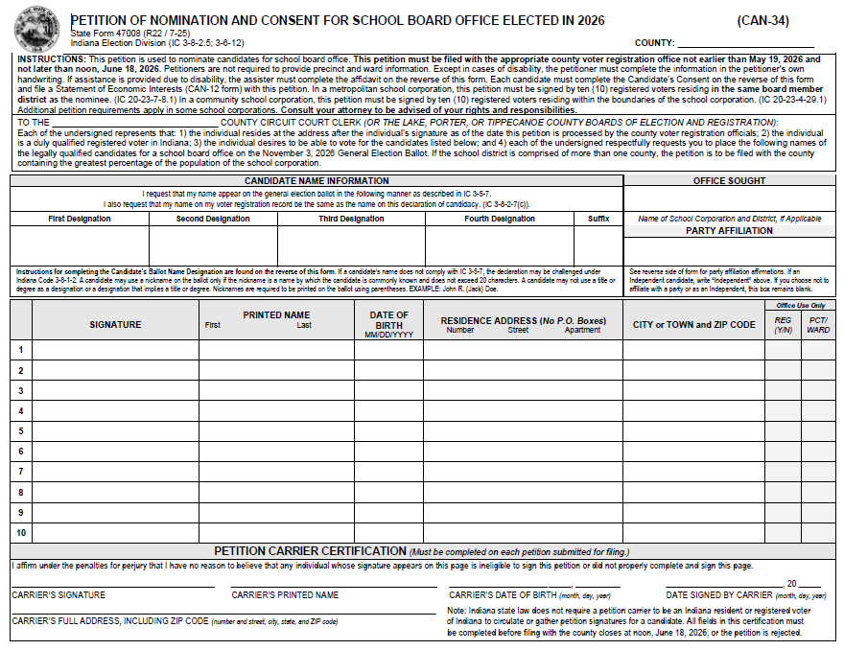
Petition Processing
2026 can-34 example (front)

Slide 10
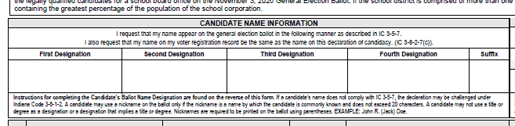
Candidate Name Designations
SURNAME (or last name) is important to designate, as candidates on the November ballot are first grouped by party and then alpha by surname.
Surname can be a name found on a birth certificate, marriage license, or on the judicial order changing a person’s name
All NICKNAMES must go in (PARENTHESES) on the ballot
Parentheses not required when nickname is used in first designation
Must be a nickname candidate is commonly known
Limited to 20 characters
Cannot use Title or Degree
Candidate Name does NOT have to match voter registration
Instead, registration updated by county to reflect candidate’s ballot name
1 First Designation
Candidate’s legal given name OR initial of candidate’s legal given name OR
Candidate’s legal middle name OR initial of candidate’s legal given name OR
Candidate’s nickname
2 Second Designation, if not used in the first designation…
Candidate’s legal middle name OR initial of candidate’s legal given name OR
Candidate’s nickname OR Candidate’s surname
3 Third Designation, if not used in the first or second designation…
Candidate’s nickname OR Candidate’s legal surname
4 Fourth Designation, if not used in the first or second or third designation..
Candidate’s nickname OR Candidate’s legal surname
5 Fifth Designation: Suffix Only

Slide 11
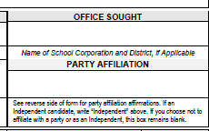
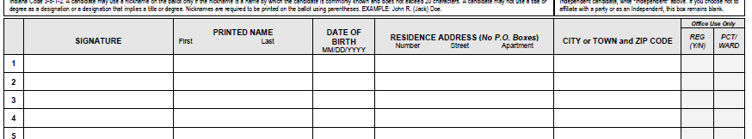
CAN-34 PETITIONER SECTION
Office sought
Enter the name of the school board seat you are seeking, whether a specific district or at-large
party AFFILIATION
Enter the party you seek to affiliate or indicate Independent status or leave section blank to not affiliate as an Independent candidate or with a political party

Slide 12

REQUIRED CAN-34 PETITION ELEMENTS
Voter’s Signature
Must substantially conform to the registration record
Check for voter assistance affidavit on back of form to see if voter had assistance with signing their name
Voter’s Printed First & Last Name
Name may have minor variation from the registration record
Voter’s Residence Address
MUST be registered to vote at the address indicated on the petition at the time the petition is reviewed by county VR officials
Minor variations may be OK; see IC 3-5-6-4 and IC 3-5-6-5 for discussion on major/minor variations
IC 3-5-6-4 | IC 3-5-6-5 | IC 3-5-6-6

Slide 13

Other CAN-34 PETITION ELEMENTS
Voter’s Date of Birth
NOT required; not a reason to reject name – helpful for county officials to identify voter in SVRS
“For Office Use Only” Columns
Voter does NOT complete this information; counties may use to assist with their count for certifications on back of petition
Instead, counties should use to confirm if voter was registered to vote and their precinct/ward
County VR officials are instructed NOT to mark through petition rows
Instead, use the “yes/no” column to indicate if voter was registered
IC 3-5-6-6 | IC 3-6-12-7 | IC 3-6-12-8 | IC 3-6-12-9

Slide 14
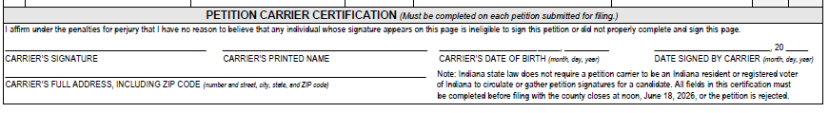
Other PETITION ELEMENTS
Petition Carrier Affidavit
All petition carriers (including candidates!) must complete the affidavit found on the bottom of each petition
All elements must be present; any missing information results in form being “incomplete”
County VR official MUST contact petition carrier to request that the affidavit be completed before deadline to file petitions for initial certification
If carrier completes affidavit by deadline (noon, June 18, 2026, for CAN-34), then county may review and process it
If carriers does NOT complete affidavit by deadline, then petition is rejected
IC 3-5-6-6 | IC 3-6-12-7 | IC 3-6-12-8 | IC 3-6-12-9

Slide 15
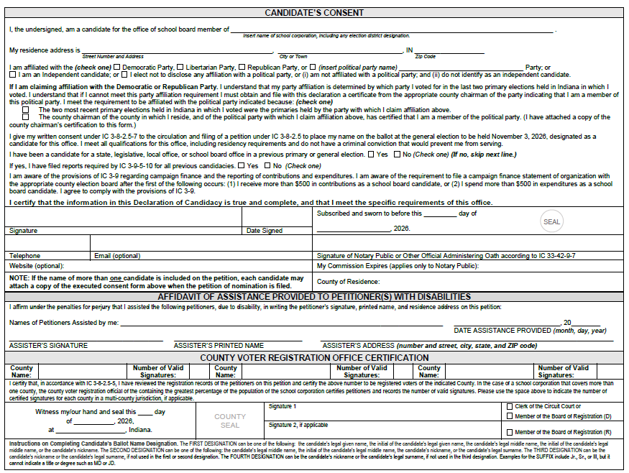
Petition Processing
2026 can-34 Example (back)

Slide 16
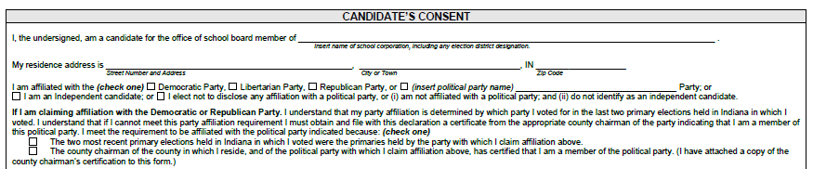
Candidate’s consent
Must specify name of school corporation, including any election district designation
Include candidate’s RESIDENCE address
Disclose candidate’s party affiliation, if any
Democratic, Libertarian, Republican, other minor party OR Independent OR no affiliation
Democratic & Republican candidates must affirm their vote history requirement OR note they have attached the chair’s certification to their filing
Confirm name of school corporation and any election district designation, if applicable
Provide your complete RESIDENCE address
Denote D/R/L or minor political party affiliation or Independent status or leave “blank” to not affiliate

Slide 17
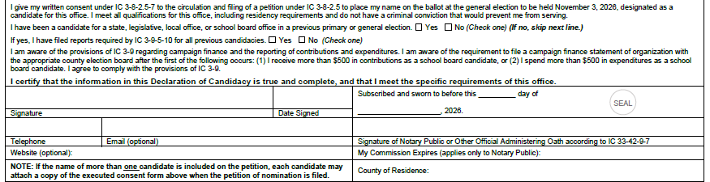
Candidate’s consent (1)
Disclose if you have run for elected office (does not include PC or party state convention delegate) previously by marking “yes” or “no”
Marking “yes” to running for office requires you to state IF you filed all campaign finance reports in the next question
Signature Box & Date
Affirms that you consent to run for elected office, understand campaign finance requirements, and completed the consent (declaration of candidacy) correctly; Telephone, email & website disclosure (optional, but helpful for CEB)
Notary box: Must wait to sign consent until you are before a notary!

Slide 18

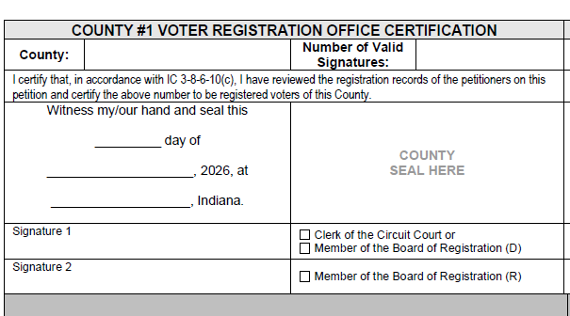
Petition Certification
County Must Certify Each Petition
Certification boxes found on the back of each form
Two boxes available in case more than one county needs to certify signatures
MUST be completed by county VR official or employee, including number of valid signatures on petition
More than one signature line in each box in case a board of registration is certifying
Using a seal is optional
ONLY certification that matters – SVRS reports are helpful, but original physical document with county VR certification is “official” count!
IC 3-8-2.5-6

Slide 19
Petition Certification (1)
Clerk sends notice to candidate if individual met the signature requirement (or not)
Have enough certified signatures?
Clerk will mail a CAN-5 to the candidate (or, if candidate is present, hand deliver the CAN-5 to the candidate)
Not enough certified signatures?
Clerk must send notice informing candidate that they did not meet the signature requirements
Candidate Options:
Go get more signatures and file CAN-34 petitions before deadline passes (May 19 to noon, June 18, 2026)
File a CAN-1 challenge to dispute the clerk’s assessment on rejecting one or more signatures
IC 3-5-4-1.3 | IC 3-8-2.5-6 | IC 3-8-2.5-7

Slide 20

Write-in candidates for school board
Write-in Candidate’s Name is NOT printed on the ballot!
Forms to file with CEB:
CAN-26: Declaration of Candidacy
No signature gathering requirement
CAN-12: statement of economic interests
Include information from 2025 only
Write-in School Board candidate filing period begins August 5 & ends at NOON, August 21, 2026
Image by macrovector on Freepik
IC 3-8-2.5-2 | IC 3-8-2.5-2.5 | IC 3-8-2.5-4

Slide 21
CANDIDATE CHALLENGES: CAN-1
CAN-1 may be filed by any voter of the election district OR a D or R county party chair within the election district.
Must be “original” wet signature, so CAN-1 must be mailed or hand-delivered.
Challenge is based on candidate’s qualifications to run and hold school board seat OR if a candidate disputes a rejected signature.
NEW! If running as a D/R, can be challenged for primary vote history requirement not being met.
File using the CAN-34/CAN-12 between May-June?
Challenge period is May 19 to NOON, August 21
CEB must determine outcome by NOON, September 4
File using the CAN-26/CAN-12 in August to be a write-in candidate?
Challenge period is August 5 to NOON, August 28
CEB must determine outcome by NOON, September 10
Candidate withdrawal: CAN-24
File using the CAN-34/CAN-12 between May-June?
Withdraw for any reason up to noon, July 15, 2026
After noon, July 15,2026, can withdraw for limited reasons (for example, death, move out of district, disqualification)
File using the CAN-26/CAN-12 in August to be a write-in candidate?
Withdraw for any reason up to NOON, August 24
After noon, August 24, can withdraw for limited reasons (for example, death, move out of district, disqualification)

Slide 22

Ballot Placement & Election Certification
Vote for Only One | Voter for More Than One
Straight Party Voting | Certifying Results

Slide 23

Office Order Placement
School Board seats appear after all “partisan” elected offices
Near the end of the ballot but before any judicial retention question
Office Order
First: At-large school board seats
Second: District school board seats
If multiple district seats are on the same ballot, list A-Z or 1-100, depending on whether districts use a number or letter designation
NEW! School board candidates may affiliate with a political party (D/R/L/minor party), run as an Independent or leave the field “blank”
School board offices have no limits on the number of candidates who affiliate with a party
This means you may have 3 Ds, 4Rs, 10 Independents running for a school board “vote for 1” office
Straight Party Device DOES NOT apply to school board races!
IC 3-11-2-6 | P.L. 7-2026

Slide 24
Candidate Groupings
1 First Tier: Grouped by political party (D/R/L)
D/R ordered determined by which SOS candidate won the county in 2022
Ls , if any, come third in every county (in 2022 SOS race, the only other party with a candidate on the ballot was the Libertarian Party)
Within each distinct party grouping, candidates are listed alphabetically by surname if there is more than one candidate
2 Second Tier: All minor party and Independent candidates
Listed in order by date the CAN-34 was filed UNLESS there is more than one candidate who filed for a specific party or as an Independent candidate & then the party candidates are grouped and then listed alpha by surname within that grouping Example: A Pink Party candidate files on 1/1/26, an Independent candidate files on 1/2/26, and another Pink Party candidate files on 1/3/26. Pink Party candidates are grouped together, since there is more than one candidate who filed as a member of that party. The county then lists the two Pink Party candidates alpha by surname within the Pink Party group. Next, the Independent candidate is listed.
3 Third Tier: All “unaffiliated” or “blank” candidates listed alphabetically by surname
Does not matter when the CAN-34 petition was filed
4 Fourth Tier: Write-in line, if a write-in candidate filed to run for SB seat
Remember, a write-in candidate’s name is NEVER printed on the ballot!
SEA 25

Slide 25
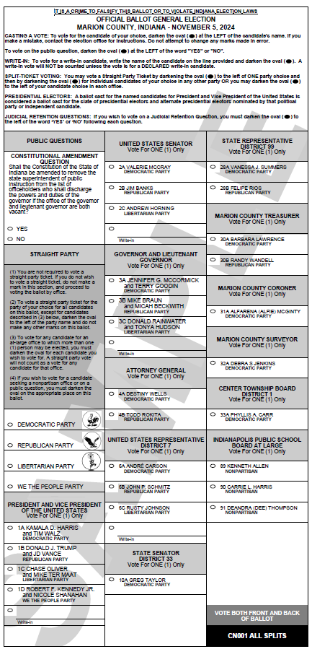
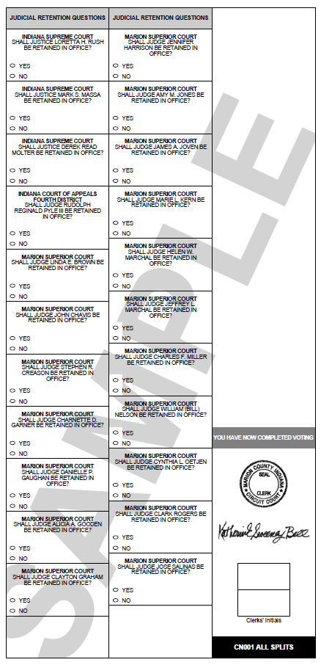
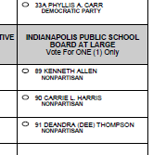
Sample Ballot
Marion County
2024 General Election
School Board Office is listed after all of the other offices on the ballot but before their judicial retention questions

Slide 26
Tabulation & Certification
Votes for all school board offices are tabulated and canvassed list any other partisan elected office
Circuit court clerks certify final results to IED through SVRS
Final results for each school board office are populated on CEB-25
School board district located only in one county:
Circuit court clerk may issue certificate of election to elected school board members not earlier than noon, November 20
School board district located in more than one county:
Circuit court clerk in county with greatest percentage of school board district’s population obtains final and certified election results from other clerks in counties where election district is located
Clerk tabulates the vote totals cast for each county in each county
This can be done using reports in SVRS that calculate the total results
Clerk issues certificate of election to winning candidate(s), not earlier than noon, November 20
IC 3-12-4 | IC 3-12-5-2 | IC 3-12-5-16

Slide 27

Campaign Finance & School Board Candidates
When to Open a Committee | Campaign Finance Reporting Schedule
Disclaimers

Slide 28
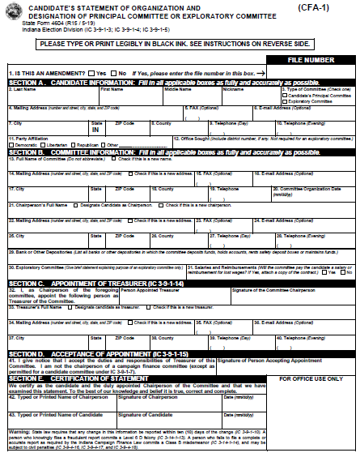
When to Open a Candidate’s Committee (CFA-1)
CFA & School Board Candidates
Only required to establish a candidate’s committee when you raise or spend more than $500 (that is, $500.01) toward running for a school board office
Filed with the CEB not later than noon, 10 days after exceeding this threshold
Unlike other offices, the act of filing a CAN-34 (or CAN-26) for school board office does not automatically require a school board candidate to open a committee
IC 3-9-1-3 | IC 3-9-1-5 | IC 3-9-1-5.5 | IC 3-9-5-6

Slide 29
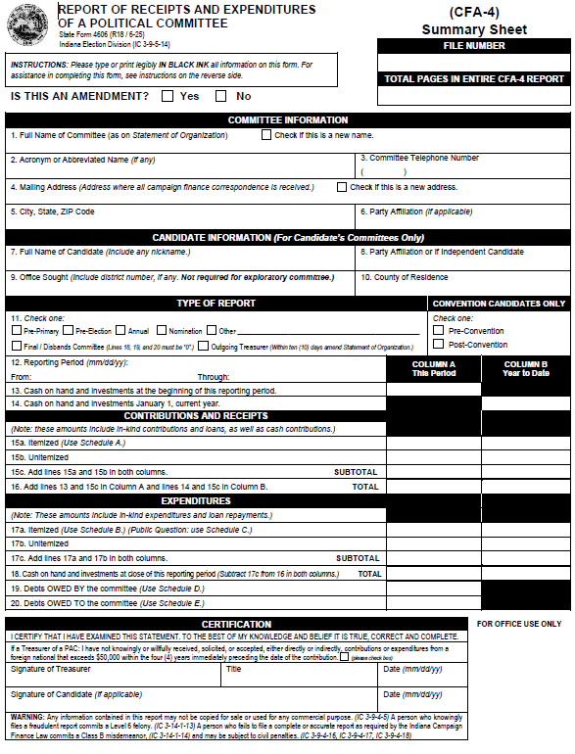
Filing CFA-4 Forms
If a school board candidate opens a committee in 2026, then follow the reporting schedule for the remainder of the year
If opening a committee on or before Oct. 9, 2026, then Pre-General Report is due by noon, Oct. 16, 2026
Reporting period is date committee opened through Oct. 9, 2026
If opening a committee after Oct. 9, 2026, the Annual Report is due by noon, January 20, 2027
Reporting period is date committee opened through Dec. 31, 2026
If you are elected in 2026, then your committee must remain open until such a time you no longer hold office
This requires filing a CFA-4 Annual Report each January

Slide 30
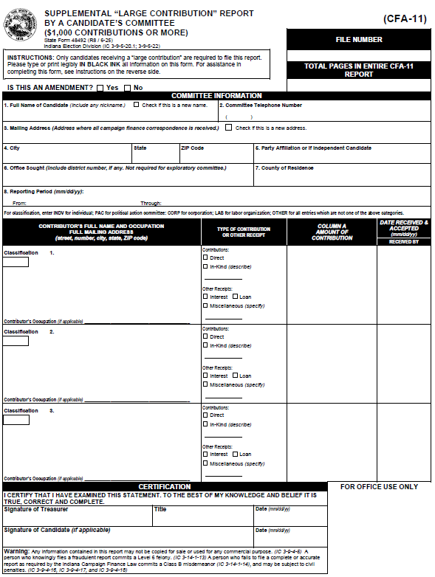
Filing CFA-11 Forms
If a school board candidate has an OPEN committee & receives a contribution of $1000 or more, lump sum or aggregate from a single source, then CFA-11 report is required
ONLY filed by a candidate’s committee during specific window of time before the pre-primary or pre-general report
For Nov. election, CFA-11 window is between Oct. 10 and Nov, 1, 2026
Must be filed with CEB not later than 48-hours after receiving & accepting a contribution
Contribution can be direct (cash, check, credit card) or in-kind (good or service in lieu of direct contribution) or a loan made to the committee

Slide 31

All OPEN committees are responsible for TIMELY FILING campaign finance reports, according to the state’s schedule, UNTIL the committee is eligible to file a final/disbands report.
NEW! ALL elected officeholders must maintain an open campaign finance committee until they no longer hold elected office and are no longer a candidate. (IC 3-5-2.1-16(b))
Image by luis_molinero on Freepik

Slide 32
Disclaimers
Must be included on printed communications that express the support or defeat of a clearly identified candidate (not radio, television, website, or emails)
“Paid for by Smith for School Board.”
The “authorized by” language must be included when another entity is coordinating with the candidate’s committee
“YES” on coordination? “Paid for by the Cardinal County Democratic Party and authorized by Smith for School Board”
“NO” on coordination? “Paid for by the Cardinal County Democratic Party and not authorized by any candidate or candidate’s committee.”
IC 3-9-3-2.5

Slide 33
Other Disclaimers
Using social media ads?
Federal Election Commission (FEC) is your best resource, even if not running for federal office
Thinking about placing a newspaper or TV ad?
Federal Communications Commission (FCC) is your best resource
Planning on using robo-calls?
Indiana Attorney General is your best resource
Check out the AGs website as it contains helpful information
Sending out absentee mailings?
Do not forget about the additional disclaimer requirements that indicate the name & mailing address of the entity sending out the communication AND that the mailing is unsolicited & not sent by a state or county party official
2026 Campaign Finance Manual includes the ABS disclaimer details
IC 3-6-4.9-10 | 3-11-4-5.2

Slide 34
Campaign Finance Resources
2026 Indiana Campaign Finance Manual
Found at in.gov/sos/elections (Election Administrator’s Portal) at Campaignfinance.in.gov
Website: Campaignfinance.in.gov
Forms & Resources
Information on committees required to file with state (IED)
Email: Campaignfinance@iec.in.gov
Directed to campaign finance staff (Abbey Taylor & Michelle Thompson)

Slide 35

FILLING A SCHOOL BOARD ELECTED OFFICE VACANCY BEGINNING IN 2027
D/R party will fill any school board vacancy created when a candidate elected as a D/R vacates their seat
Follow procedures in IC 3-13-11, generally
Current school board members fill a school board vacancy if person was elected as a minor party or Independent candidate, or did not affiliate
HOLDOVERS
“Holdover” in office if not enough candidates elected (Article 15, Section 3 of Indiana Constitution)
Example 1: Vote for 1 seat where no one filed to run; incumbent holds over for a new term
Example 2: Vote for 3 seat where one incumbent filed to run again, one non-incumbent filed; and no one filed to run in the third seat. School board determines which of the two incumbents holds over for a new term.
IC 20-23-4-30 | IC 20-26-4-4

Slide 36
Questions?
Presented by the Indiana Election Division
Brad King, Co-Director
Angie Nussmeyer, Co-Director
elections@iec.in.gov | in.gov/sos/elections
Images by freepik

