Slide 1
Navigating the
Election Maze
Presented by Joe McLain & Angie Nussmeyer
Co-Directors, Indiana Election Division
ILMCT Institute & Academy | July XX, 2026

Slide 2
Elections 101
Acronyms
ABS = Absentee
D/R/L = Democratic, Republican or Libertarian Parties
IEC = Indiana Election Commission
IED = Indiana Election Division
SOS = Secretary of State
SVRS = Statewide Voter Registration System
VR = Voter Registration
Primary Election
  Major political parties nominate candidates for November elections
  In Indiana, primaries are held in May
General Election
  All candidates appear on the ballot
    Federal, state, local
  November election in even-numbered years
    Presidential & mid-term elections
Municipal Election
  Local candidates on the ballot
  November election in odd-numbered year between mid-term and presidential elections

Slide 3
Key Players
FEDERAL GOVERNMENT
Federal Election Commission (FEC)
  Enforces campaign finance law for federal candidates/PACs
Election Assistance Commission (EAC)
  Offers best practices in election administration
  Approves voluntary voting system guidelines (VVSG)
Federal Communications Commission (FCC)
  Handles complaints regarding radio/television/internet communications for all candidates & committees
STATE GOVERNMENT
Secretary of State
  Serves as state’s chief election official
Indiana Election Division
  Bi-partisan staff who partners with the SOS to maintain SVRS
  Supports the Indiana Election Commission
  Receives candidate & campaign finance filings at state level
Indiana Election Commission
  Made up of four members: 2 Ds + 2 Rs
  Certifies voting systems for use in Indiana
  Enforces campaign finance laws
  Rules on candidate challenges

Slide 4

Key Players
LOCAL GOVERNMENT
  County Clerk
    Serves as chief election & voter registration official
      NOTE: A few counties have a bi-partisan Board of Voter Registration, which serves as the county’s chief VR official
  County Election Board
    Made up of three members: 1 Democratic, 1 Republican member + County Clerk
    Conducts all elections in the county
    Enforces campaign finance laws
Towns, generally, do not manage elections, but stay tuned for the exception.
Image created by Freepik

Slide 5
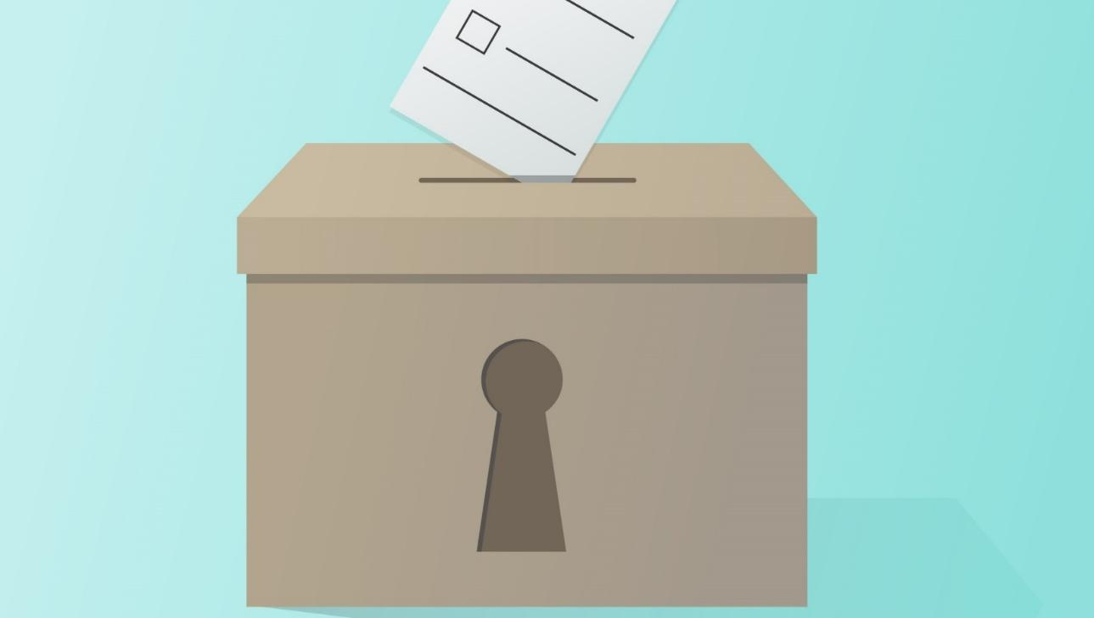
Image Created by Freepik
Election Overview
Voter Registration
Absentee Voting
  By Mail
  In-person at Clerk’s Office & other early voting sites
  Travel Board
Public Test of Voting Equipment
Election Day Operations

Slide 6
Voter Registration
General Requirements
  Must be 18 on or before the date of the November election
    A 17-year-old may register and vote in the May primary election, though cannot vote on public questions
  Must be a US citizen
  Must reside in their Indiana precinct at least 30-days before an election
  Must not be currently imprisoned after being convicted of a crime
Ways to Register to Vote
  Online at indianavoters.com
    Requires Indiana driver’s license or state ID to enter for voter ID number
  Paper Forms (federal mail-in form, state forms VRG-7, VRG-11)
    Requires voter to provide one of the following for voter ID number: Indiana driver’s license or state ID number OR last four of Social Security Number
      If voter has neither, may write in “NONE” and an ID number is created for them
  BMV during credential transactions (that is, getting a driver’s license or state ID card)
Statewide VR Deadline is 29-days before each election

Slide 7
Absentee Voting
By Mail
  Requires a voter to mark a reason on the ABS-Mail form
  Ballots mailed at least 45-days before Election Day
  ABS-Mail application deadline is 11:59PM, 12-days before election
  Voted ballots must be received by 6PM on Election Day
Travel Board
  Bi-partisan team sent to aid voter who is confined to their home or their caregiver to complete their ballot
  ABS-Traveling Board deadline is noon, day before election
  Travel board appointments begin 19-days before the election
In-Person (“Early” Voting)
  Starts 28-days before each election, ending at noon the day before the election
  Does not require a reason, but voter must show photo ID that complies with state law
While photo ID is not required to vote by mail or travel board, it must be included with the ABS application or the voter must provide their voter ID number.

Slide 8
Election Prep & Election Day Duties
Public Test of Voting Systems
  Each CEB must put their voting systems through a mock election to ensure that:
    each candidate and, if applicable, each political party or public question receives at least one vote;
    votes tallied on voting system unit match the total from the main tabulation computer; and
    accessible features are working as intended.
Recruiting Election Workers
  D/R Parties nominate & CEB appoints:
    election Day poll workers, absentee voter boards, central count teams
Distributing Election Materials & Training Workers

Slide 9

Small Town Elections
Municipal Primary Elections or Town Convention
Town Election Board
Small Town Election Checklist
Small Town Election Reminders
Created by Iconicbestiary - Freepik.com

Slide 10
Small Town Elections
In the even-numbered general election years, the county election board conducts all elections
  Note: All municipalities must hold a primary election to nominate D/R candidates, if the city or town has opted to move their elections to an even-numbered year. Libertarian candidates still use the town nominating convention, however.
In the odd-numbered municipal election year, towns with a population less than 3,500 MAY conduct their own municipal election
  Population is determined by the decennial census (2020)
    NOTE: Not an option for small towns within Marion County
IC 3-8-5 | IC 3-10-6.5 | IC 3-10-7

Slide 11
D/R Candidate Nominations in Even-Year (2026)
Primary Election
State law requires all small towns to nominate their D/R candidates at the primary election
  Candidate filing is the same as other D/R candidates (early Jan to mid-February)
  County Election Board runs the election
    Town does not reimburse the county for the election expense
Note: Small Town Nominating Conventions are NO longer permitted for D/R candidates in even-numbered year
    Libertarian candidates are nominated at a town convention, however, as that’s their ballot access route in state law
IC 3-8-5-2.5 | IC 3-8-5-10

Slide 12
D/R/L Candidate Nominations in Odd Year (2027)
Town Convention
  D/R/L hold town convention before August 28, 2027, to nominate contested candidates for November election
  Default option if town council takes no action to pass an ordinance for a primary election (see below)
Town Primary Election
  Town Council passes ordinance by January 1, 2027
  Town Clerk-Treasurer files ordinance with county clerk by noon, January 6, 2027
  Ordinance may not be changed more than one time in a 12-year period
  County Election Board runs the election
    Town does reimburse county for the election expense
IC 3-5-3-7 | IC 3-8-5-2

Slide 13
Small Town Municipal Elections
Even Numbered Year November Election (2026, 2028, etc.)
  CEB runs small town municipal election
  Town does not reimburse county for election expense
Odd Numbered Year November Election (2027, 2031, etc.)
CEB runs small town municipal election for fixed fee or variable amount
  Town does reimburse county for expenses
Town Election Board runs small town municipal election
  Town Council adopts resolution between Jan. 1, 2027, and Aug. 8, 2027
  Town Clerk-Treasurer files copy of resolution with county clerk by noon, Aug. 23, 2027
    Move from August 21 because the 23rd falls on a Saturday
  Town Election Board manages November 2027 election
  Resolution expires December 31, 2027
  Town is responsible for all costs of the election
IC 3-5-3-7 | IC 3-10-7-2(b) | IC 3-10-7-4 | IC 3-10-7-5.5

Slide 14
Small Town Election Board (2027)
Three member bi-partisan board
  Used ONLY if town council adopts resolution to run November municipal election
  Democratic & Republican town committee chairs are members
    Must select one to serve as chair of board
  Town Clerk-Treasurer
    Serves as Secretary
Required to follow Indiana & federal election law
Must call meetings, preserve meeting minutes
May hire staff, deputy election commissioners
Town council sets compensation for board members
IC 3-8-5-3 | IC 3-10-7-7 | IC 3-10-7-11 | IC 3-10-7-12 | IC 3-10-7-13 | IC 3-10-7-15 | IC 3-10-7-16 | IC 3-10-7-20 | IC 3-10-7-21

Slide 15
Small Town Election Checklist (2027)
Determine Voting Method
  Hand-counted paper ballots (IC 3-11-2; IC 3-11-11)
  Optical scan ballot cards (IC 3-11-13)
  Direct Recording Equipment (DRE) (IC 3-11-14)
    Remember, must have a voting option available for persons with disabilities to vote independently and privately
Build ballot according to IC 3-11-2 and voting method chapter above
  Hand-counted paper ballots may be modified slightly; see IC 3-11-11
Conduct public test of voting equipment
  Must have voting equipment to assist voters with disabilities, so town election board would conduct public test
This is NOT an exhaustive list of responsibilities to comply with Title 3 requirements.
IC 3-10-7-32

Slide 16
Small Town Election Checklist (2027)
Provide Absentee Voting
  Must offer absentee by mail, in-person “early” voting, travel board
    Town board may adopt a resolution to reduce the number of early voting days by unanimous vote
    Must include “findings of fact” to justify shortened days and hours (see IC 3-11-10-26.5)
  Absentee ballots to military & overseas voters MUST be mailed no later than 45-days before the election; failure to do so may be subject to US Department of Justice investigation
    Some military/overseas voters prefer to vote by fax/email, and the deadline date will differ
  Bi-partisan travel board teams must begin their appointments 19-days before the election
Have a plan to appoint election officials via party nominations
Identify polling locations for each precinct
    Polling locations must be accessible to persons with disabilities
Post public notice of elections
IC 3-10-7-22 | IC 3-10-7-23 | IC 3-11-10-26.5

Slide 17
Small Town Election Reminders
Election Equipment
  May borrow equipment from county election board
    Town is responsible for reimbursing county for moving equipment and any damage to the machines
Poll Books
  County clerk (or board of voter registration, if applicable) prepares a list of voters in each precinct within the election district
    Lists are printed no later than 10 days before the election
      Must included voter’s full name, address, and assigned identification number
    Two copies of each precinct list are given to town election board
Canvass results
  Town election board canvasses results to determine the total vote cast on election day
IC 3-10-7-31 | IC 3-10-7-30

Slide 18
Small Town Election Reminders
Secure election materials
  Poll lists, ballots, tally sheets, and other materials are filed with the county election board for preservations
Provide certificates of election, upon request
  After the canvass, the town election board certifies the winners of the election to the town clerk-treasurer
    If a public question is on the town ballot, the town election board would declare if the question was approved or defeated
  Town clerk-treasurer may issue a certificate of election to each person electedion
Election Reports filed with the Indiana Election Division:
  CEB-9 (County Election Report)
  Precinct level Results
  Names and mailing addresses of elected town judges
    Governor issues a commission, and this information is necessary to complete this process
IC 3-10-7-33 | IC 3-10-7-34 | IC 3-6-5-17 | IC 3-6-5-17.5 | IC 3-12-5

Slide 19
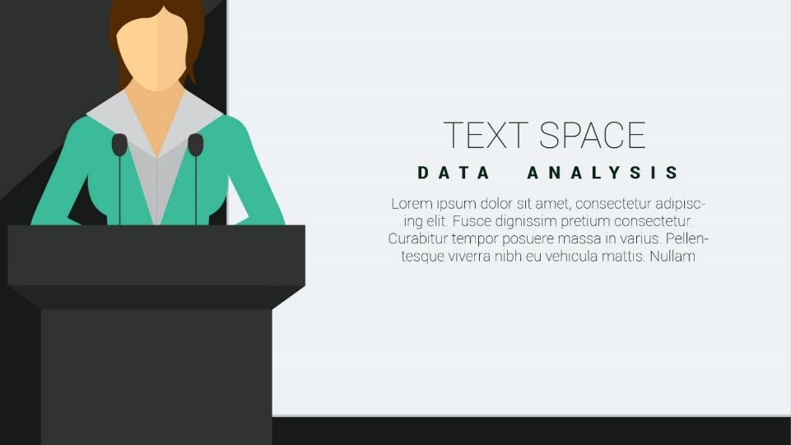
Serving Town Office &
Filling Office Vacancies
Image Created by Freepik

Slide 20
Town Office (Candidate) Qualifications
Town office candidates, generally
  Must be a registered voter in the election district
    NOTE: town judges must be registered to vote in the county where the municipality is located
  May not have a felony conviction (see IC 3-8-1-5 for full details)
  Must file a statement of economic interest with declaration of candidacy or candidate consent
Residency Requirements
  Town Council candidates must reside in the district in which seeking election, if applicable
  Town Clerk-Treasurer & Town Judge candidates do not have residency requirements beyond being a registered voter of the election district
IC 3-8-1-1 | IC 3-8-1-1.5 | 3-8-1-29

Slide 21
Town Office (Candidate) Qualifications
Government Employees Holding Office
  A government employee may not hold elected office for the same unit of government & remain employed
  Does not disqualify a person from running; rather, the person is considered to have resigned from their job, if elected and qualified
    Example: Sally is the town planner. She decides to run for town council. Sally wins her election. Since the elected office (town) IS the same unit of government as her employer (town), she effectively resigns her position as town planner.
    Example 2: Joe is a town planner. He decides to run for county council. Joe wins his election. Since the elected office (county) is not the same unit of government as his employer (town), he may hold elected office and remain in his job.
  NOTE: Firefighters who are not in a full-time, paid position (i.e. volunteer) are exempt from the statute.
IC 3-5-9

Slide 22
Town Office Candidate Filing
Democratic & Republican candidates
To run in primary election or town convention, candidate must:
  In the last two primaries in which the candidate voted in Indiana, they must have requested a party ballot for the party they are affiliating with on the ballot OR
  File certification from the county party chair of the major political party that the candidate is a member in good standing of the party
File paperwork with county clerk by deadline, including:
  Statement of Economic Interests (CAN-12)
  Form CAN-2 or CAN-42, if holding primary election in an even- or odd-numbered year
  Form CAN-16, if holding a small town nominating convention in an odd-numbered year
IC 3-8-2 | IC 3-8-5-10.5

Slide 23
Town Office Candidate Filing
Libertarian Candidates
Nominated at a town convention
File paperwork with county clerk by deadline, including:
    FORM CAN-16
    Statement of Economic Interest (CAN-12)
Write-in Candidates
Name is NOT printed on the ballot
File paperwork with county clerk by deadline, including:
    FORM CAN-3 or CAN-51 (even-numbered years); FORM CAN-51 (odd-numbered years)
    Statement of Economic Interest (CAN-12)
Candidate filing requirements on these slides are not exhaustive;
please consult proper statutes for further guidance.
IC 3-8-2-4 | IC 3-8-5-17

Slide 24
Town Office Candidate Filing
Minor Party & Independent Candidates
  For name to appear on the ballot, the candidate:
    Must collect signatures of registered voters within the election district totaling 2% of the total votes cast in the last Secretary of State’s race
      Reach out to county clerk for precinct results from 2022 (for 2026) or 2026 (for 2027, 2028, 2030) November election to determine threshold
    Submit petitions (CAN-21 in even years; CAN-44 in odd years) to county VR official for certification
    File certified petitions (CAN-21 or CAN-44), candidate consent (CAN-20 in even years; CAN-45 in odd years), and statement of economic interest (CAN-12) by deadline
Democratic, Republican & Libertarian parties may fill ballot vacancies; minor party/independent candidates & write-in candidates may not.
IC 3-8-6

Slide 25
Filling Town Office Vacancies
Resignation (IC 5-8-3.5)
  Resignation letter must be filed with the county clerk
  Procedures in law to fill the vacancy if resignation if not properly filed
Death (IC 5-8-6)
  County clerk must receive information that the individual has passed
  If “reasonably satisfied” it’s true, then notifies the person or entity that can fill the vacancy
  CANNOT fill an elected office vacancy due to death until county clerk gives notice!
Declaring Town Council Seat Vacant (IC 5-8-5, IC 36-5-2-6.5(3))
  Procedures set forth in state law to declare a town council seat vacant if official has moved out of the election district & not resigned
IC 3-13-9-1 | IC 3-13-9-2 | IC 3-13-9-3 | IC 3-13-9-4 | IC 3-13-11 | IC 5-8-6-3.5 | IC 5-8-5 | IC 5-8-6-6

Slide 26
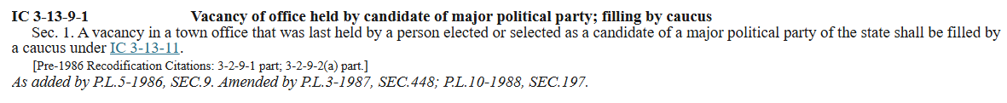
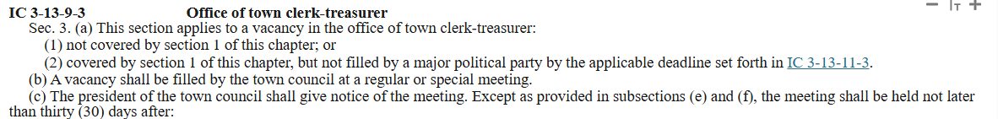
Filling Town Office Vacancies
Rules for filling town office vacancies (IC 3-13-9)
Don’t skip over IC 3-13-9-1!
  This section mandates that if the elected official was a D or R, then the D or R party gets first pass at filling the vacancy
Example: IC 3-13-9-3 tells us that this section (meaning IC 3-13-9-3) does not apply if the vacancy is covered by IC 3-13-9-1 (meaning the candidate was a D or R) OR is covered by section 1 but the party has not filled the position within their 30-day time frame to do so

Slide 27
Filling Town Office Vacancies
If elected official creating vacancy is a D or R…
  Clerk sends notice of vacancy to county chair & chair fills elected office vacancy by a caucus not later than 30-days from the date the vacancy occurred
    NOTE: If fewer than two precinct committeemen are eligible to participate in the caucus, the chair makes a direct appointment
  Paperwork is filed with the county clerk’s office not later than noon, 5 days after filling the vacancy
If elected official creating vacancy is a D or R BUT the chair fails within 30-days…
  Town Council may fill the open position using the procedures found in IC 3-13-9-2 (town judge); IC 3-13-9-3 (town clerk-treasurer); IC 3-13-9-4 (town council)
If elected official is an Independent, Libertarian, or other minor party…
  Town council must fill the open position using procedures found in IC 3-13-9-2 (town judge); IC 3-13-9-3 (town clerk-treasurer); IC 3-13-9-4 (town council)
IC 3-13-9-1 | IC 3-13-9-2 | IC 3-13-9-3 | IC 3-13-9-4 | IC 3-13-11 | IC 5-8-6-3.5 | IC 5-8-5 | IC 5-8-6-6

Slide 28

Image Created by Freepik
Campaign Finance
Campaign Finance Forms
When to Open Committee
Reporting Deadlines

Slide 29
Campaign Finance Forms & Opening a Committee
CFA FORMS
CFA-1: Statement of Organization for Candidate’s Committee
Used to establish committee to raise/spend funds to run for office
CFA-4: Report of Receipts & Expenditures
Used to report financial information at specific times during the year
CFA-11: Supplemental Report
Used during specific windows of time before each election when a candidate raises $1000 or more from a single source within 48-hours of accepting it
When do you open a candidate’s committee - how much does the elected office pay in a calendar year?
  Less than $5,000 per calendar year, file CFA-1 when:
    Candidate raises or spends more than $500 ($500.01+) toward running for office
      CFA-1 must be filed no later than noon, ten days after raising/spending the $500
  More than $5,000 per calendar year, file CFA-1 when:
    No later than noon, ten days after candidate raises or spends more than $100 ($100.01+) toward running for office or assumes an office vacancy OR
    No later than noon, seven days after candidate filing deadlines passes, whichever comes first
      This is a requirement of all candidates running for an office meeting this salary threshold, even if the candidate does not intend to raise or spend any money

Slide 30
Reporting Deadlines
Once a candidate opens a committee, the committee MUST submit campaign finance reports until the committee is closed.
  If candidate is on the ballot in 2026:
    2026 Pre-Primary Report (deadline passed)
    2026 Pre-Election Report, due October 16, 2026 (NOON)
      CFA-11 (“48-hour” report) may be required between October 10 and November 1, 2026
    2026 Annual Report, due January 20, 2027 (NOON)
  If candidate is NOT on the ballot in 2026:
    2026 Annual Report, due January 20, 2027 (NOON)
NEW! ALL elected officials must have an active campaign finance committee until such a time they no longer hold office and are not a candidate.

Slide 31
Questions?
Indiana Election Division
200 West Washington Street, Room E204
Indianapolis, Indiana 46204
www.in.gov/sos/elections | campaignfinance.in.gov
317-232-3939 | elections@iec.in.gov

