Slide 1
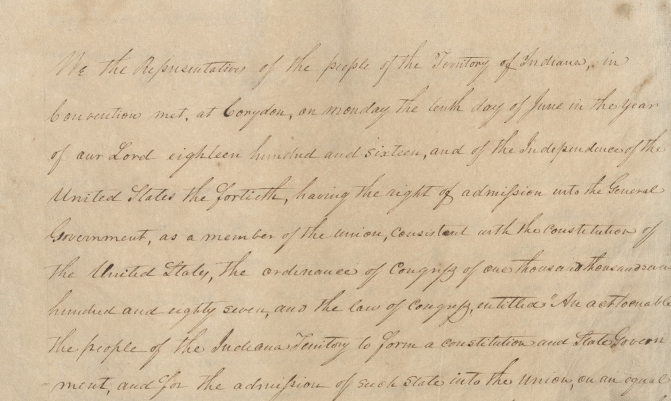

IED Presentation – December 2023

Slide 2

S. Chandler Lighty
Executive Director
Indiana Archives & Records Administration
(317) 473-9670
clighty@iara.in.gov
www.in.gov/iara
402 W Washington St.
W 472, Indianapolis, IN 46204

Slide 3
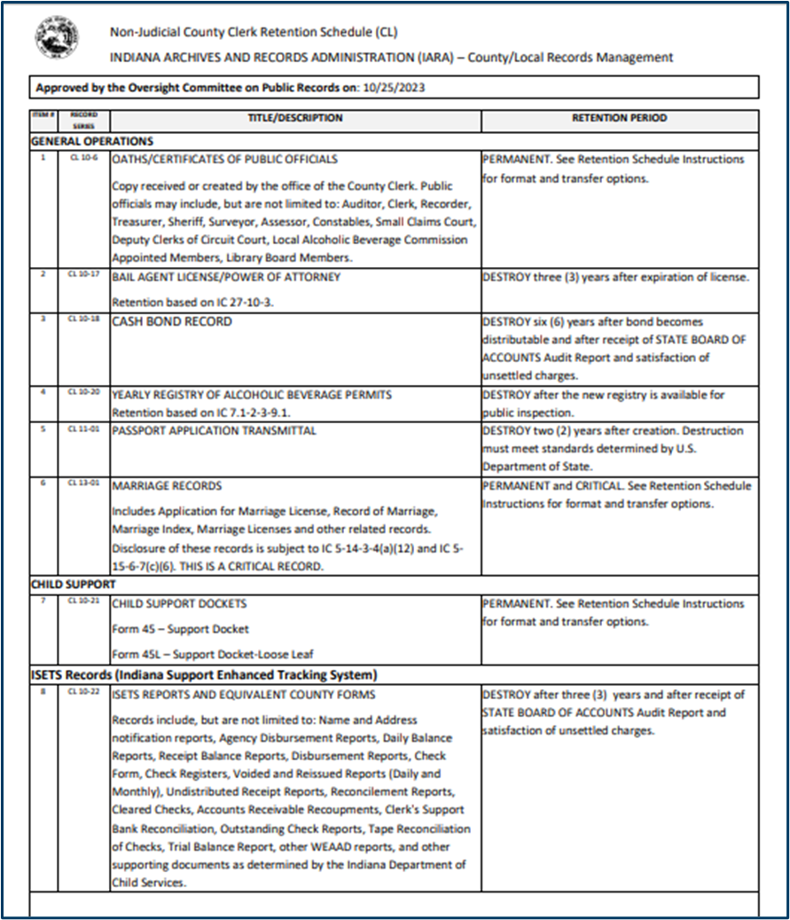
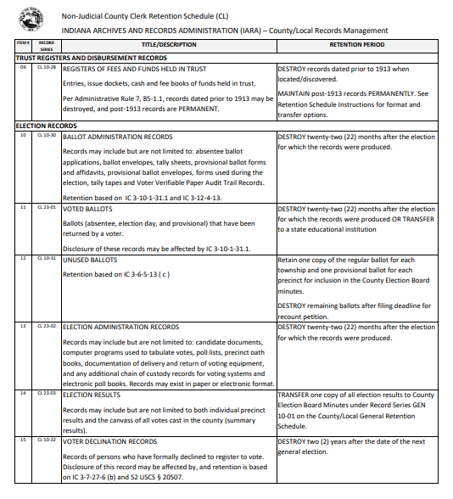
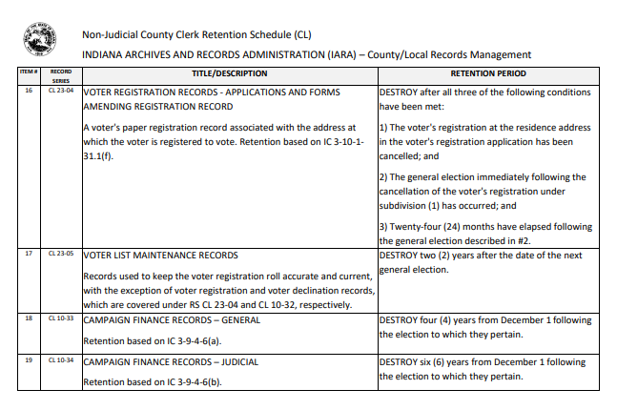
Updated CL Retention Schedule
(3 pages)
Changes APPROVED at OCPR in OCTOBER!
A taskforce of county clerks, deputy clerks, IED, and IARA staff met monthly from March to Sept. to review the CL schedule. This is now the current schedule, see next slide for updates review.

Slide 4
Office-Specific: Non-Judicial County Clerks (CL)
19 record series
(previous schedule had 34 record series)
5 brand new record series
(all a part of Election Records section)
12 amended record series
(updated title or description or retention)
20 deactivated record series
Includes Record Series Update Overview explaining the changes approved at October’s OCPR meeting

Slide 5
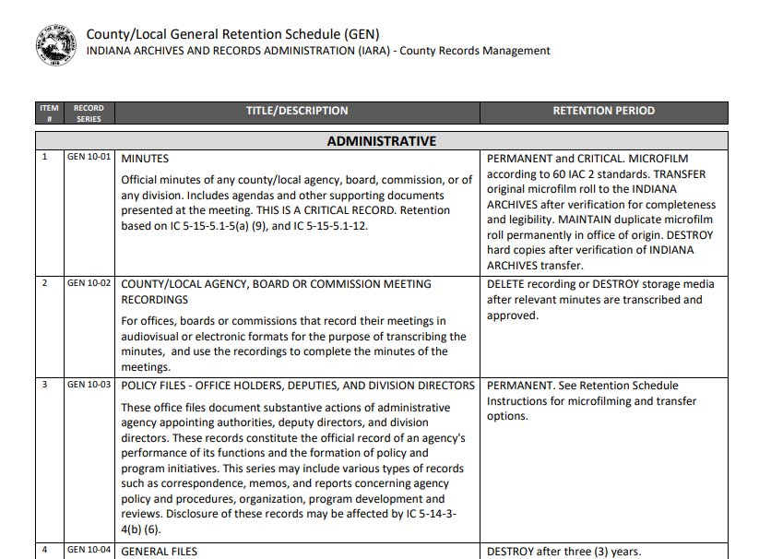
County/Local General (GEN) Retention Schedule
This Retention Schedule is divided into five (5) categories:
1. Administrative
2. Accounting and Finance
3. Personnel
4. Publications and Reports
5. Audio, Video and General Media
GEN schedule is applicable to ALL offices in addition to their office specific Retention Schedule.
Record Series Update Overview explains changes to the schedule.
Changes APPROVED at OCPR in APRIL!

Slide 6







Electronic Records Program
Creates guidelines and policies for state and local governments to aid in effective electronic records management.
Addresses the creation, maintenance, use, and disposition of electronic records over the course of their lifecycle. ​
Provides best practices on preservation and access, media and formats, trustworthiness, and storage of electronic records.
Manages the transfer of State archival electronic records
Contact: erecords@iara.in.gov

Slide 7
Brand new Critical Records Program
Provides support through guidance and policies developed to assist state and local governments in making defensible and sustainable decisions about how they create, maintain, access, and preserve their records designated as CRITICAL on an Oversight Committee on Public Records approved retention schedule. This program was developed in accordance with IC 5-15-5.1-12.
Critical Records are defined in IC 5-15-5.1 as records that are necessary to:
    Resume or continue governmental operations;
    Reestablish the legal and financial responsibilities of government in Indiana; or
    Protect and fulfill governmental obligations to the citizens of Indiana.
If you have questions about this program, please reach out to rmd@iara.in.gov if you are with the State, and to cty@iara.in.gov if you are with a County/Local office. See the webpage, Critical Records Program for more information.

Slide 8

Questions about the CL schedule or RIM at the county/local level?
Contact IARA’s
Records & Information Management
division:
Amy Christiansen
Records Management Liaison
(812) 929-3882 (Please leave a VM)
cty@iara.in.gov

Slide 9

Thank You!
Visit IARA’s website: in.gov/iara for more information

