Slide 1
ELECTION SECURITY
Indiana Department of Homeland Security
December 2025

Slide 2





INDIANA DEPARTMENT OF HOMELAND SECURITY

Slide 3

IDHS ROLE IN ELECTION SECURITY
Develop guidance
Ex: 2024 Presidential Election and Polling Place Security Guidance
Coordinate and respond to natural, man-made or technological incidents during election process
Remember: every county should develop their own emergency plan that is reviewed, exercised and tested prior to election day

Slide 4
PRE-ELECTION PREPAREDNESS

Slide 5
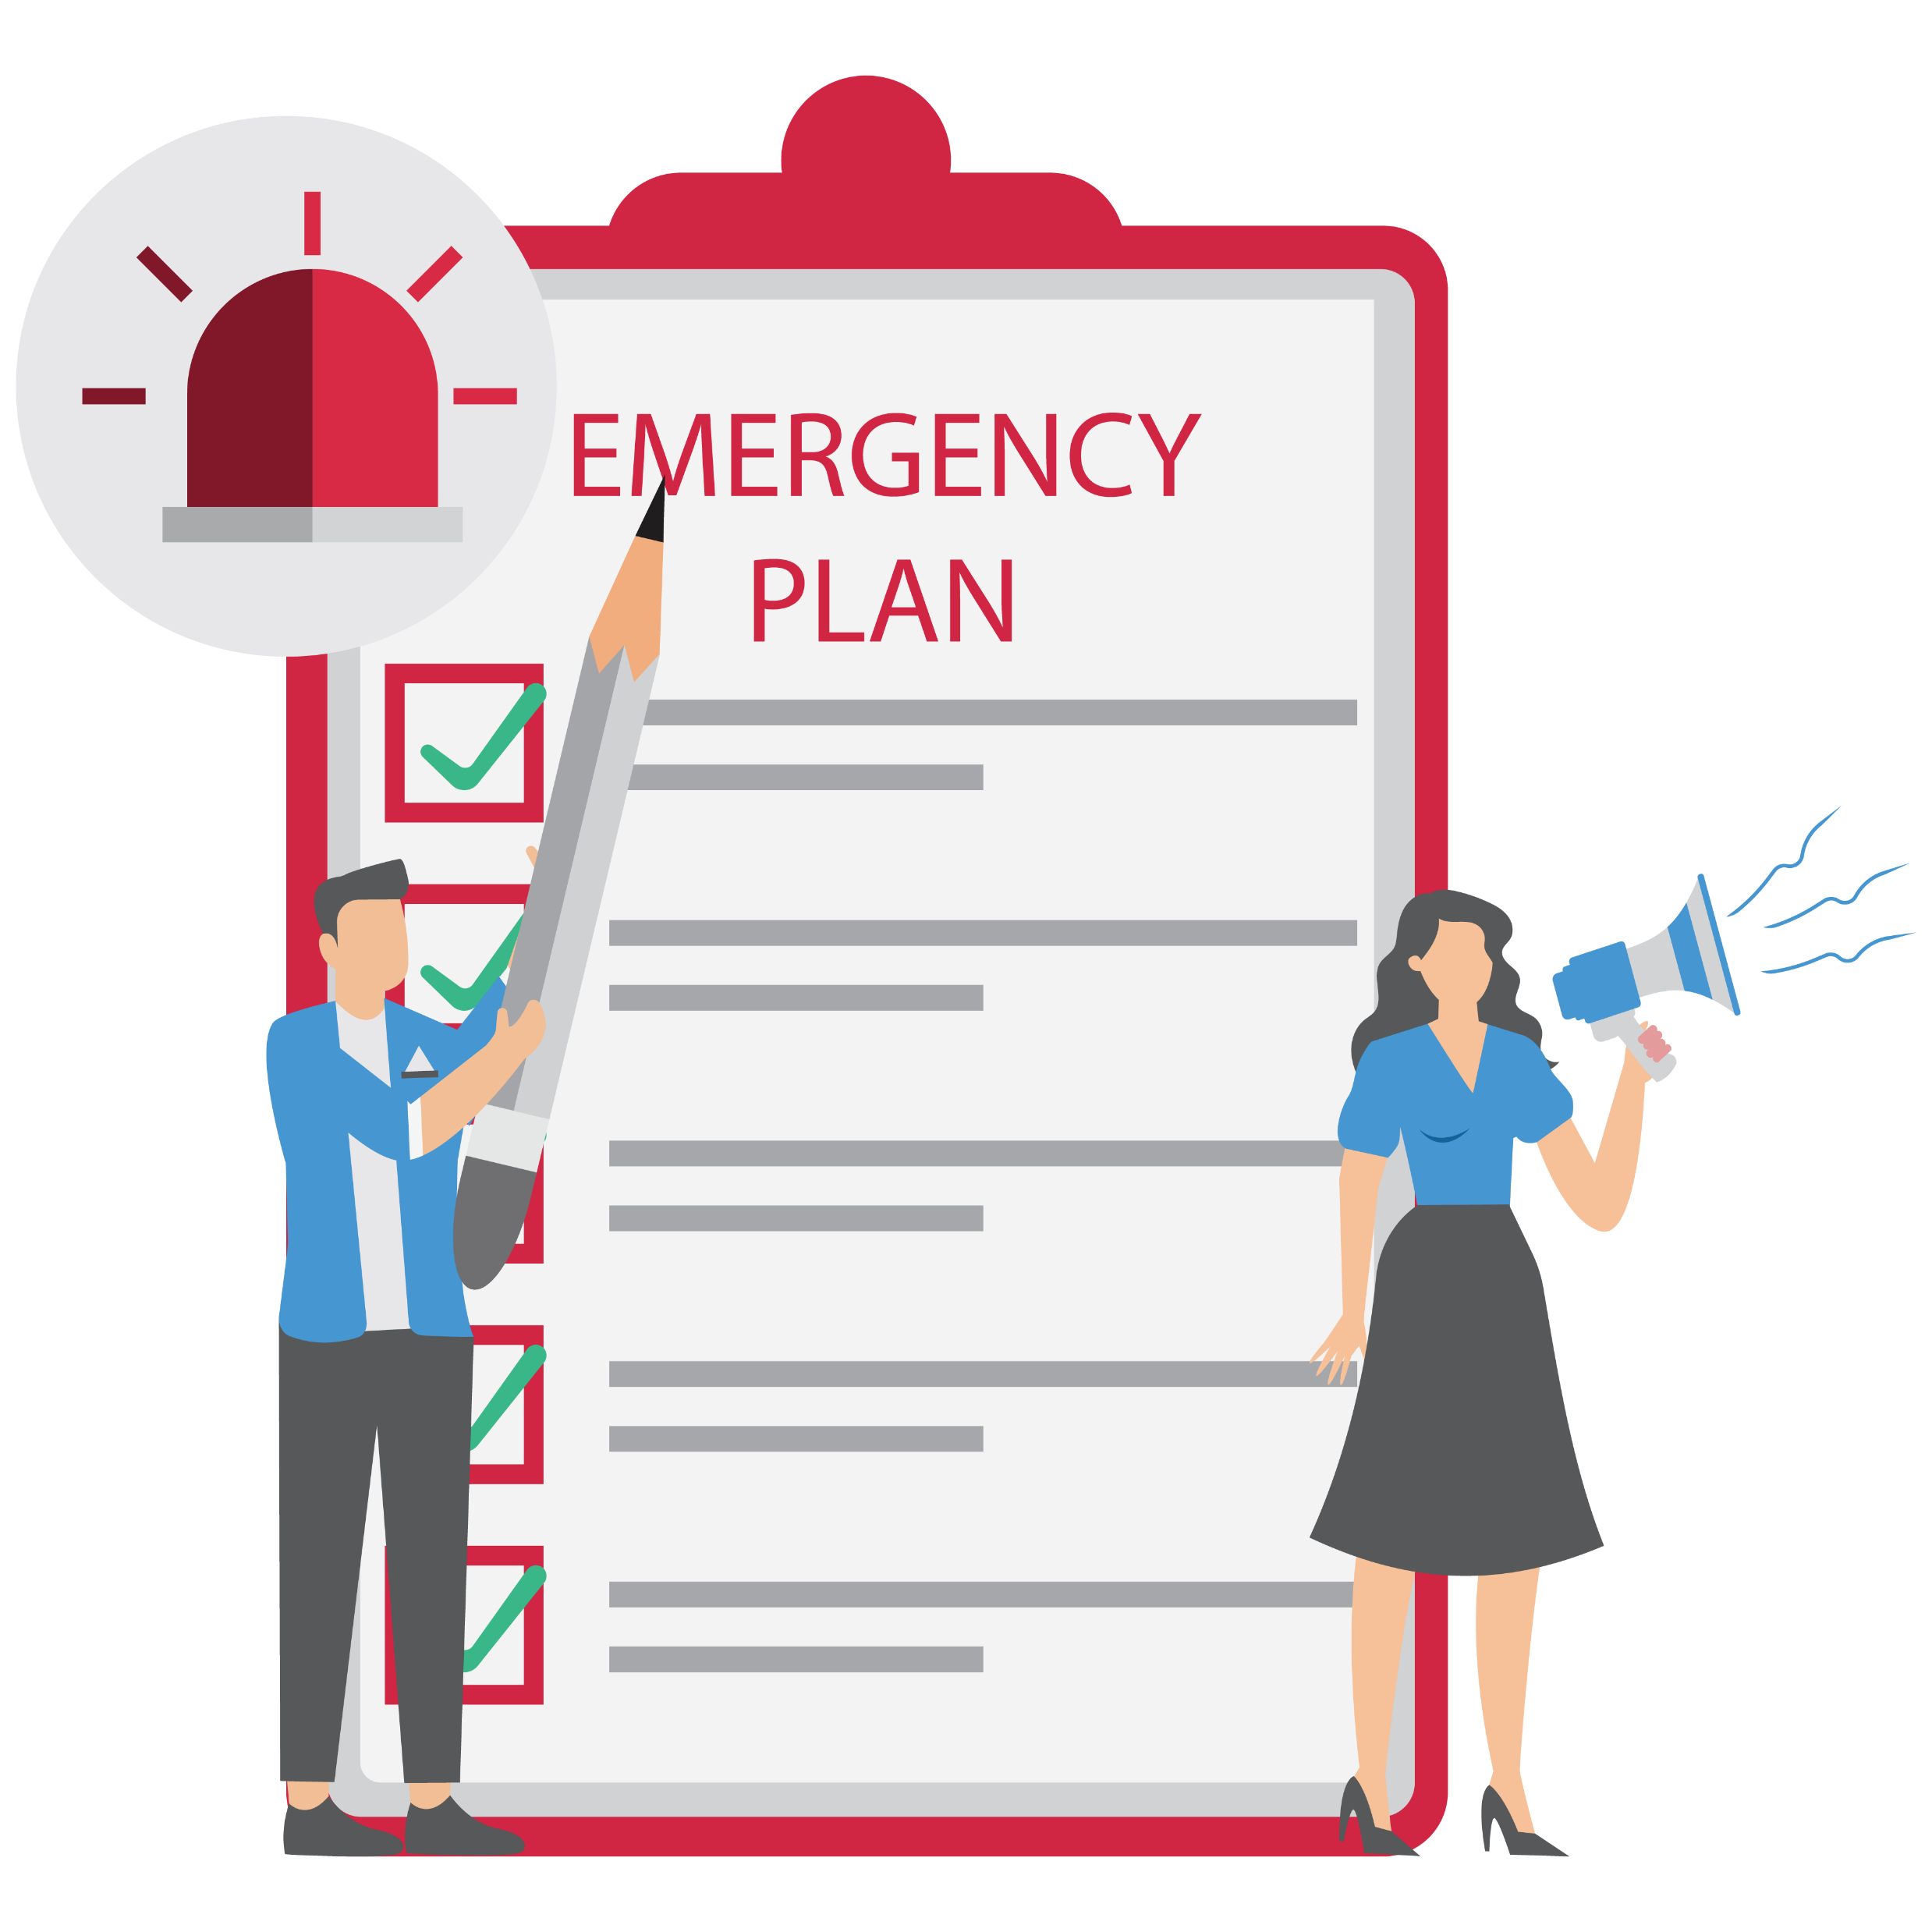
EMERGENCY PLANNING
The county Emergency Management Agency (EMA) is responsible for developing all-hazards emergency preparedness and response efforts.
Months leading up to elections, county election boards should meet with EMA to review:
State and local statutes and regulations regarding election processes
Emergency procedures
Implementation of appropriate training measures for poll workers

Slide 6
CONTINGENCY PLANNING
Important things to consider in the event of an incident interfering with election processes:
Plan for relocating polling places
Assign IT staff
Chain of command
Emergency supplies
List of emergency contact information
Identify emergency communications methods
Develop a plan to secure or relocate voting equipment and paper ballots
Designate an alternate meeting place
Develop an action plan for every possible hazard/threat
Develop a communications network

Slide 7
SITE SECURITY AND ACCESS
Personnel vetting: Ensure only allowable people are inside polling locations.
Evacuation planning: Polling officials must ensure each site has emergency preparedness and/or evacuation plans. Plans should include:
How poll workers/voters evacuate
How to accommodate individuals with disabilities
Alternate meeting spots
Methods for accounting personnel
Keeping aisles clear

Slide 8

SITE SECURITY AND ACCESS
Physical security: Many polling locations include government buildings, faith-based organizations and schools, which often lower their security posture to allow for voting.
The following physical security measures in place will mitigate the risk to polling place sites:
Natural surveillance
Access control
Territoriality
Separate points of entry
Staff awareness

Slide 9
CYBERSECURITY
Recommended safeguards and resilience measures against cyberattacks:
Protect voter registration
Security training
Have an intrusion detection/prevention system in place
Limit authorized personnel access
Track database changes
Conduct threat and vulnerability tests regularly
Ensure security measures meet federal standards
Multi-factor authentication
Encrypt electronic pollbooks
Independently test voting equipment using industry-accepted protocols

Slide 10
ELECTION DAY

Slide 11
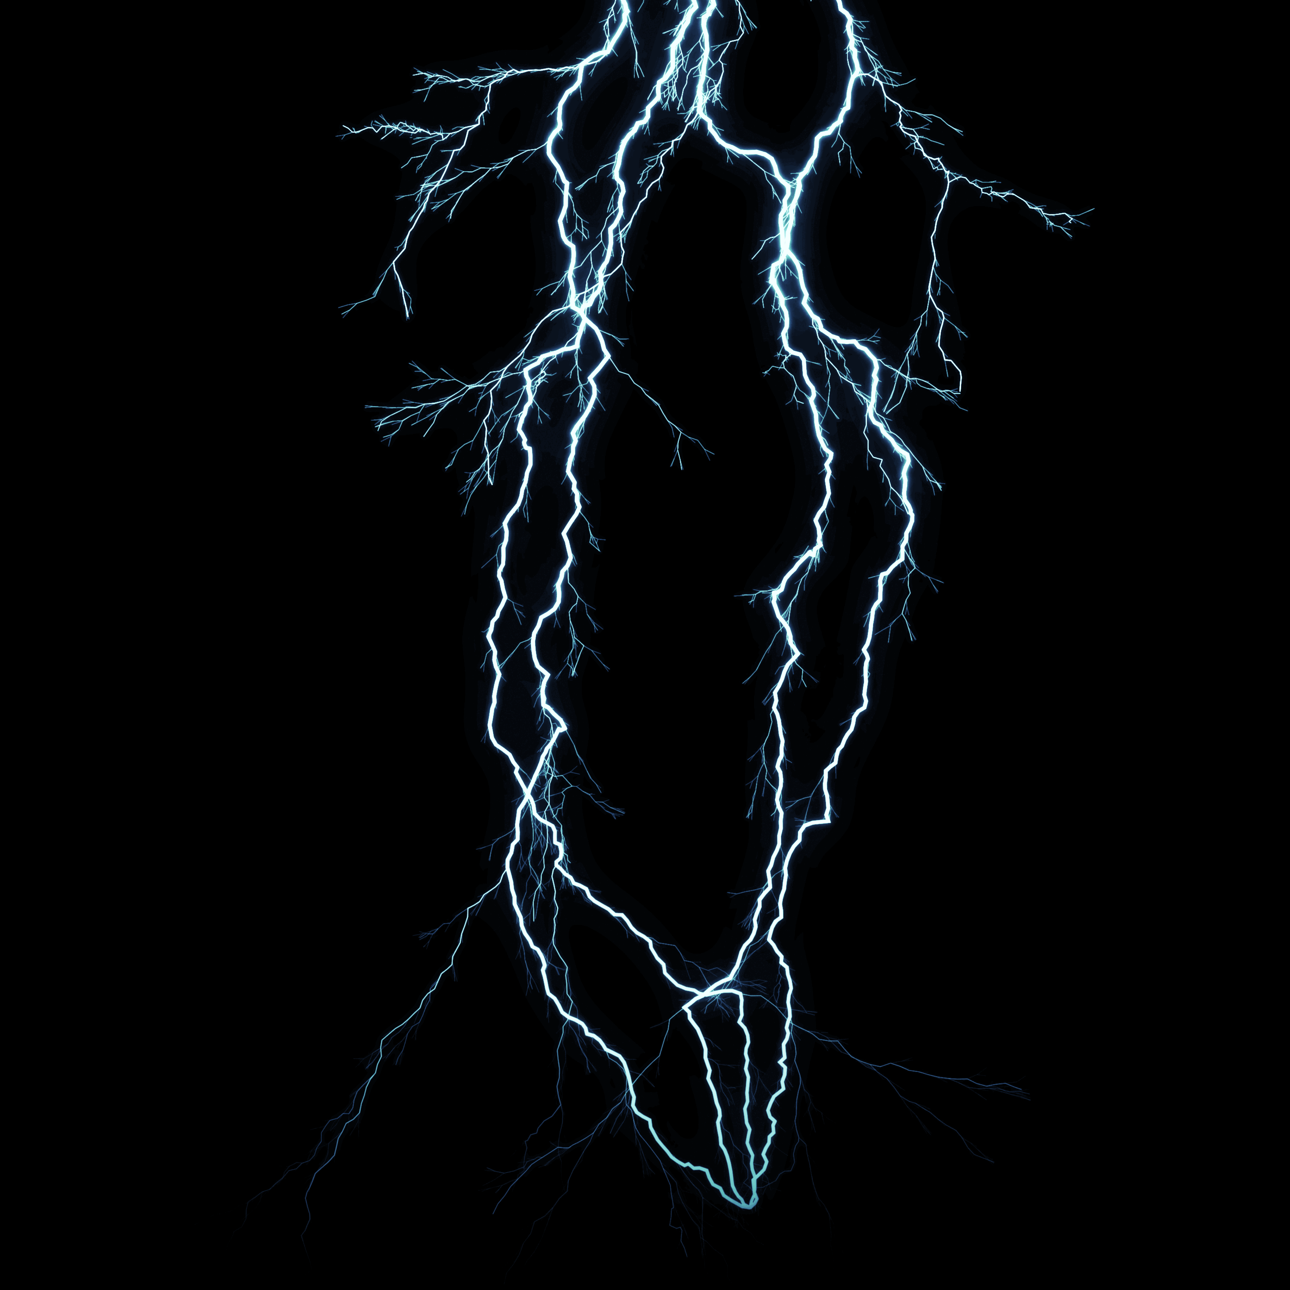
NATURAL HAZARDS
Due to the time of year elections are held, severe weather, winter weather, flooding and earthquakes should all be considered.
Severe weather
Multiple ways to receive alerts: weather radios, wireless emergency alerts and outdoor warning sirens.
Suggested actions: Depending on the severity of the alert, monitor official weather sources, move staff and voters to designated shelter area and secure the voting systems.
Flooding
Flash floods occur mainly along streams – polling places can determine its risk based on proximity to bodies of water and other low-lying areas.
Suggested actions: Advise staff of weather conditions that are approaching and begin evacuation procedures if necessary; secure voting systems, ballots, poll lists and other election documents.

Slide 12
NATURAL HAZARDS
Winter weather
Suggested actions:
Have a plan for clearing snow and ice from primary walkways.
Indoor floor surfaces should be kept dry, and waiting lines should be redirected indoors to the extent possible.
Earthquake
Rare, but can happen in Indiana.
Suggested actions:
Drop, cover and hold.
When shaking stops, evacuate and begin a basic damage assessment of the facility.
Secure voting systems, ballots, poll lists and other election documents to the extent possible.
Assign staff to stay with injured individuals.
Determine next steps based on present danger, weather and other factors, as well as communicate with county/state election board.

Slide 13
HUMAN-CAUSED THREATS
Poll workers may be the first line of response to incidents disrupting election operations, and should be provided with:
De-escalation techniques
Clear reporting procedures
Emergency contact information
Insider threat:
Individual or group who uses their authorized access or special knowledge to cause harm to an organization or entity.
Potential indicators:
Attempts to alter or destroy ballots
Turning off security cameras
Unnecessarily copying material
Remotely accessing computer material at odd times
Disregarding computer policies
Intimidating/threatening staff

Slide 14
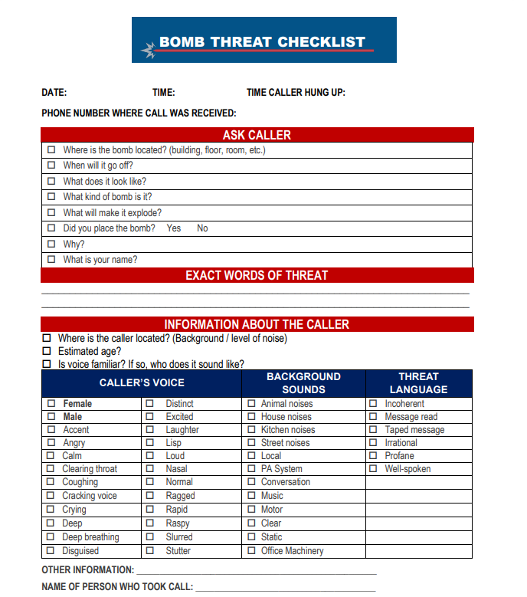
HUMAN-CAUSED THREATS
Bomb threat:
Written, phone, suspicious package or object.
Suggested actions:
Take all threats seriously
Report to Precinct Inspector to determine next steps
Notify law enforcement
Stay away from suspicious object
Evacuate in coordination with law enforcement

Slide 15
HUMAN-CAUSED THREATS
Active shooter:
Active shooter situations are often over within 10-15 minutes.
Suggested actions:
Take note of the two (2) nearest exits of the facility.
Utilize Run, Hide, Fight protocol.
Attempt to evacuate the area
If you are in an office, stay there and secure the door.
If you are in a hallway, get into a room and secure the door.
As a last resort, attempt to take the active shooter down.
Call 911 and notify the Secretary of State (SOS) and Indiana Intelligence Fusion Center (IIFC).

Slide 16

HUMAN-CAUSED THREATS
Cyberattack:
The county election board is responsible for establishing access protocols for voting systems and electronic poll books.
Resources:
Indiana Election Division: (317) 232-3939 or Elections@IN.gov
Indiana Intelligence Fusion Center (IIFC): (866) 400-IIFC (4432) or IIFC@IIFC.IN.gov
Indiana Office of Technology (IOT): (317) 232-3172
Worldwide terrorism event:
All elections should continue and remain functional, unless federal or state officials state otherwise.

Slide 17

TECHNOLOGICAL HAZARDS
Fire
If a fire or fire alarm disrupts election activities, suggested actions include:
Call 911
Evacuate as necessary
Account for all personnel
Secure voting systems and ballots
Utility disruption
Prior to election day, remind utility operators of critical nature of services for the day
Request delay of any maintenance or scheduled work
Suggested actions:
Purchase/lease supplies from state’s vendors (ex: generators)
Assist voters and staff in the area
Use emergency lighting
Turn off voting equipment
Long-term power outages may affect voting machines

Slide 18

TECHNOLOGICAL HAZARDS
Hazardous material incident: the accidental or intentional release of toxic chemicals or hazardous materials, as well as other emergencies where air quality is threatened.
Suggested actions:
Inside facility – precinct inspector should determine, along with facility manager, if it is safe to shelter in place or evacuate. Call 911 and secure voting systems and ballots.
Outside facility – shelter in place as per orders from emergency responders or local officials, to include:
Close all doors and windows
Turn off all heating and air
Seal any gaps
Turn off exhaust fans
Hold wet handkerchiefs or cloths over nose/mouth
Secure voting systems and ballots

Slide 19
FINAL THOUGHTS

Slide 20
CONNECT, PLAN, TRAIN AND REPORT
Connect – develop relationships in your community with first responders and emergency management teams to increase vigilance and help with response time should something happen.
Plan – take the time to plan for these events now.
Train – provide election workers with training resources and exercise your plans.
Report – provide employees and volunteers with training resources and plans often to know that plans are effective.
Disasters begin and end local: election administrators and poll workers will be first line of defense and should be prepared to handle any incident that occurs.
For more information – visit CISA.GOV

Slide 21
Contact Information
CISA
central@cisa.dhs.gov
Indiana Election Commission
elections@iec.in.gov
IDHS
317-232-2222

Slide 22
The End

