Slide 1
2023 Election Conference Jack Sanders, Baker Tilly Project Manager
Absentee Ballot Security Envelope Redesign

Slide 2
What is this Project?
Absentee Envelope Standardization Overview
At this time, there is not a standard mail design being used by counties for outgoing and return absentee mail
Why create a standardized absentee mail design?
Increase voter recognition of election mail
Easy identification of election mail for voters, mail carriers, and USPS processing facilities
Reduces risk voters may experience for mail delivery issues
Which Absentee Envelopes have been redesigned?
ABS-6 (Domestic Return Envelope)
ABS-8 (Domestic Outgoing Envelope)
ABS-10A (UOCAVA Outgoing Envelope)
ABS-10B (UOCAVA Envelope for Office Use)
ABS-16 (UOCAVA Return Envelope)
Counties can refer to the Absentee Envelope Style Guide, recorded training session, and training documentation with design guidelines and configuration options.

Slide 3
County Resources and Training Materials
Project Materials
ABS Envelope County Trainings conducted 10/16 & 10/18
Meeting materials available in SVRS County Portal:
10/18 Training Recording: Meeting Recording Link
10/18 Training Slide Deck: Training Slide Deck Link
Updated ABS Envelope Style Guide: ABS Envelope Style Guide Link
Camera-Ready Files Information Gathering Survey
Survey Link: https://www.surveymonkey.com/r/TJ5GW3M
Survey Due Date: Thursday, December 21st

Slide 4
Template Development Update
Timeline Overview
Envelope design templates are undergoing finalization with updated revision numbers
Designs will be submitted for Forms Management review and approval
Counties will receive official forms order from IED in the near future
Counties may begin coordinating with print vendors and purchasing standardized stock

Slide 5
Next Steps for Counties
Next Steps
Identify desired customizations & mail types by referring to the Style Guide and completing the Camera-Ready Files Information Gathering survey
Complete the survey by Thursday, December 21st (47 of 92 counties have responded)
The Jackson Group can develop camera-ready files at no cost to counties; Counties may also choose to use their own design vendor
Base templates have received preliminary approval from Mail Design Analysts
Counties should work with their print vendor to secure USPS MDA Approval after camera-ready files
Coordinate purchase of stock and printing services with desired print vendor

Slide 6
Questions?

Slide 7
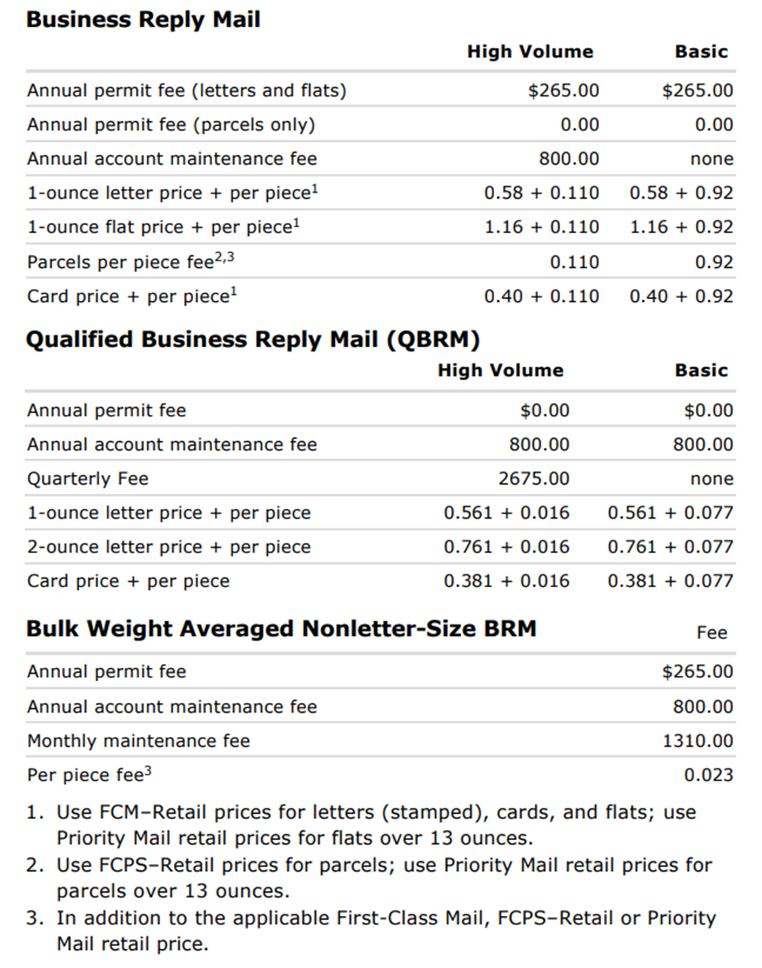
Appendix: Purpose of the Survey
Survey Review
The Information Gathering Survey for Camera-Ready Files will be used to gather county mailing information and preferences regarding the use of:
Business Reply Mail
Intelligent Mail Barcodes (IMB)
Other optional information that may be present on the envelopes
Once survey responses have been collected, the Election Division will work with The Jackson Group to streamline the file creation process and provide individual print-ready templates for any counties.
Counties can choose to work with The Jackson Group or their desired print vendor to produce envelopes that will be utilized to send absentee materials during the election.
Election Mail Toolkit – All resources Election Mail
Voters using Prepaid Postage Overview:
BRM Quick Service Guide
Basic Qualified Business Reply Mail (QBRM)—Annual account maintenance fee is required. Per piece charge in addition to QBRM First-Class Mail postage. Paid through an advance deposit account. Used only on barcoded automation-compatible cards and letter-size mail weighing up to 3.5 ounces if design is approved for QBRM by USPS before distribution (505.1.3). A unique ZIP+4 code is assigned by USPS for each price category of QBRM to be returned (one for card-price pieces, one for letter-size pieces weighing up to and including 3.5 ounces).Best suited if the QBRM customer’s return volume is approximately 613 letters or more, or 610 cards or more, expected annually
High-Volume QBRM—Annual account maintenance fee, and a separate quarterly fee is required. Mailers can pay a quarterly fee for any consecutive 3-calendar-month period. Per piece charge in addition to QBRM First-Class Mail postage. Paid through an advanced deposit account. Best suited if the QBRM customer’s return volume is approximately 43,043 pieces or more quarterly or 172,174 pieces or more annually

Slide 8
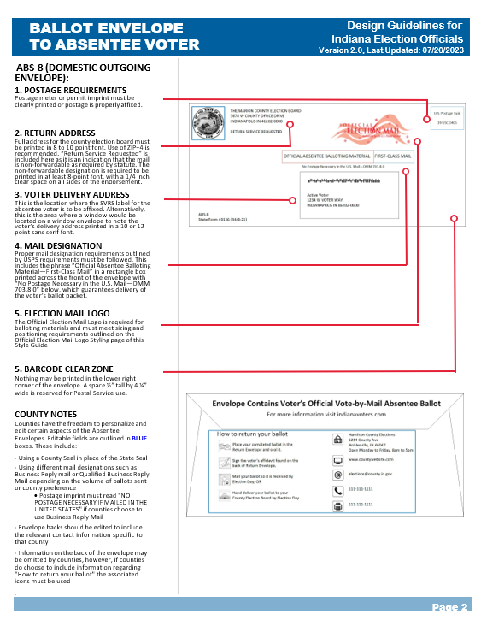
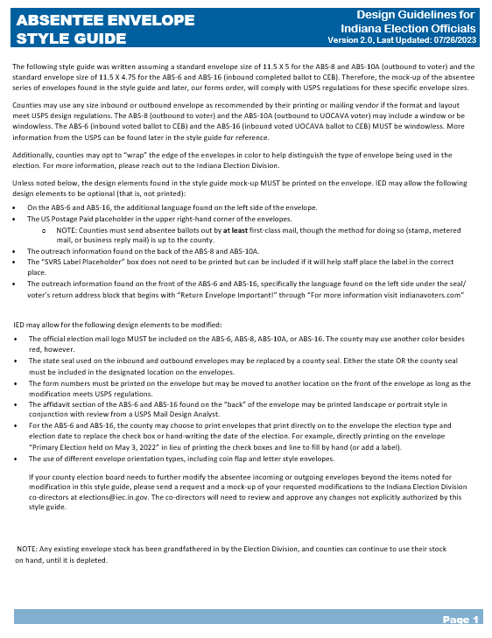
Appendix: Absentee Envelope Style Guide Overview
Style Guide Review
The Style Guide provides direction to counties regarding the ABS-6, 8, 10A, 10B and 16, on:
Specific Envelope Features
Size of Envelopes
Postage Requirements
Return Address
Voter Delivery Address
Mail Designation
Election Mail Logo
Par Avion
Barcode Clear Zone
County Preference Design Elements
The complete Style Guide can be found on the County Portal here.
Notes:
Any existing envelope stock has been grandfathered in by the Election Division, and counties can continue to use their stock on hand, until it is depleted. IED shared the decision on this will be stated in the forms order the Division will approve once the forms changes are complete.

Slide 9
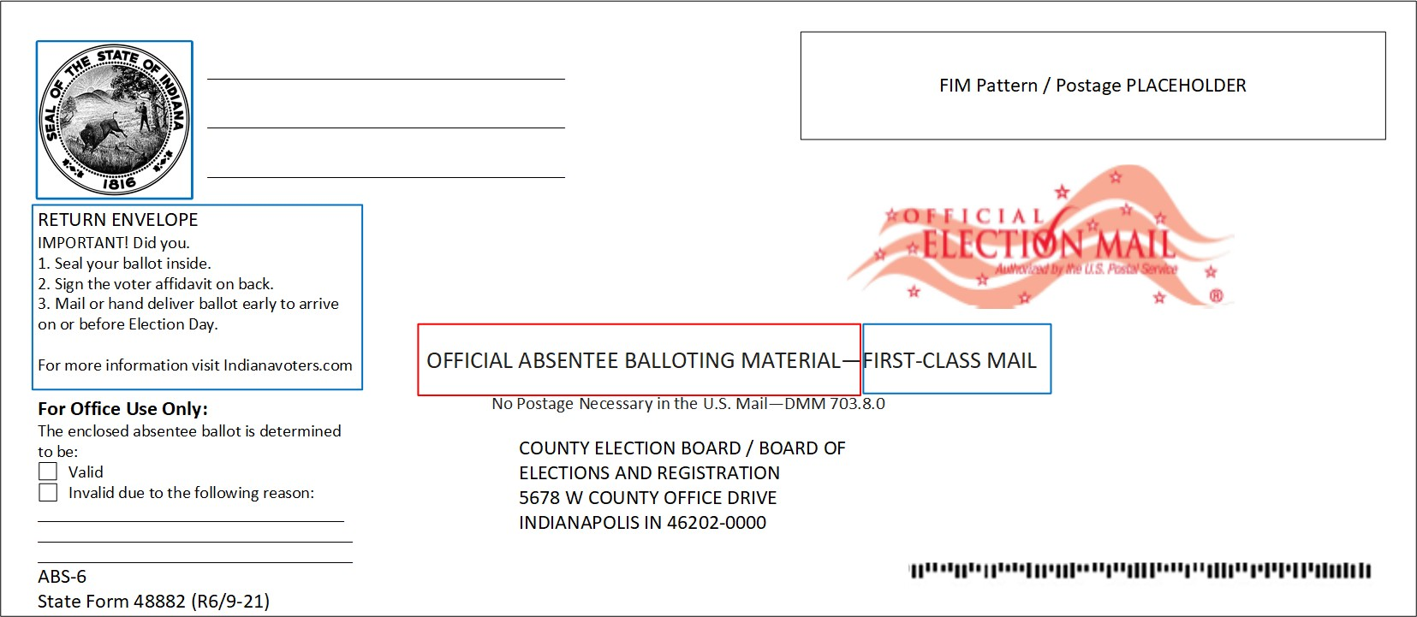
DRAFT ABS-6 County Customizations (Domestic Return Envelope)
Review of Updated Envelope Templates
1
3
2
Counties have the freedom to personalize and edit aspects of the Absentee Envelopes outlined in BLUE boxes. These include:
Using the County Seal or the State Seal
Using different mail designations such as Business Reply mail or Qualified Business Reply Mail depending on the volume of ballots sent or county preference
Postage imprint must read "NO POSTAGE NECESSARY IF MAILED IN THE UNITED STATES" if counties choose to use Business Reply Mail
Return Envelope information on the front of the envelope

Slide 10
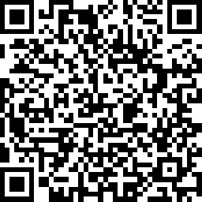
Camera-Ready Files Information Gathering Survey
Link: https://www.surveymonkey.com/r/TJ5GW3M
Survey Web Link and QR Code

