Slide 1










Differences Between Indiana
& Other states
Valerie Warycha, Republican Co-Counsel
Indiana Election Administrator’s Conference December 13, 2023

Slide 2




How do I get a question on the ballot?

Slide 3



Indiana Ballot Question Laws
Referendum
Initiative
An election that allows the voters to say “yes” or “no” to a public question on the ballot.
A referendum can only be put on the ballot if authorized by a state law.
A county or town election board cannot print any referendum on the ballot unless the state legislature has already passed a law to permit the referendum to be on the ballot. Example: School Tax Levy or Safety Referendum
(IC 3-10-9-5 | IC 36-1-3-8(a)(12))
A law enacted directly by the voters, without being passed by the state legislature or approved by the governor.
Indiana does not allow initiatives
The Indiana Constitution requires all laws be passed by the state legislature. Article 4, Section 1 of the State Constitution reads in part: “No law shall be enacted, except by bill.”
The State Constitution would have to be amended before the voters could pass any initiative.

Slide 4




How do I throw
the dog catcher
out of office?
There are dogs
running lose everywhere!
Recalls
What is a “recall”?
A recall means a special election held to decide if an elected official should be removed from office before the date the official’s term is scheduled to end.
Does Indiana allow elected officials to be removed by recall vote?
No. The Indiana Constitution permits state and local officials to be removed only “in the manner provided by law.” (Article 6, Section 8)
There is currently no Indiana law to permit recall elections, although some other states do allow recall elections.

Slide 5






Runoffs
Usually used if no candidate in the first round receives a majority vote (more than 50%)
2 candidates who received the most votes in the first round or received a certain portion are the candidates in the second round of voting.
Not used in Indiana.

Slide 6
Party Registration/Open Primary
There is no Party Registration in Indiana!
A voter is eligible to vote in an Indiana primary if they are a registered voter.
Voters chose a D or R ballot based off the majority of candidates they voted for in the last general election or intend to vote for at the next general election. (IC 3-10-1-6)
Open Primary
Voter of any affiliation may vote in the primary.
Closed Primary
Voter must be registered as a member of the party to vote in the primary.

Slide 7
Voter Registration
No Voter Registration
Same Day Registration
“Felon” Registration
A person may register to vote once no longer incarcerated following conviction of a crime, even if on probation, parole, home detention, or community corrections.
North Dakota is the only state that does not requires some form of voter registration.
Indiana requires all voters to register to vote.
There is no same day registration in Indiana.
Indiana requires voters to register 29 days prior to election day.

Slide 8
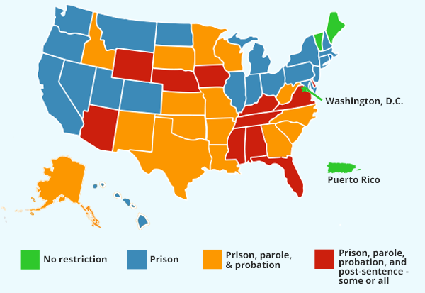
Voter Registrations & Convictions
Indiana law only prohibits those who have been convicted of a crime and are currently serving their sentence from voting.
If awaiting trial, can vote.
Graphic from standupamerica.com

Slide 9





Vote by mail
Allow all mail elections
California, Colorado, Hawaii, Nevada, Oregon, Utah, Vermont, and Washington
Indiana allows voting by mail if you meet one of the reasons needed to vote by mail such as out of town on election day or over 65.
County Option
Nebraska and North Dakota
Allowed for Small Elections
Alaska, Arizona, Florida, Kansas, Maryland, Missouri,
Montana, New Mexico, and Wyoming
For certain small jurisdictions
Idaho, Minnesota, New Jersey, and New Mexico

Slide 10


Rank Choice Voting
Voters rank the candidates for a given office by preference on their ballots.
If a candidate wins an outright majority of first-preference votes (i.e., 50 percent plus one), he or she will be declared the winner.
If, on the other hand, no candidates win an outright majority of first-preference votes, the candidate with the fewest first-preference votes is eliminated.
All first-preference votes for the failed candidate are eliminated, second-preference choices on these ballots are then elevated to first-preference.
A new tally is conducted to determine whether any candidate has won an outright majority of the adjusted voters.
The process is repeated until a candidate wins a majority of votes cast.

Slide 11







Deceased Voters
A voter who votes early and dies before election day will not have their ballot counted in Indiana.
Indiana Constitution says must be a citizen to vote.
Dead people are not citizens and therefore, cannot vote.
A vote cast by a deceased voter does not invalidate an election
(IC 3-11.5-4-17)

Slide 12
Drop Boxes
Drop boxes that are not under direct control of the county election board are prohibited by Indiana law.
If there is a drop box for another office (ex property tax payment deposit box) in the courthouse, you must put a note saying, “Do not deposit a voted absentee ballot into this box or container. The absentee ballot will not be counted.”
IC 3-11-10-24 (f) and (g)

Slide 13


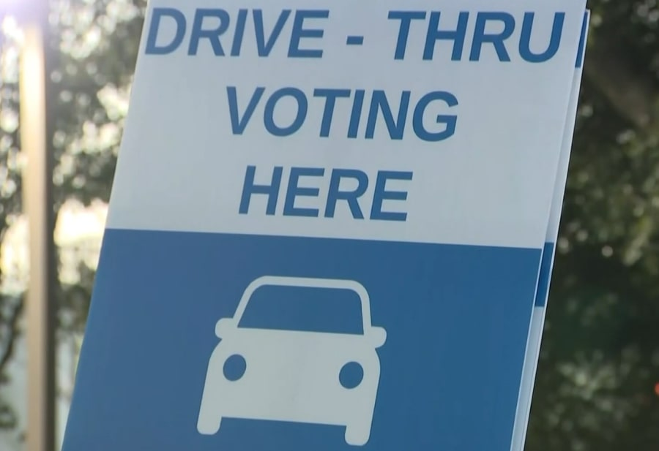


Drive-Thru / Curbside Voting
Drive-thru or curbside voting is not permitted in Indiana.
All voting locations must be accessible.
All voting procedures must be authorized by Indiana law.
There is no HOME RULE in election law (IC 36-1-3-8(12))

Slide 14





Pre-Scanning Ballots
NO equipment has been certified by the Indiana Election Commission to pre-scan.
Indiana Election Commission Advisory Opinion 2022-8 Advises each county election board that until the Indiana General Assembly amends IC 3-11.5-4-6 or otherwise amends Title 3 of the Indiana Code to authorize the scanning of optical scan absentee ballot cards before election day, which is prohibited by IC 3-11.5-4-6, optical scan absentee ballot cards shall not be scanned before election day.
  .

Slide 15




Private Funding
CANNOT accept private donations to prepare, administer, or conduct elections or to pay employee staff or temporary employees .
MAY receive funds from the state or federal government to prepare, administer, or conduct an election.
IC 3-5-3-1

Slide 16








Thank you

