Slide 1
In partnership with
OmniBallot Accessible Absentee Balloting Solution
Presentation to the State of Indiana
Democracy Live Presentation to the State of Rhode Island
September 27th, 2023

Slide 2
OmniBallot - Deployed in over 5,000 elections
First in nation to deploy remote electronic balloting (2008)
Deployed in 2,500 jurisdictions across 34 states
Selected by U.S. Department of Defense and U.S. State Department
Serving over 20 million voters since 2008

Slide 3
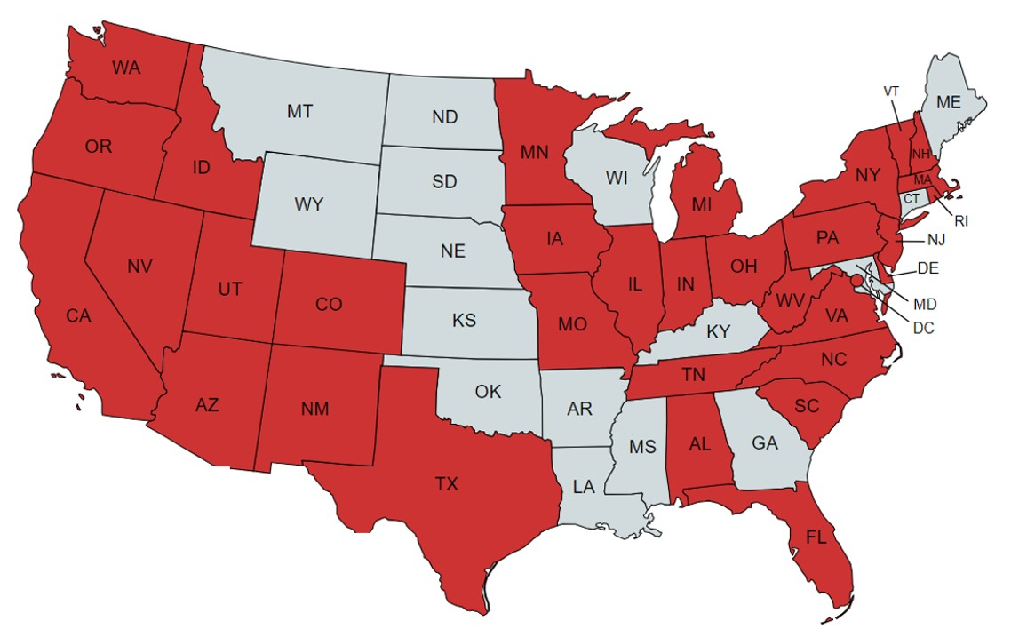
Deployed in 4 Presidential Cycles, across 34 States.
80% of all accessible ballot transmission since 2008
90% of all accessible electronic ballot return deployments in the U.S.

Slide 4
Security Reviews
U.S. Department of Homeland Security – Ongoing Penetration Testing
Cybersecurity and Infrastructure & Security Agency (CISA) –Security & Vulnerability Test and Code Review
Ongoing Testing from a pool of over 1,500 Cybersecurity Researchers – Ongoing, continuous penetration and threat assessment (Synack Cybersecurity)
EAC-approved Lab (SLI) – Center for Internet Security CIS) Best Practice Guidelines
24/7 Independent Monitoring of Portal – Critical Insight – Reports available to customers
SOC 2 Type 2 – Full compliance with SOC 2 Type 2

Slide 5
Accessibility
First accessible absentee balloting technology in the U.S. to meet Section 508, WCAG deployed in the U.S.
Only technology to be awarded funding by both the EAC and Federal Health & Human Services for accessible voting
Winner of Amazon Innovation Award for accessible voting, voted on by State and local governments
Winner of 2019 Accessible Voting award, presented at the United Nations
“The work of Democracy Live demonstrates that compliance with international standards on accessibility is readily achievable in the elections and voting space. Voters around the world have the right to equal access to participating in the democratic process and Democracy Live is a leader in achieving that goal.”
Janet Lord
Harvard Law School Project on Disability

Slide 6
"To whom it may concern,
The creation of the accessible absentee ballot developed by Democracy Live, has been revolutionary and life-changing to individuals who are blind, or have low vision. The software is extremely intuitive and easy to use. The system is consistent, accurate, and secure. Thanks for making this amazing technology that ensures our voices are now heard.“
Sheri Koch, President
National Federation of the Blind

Slide 7
Accessibility Reviews and Awards
Reviewed by the University of Washington Center on Technologies and Disabilities to meet the highest levels of accessibility (2023).
Reviewed and funded by the U.S. Department of Health & Human Services for accessible balloting tools.
Reviewed by over 40 independent testers to comply with 95 combinations of accessibility tools, such as screen readers, sip and puff, braille keyboard, navigational aids and virtually all common accessible input technologies.
Democracy Live contracts with a team of accessibility advocates around the nation to continually test OmniBallot to ensure full and complete accessibility.

Slide 8
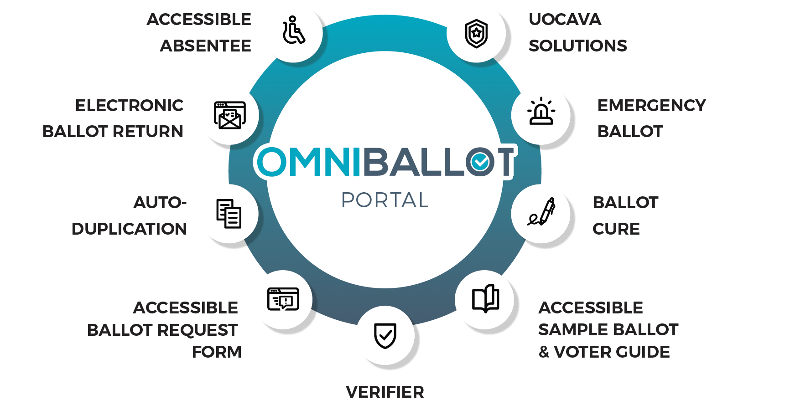
One Secure Portal with Menu of Services

Slide 9
Indiana Accessible Absentee Workflow
https://in.omniballot.us/sites/18/demo/app/home?fname=sample&lname=voter&dob=1999-01-01

Slide 10
For any questions or to schedule a zoom training Contact: Felicia@democracylive.com

