Slide 1
SVRS Overview: What It Is & What It Does
Isaac Miller & Anola Gallion, Proficiency Management, Civix

Slide 2
What is SVRS?
The State Voter Registration System (SVRS) serves the purpose of aiding Indiana County Clerks, the Indiana Election Division, and the Indiana Secretary of State in managing election data and voter registrations for the state.

Slide 3
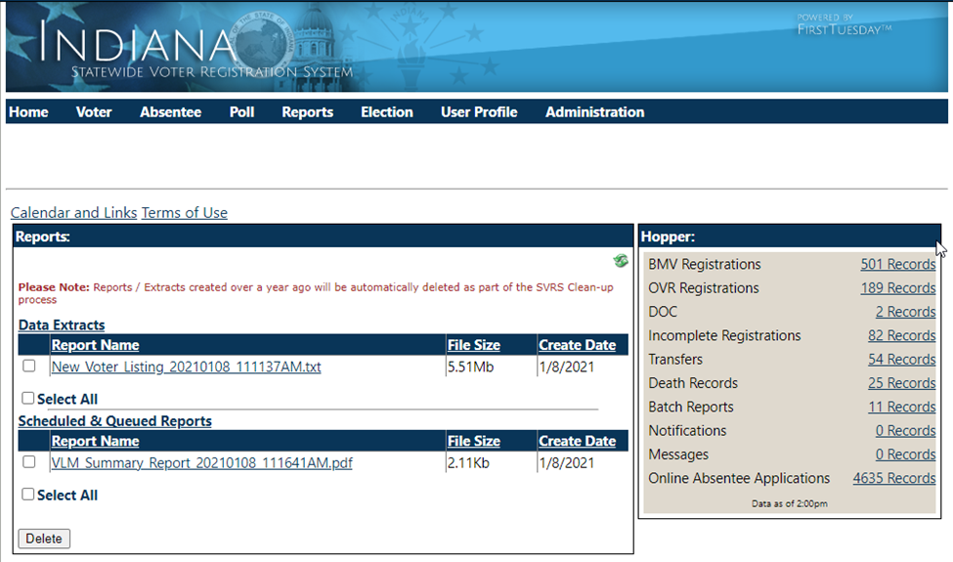
Introduction to SVRS

Slide 4
Quick link to County Portal, Step by Steps, and Web Training
Menu Bar for most frequently used functions
Easy access list of Hoppers link to upcoming to-do and notification items
Notes:
On the home page, there is a menu bar for the most frequently used functions across the top that correspond with the step-by-steps on the county portal.
There is a quick link menu that takes you to the County Portal for Build Notes, Recorded Web Training Sessions, Step by Step documents and a Calendar.
The easy access hopper menu provides links to upcoming to-do and notification items.

Slide 5
SVRS Features:
Menus laid out logically by function
Voter
Absentee
Poll
Reports
Election
Notes:
SVRS menus are laid out logically by their function
We will begin with Voter

Slide 6
County Portal
Step by Steps
SOPs
Web Training
Calendar
Archive
Recorded Sessions
Notes:
We also have a County Portal where you can find detailed step-by-steps with screenshots.
You can also access copies of the standard operating procedures from the Secretary of State.
And you can access the web training calendar or access previously recorded training sessions.

Slide 7
SVRS Lingo

Slide 8
SVRS Terms to Know
CAF = County Authorization Form
SSR/RSE = Request for System Enhancement
Hotfix vs. Builds
Two-Factor Authentication
Hopper(s) = The locations in SVRS where action items live
Registration – BMV, OVR, VPD
Death Records
ABS Hoppers
DOC
Incompletes
Notes:
SVRS menus are laid out logically by their function
We will begin with Voter

Slide 9
Business Rules
Business Rules are the instructions that tell the software what to do. Developers at Civix write the system code to follow business rules. Software code is very literal and is written to follow exactly what the business rules define.
Simply put, these are guardrails that guide the behavior of SVRS.

Slide 10
SVRS Credentials & Tokens

Slide 11
Upcoming Training:
Office, Election, Candidate set-up – 1/3 at 3:00 p.m. & 1/5 at 1:00 p.m.
New user overview – 1/10 at 3:00 p.m. & 1/12 at 1:00 p.m.
County admin training – 1/17 at 3:00 p.m. & 1/19 at 1:00 p.m.
How to access the county portal – 1/24 at 3:00 p.m. & 1/26 at 1:00 p.m.

Slide 12
Questions

