Slide 1
Petitions and Candidate Filings in SVRS
2023 Election Conference
Anola Gallion & Jason Jacobs, Proficiency Management Leads

Slide 2
Step-By-Steps to Review
Find these on the County Portal under the Election category of the step-by-steps
Election, Office, candidate, and Referendum setup
Master Petition-Petition

Slide 3
Building the Election in SVRS
The 2024 elections have been created in SVRS by the HAVA administrator. The counties now have the job of tying the correct offices to the election, and then adding candidates as filings are received.
Added by the State:
  Offices and candidates for Federal, State, State Legislative, and Judicial offices
  Statewide Referendums
Added by the Counties:
  Offices and candidates for local and party offices
  Local public questions (using the Referendums module)
  Party offices for election in the 2024 PRIMARY ONLY:
Republican Precinct Committeemen
State Convention Delegates for both parties

Slide 4
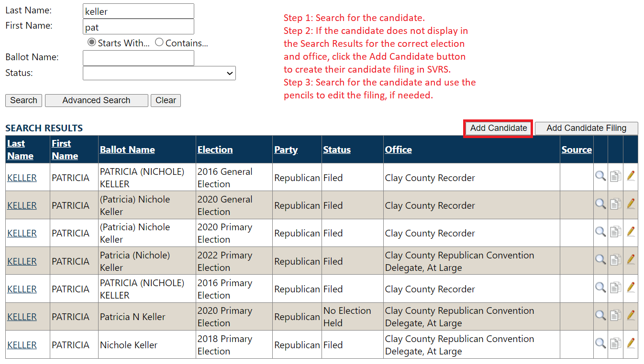
Searching Candidate Filings
Pay attention to the Election and Office so you do not create duplicate candidate records.

Slide 5
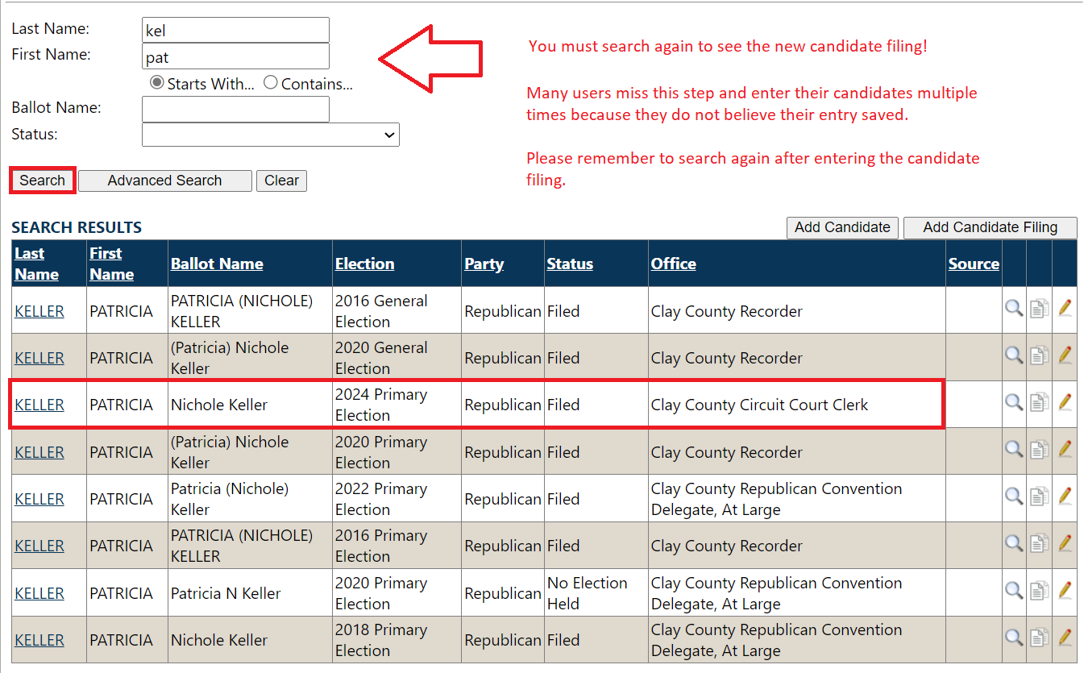
Adding Candidate Filings
After a candidate filing has been added in SVRS, you must search the candidate again to see the new filing!

Slide 6
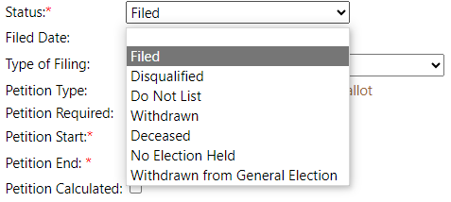
Choosing a Candidate Status
Filed – use this status for a candidate that will be appearing on the ballot.
Do Not List – use this status when a filing has been entered in error. You cannot delete a filing once created, so change the status to Do Not List to prevent the filing from being listed anywhere.
No Election Held – use this status if a candidate is uncontested and will not appear on the ballot.
For further questions regarding which status a candidate should be in, please contact the Indiana Election Division.

Slide 7
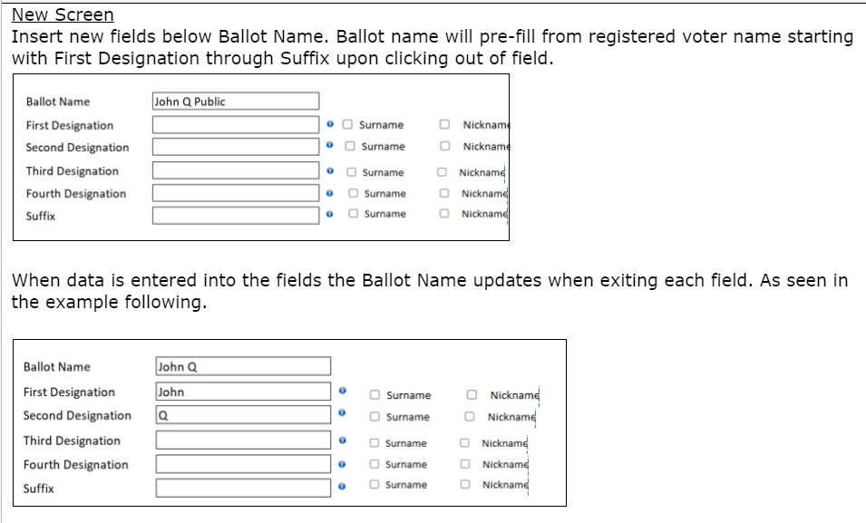
Upcoming Enhancements
The 2023 legislative session changed the format of the forms used for candidate filings.
SSR 2182 will update the candidate filing screen to match the new forms.
Note: This is a mockup of the new screen, but this functionality has not yet been released to SVRS.

Slide 8
Master Petitions
The master petition for State and Federal candidates is created by the HAVA Administrator
County users will need to create the Master Petitions for local offices by navigating to Election > Petition > Master Petition

Slide 9
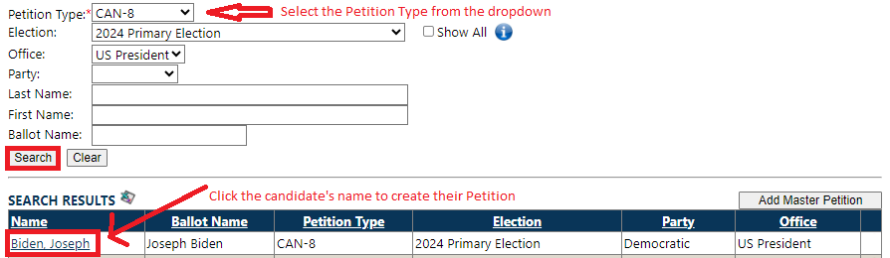
Petitions
Petitions are added to the master petition by navigating to Election > Petition > Master Petition and searching and selecting the candidate

Slide 10
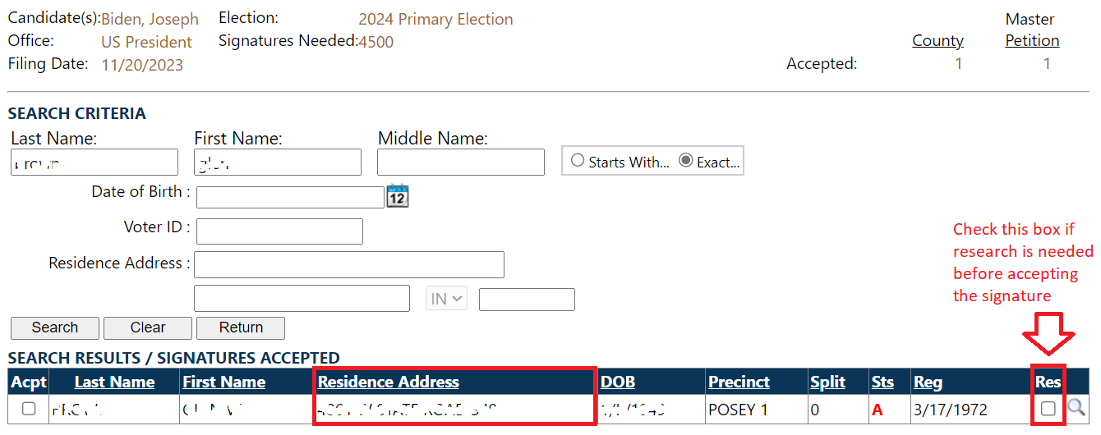
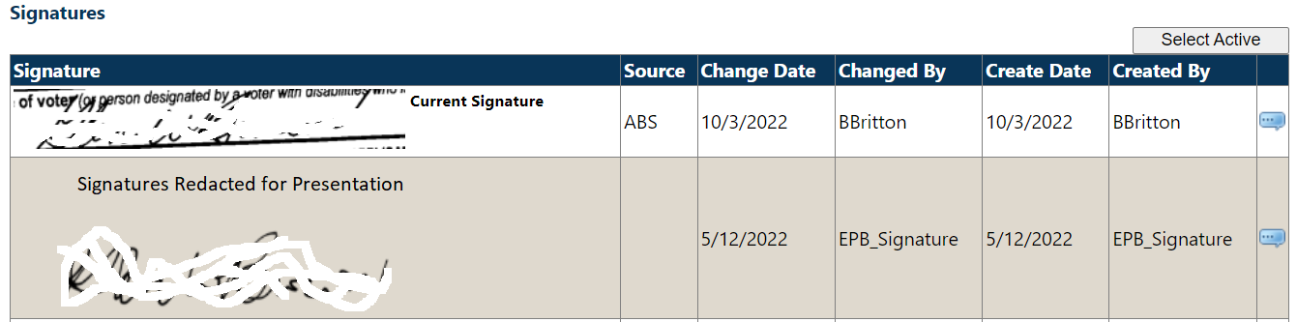
Tools for Validating Petition Signatures
The Residence Address on the voter’s current registration record will display on the Search Results screen when adding signatures to a petition.
Check the Res box if more research is needed before accepting a signature.
The voter’s signature history can be viewed by searching for the voter and navigating to Voter Overview > Signature History

Slide 11
Resources for Counties
Web Training Sessions on Microsoft Teams
  Election, Office, Candidate, and Referendum Setup – December 19 & 21
  Petitions – January 9 & 11, tentative
Step by Step and SOP Documents on the County Portal
3. HelpDesk Contact:
1-888-467-8771
INSVRSHelpDesk@gocivix.com

Slide 12

Questions

