Slide 1
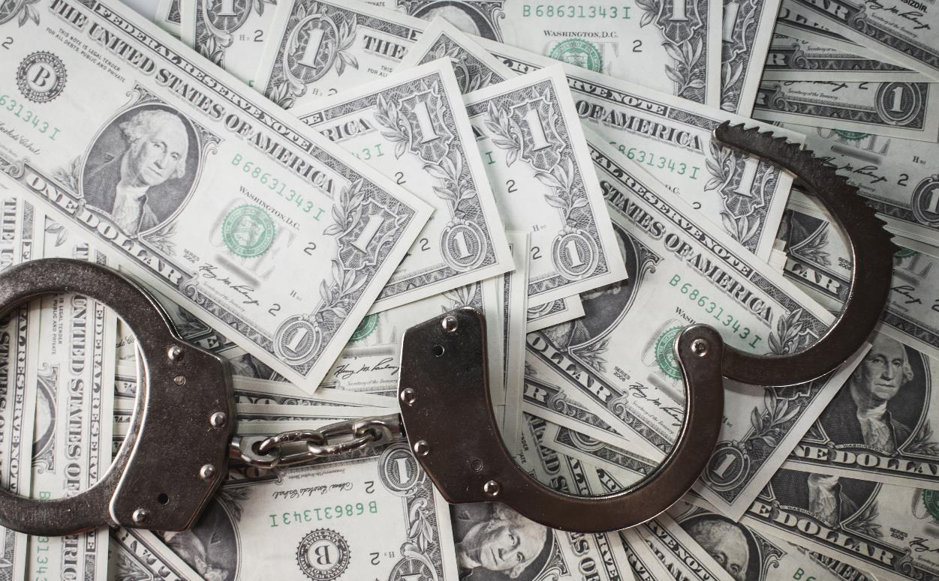
Campaign Finance Enforcement
Presented by Matthew Kochevar, Co-General Counsel
2024 Indiana Election Administrators Conference
Covering
Delinquent & Defective Reports
Audits
Penalty Schedule
Enforcement Proceedings
Proxies
Collecting Fines
Money photo created by wirestock - www.freepik.com

Slide 2
Acronyms
AOPA = Administrative Orders and Procedures Act
CEB = County Election Board
CFA = Campaign Finance Act

Slide 3
Delinquent or “Late” Reports
Committee failed to file required campaign finance report by NOON deadline
Applies to ALL committees
MUST send committee notice of delinquent report not later than 30 days after the report was required to be filed
See Form 1 in tool kit found in 2024 Campaign Finance Manual
CEB not required to send “reminder” notice before deadline, but may do so uniformly
MUST post list of delinquent committees on clerk’s public notice board
MUST conduct a campaign finance hearing, providing best possible notice to the delinquent committee (covered later)
IC 3-9-4-14 | IC 3-9-4-17 | IC 3-9-4-19

Slide 4
Defective Reports
What makes a report defective?
Omission of required elements on a CFA-1, CFA-2, CFA-3, CFA-4, CFA-11, et al
Examples, include but are not limited to:
Missing dates or using date range
Omitted expenditure classification codes
Not including full name, address of itemized contributions, expenditures
Not using current version of CFA forms
Campaign finance filings are NOT rejected, if submitted on an approved form! Instead, the committee’s filing may be found defective or delinquent and subject to civil penalties

Slide 5
Defective Reports
A report appears to be defective, what’s next?
If the CEB agrees that a campaign finance filing appears to be defective, then:
Notice is sent to the committee
NOTE: Tracking date the notice was received is important for enforcement as…
Committee has five days after the receipt of the notice to cure defects and file corrected report
IC 3-9-4-14 | IC 3-9-4-17

Slide 6
Defective Reports
How should CEB manage defective reports?
Investigate upon filing of a written complaint
Conduct an audit from time-to time
Ascertain whether the report is defective after it’s filed
Any review should not delay or prevent a person from filing their campaign finance document
Any review should be uniform and non-discriminatory
IC 3-9-4-13 | IC 3-9-4-14

Slide 7
Audits
State law is NOT specific on campaign finance audits:
Must be performed from “time-to-time”
Best practice
Establish a CEB policy on audit procedures to ensure uniform application
Will audit be performed after every filing period? Annually? During off-years?
Will policy just check the math? Look for all missing required elements?

Slide 8
Penalty Schedule
Delinquent Reports
$50 per calendar day, up to $1,000
Starts at noon (12:00:01) on filing deadline day
Includes all days (weekends and weekdays)
Must conduct a hearing to waive or reduce fine
Defective Reports
$10 per calendar day, up to $100
Committee has five days after receiving notice to respond to notice or cure defects before fine can be assessed
IC 3-9-4-17

Slide 9
CFA Enforcement Proceedings
Applicable Law
Indiana Open Door Law (IC 5-14-1.5)
Administrative Orders and Procedures Act (AOPA) (4-21.5-3)
Indiana Election Law (IC 3-9-4)
Campaign Finance Enforcement Tool Kit is found in the Appendix of the 2023 Campaign Finance Manual

Slide 10
Open Door Law Requirements
Public Notice Requirement
Meeting notice must be posted 48 hours before (excluding weekends and holidays)
Notice should include date, time & location
See Form 2 in tool kit found in 2024 Campaign Finance Manual
Notices must also be mailed, emailed or Faxed to media, if requested in writing by Jan. 1 of the year
Generally, notice is not required to be published in newspaper
Publication of notice is not required for a campaign finance enforcement hearing unless the meeting also contains agenda items that require published notice
Agenda, if used, must be posted at entrance prior to meeting
IC 5-14-1.5-4 | IC 5-14-1.5-5

Slide 11
AOPA Requirements
Administrative Orders & Procedures Act (AOPA) applies to finance hearings
Requires Individual Notice to Committee
At Least 5 Days Notice (excluding Sat, Sun, and holiday)
(IC 4-21.5-3-20)
Content of Notice
Time, Place, and Nature of Hearing;
Possibility of default for not appearing, and
Contact information (IC 4-21.5-3-20(c))
See form 3 in tool kit
Issue Order
See form 5 in tool kit
IC 3-9-4-17(j)

Slide 12
AOPA Requirements
AOPA requires testimony of witnesses be given under oath
Any CEB member may administer
See Form 4 in tool kit
CEB may subpoena persons and papers
Proceedings may be informal without resorting to rules of evidence applicable to courts
IC 4-21.5-3-26(b) | IC 4-21.5-3-25(b)

Slide 13
Enforcement Proceeding Overview
CEB Must:
Conduct a public fact-finding hearing
Give “notice” (see form 3 in tool kit)
Provide an “opportunity to be heard”
Vote in public meeting whether to waive, reduce, or assess penalty
Vote must be unanimous to waive or reduce penalty
Adopt written order (see form 5 in tool kit)
Parties have 30 days to appeal decision
Requires civil case to be filed in circuit, superior or probate court
IC 3-6-5-34

Slide 14
Enforcement Proceeding
Delinquent (Late) reports require various notices be sent to committees
Delinquency Notice (see form 1 in tool kit)
Audit for late reports
Mail notice not later than 30 days after deadline
Does not need to be sent via certified letter
Refer to form 1 in tool kit
Hearing Notice
See form 3 in tool kit
Refer to AOPA requirements
IC 3-9-4-14

Slide 15
Hearing Overview
CEB presents evidence against committee
Committee given opportunity to defend
CEB may ask questions
CEB can waive or reduce penalty by unanimous vote if “unjust under the circumstances”
IC 3-9-4-17; IC 3-9-4-19
See Form 5 in tool kit
CEB must vote to assess penalty

Slide 16
Fines
Committees MUST* be assessed a fine based on the schedule outlined in law
$50 per calendar day, up to $1,000 for delinquent reports
$10 per calendar day, up to $100 for defective reports
*IC 3-9-4-17 uses “shall” in some subsections, but “may” in other subsections when it comes to the Board imposing a civil penalty
CEB should read this statute carefully to decide under which circumstances they will impose a civil penalty
Any reduction or waiver of a campaign finance fine MUST be unanimously agreed to by the CEB at the campaign finance hearing

Slide 17
Proxies
Proxy for CEB Members
An individual may serve as proxy if a member has a conflict of interest and is unable to remain impartial during a campaign finance hearing or any other hearing
Proxy may not be an elected official or the chair or treasurer of a candidate’s committee
Notice of proxy should be filed ahead of meeting
See form 6 in tool kit
IC 3-6-5-4.5

Slide 18
Fine Collection
How do we enforce collection of a fine?
Check with county attorney to determine if a collection agency works on behalf of the county and county election board to collect overdue fines
Suggestion: Set a policy as to what constitutes an “overdue” fine and at a CEB meeting, pass a motion to send committees with an “overdue” fine to the collection agency
If person has a civil penalty assessed AND is elected to an office in the subsequent election, then CEB may ask fiscal officer to withhold the amount of the civil penalty from the elected official’s paycheck
Treasurer of the committee & the candidate may be held personally liable for any debts of the committee
Victory Committee v. Genesis Convention Center, 597 N.E.2d 361 (Ind. App 1992)
IC 3-9-4-17 | IC 3-9-4-18

Slide 19
Fine Collection
Fines collected for campaign finance enforcement go into a separate county fund that does not revert
Funds available, with the approval of the county council, to supplement funds appropriated for any election-related purposes
Contact county auditor if information needed regarding campaign finance enforcement account
IC 3-6-5-4.5 | IC 3-9-4-17(j)(k)

