Slide 1
U.S. Election Assistance Commission
Subject Matter Expert Ben Jackson
December 14, 2022

Slide 2
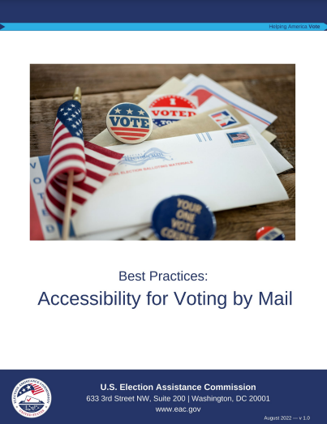
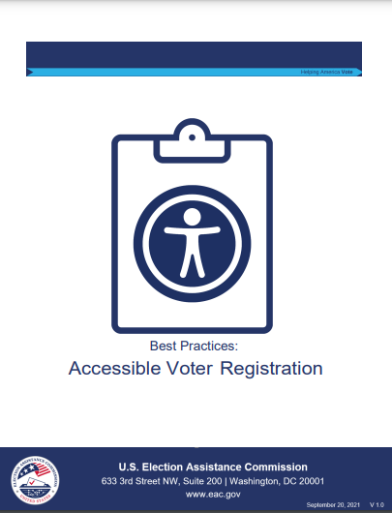
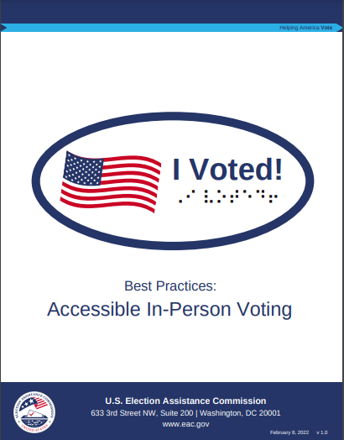
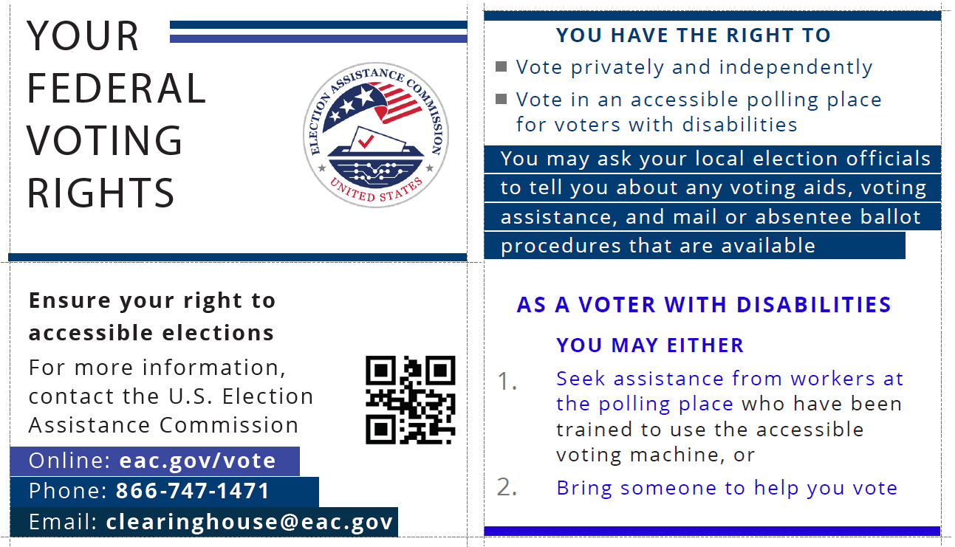
Accessible Voting and the EAC
Notes:
Because of HAVA, the EAC strives to incorporate the needs of voters with disabilities into everything we do.
The EAC provides election officials with best practices, timely research, and other resources on voter accessibility.
To create these resources, the EAC has implemented an enhanced Clearinghouse Division made up of subject matter experts who have specialized knowledge from their experience as former election officials.
You can see a few of these resources on this slide, including our best practice guides. These provide election officials with best practices on accessible voter registration, in-person voting, and voting-by-mail.
The EAC also developed a pocket-sized voter card and a large print version in Braille that serve as guides about voting rights for voters with disabilities.
The EAC has worked with advocacy groups and election officials to distribute the card, including disseminating more than 25,000 voter cards in Braille over the past two years.
Additionally, we ensure our website, which has all of these resources, is accessible.
We caption all of our videos, and we have interpreters and live captioning at in-person events.
The EAC has also issued FAQs for election officials to help make sure that everything they do is accessible, like absentee voting or voting-by-mail.

Slide 3
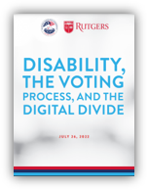
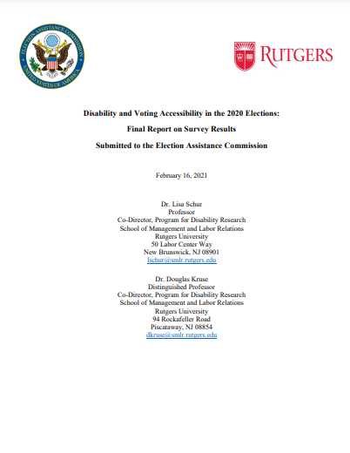
Accessibility Considerations
EAC Funded Research
Disability and Voting Accessibility in the 2020 Elections
Digital Divide
Notes:
The EAC also conducts research to determine accessibility gaps and other resources.
For example, we commissioned Rutgers University to conduct a survey to identify accessibility advancements and deficiencies for voters with disabilities during the 2020 election.
The key findings of that survey were:
Turnout amongst voters with disabilities increased and reported barriers decreased when compared to previous elections.
However, voters with disabilities were still less likely to vote and reported facing barriers more than twice as often as voters without disabilities.
The progress appeared to be in polling places where the biggest declines in difficulty were in reading or seeing the ballot as well as difficulty understanding how to vote or use the voting equipment.
The survey found that voting by mail was particularly difficult for voters with vision impairments.
Most recently, we worked with Rutgers University to conduct a survey to explore the digital divide of accessing voting information among people with and without disabilities.
In that survey, we found that people with disabilities are less likely to use computers or the internet and are more likely to use non-internet based sources for voting information.
This emphasizes the need for election officials to use a range of communications tools in order to reach all voters with election and voting information.

Slide 4
EAC Resources
Language Access and Accessibility
Best Practices for Accessible Voter Registration
Best Practices for Accessible In-Person Voting
Best Practices: Accessibility for Voting By Mail
EAC Clearie Awards Improving Accessibility for Voters with Disabilities.
Quick Start Guide: Ballot Drop Boxes
Notes:
Here is a list of EAC accessibility resources that are currently available.
The best practices guides highlight the primary barriers to accessibility in the voter registration process, in-person voting, and voting-by-mail and provide best practices to help ensure voters with disabilities have equal access to the voting experience.
The checklists and best practices in these guides can be utilized by election officials, policymakers, and advocates.
The EAC recognizes outstanding innovation in elections and best practices in accessibility, including Contra Costa County California's "A simple (Accessible) Path for All" initiative, which launched the innovative Accessible Polling Place Location and Equipment (APPLE) class and provided toolkits for establishing and maintaining accessible polling places.

Slide 5
Upcoming Resources
EAC and URI Election Processes Simulation Video Series
Formula for Deploying Accessible Voting Machines
Survey of the impact of the 20 years of HAVA
Election Official Training Resources
Accessibility Survey of the 2022 Election
Notes:
The EAC also has a number of upcoming resources.
In partnership with the University of Rhode Island, the EAC has released a series of simulation videos that replicate common Election Day issues.
The simulations that were used to create this video series are based on several inputs that are common to many polling places.
The first series addressed polling place consolidation, and in the coming months the EAC will release an additional series to help election officials develop a formula for deploying accessible voting machines in voting locations.
The EAC is also working once again with Rutgers on a new study on the impact the Help America Vote Act has had on accessible voting.
This study, with the other research the EAC has conducted, will give a better picture with supporting data of the progress that has been made, and the work still yet to do.
WGBH, a public radio station in Boston, and the National Center for Accessible Media (NCAM) will produce webinar style training modules on topics topic essential to voting accessibility
And finally, similar to the studies done after the last presidential election, Rutgers University will survey voters after the 2022 election to determine if the gains made during the 2020 election have had a lasting impact

Slide 6
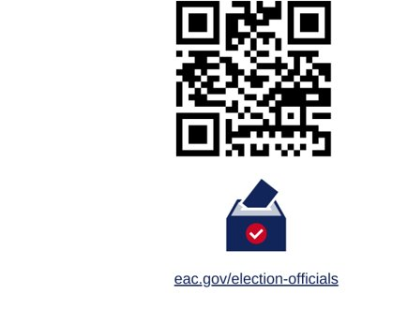
Election Official Resources
Latest Resources
Accessibility
Security
Toolkits
Communications
And more!
Notes:
In addition to the accessibility resources from the EAC, there are a variety of materials that are in development that we will continue to build on the catalog of EAC resources for election officials.
Eac.gov/election-officials is a landing page for the many resources available to election officials

Slide 7
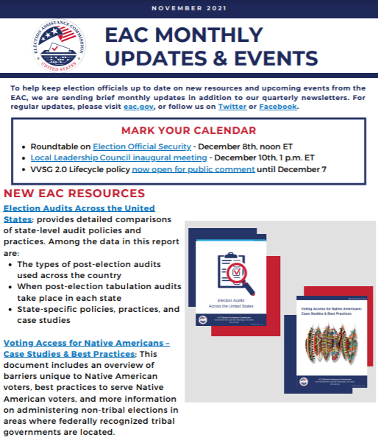
Sharing EAC News
Monthly newsletter
www.eac.gov/newsletter
Notes:
I want to make you aware the EAC has a monthly newsletter that includes upcoming events, new resources, and any other relevant information to assist you.
This is a good way to keep up with what is happening at the EAC.
If you don't you don't already receive the newsletter, you can go to this link and sign up and find the previous issues.

Slide 8
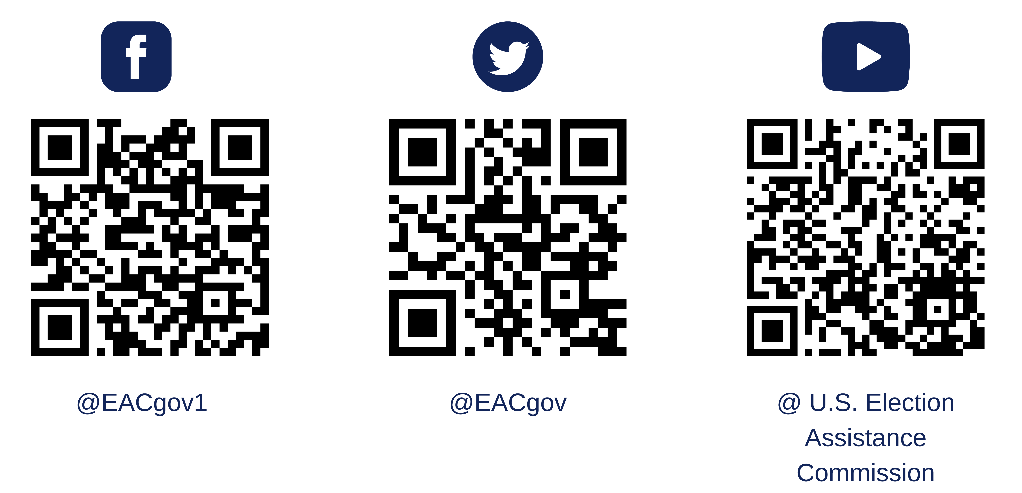
Follow the EAC on Social Media
Notes:
The EAC also shares updates on news, new resources, events, and other information on our social media accounts.

Slide 9
Questions?

