Slide 1
ABS-24 Notice of ABS Application Defect or Denial
Matthew Kochevar
Co-General Counsel
Indiana Election Division

Slide 2
When ABS Application Cannot Be Approved
General Assembly amended state election law to require voter to receive a defect notice, in certain cases, when the voter’s absentee ballot application cannot be approved under IC 3-11-4
To comply with updates in law IED modified the ABS-24 notice of disposition to add in the new defect notices now required by law
Previously ABS-24 was a notice to inform voter their absentee ballot application was denied
Now ABS-24 contains multiple notices require by law for the various requirements to hold certain application defects

Slide 3
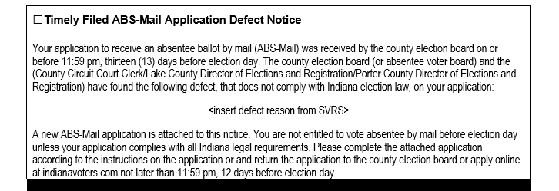
Defect Notice Process No. 1
(Timely Filed ABS-Mail Application Defect Notice in ABS-24)

Slide 4
Defect Notice Process No. 1
This notice applies if an ABS-Mail application does not have all the required information to receive an absentee ballot ​and is received by the county more than 12 days before the election
The county must send the voter:
A new absentee ballot application; and
The ABS-24 ​notice with the “Timely Filed ABS-Mail Application Defect Notice” marked and a brief explanation of defect found on the ABS-Mail application that does not comply with the election code
The reason will be selected from a dropdown in SVRS when you mark the application as not approved
The law is silent on what to do if a defective ABS-MAIL application comes in on day 12 before election day
May be resolved in 2024 short session.
Image by master1305 on Freepik
IC 3-11-4-17.5 | IC 3-11-4-17.6

Slide 5
Defect Notice Process No. 1
The notice will also inform the voter:
That the voter is not entitled to vote before election day by absentee ballot unless the application complies with all legal requirements
Provide instructions for submitting a second application for an absentee ballot
IC 3-11-4-17.5 | IC 3-11-4-17.6

Slide 6
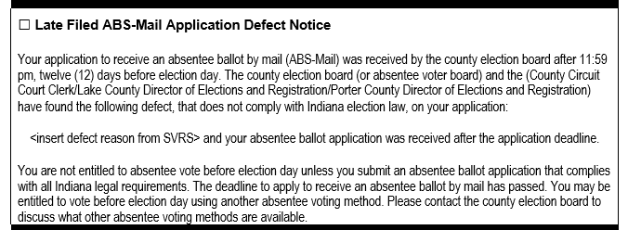
Defect Notice Process No. 2
(Late Filed ABS-Mail Application Defect Notice in ABS-24)

Slide 7
Defect Notice Process No. 2
This notice applies if an ABS-Mail application does not have all the required information to receive an absentee ballot ​and is received by the county after ABS-Mail application deadline
The county must send the voter:
The ABS-24 ​notice with the “Late Filed ABS-Mail Application Defect Notice” marked and a brief explanation of defect found on the ABS-Mail application that does not comply with the election code
The reason will be selected from a dropdown in SVRS when you mark the application as not approved
This notice is already includes wording that the application was also received after the application deadline
IC 3-11-4-17.5 | IC 3-11-4-17.6
Image by master1305 on Freepik

Slide 8
Defect Notice Process No. 2
The notice will also inform the voter:
That the voter is not entitled to vote before election day by absentee ballot unless the application complies with all legal requirements
That the voter may have also absentee voting methods available to them and to contact the county election board for more information
IC 3-11-4-17.5 | IC 3-11-4-17.6

Slide 9
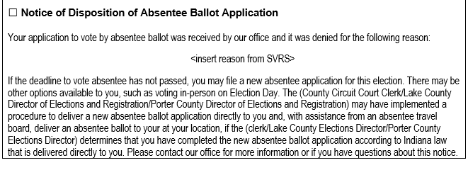
Defect Notice Process No. 3
(Notice of Disposition of Absentee Ballot Application)

Slide 10
Defect Notice Process No. 3
Applies to ALL other ABS ballot applications
Used to inform voter why application was denied
Informs voter of optional procedure to deliver a new absentee ballot application to vote if the county adopted use of the procedure
This is the original disposition notice that was used for all applications before the law was amended in 2023
Image by master1305 on Freepik
IC 3-11-4-17.5 | IC 3-11-4-17.6

Slide 11
Optional Procedure to Deliver Absentee Ballot Application & Ballot to Voter
If a voter submits a defective application before the deadline to receive an absentee ballot then the clerk MAY:
Deliver an absentee application in-person;
Approve the ​second application if the defect is corrected,
If accompanied by a bi-partisan absentee voter board, provide an absentee ballot to the voter; and
Return the voter’s ballot to the absentee voter board or county election board (unless voter wishes to return ballot).
This procedure is allowed notwithstanding the requirement under law (IC 3-11-10-25(e)) for previous unanimous approval from the ​county election board
If a county clerk chooses to provide this service to a voter, it must be done in a uniform manner to all ​applications governed by this procedure​
IC 3-11-4-17.6

Slide 12
Questions?
Image by Freepik

