Slide 1
2024 Indiana Election Administrators’ Conference
Local Public Questions
December 13, 2023
Notes:
1

Slide 2
Public Questions Certified by DLGF
Capital Project/Controlled Project Referenda (IC 6-1.1-20)
Operating Referenda (Schools Only) (IC 20-46-1)
School Safety Referenda (IC 20-46-9)
Bond Refunding Referendum (Schools Only) (IC 5-1-5-2.5)
Reorganization Referenda (IC 36-1.5-4)
Transit Referenda (Certain Counties) (IC 8-25-2)

Slide 3
Capital Project/Controlled Project Referendum Process
Political subdivision issues the public notice of preliminary determination hearing 10 days before the hearing. (IC 6-1.1-20-3.5(b)(1))
Political subdivision holds the preliminary determination public hearing to provide information to the public and adopt resolution or ordinance to issue bonds or enter a lease to finance the project. (IC 6-1.1-20-3.5(b)(1))

Slide 4
Capital Project/Controlled Project Referendum Process
Political subdivision must publish notice of the preliminary determination within 30 days of the passage of the ordinance or resolution. (IC 6-1.1-20-3.5-(b)(2)-(3))
After notice of the preliminary determination is published, taxpayers may file a remonstrance petition with the county voter registration office. (IC 6-1.1-20-3.5(b)(4)-(7))
500 individuals or 5% of registered voters.
Must be filed not more than 30 days after notice of the preliminary determination is published.

Slide 5
Capital Project/Controlled Project Referendum Process
After receipt of petition, the county voter registration office must determine that all persons who signed the petition (up to 525 persons) are registered voters. (IC 6-1.1-20-3.5-(b)(8))
If the county voter registration office is unable to verify that all persons who signed are registered voters, the office must forward the petition to the county auditor no later than 15 days after receiving petition. (See Next Slide)
If the county voter registration office is able to verify that all signatures are from registered voters, the office must make the final determination of whether a sufficient number of persons has signed the petition within 10 days.

Slide 6
Capital Project/Controlled Project Referendum Process
If county voter registration office forwards the petition to the county auditor due to signature deficiencies, the county auditor must provide the following to the county voter registration office no later than 10 days after receiving the petition:
Statement verifying whether a person who signed the petition as a registered voter but is not a registered voter is the owner of real property in the political subdivision; and
State verifying whether a person who signed the petition as an owner of the property does in fact own property within the political subdivision.

Slide 7
Capital Project/Controlled Project Referendum Process
The county voter registration office must file a certificate and each petition with either the township trustee (if the political subdivision is a township) or the body that has the authority to issue bonds or execute the lease. Certificate and petition must be filed within 35 days of the filing of the petition.
If a petition is received with the required number of signatures, the political subdivision must not impose property taxes to pay debt service on bonds or lease rentals unless it is approved via a local public question. (IC 6-1.1-20-3.6(b))

Slide 8
Capital Project/Controlled Project Referendum Process
If the capital/controlled project must be voted on via a local public question, the county election board must approve the ballot language, as outlined in Ind. Code § 6-1.1-20-3.6.
Once the county election board approved the ballot language, the board must submit the public question language to the Department for review.
The Department may recommend a modification of the ballot language, and the county election board must submit the modified ballot language to the Department.

Slide 9
Capital Project/Controlled Project Referendum Process
The Department must certify its final approval of the ballot language for the public question to the county auditor. (IC 6-1.1-20-3.6(d))
The county auditor must certify the finally approved question to the county election board no later than noon 74 days before a primary election or August 1 if the question is to be placed on general election ballot.

Slide 10
Capital Project/Controlled Project Referendum Process
A political subdivision may voluntarily decide to place a referendum on the ballot instead of going through the petition and remonstrance process.
A resolution must be adopted by the date of the preliminary determination and must be certified to the county election board in each county where the political subdivision is located. (IC 6-1.1-20-3.8)

Slide 11
Capital Project/Controlled Project Referendum Process
Special Election
If a primary, general, or municipal election will not be held during the first year the public question is eligible to be placed on the ballot and the political subdivision requests the question be placed on the ballot at a special election, the question shall be placed on the ballot at a special election to be held on the first Tuesday after the first Monday in May or November of the year.
The certification must occur not later than noon 74 days before a special election to be held in May or noon on August 1 if the special election is to be held in November.

Slide 12
Capital Project/Controlled Project Referendum Process
Special Election
The fiscal body of the political subdivision that requests the special election shall pay the costs of holding the election.
The county election board must publish notice one time, at least 10 days before the date of the special election.
The special election is under the direction of the county election board, which must take all steps necessary to carry out the special election.

Slide 13
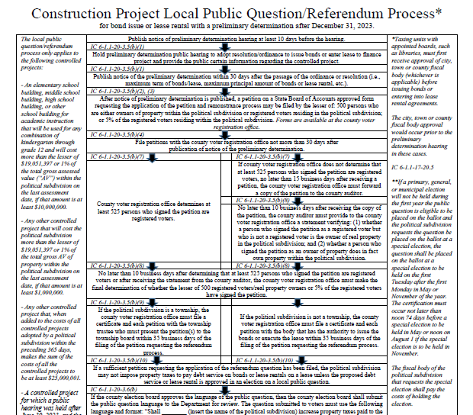
Referendum Process Flow Chart
Construction Project Local Public Question/Referendum Process Flow Chart
www.in.gov/dlgf/referendum-information/

Slide 14
Public Questions Not Certified by Department
Change in Number of Members in Legislative Body (IC 36-5-2-4.2)
Town of Atlanta (2022), (2020)
Town of Jamestown (2022)
Town of Winslow (2022)
Extension of Parks Services (IC 36-10-3-35) (IC 36-10-4-5)
Town of Knightstown (2022)
Withdrawal of Township from Planning & Zoning (IC 36-7-4-1212)
Establishment of a Utility Service Board (IC 8-1.5-3-3)
Huntertown (2022)
Removal of Municipally Owned Utility from IURC (IC 8-1.5-3-9)
Wayne County (2022)

Slide 15
Questions?
Emily Crisler
General Counsel
Telephone: 317-234-8624
Email: emcrisler@dlgf.in.gov
David Marusarz
Deputy General Counsel
Telephone: 317-233-6770
Email: dmarusarz@dlgf.in.gov

