Slide 1
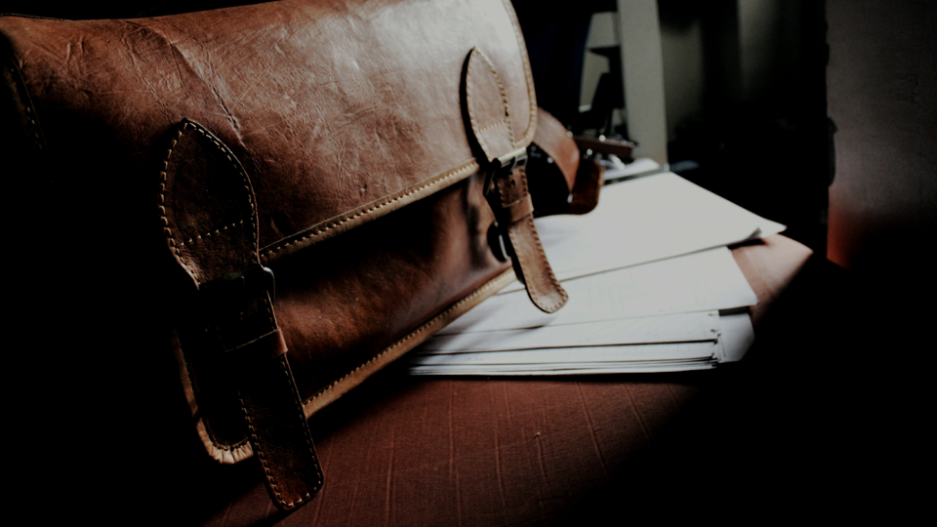
Indiana Election Division – Part 1
Joe McLain, Co-Director (R)
Ron Miller, Co-general counsel (R)

Slide 2
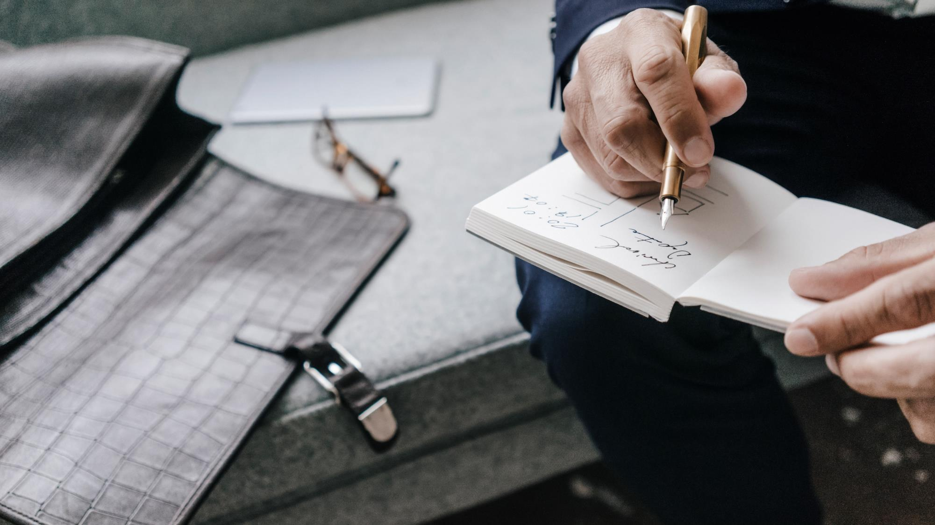
Agenda
1) Meet Joe and Ron
2) 3rd Party Groups and VR forms
3) Thoughts on litigation matters
4) Ballots, voting and Recount issues
5) Questions & Insightful Answers
6) Joe and Ron running for the exit

Slide 3
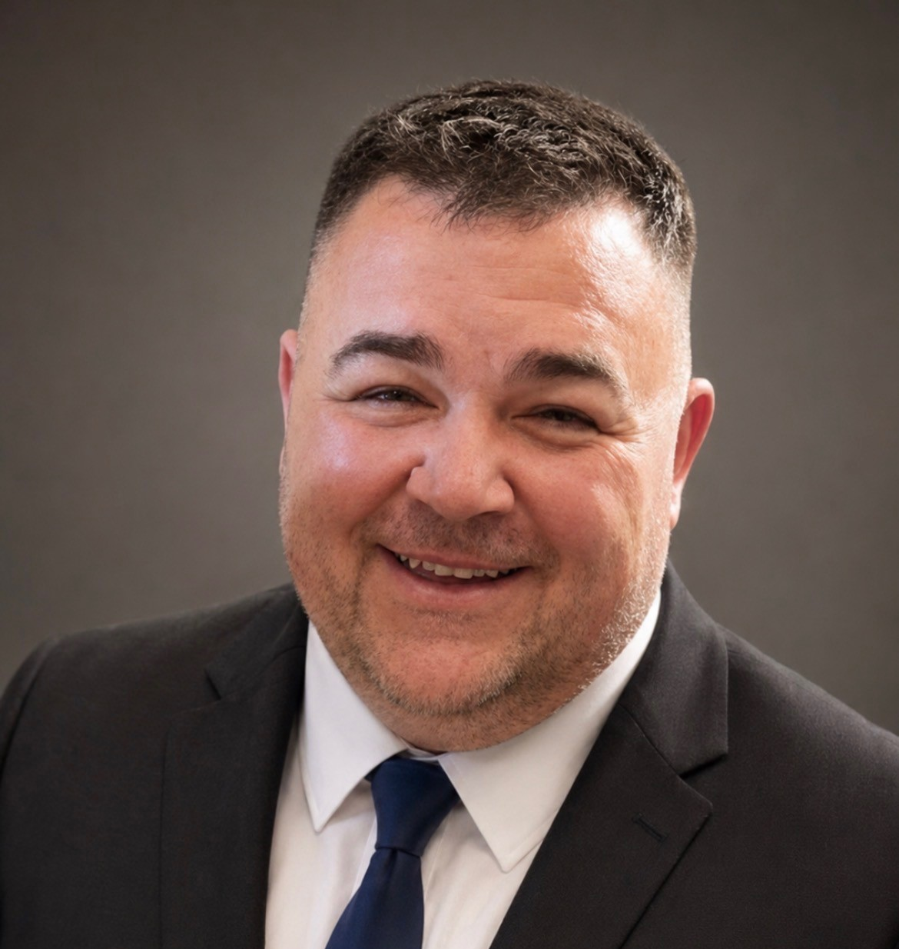
Joe McLain
Co-Director (R)
Joe McLain, native son of South Bend, Indiana, left the Hoosier state as an army brat pre-teen, and returned to earn his BS from Indiana University – home of the CFP National Champions! He started his career working for the Indiana House Republicans. Later, he was a local election administrator in Marion County, Indiana’s first HAVA Administrator, congressional staffer, and Election Division employee before succeeding Brad King.

Slide 4

More about Joe
During his 16-year career in election administration, Joe has witnessed major changes in elections. He ran the last Marion County election using lever machines. As HAVA Administrator, he helped develop SVRS, online voter registration, WAYEO, and vote centers. He managed the initial voting system reimbursement program and worked with counties to make polling places accessible.
Joe and his wife, Sonja, live on the southside of Indianapolis with their daughter, Baily, a junior at Perry Meridian High School. They have two older sons, Andrew and Charlie, attending Purdue University and Indiana University-Bloomington. Joe enjoys attending sporting events and concerts with his friends and family and has an extensive sports cards and pop culture items collection.

Slide 5
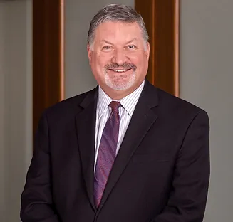
Ron Miller
CO-GENERAL COUNSEL (R)
Ron Miller, a Martinsville, Indiana native, earned his BA from DePauw University, MBA from Western Governors University, and JD from Indiana University. He began his career in IT and data processing management before transitioning to law, working with the Indiana Supreme Court, Marion County courts, State of Indiana, several prominent law firms, including Barnes & Thornburg and Frost Brown Todd. More recently he also founded a solo general practice in Hancock County.

Slide 6
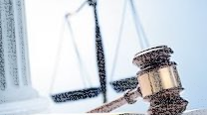
More about Ron
During his 26-year career as an attorney, Ron has handled a wide variety of cases that have included civil litigation, family law, contracts, commercial real estate, mergers and acquisitions, juvenile law, criminal law, estate planning / probate, space law, and political law (including election law and campaign finance). Ron serves as a volunteer CASA in Juvenile cases in Hancock County.
Ron and his wife, Emily, reside in New Palestine with their daughter, Amanda, a student in New Palestine schools. He also has two older daughters, Sarma, a proud Boilermaker embarking on a career in public safety, and Liene, who is a registered nurse and former professional volleyball player. In his free time, Ron enjoys golf, writing fiction, cooking, and spending time with family and friends.

Slide 7


3rd Party Groups and VR Forms
Common 3rd party voter registration drives
  Out-of-state voter advocacy groups
    Usually conducted by mail
    Cannot pre-fill voter information
    Voter submits via mail to IED, forwarded to counties
    Ex. Voter Participation Center, Center for Voter Information
  In-state organizations
    Usually conducted at public events or door-to-door
    3rd party group submits to county VR office or IED
    Must submit by noon within 10 days or the VR deadline
    Cannot pre-fill voter information
    Ex. League of Women Voters, student organizations, candidates, party organizations, nursing homes

Slide 8
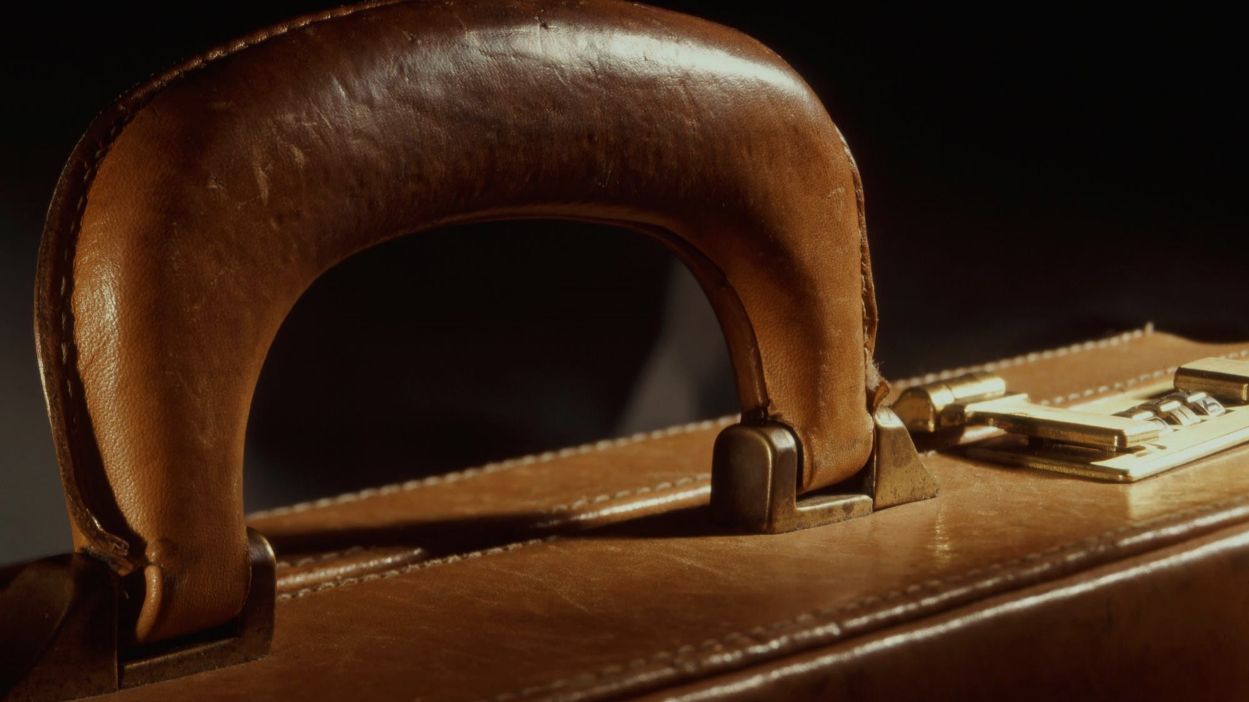
3rd Party Groups and VR Forms
Forms permitted for use
  VRG-7 (State Form 50504)
  VRG-11 (State Form 46965)
  National Voter Registration Application (“federal form”)
Possible issues with 3rd party forms
  Missing information
  Late submissions
What can you do to help?
  Meet with local 3rd party organizations
    Provide correct forms
    Develop a checklist of critical info
    Share deadlines

Slide 9
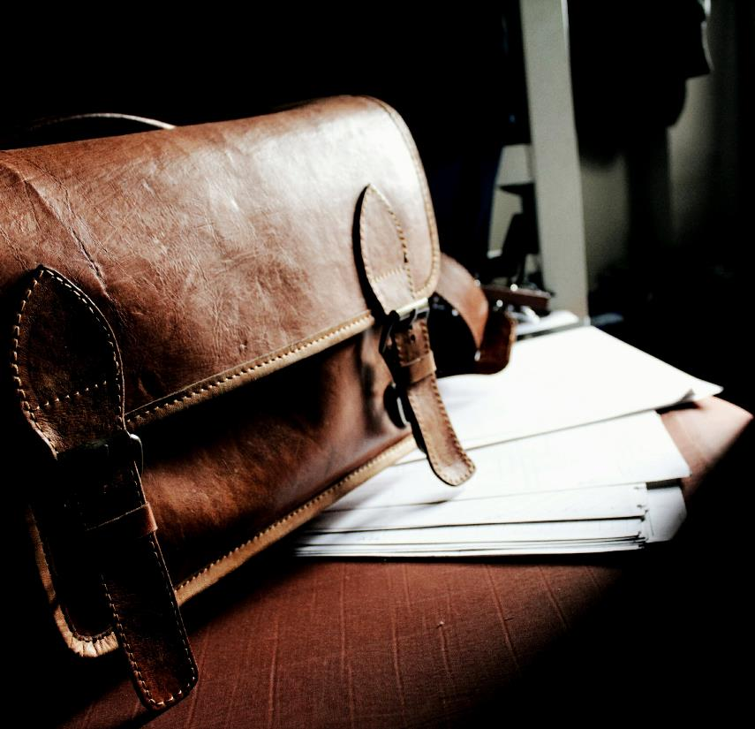
Thoughts on litigation matters
From time to time, election officials will encounter litigation from various outside groups, from candidates, from concerned voters, and from others.
We know that litigants may initiate discovery being directed at counties about crosscheck processes, voter registration processes, election activities, SVRS activities, etc.
IMPORTANT: If you get a discovery request or subpoena, call your county attorney IMMEDIATELY!
  While the IED / SoS / Civix and others may have already provided a number of responses to these kinds of requests, you are legally obligated to answer any discover requests you receive, and your county attorney is your best starting point to review and discuss.
It is also helpful if you let IED know about discovery or litigation notices you receive.
**Also note that public records requests may increase around these topics as media and others attempt to independently verify information.**

Slide 10
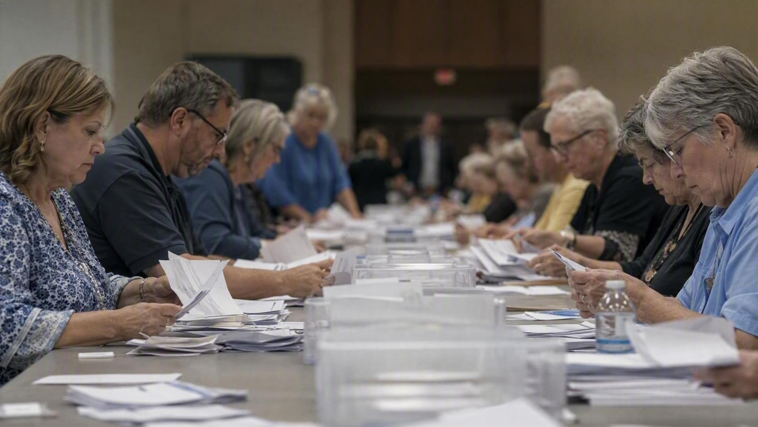
Ballot, Voting and Recount Issues
Ballot, voter registration, voting and recount processes are very technical and specific to statutory requirements for election administration, voting, and ballot security.
  When was the ballot voted/received?
  Where was the ballot voted/received?
  Who handled the ballot? How was it stored/disposed?
  Was the voter eligible and properly registered?
  Chain of custody issues.
  Was the voter challenged? How was a challenge ultimately resolved?
  Absentee / early voting / Election Day issues.

Slide 11

“The right to vote is the crown jewel of American liberties, and we will not see its luster diminished”
Ronald Reagan

Slide 12
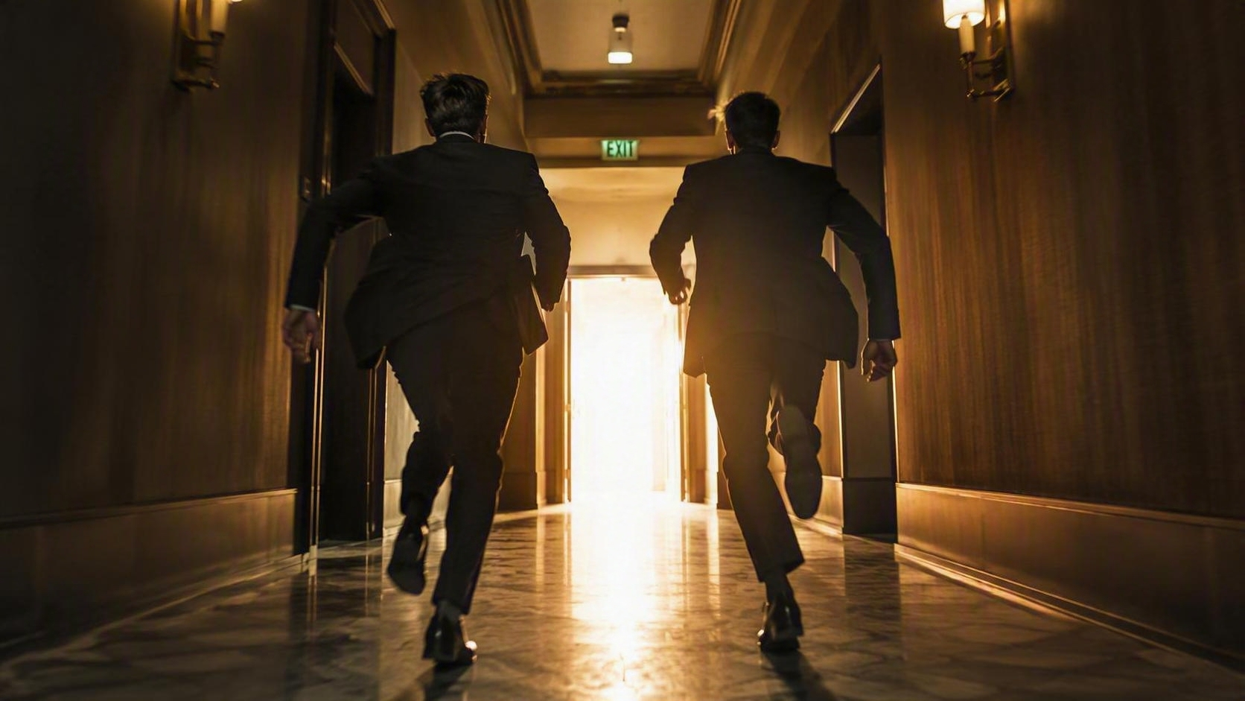
Thank you
Joe – jmclain@iec.in.gov
(317) 233-1948
Ron – ronmiller@iec.in.gov
(317) 232-3929

