Slide 1
Tuesday, December 16, 2025
Absentee Processing Procedures
USPS Mailing Best Practices Conversation
Baker Tilly Advisory Group, LP and Baker Tilly US, LLP, trading as Baker Tilly, operate under an alternative practice structure and are members of the global network of Baker Tilly International Ltd., the members of which are separate and independent legal entities. Baker Tilly US, LLP is a licensed CPA firm that provides assurance services to its clients. Baker Tilly Advisory Group, LP and its subsidiary entities provide tax and consulting services to their clients and are not licensed CPA firms. The name Baker Tilly and its associated logo is used under license from Baker Tilly International limited. The information provided here is of a general nature and is not intended to address the specific circumstances of any individual or entity. In specific circumstances, the services of a professional should be sought. © 2025 Baker Tilly Advisory Group, LP

Slide 2
Helpful Tools & Information
USPS Mailing Best Practices Conversation
The Absentee Envelope Modernization Templates and Guide folder in the Shared Documents section of the County Portal contains all the tools counties need to create and update ABS envelopes. Included in this folder are:
  Absentee Envelope Templates for the ABS-6, ABS-8, ABS-10A, ABS-10B, and ABS-16
    Changes for 2026: The form number, domestic or UOCAVA indicator, and revision number are to be included on the back envelop flap for the ABS-8 and ABS-10A and the back of the ABS-6 and ABS-16 under the SVRS label placeholder
  ABS Envelope Style Guide
  USPS Publication 631 (January 2024): Provides USPS graphic and logo guidelines
  Intelligent Mail Barcode Technical Resource Guide
  ABS Envelope Standardization County Training Meeting Recording from 10/18/2023

Slide 3
USPS Mail Design Analysts (MDAs)
USPS Mailing Best Practices Conversation
Mailpiece Design Analysts provide free assistance to help prevent delays and ensure your mailpieces are ready for processing by meeting automation and other postal standards
Counties can send mailpieces for MDA review by sending an email and attaching a PDF file of mailpieces to mda@usps.gov

Slide 4
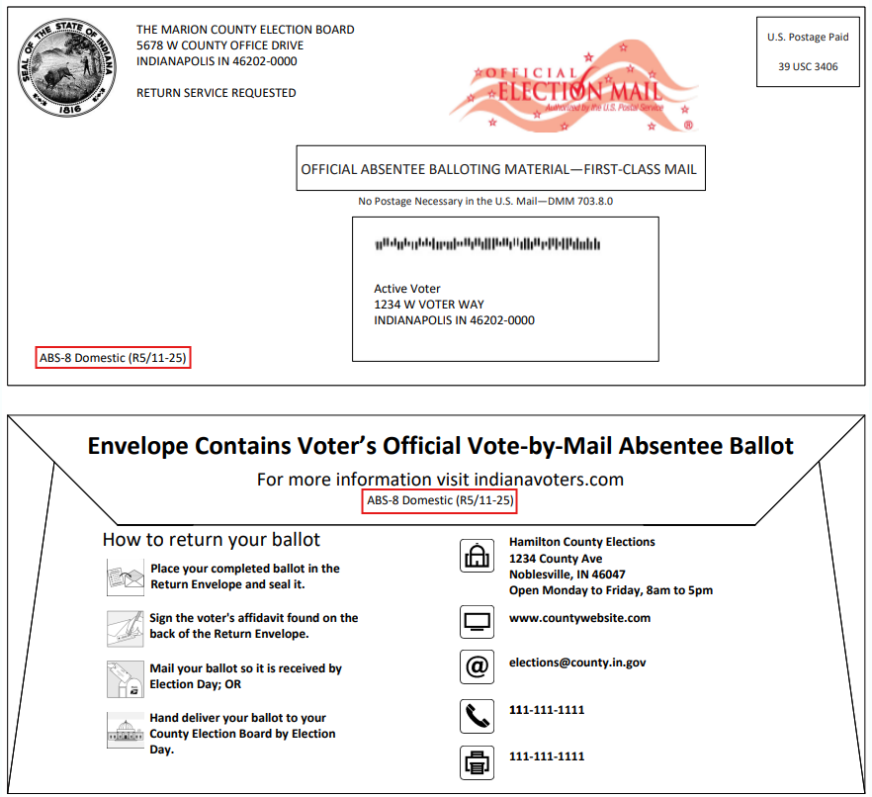
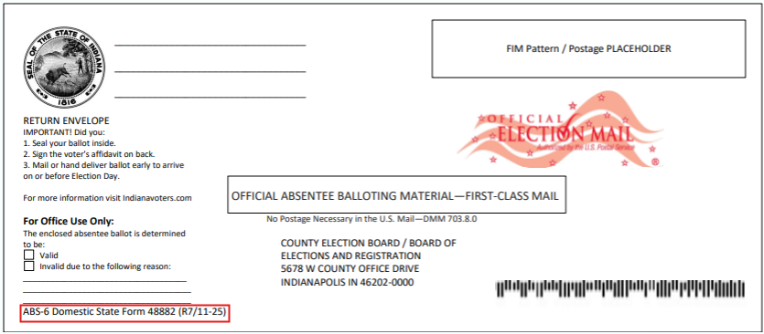
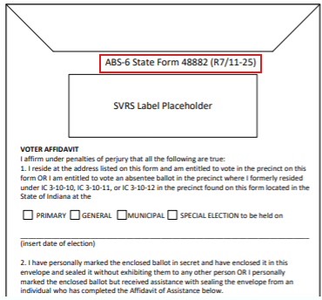
Domestic ABS Envelope Changes for 2026
USPS Mailing Best Practices Conversation

Slide 5
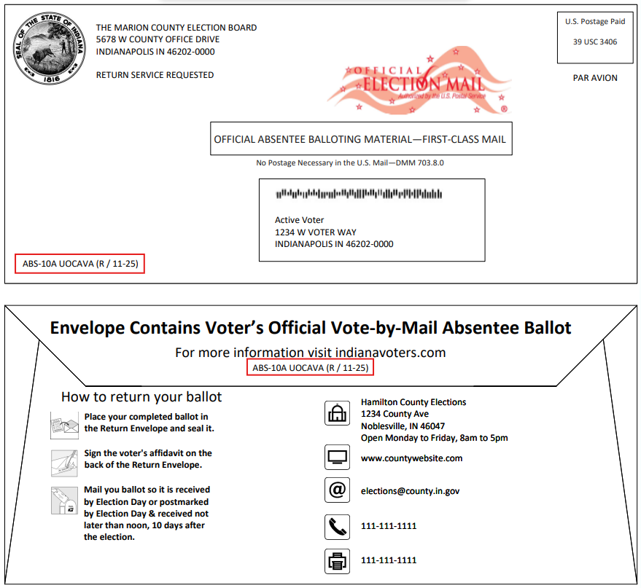
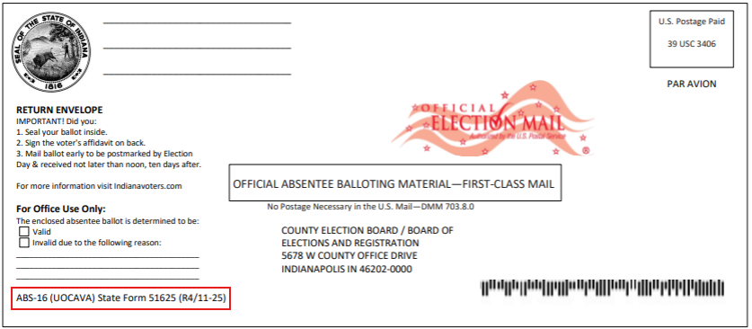
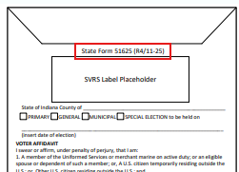
UOCAVA ABS Envelope Changes for 2026
USPS Mailing Best Practices Conversation

