Slide 1
2024 Election Mail Planning
2024 Indiana Election Administrators’ Conference
December 12, 2023
Adrienne Marshall
Executive Director – Election and Government Mail Services
Jerod Siddle
Central Field Specialist – Election and Government Mail Services

Slide 2
2023 Election Mail Planning
Agenda
2022 Election Cycle Recap/Highlights
Election and Government Mail Services Team
Election Mail Security
USPS Outreach and Communications
Policies and Mailing Recommendations
Postmarking
Mailpiece Visibility
Ballot Mail Service Type Identifiers (STIDs)
Addressing
Mailpiece Design
Printing & Mailing Schedule
Prepaid Reply Mail Options
Informed Delivery
Informed Visibility Mail Tracking and Reporting
Resources

Slide 3
2023 Election Mail Planning
The Postal Service’s Role in the Election Process
The Postal Service is committed to fulfilling our role in the electoral process and we provide a secure, efficient and effective way for citizens to participate when policymakers decide to use mail as part of their elections. The Postal Service has a robust and tested process for proper handling and timely delivery of Election Mail.
Every federal election cycle, we make efforts across the nation to inform local and state election officials about mailing procedures, our operational standards, and our recommended best practices for utilizing the mail.

Slide 4
2022 Election Cycle Recap/Highlights
Thank you for your partnership in the 2022 midterm elections as the United States Postal Service’s executed its role in the vote-by-mail process.
Monday, January 9, 2023, we released our 2022 Post-Election Analysis Report. The final performance numbers for the 2022 election cycle show that the Postal Service once again performed strongly in delivering the nation’s election mail.

Slide 5
Election & Government Mail Services
Director of Election & Government Mail Services
Adrienne Marshall
Election & Govt. Mail Specialist
Jerod Siddle
Election & Govt. Mail Specialist
Daniel A. Garcia
Election & Govt. Mail Specialist
Steven J. Carter
Election & Govt. Mail Specialist
Tiffany Todd
Election and Govt. Mail Specialist
Emily Matyas
Election and Govt. Mail Specialist
Vacant
Manager, Policy & Strategy
Dan Bentley
Election & Govt. Mail Specialist
Lisa Del Rio
ATLANTIC AREA & PROCESSING DIVISIONS
CENTRAL AREA & PROCESSING DIVISIONS
SOUTHERN AREA & PROCESSING DIVISIONS
WESTPAC AREA & PROCESSING DIVISIONS

Slide 6
Election Mail Outreach Teams
4 Area Election Mail Field Specialists
Area leadership to promote HQ Election Mail policies with field operations
4 Area Directors of Customers Relations
Area leadership and senior point of contact to election officials
50 Managers of Customer Relations at the District level
Primary point of contact for the District with Election Officials
District Election Mail Strike Teams
Cross-functional support to ensure the timely processing and delivery of Election Mail, and address and resolve mailing issues
Director, Election & Government Mail Services
(w 4 Area Specialists)
HQ Cross
Functional
Election Team
4 Area VPs
Retail
& Delivery
2 Processing &
Maintenance
Regions
4 Area
Directors,
Customer
Relations
50 District
Managers
Customer
Relations
District
Strike Teams
(Cross
Functional)
Chief State
Election Executives
State
Elections
Directors
7,500+ Local Jurisdiction Administrators
Tribal Election Leaders

Slide 7
USPS - Areas and Districts Map
Central
Alaska
Washington
Maine
Vermont
Montana
North Dakota
Minnesota
Michigan
(upper peninsula)
New Hampshire
Oregon
Wisconsin
New York
Massachusetts
Rhode Island
Idaho
South Dakota
Michigan
Connecticut
Wyoming
Pennsylvania
New Jersey
Atlantic
Iowa
Ohio
Delaware
Nebraska
Maryland
WestPac
Nevada
Illinois
West
Virginia
Utah
Indiana
Virginia
California
Colorado
Kansas
Missouri
Kentucky
North Carolina
Oklahoma
Tennessee
South Carolina
Arizona
Arkansas
New Mexico
Mississippi
Alabama
Georgia
Hawaii
Texas
Louisiana
Florida
Southern

Slide 8
Election Mail Security

Slide 9
Election Mail Security
ENSURING THE SECURE DELIVERY OF OUR NATION’S ELECTION MAIL
Supports USPS by responding to customer and partner driven election related security questions and incidents, including those reported by customers (boards of election and voters).
Coordinates closely with federal, state and local partners on election security table-top exercises, planning meetings and other events on an ongoing basis.
Operates a 24hr law enforcement reporting line for election officials. (877)876-2455 (please select #4).
Triages reports of election mail security and criminal incidents from election officials throughout election cycles.
Monitors the postal network for election mail related issues including potential unauthorized delay, delivery, and changes of address related to election mail.
Works with state and federal law enforcement authorities to support election offense investigations.
Monitoring and oversight of the Postal Service’s ability to timely process and deliver Election Mail.
Coordinates closely with federal, state and local partners on election security table-top exercises, planning meetings and other events on an ongoing basis.
Conduct site visits to observe and monitor operations at postal facilities around the country.
Continued focus on protecting the integrity of political and election mailings.
Works with state and federal law enforcement authorities: to support election offense investigations involving USPS employees

Slide 10
Recent USPS Outreach and Communications

Slide 11
ELECTION & GOVERNMENT MAIL SERVICES
USPS Outreach and Communications
USPS Election Mail Visibility Survey March 21 - April 14, 2023
Survey of state and local election jurisdiction’s use of Election Mail visibility tools
USPS Request for Information on Ballot Mail Return Address List
Ballot Mail Return Address Lists help USPS improve mail processing procedures and more effectively implement Election Mail “extraordinary measures.”
National Postal Forum - Election Mail Day – May 24, 2023 - Charlotte, NC
Topics: Election Mail Visibility, Mail Security and the Postal Inspection Service, Address Management Services, Mailpiece Design, Analytics
Next National Postal Forum - June 2 – June 5, 2024 - Indianapolis, IN

Slide 12
USPS Election Mail Policies and Mailing Recommendations for Election Officials

Slide 13
2023 Election Mail Planning
Postmarking
We do not postmark every piece of mail under ordinary processing procedures.
However, it is our long-standing policy to try to ensure that every return ballot mailed by voters receives a postmark, regardless of their method of paying postage.
The Postal Service has instructed employees throughout the country about our ballot postmarking processes and procedures and reviewed the standard operating procedures for ballot postmarking.
We acknowledge that circumstances can arise that prevent ballots from receiving a legible postmark.
Voters are reminded to check collection times posted on collection boxes and at Post Office locations and retail facilities. Ballots deposited after the collection time won’t be picked up, or postmarked, until the following business day.

Slide 14
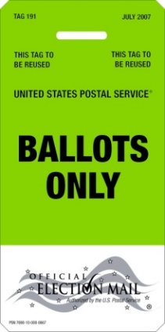
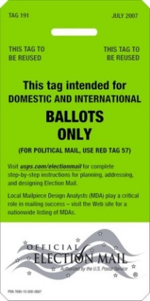
2023 Election Mail Planning
Election Mail Visibility Tools
Official Election Mail logo
Tag 191, Domestic and International Ballots
Serialized Intelligent Mail barcode (IMb®)
Ballot Mail Service Type Identifiers (STIDs)
Election Mail Postage Statement Check Box
Official
Election Mail
Logo
Tag 191
IMb
&
STID
Defined STID
Assigned MID
Matching Serial Number
Recipient / Voter Address

Slide 15
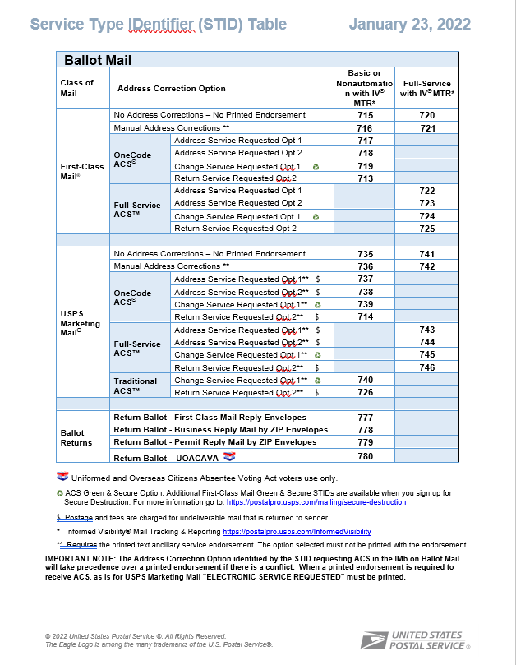
Official Ballot Mail Tracking
Ballot Mail Service Type Identifiers (STIDs):
Outbound Ballot Mail
Use appropriate Ballot Mail STID for First-Class Mail® ballots or Marketing Mail® ballots and services desired
Return Ballots
Use appropriate Ballot Return STID for payment method
Ballot Mail STIDs are reserved for ballots ONLY.

Slide 16
Election Officials that want to receive discounted First-Class® and USPS Marketing Mail® postage rates are required to use an approved Move Update option
NCOA^{Link®}
Pre-mailing, secure automated process that allows mailers to submit a listing of names and addresses or a mail piece for matching to a Change-Of-Address record to find and update to the new address.
ACS™
Post-mailing service that acts on the mail piece to determine the correct disposition of undeliverable mail and generates an electronic address correction notice which includes Change-of-Address information.
Ancillary Service Endorsements
Post-mailing service that provides manual address corrections or return of the mail depending on endorsement used (Address, Return, and Change Service Requested).
Alternative Methods
Pre-approved exceptions available for First-Class® Mail
Mailer is tested to demonstrate their mailing list is 99% accurate
Documented Legal Restraint that prohibits updating of list without customer approval

Slide 17
2023 Election Mail Planning
Sample Outgoing Ballot
Mailpiece Design
Design Considerations
Letter-size Reply Envelopes
Colors
Weight limitations
Proper wording
Placement of postal markings
Mailpiece Design Analyst Review
Consultation for mailing standards
Guidance regarding automation rate qualification
Technical assistance for printers, graphic designers, and envelope manufacturers
We recommend that every Election Mail envelope design be reviewed by an MDA before it is used
Sample BRM/QBRM Design Standard
Mailing & Shipping Solution Center (MSSC)
MSSCadmin@usps.gov
or 1-877-672-0007

Slide 18
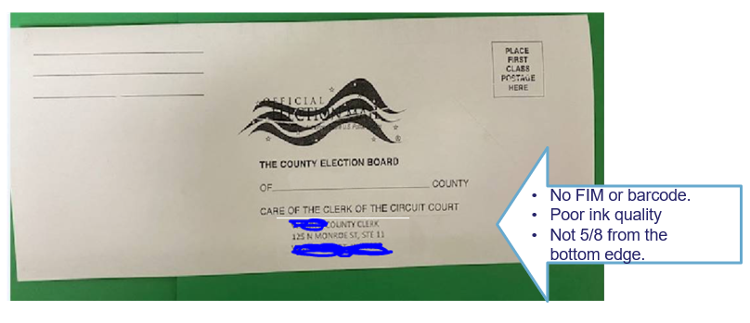
2023 Election Mail Planning
Mailpiece Design: Ballot Mail Design Challenges:
Poor Print Quality
FIM, IMb, poor print quality, and placement of address block all have a significant impact on the ability of USPS automation equipment to scan the mailpiece accurately.
When USPS automation equipment cannot read mailpieces, they are sorted into manual operations, which causes delays.

Slide 19
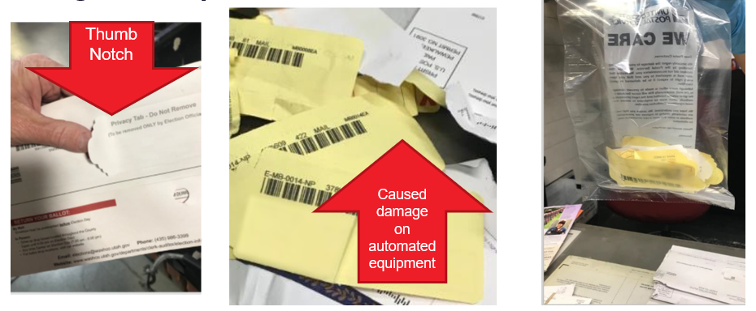
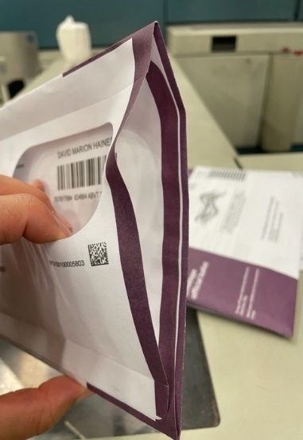
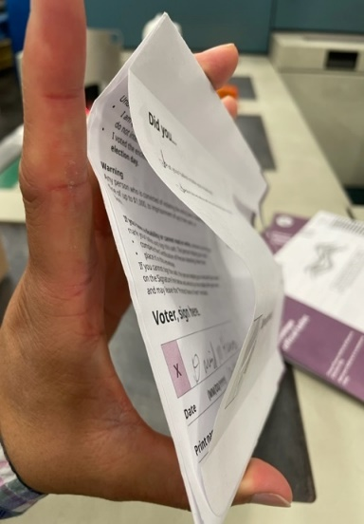
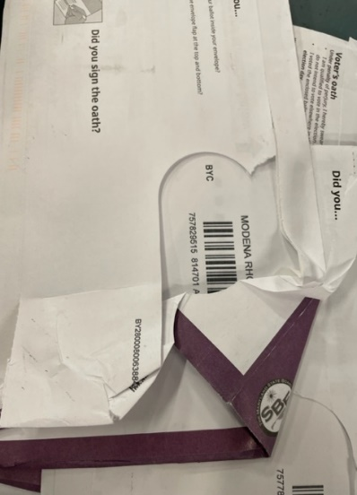
2023 Election Mail Planning
Mailpiece Design: Ballot Mail Design Challenges:
Ballot Mail is not tabbed on both ends. This design causes damage to the mailpiece.
Ballot Mail thumb notch catches on automation equipment and causes damage to the mailpiece.
Damaged mailpieces in processing require manual processing, which is the leading cause of delayed mail. Damaged mailpieces can also result in no cancellation (postmark) or complete destruction, which may require that ballot to be reissued.

Slide 20
2023 Election Mail Planning
Printing & Mailing Schedule:
The Postal Service continues to recommend the use of First-Class Mail for time sensitive election mail, particularly outbound ballots.
The process for designing, printing, and mailing Election Mail materials takes time. Be sure to consult with a Mailpiece Design Analyst early in the process to ensure your Election Mail is designed properly and includes all of the recommended visibility tools.
Managers of Customer Relations, Mailpiece Design Analysts, and other Postal Service experts are available to assist you with your Election Mail program. Sharing information regarding your mailpiece design, estimated volume, mailing date, mail entry location, and other information about your mailing plans supports the timely processing and delivery of Election Mail.

Slide 21
2023 Election Mail Planning
Prepay Reply Mail Options:
The Postal Service offers a variety of ways for elections officials to prepay for mail returned to them, such as voter registration forms, ballots, or other materials. Depending on your expected volume of reply mail, tracking requirements, and other factors, the Postal Service has a solution that will meet your needs.
State and local officials may choose to offer their voters a prepaid reply mail option such as:
Business Reply Mail
Qualified Business Reply Mail
Metered Reply Mail
Permit Reply Mail
Stamps
For more information, contact
Mailing & Shipping Solution Center (MSSC)
MSSCadmin@usps.gov
or 1-877-672-0007

Slide 22
2023 Election Mail Planning

Slide 23
Informed Visibility Mail Tracking and Reporting
2023 Election Mail Planning
Informed Visibility Mail Tracking & Reporting (IV®-MTR) is the U.S. Postal Service’s solution for near real-time letter and flat mail tracking information
The IV-MTR application provides end-to-end mail tracking information for letter and flat pieces, bundles, handling units, and containers
We encourage elections officials to make use of Informed Visibility to better plan Election Mail mailings and resources.
36

Slide 24
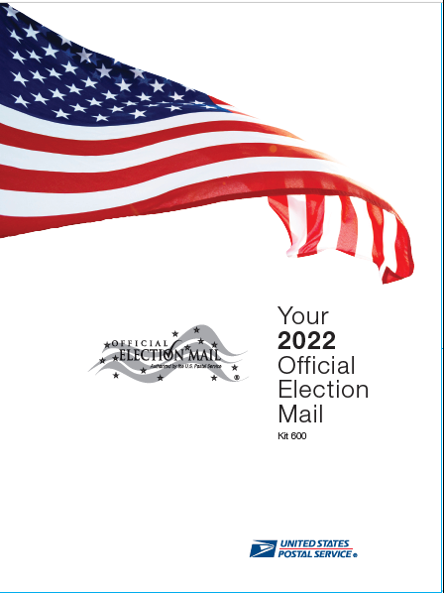
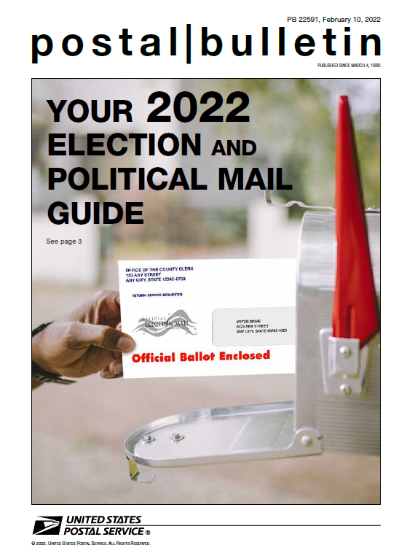
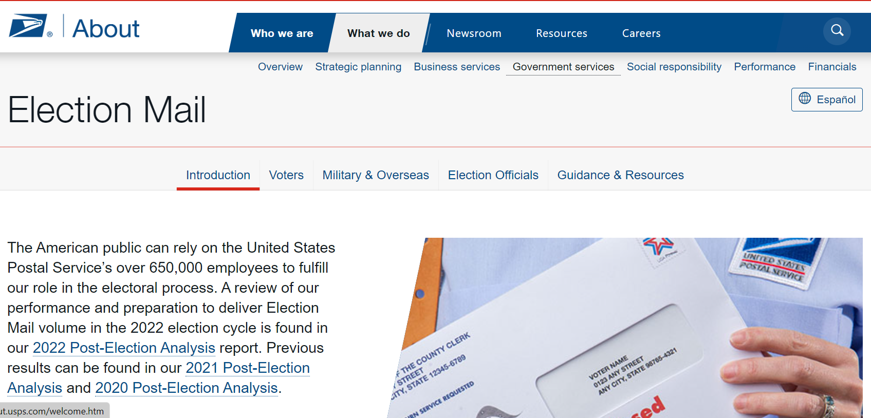
Election & Government Mail Services
Resources
Kit 600 - The 2022 Official Election Mail Program Kit
Postal Bulletin: The 2022 Official Election Mail Guide
USPS.com/electionmail

Slide 25
USPS.com/electionmail

Slide 26
2023 Election Mail Planning
USPS Point of Contact:
The Postal Service has designated your District Manager of Customer Relations as a single point of contact for your election mail planning. Your Manager of Customer Relations is supported by local and national Election Mail experts to assist you with questions, issue resolution, mailpiece design, and other issues. These dedicated postal employees are deeply knowledgeable about and fully committed to the timely delivery of Election Mail.
Indiana District Manager of Customer Relations:
Kimberly Pickett kimberly.l.pickett@usps.gov (317) 870-8545
Indiana Manager Business Mail Entry:
Terri Beckham terri.a.beckham@usps.gov (480) 931-0793
EGMS Central Field Specialist:
Jerod Siddle Jerod.A.Siddle@usps.gov (980) 226-7393

Slide 27
Thank You for Your Time and Attention!

