Slide 1
INDIANA PUBLIC ACCESS LAWS
Presented by
Luke Britt, Indiana Public Access Counselor

Slide 2
LEGISLATIVE INTENT
Indiana Code § 5-14-3-1 through 5-14-3-10
Enacted in 1983 (“APRA”)
A fundamental philosophy of the American constitutional form of representative government is that government is the servant of the people and not their master.
Accordingly, it is the public policy of the state that all persons are entitled to full and complete information regarding the affairs of government and the official acts of those who represent them as public officials and employees.
Providing persons with the information is an essential function of a representative government and an integral part of the routine duties of public officials and employees, whose duty it is to provide the information.

Slide 3
PUBLIC ACCESS COUNSELOR
The Public Access Counselor provides advice and assistance concerning Indiana's public access laws (the Access to Public Records Act and the Open Door Law) to members of the public and government officials and employees.
Conducts research.
Prepares interpretive and educational materials and programs in cooperation with the office of the attorney general.
Distributes to newly elected or appointed public officials the public access laws and educational materials concerning the public access laws.
Responds to informal inquiries made by the public and public agencies by telephone, in writing, in person, by facsimile, or by electronic mail concerning the public access laws.
Issues advisory opinions to interpret the public access laws upon the request of a person or a public agency.
Makes recommendations to the general assembly concerning ways to improve public access.

Slide 4
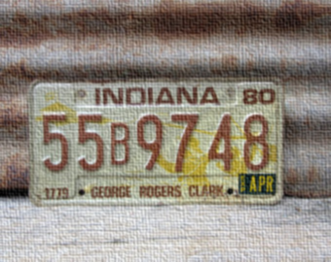
2020-2021 FISCAL YEAR
Received approximately 10000 Requests for Assistance
500 Formal Complaints Filed
10-20 Informal Inquiries Filed
Conducted 40 Trainings and Presentations
Opinions and Annual Report found at www.in.gov/pac
* Reports filed with the General Assembly every July 1

Slide 5
INDIANA OPEN DOOR LAW (“ODL”)
“…It is the intent of this chapter that the official action of public agencies be conducted and taken openly, unless otherwise expressly provided by statute, in order that the people may be fully informed…” IC 5-14-1.5-1.

Slide 6
BASIC RULE
Majority
Governing Body
Official Action
Public Business
48 Hours Notice
Must be open to the public
Notes:
“

Slide 7
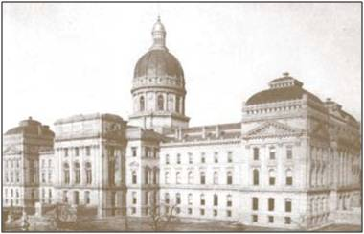
REQUIRED NOTICE
48 business hours in advance
Date, time and place where Governing Body will meet
Generally no requirements to publish in newspaper (public hearings are different than public meetings)
Annual notices are permitted
Emergency meetings are exception to notice requirement
Must post at principal place of business or meeting location – mere website or newspaper notice is insufficient
Special meetings of County Executives IC 36-2-2-8 (must state specific subject matter)
Prohibition on serial meetings

Slide 8
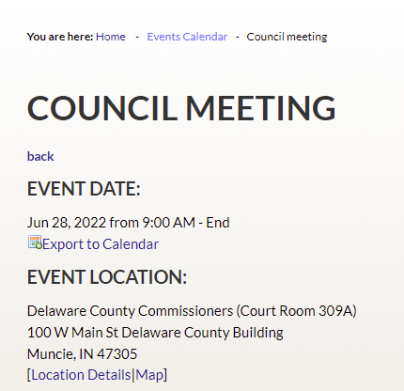
EXAMPLE OF PUBLIC NOTICE
Notice of Public Meeting:
Delaware County Council Meeting
Tuesday, June 28, 2022
9:00 a.m.
Court Room 309A
100 W Main St. Delaware County Building, Muncie, IN 47305

Slide 9
EXECUTIVE SESSIONS
The “exception” to meetings that are open to the public
Notice must include statutory purpose(s) for the meeting excluding the public.
Meeting minutes or memoranda must include certification that only the topics permitted under the ODL for executive session were discussed.
Should be irregular
NO FINAL ACTION

Slide 10
PROPER EXECUTIVE SESSION NOTICE

Slide 11
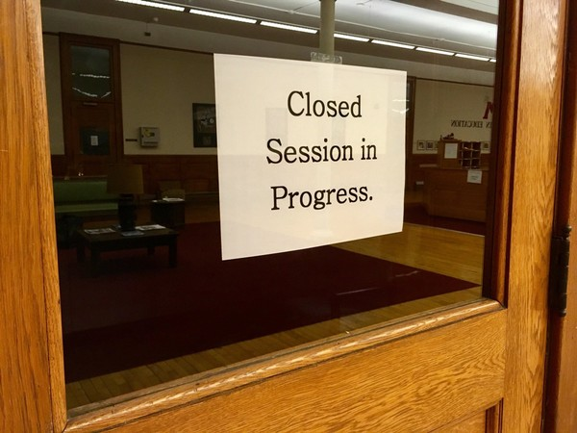
COMMON EXECUTIVE SESSIONS
To discuss:
records classified as confidential by state or federal statute
the alleged misconduct of an employee
strategy with respect to pending litigation or litigation threatened in writing
To receive information and interview prospective employees

Slide 12
MISCELLANEOUS ODL CONSIDERATIONS
No right to speak under ODL unless some other statute requires it (i.e. public hearings)
No right to participate by public
Minutes/Memoranda (Draft copies)
Electronic Meetings
No secret ballots when voting

Slide 13
ACCESS TO PUBLIC RECORDS
“Public record” means any writing, paper, report, study, map, photograph, book, card, tape recording, or other material that is created, received, retained, maintained, or filed by or with a public agency and which is generated on paper, paper substitutes, photographic media, chemically based media, magnetic or machine readable media, electronically stored data, or any other material, regardless of form or characteristics.
Indiana Code § 5-14-3-2(n)

Slide 14
RESPONDING TO APRA REQUESTS
Time frames for responding to APRA Requests depend on the manner in which the public agency receives the request.
If requestor is physically present in the office, the agency has 24 hours to respond.
If the request is made by mail or by facsimile, the public agency has 7 days from the date it was received.
Important: Production of documents is not required in these time frames, but within a reasonable time.
Copy fees

Slide 15
REASONABLE PERIOD OF TIME
All records must be provided within a “reasonable period of time” after the request is received.
Factors considered:
How broad is the request
Where are the records located
How much redaction is necessary
Busy time at the agency
Common sense factors
What I like to see:
Communication – Status Updates
Piecemeal disclosures

Slide 16
REASONABLE PARTICULARITY
A request from the public must be reasonably particular – a subjective standard
Two conflicting cases
Can you find it?
Are there objective elements in the query?
What I like to see:
No blanket denial
Cooperate to narrow request

Slide 17
THREE CATEGORIES OF PUBLIC RECORDS

Slide 18
THE GOOD: DISCLOSABLE RECORDS
Meeting Minutes
Budgets
Invoices
Receipts
RFPs
Contracts

Slide 19
THE BAD: CONFIDENTIAL PUBLIC RECORDS
Some Personal Health Information
Trade secrets
Student records
Social Security Numbers
Those declared confidential by state statute or federal law

Slide 20
THE UGLY: DISCRETIONARY PUBLIC RECORDS
Investigatory records of law enforcement agencies
Attorney work product/client communication
Deliberative material
Personnel files of public employees

Slide 21
EMAILS
A public record includes electronic media that is created received, retained, maintained, or filed by or with a public agency.
Electronic mail must be available for inspection and copying by the governing body unless an exception to disclosure, based on the content of the email, applies.
Electronic mail must be maintained in accordance with records retention schedules, pursuant to I.C. 5-15.
Most agencies have their own retention schedules.
Notes:
Since there is room, spacing out the points on this slide might make it easier for the audience to read.

Slide 22
DENIALS
If a request is made orally, the agency may deny the request orally.
If request is made in writing, the agency must deny the request in writing.
Before the trial court, the burden is on the agency to demonstrate that the denial complied with the APRA.
Court may review the records in-camera; the court may review the records if redaction of the record has occurred.
Notes:
Make font bigger if possible. Make everything after the colon bullet pointed.

Slide 23
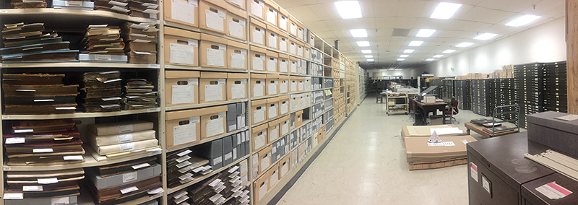
NONCOMPLIANCE
Consequences
Complaint to Public Access Counselor
Lawsuit
Penalties
Court action seeking order to produce records and potentially order to pay attorney’s fees
Fines for knowing and intentional withholding of public records or violation of the ODL
Bad press and damage to public perception

Slide 24
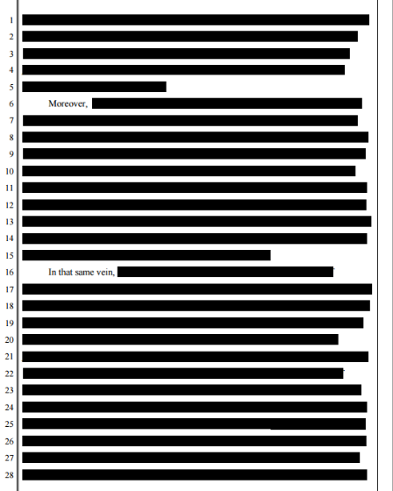
COMMON MISCONCEPTIONS OF AGENCIES
Offering to allow inspection is sufficient.
Everything can be redacted
Denials do not have to be explained
Any document containing confidential information may be omitted from public records response

Slide 25
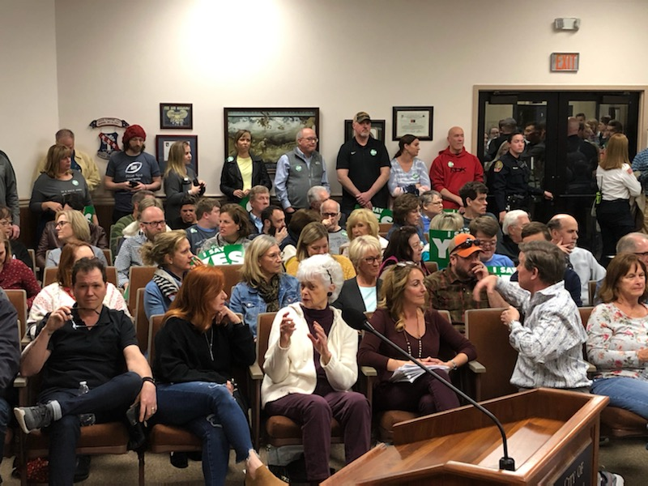
COMMON MISCONCEPTONS OF CITIZENS
A public agency should:
Answer questions under APRA
Give me immediate access
Keep public records forever
Handle public records requests before handling other matters of the public agency
Keep public records in a format that is most convenient for me.

Slide 26
Public Access Handbook:
http://www.in.gov/pac/files/pac_handbook.pdf
Public Access Counselor Website:
http://www.in.gov/pac/
Contact Information:
Indiana Public Access Counselor
402 W. Washington St, W470
Indianapolis, IN 46204
317.234.0906
pac@opac.in.gov

