Slide 1


AmeriCorps State Funding 2023-2024
Application Technical Assistance Webinar

Slide 2
Training Goals:
Understand Serve Indiana’s role with AmeriCorps in Indiana
Answer frequently asked questions
Discuss new applicant requirements
Answer Questions/Concerns
*Webinar mirrors information available in NOFO and Application Instructions on Serve Indiana’s website: https://www.in.gov/serveindiana/funding-opportunities/

Slide 3
Who should attend
2023-24 Potential Applicants:
New applicants applying for funding in Indiana
Any organization interested in learning more about AmeriCorps and AmeriCorps State funding in Indiana

Slide 4
Serve Indiana
Mission: Advance service and volunteerism by informing, connecting, and promoting opportunities and resources that enrich the lives of Hoosiers
Programs: AmeriCorps State
Initiatives: Day of Service Grants, Awards for Excellence
Known as the “state commission” for AmeriCorps State funding and “grantee”
Applicant organizations = “sub-grantees” or “programs”
Staff:
Marc McAleavey: Executive Director
Willie Brooks: Director of Programs
Cassandra Gillenwater: Director of Grants
Kim Woods: Communications & Training Manager

Slide 5
GARP Contact & Information
How to keep up to date:
Sign up for newsletter, receive emails
Check website frequently
Follow us on Facebook and twitter
Main Contact: Cassandra Gillenwater
Email: ckellogggillenwater@serveindiana.gov
Phone: 317-220-1659

Slide 6


www.nationalservice.gov
AmeriCorps Seniors
www.seniorcorps.gov
AmeriCorps
www.americorps.gov
RSVP/Retired Senior
Volunteer Program
State/National
Volunteer Generation Fund
FEMA Corps
Foster Grandparents
VISTA – Volunteers in
Service to America
Justice Corps
Senior Companions
NCCC – National
Civilian Community
Corps

Slide 7
AmeriCorps State Funding Basics:
Funding types: Competitive or Formula
Application types:
Fall Submissions:
Competitive continuation (year 1 & 2)
Competitive & formula re-compete (year 3)
New applicant (No previous funding, within 5 years)
Spring Submission:
Formula continuation (year 1 & 2)
Types of grants
Cost reimbursement
Fixed
Education Award only, professional corps, etc

Slide 8
Frequently Asked Questions

Slide 9
What is AmeriCorps funding and who gets it?
What does AmeriCorps Funding Do?
Provides high quality programs that demonstrate an evidence-based or evidence-informed approach to strengthening communities and solving community problems by engaging individuals in service as AmeriCorps members
Who are awarded grants?
Nonprofits, Indiana tribes, colleges and universities, and state and local public agencies
What do grants accomplish?
address unmet needs in education, economic opportunity, veteran services, disaster services, health, the environment and more

Slide 10
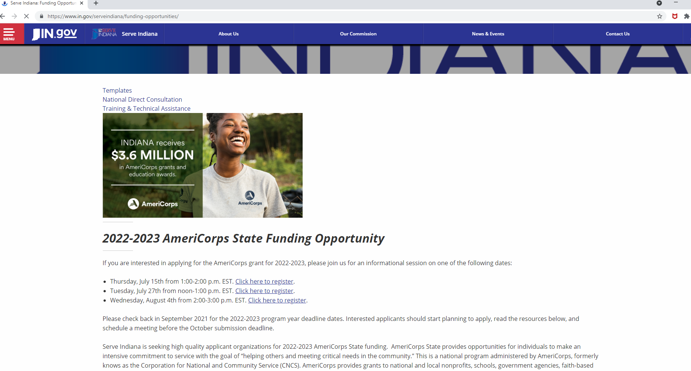
Where do I find the application materials, TA items, updates?
https://www.in.gov/serveindiana/funding-opportunities/

Slide 11
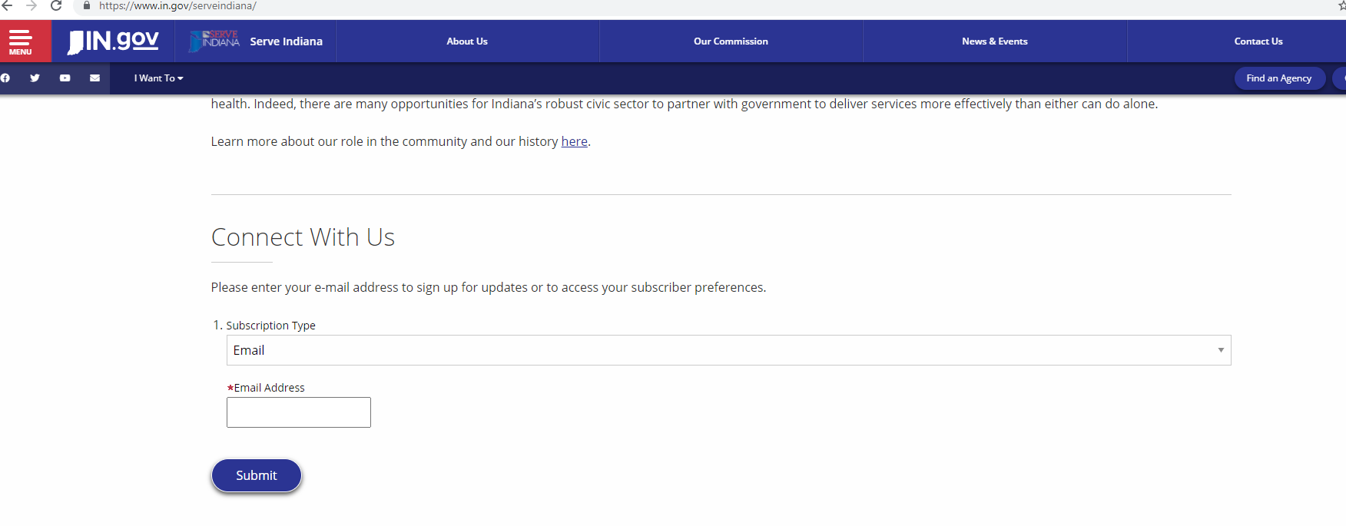
How do I get the best updates?

Slide 12
What are the application materials?
NOFO: Notice of funding opportunity
Supplemental Guidance: Definitions
Performance Measure Instructions
Application Instructions
Attachments with detailed budget instruction and performance measure submission instructions
Applicants must read and understand all materials to successfully complete grant
All items & updates are available on Serve Indiana website: https://www.in.gov/serveindiana/funding-opportunities/

Slide 13
Can I use funding for an existing program?
A grantee might use AmeriCorps resources to make an existing program more effective, to reach previously underserved communities or to expand their activities beyond what they were able to do without AmeriCorps.
AmeriCorps funding should not duplicate, displace or supplant resources that currently exist in the community. AmeriCorps members cannot be used to take the place of staff, current volunteers or existing funding.

Slide 14
What do grants include?
An allotment of AmeriCorps member positions and funds that are directly tied to a specific number of members
Are solely for program expenses and are not for general organizational expenses
Provide partial funding to support AmeriCorps projects/programs
Grant recipients must contribute cash or in-kind match funding to support the project

Slide 15
What other requirements are there?
Serve Indiana does not recommend an application with less than 10 MSY
New applicants cannot apply for fixed grant funding
Cost per MSY budget restrictions
Living allowance total restrictions
Additional restrictions:
Prohibited activities, lobbying activities, no convictions of federal crimes, unpaid federal debt, unpaid unemployment taxes state of Indiana, etc.
Notes:
Under section 132A(b) of the NCSA, organizations that have been convicted of a federal crime may not receive assistance described in this Notice.
Note that under section 745 of Title VII, Division E of the Consolidated Appropriations
Act, 2016, if CNCS is aware that any corporation has any unpaid Federal tax liability which—
has been assessed,
for which all judicial and administrative remedies have been exhausted or have lapsed, and
that is not being paid in a timely manner pursuant to an agreement with the authority responsible for collecting the tax liability, that corporation is not eligible for an award under this Notice. A similar restriction may be enacted with the appropriation which will fund awards under this Notice. However, this exclusion will not apply to a corporation which a federal agency has considered for suspension or debarment and has made a determination that suspension or debarment is not necessary to protect the interest of the federal government
Pursuant to the Lobbying Disclosure Act of 1995, an organization described in Section 501(c)(4) of the Internal Revenue Code of 1986, 26 U.S.C. 501(c)(4) that engages in lobbying activities is not eligible to apply for CNCS funding.

Slide 16
What are the responsibilities and requirements of the program host?
Employ strong fiscal and program management systems
Monitor financial management, program performance and member activities
Train and provide technical assistance to staff and members
Ensure the recruitment, orientation and training of members
Track and ensure the accuracy of member hours and activities
Track progress toward meeting approved performance measures
Act as a liaison between the State Service Commission and other components of the program

Slide 17
Am I ready to run an AmeriCorps State program?
Experience managing federal funds
Organizational capability
Staff skilled in training, supervision and oversite
Community partners
Intervention, logic model, research, performance measures
Readiness assessment through Serve Indiana

Slide 18
Who submits the application?
Submission roles:
Main applicant: Serve Indiana
Sub-applicant: Programs/Organizations
Review materials:
Read all materials on website
Review Serve Indiana AmeriCorps handbook
Review Serve Indiana State Service Plan
Review AmeriCorps State Terms and Conditions

Slide 19
When is the application due?
Fall Due Dates: New Applicants
October 3rd: Notice of Intent to Apply via email
November 1st: Application Due via eGrants
Additional clarification and notification dates available in NOFO/Application Instructions

Slide 20
Where else can I get help?
Pre-Submission
Office Hours
1:1 Conversations with Cassandra
Submit drafts of logic model, evidence section early in October
TA Webinars on Website
Post-submission
Webinar series: One call each month from existing programs
Contact Cassandra or info@serveindiana.gov

Slide 21
What does the application include?
Narratives:
Standard Form 424 (SF-424) Face Sheet:
Executive Summary
Program Design
Organizational Capability
Cost Effectiveness and Budget Adequacy
Evaluation Plan(if applicable)
Logic Model/theory of change
Logic model
Documents: Evaluation, Labor Union Concurrence, etc.
SF 424 Budget
Performance Measures

Slide 22
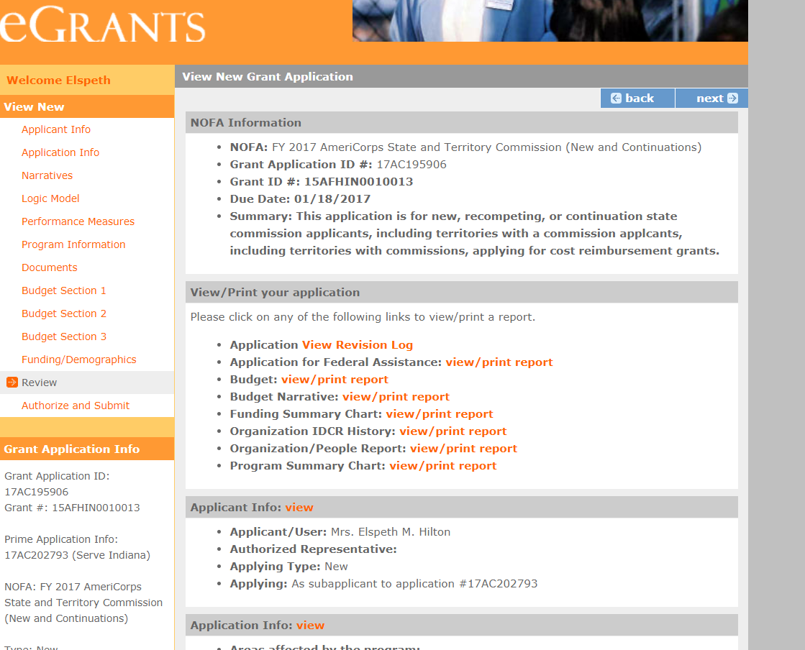
What does it look like in eGrants?

Slide 23
Are there page limits?
Application narratives must not exceed 10 pages
Includes: Executive Summary, SF 424 Facesheet, and The Narrative portions contained in the Program Design, Organizational Capacity, and Cost Effectiveness and Budget Adequacy sections of the application.
Logic Model may not exceed 3 pages printed
Additional Information:
Print out from “Review” tab in web-based system
The application page limit does not include:
The Budget, narrative portion of the evaluation plan, performance measures, or the supplementary materials, if applicable.

Slide 24
Best practices for grant writing
Best practices:
Be clear and concise; no jargon
Focus on strengths and align with your organization
Focus effort on evidence based or evidence informed program
Follow deadlines, no late submissions
Grant takes between 40-80 hours to complete
Engage full organization for program model & review

Slide 25
Do not begin in eGrants!
Read ALL Application Materials
Draft theory of change and logic model
Draft performance measures
Draft program Design narrative: Evidence section
Draft program Budget
Draft evaluation plan (if re-competing for second time)
Write remaining narratives
Read ALL Application Materials

Slide 26
Evidence is Important
Serve Indiana & CNCS value programs who value evidence
Programs should work to move from evidence informed to evidence based (see next slide)
In 2018, the evidence tiers of successful AmeriCorps State and National applicants that were competing were as follows: Strong 9%, Moderate 5%, Preliminary 40%, and Pre-Preliminary 46%.
When you build/create your program, evidence should always be involved.
Documents why you think your intervention will achieve the intended outcome
Supports the use of a particular design, frequency, intensity and duration of intervention that is optimal
Ensure your member’s activities align with these ideas

Slide 27
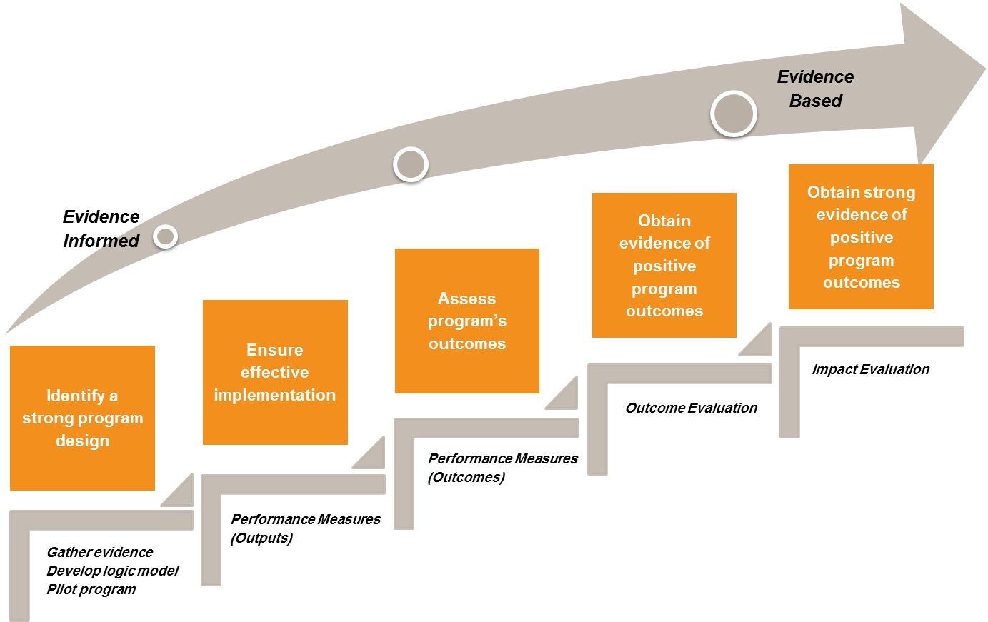
Building evidence of effectiveness
Notes:
CNCS and SI value programs that move towards evidence based.
The goal is to have strong evidence to support your specific program model (i.e. theory of change/logic model)
Most programs are at the evidence informed level. We want to see programs moving from informed to evidence based
Program evaluation, performance measures, data collection all help programs move up on continuum-Building evidence is key to that success
Why do evaluation? To build evidence of effectiveness, and for program improvement.
Facilitators Notes: This diagram illustrates CNCS’s overall developmental approach. It shows that evidence falls along a continuum with the understanding that identifying an evidence-based program model requires organizational capacities that correspond to an organization’s life cycle.
The key building blocks for generating evidence are shown in the diagram.
The first step is identifying a strong program design by gathering evidence that supports the intervention to be used. During this initial process, it is helpful to develop a logic model which clearly communicates the central model of your program.
It also is recommended that the program be piloted during this initial step to ensure its effective implementation prior to expanding the program more widely.
Once a strong program design has been identified, the second building block is ensuring the effective full implementation of the program. Efforts should be made to document program processes, ensure fidelity to the central program model, evaluate program quality and efficiency, and establish continuous process improvement protocols.
Much of these activities can be supported through the identification and regular monitoring of performance measures.
The next level in the continuum is assessing the program’s outcomes. This process involves developing indicators for measuring outcomes, possibly conducting one of the less rigorous outcome evaluation designs, such as a single group pre-post design to measure program outcomes, and conducting a thorough process evaluation. We will discuss what these types of evaluation designs entail later in this presentation.
One step further in the continuum is obtaining evidence of positive program outcomes by examining the linkages between program activities and outcomes. Programs at this level of the continuum will have performed multiple pre- and post-evaluations and conducted outcome evaluations using an independent evaluator.
Finally, the highest level of evidence allows a program to make the claim of being evidence-based by attaining strong evidence of positive program outcomes. At this level, programs have established the causal linkage between program activities and intended outcomes/impacts. Programs at this level have completed multiple independent evaluations using strong study designs, such as a quasi-experimental evaluation using a comparison group or an experimental, random assignment design study.
Many of these programs also have measured the cost effectiveness of their program compared to other interventions addressing the same need.
Based on this understanding of a continuum of evidence, a strong program design, sound performance measures, and the identification of measureable program outcomes are a fundamental starting point for building evidence of effectiveness. Consequently, attempts to generate experimental evidence before earlier developmental work has been completed is not recommended and may result in wasting valuable resources. As an agency, CNCS continues to develop a funding strategy that will create a portfolio of programs reflecting a range of evidence levels (e.g., strong, moderate, preliminary) that are appropriate to the program’s life cycle and investment of public dollars. CNCS sees value in infusing evaluative thinking and knowledge into every phase of a program’s life cycle – program development, implementation, improvement, and replication/scaling.

Slide 28
Logic Models

Slide 29
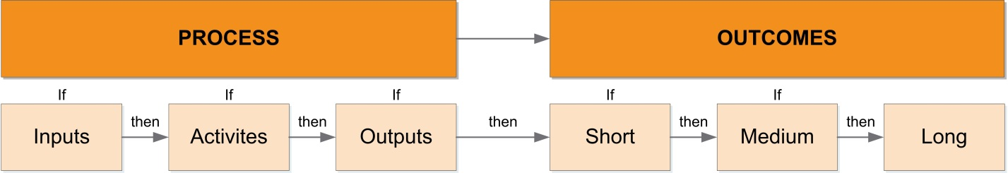
What is a logic model?
A logic model is a graphic “snapshot” of how a program works (its theory of change); it communicates the intended relationships among program components.
Inputs, activities, and outputs on the left side of the logic model depict a program’s processes/implementation
Changes that are expected to result from these processes are called outcomes and are depicted on the right side of the logic model
Notes:
Facilitator notes: As you begin to define the purpose and scope of your evaluation, it is helpful to refer to your program’s logic model to clarify and confirm your program’s operations or processes and intended outcomes. For an overview of logic models, CNCS grantees can refer to the module, “How to Develop a Program Logic Model” located on the Knowledge Network.
To briefly review, a program logic model is a detailed visual representation of your program and its theory of change that communicates how your program works, the resources you have to operate your program, the activities you carry out, and the outcomes you hope to achieve. It communicates how your program works by depicting the intended relationships among program components. Key program components consist of:
Inputs or resources - which are considered essential for a program’s activities to occur.
Activities – which are the specific actions that make up your program or intervention.
Outputs – what a program’s specific activities will create or produce, providing evidence of service delivery (e.g., the number of beneficiaries served or the number of children improving reading scores).
Outcomes - the specific changes that may result from a program’s activities or intervention.
In addition, we can think of a logic model as essentially having two “sides.” The process side focuses on a program’s implementation or its planned work – inputs/resources, activities, and outputs (direct products). The outcomes side of the logic model describes the expected sequence of changes that the program is to accomplish, which can be short-term, medium-term, and/or long-term changes. The outcomes side reflects the difference the program intends to make.
Please see your handout, for an example of what a logic model might look like for a fictional AmeriCorps homelessness prevention program.

Slide 30
How do I create/change my logic model?
Two main approaches to create:
Reverse logic (right to left): Asks “but how” questions
Forward logic (left to right): Uses “if…then” statements

Slide 31
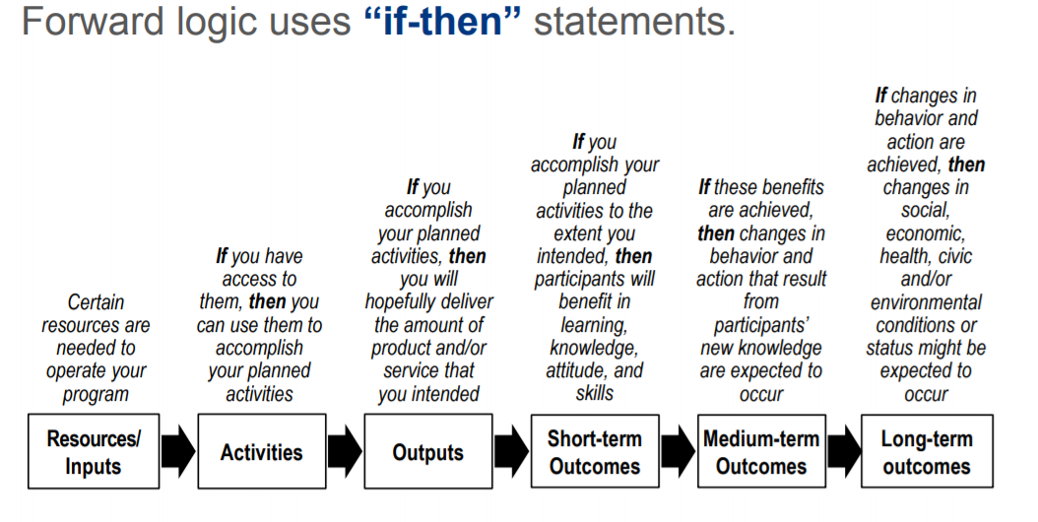
Forward logic approach

Slide 32
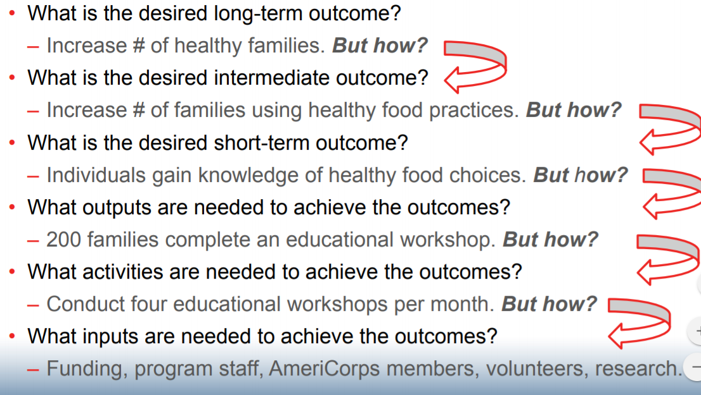
Reverse logic approach

Slide 33
Performance Measures

Slide 34
Performance Measures
Type: National and program created
CNCS requires all applicants to have one aligned performance measure for the primary intervention.
Applicants may have additional aligned measures provided that they measure significant program activities.
Members may follow activities that do not align with a PM
Serve Indiana suggests only one national performance measure with one outcome and one output
Pick the PM that aligns best with your program

Slide 35
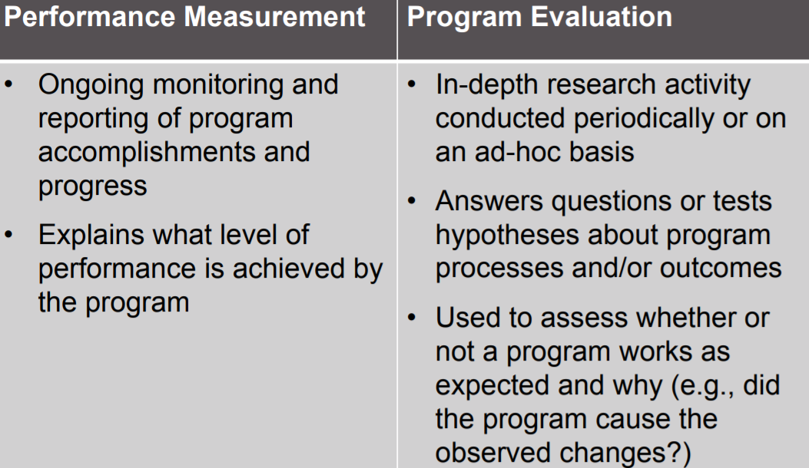
What is the difference between performance measurement & program evaluation?

Slide 36
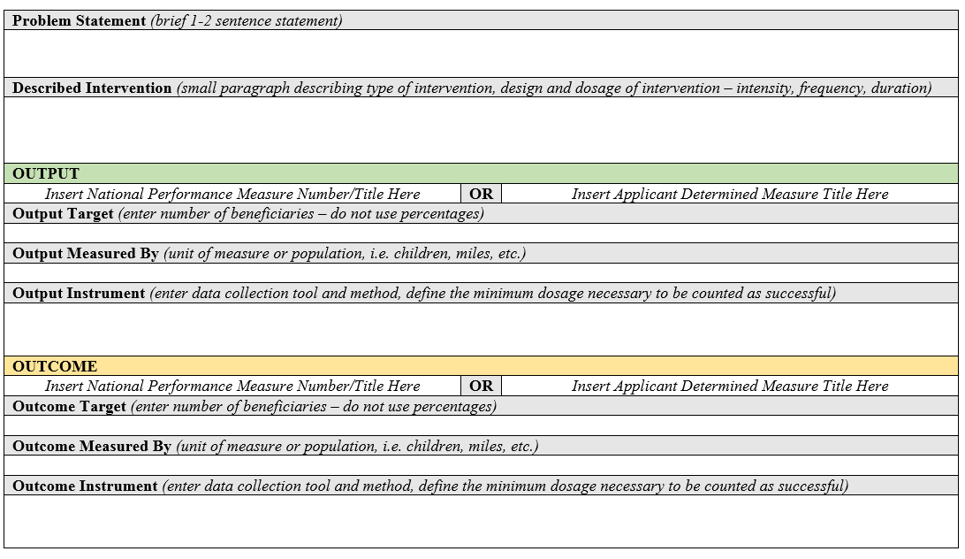
What does a performance measure entail?

Slide 37
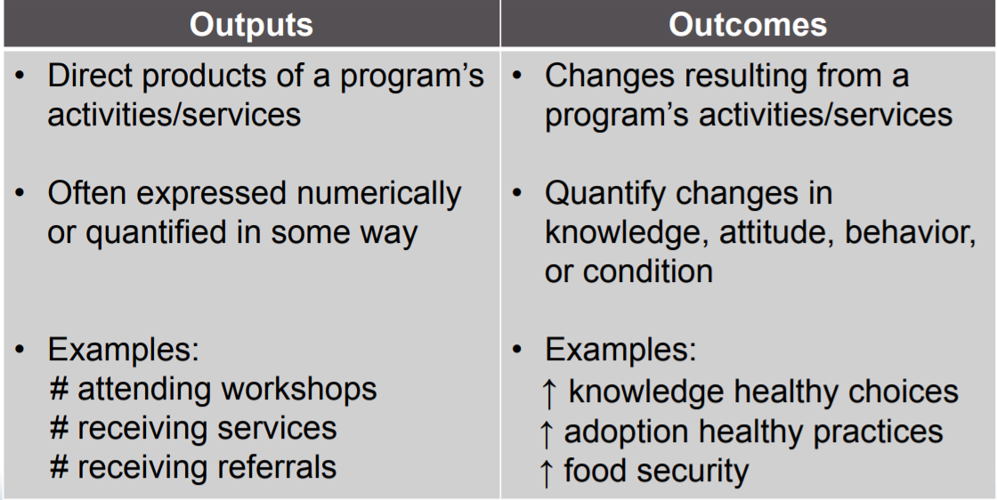
What’s the difference between an output and outcome?

Slide 38
Can I have the same target for outputs and outcomes?
Intervention
Output
Outcome
100
75
Notes:
Let’s consider how to ensure strong alignment within a set of performance measures; that is between an output performance measure and an outcome performance measure.
When we talk about an aligned set of performance measures, we are referring to the strong link between the output and outcome; the outcome results from the output. Remember, an output is the amount of service completed, such as the number of students mentored. An outcome reflects the changes or benefits that occur as a result of the service activity, such as improved school attendance.
Alignment also means that the output you are measuring is produced by the intervention. For example, if the intervention is that national service participants mentor youth, then the output would track the number of youth who are mentored.
In addition, an aligned output and outcome measure the same intervention and the same beneficiaries.
By measuring outputs along with outcome, programs have the context for reporting; they will know their level of success. Of those served, how many change? For instance, the output is that 100 children complete the early education program and the outcome is 75 of those children improved numeracy skills. The output establishes the pool of beneficiaries we are looking to change. In the example, the level of success is that 75 out of 100 of the children improved numeracy skills.
Let’s look at a couple of examples and see if the output and outcome are aligned.

Slide 39
What are some commonly missed items?
Program has same target number for output and outcome
Program does not communicate data collection mechanisms and why those practices will yield valid and reliable data
Program does not plan to use the same assessment for all PM/intervention
Program does not communicate rate of change to be counted in an outcome (% improved from pre to post tests)
Program does not follow the national performance measure instructions exactly
Program does not tie performance measure back to logic model
Program does not use approved performance measure from application in program data collection

Slide 40
Resources
NOFO/Application Instructions: https://www.in.gov/serveindiana/funding-opportunities/
Performance Measure Template: https://www.in.gov/serveindiana/funding-opportunities/
Notes:
This concludes the module on High Quality Performance Measures.
For more information on CNCS performance measures, including Agency-Wide Priority Measures, go to https://www.nationalserviceresources.org/npm/home.
Also see http://www.nationalservice.gov for more information on program specific notices of funding opportunities and application instructions.

Slide 41
Program Design Section: Evidence Narrative

Slide 42
Program Design Section
Theory of Change & Logic Model Narratives
Explain rationale behind logic model section
Evidence Base Narrative
Evidence tier and evidence quality (and degree to which support theory of change)
Notice Priority
What CNCS focus area/priority do you align with?
Member Experience
What will the members do and how aligns with logic model?

Slide 43
Evidence Base Narrative
Overview:
Opportunity for applicant to document why chose theory of change
Applicant must support why intervention will lead to intended outcome with research
Includes Evidence Tiers (type of study) & Evidence Quality (fit & validity) review
Applicants should focus on
Supporting why the members are doing what they are doing and why this will lead to the outcomes for the beneficiaries
Aligning evidence to logic model and theory of change
Understanding the difference between studies and evaluation reports included in this section and the performance measure data
Reviewing supplemental guidance for additional information

Slide 44
Evidence Tiers
Two most common:
Pre-Preliminary: No outcome/impact program evaluation, some performance measure data collected, must describe how intervention is evidence informed (may cite performance measure data)
New applicants/early programs
Preliminary: Applicant has submitted up to two outcome evaluation reports that evaluated same intervention described intervention (with positive results; internal or external; pre/post assessment); can submit 2 reports on top of evaluation report;
New applicant/most Serve Indiana programs

Slide 45
Requirements of Studies/Evidence:
The intervention evaluated in the submitted report(s) must match the intervention proposed by the applicant in the following areas, all of which must be clearly described in the Program Design and Logic Model sections of the application:
• Characteristics of the beneficiary population
• Characteristics of the population delivering the intervention
• Dosage (frequency, duration) and design of the intervention
• The context in which the intervention is delivered
• Outcomes of the intervention

Slide 46
Additional Guidance:
Make sure to summarize the study design and key findings of any evaluation report(s) submitted
Use current reports (within the last 6 years)
Cite within the application and submit reports following “additional documents” submission instructions
Follow the NOFO and Supplemental Guidance Instructions around your evidence tier

Slide 47
Evidence Quality
The submitted reports are of satisfactory methodological quality and rigor for the type of evaluation conducted
(e.g., adequate sample size and statistical power, internal and/or external validity, appropriate use of control or comparison groups, etc.);
The submitted reports describe evaluations that were conducted relatively recently, preferably within the last six years;
The submitted reports show a meaningful and significant positive effect on program beneficiaries in at least one key outcome of interest.

Slide 48
Program Evaluation & Plans
All applicants, including new grantees, are required to provide additional information in the Evaluation Summary or Plan field of the application

Slide 49
What are the basic AC/SI requirements of program evaluations?
Programs have different requirements based on their annual AmeriCorps dollars received
Over $500,000
You must arrange for an independent evaluation of your program, and you must submit the evaluation report/plan with application as noted in NOFO.
Under $500,000
You must conduct an internal evaluation of your program, and you must submit the evaluation report/plan with application as noted in NOFO.

Slide 50
What do I submit in the application and when?
If you are submitting for… | Submit evaluation plan | Submit evaluation report | If funded
Your first 3 year cycle (first grant) | No but submit data collection plan |  | Begin the evaluation planning process
Your second, 3 year grant (first re-compete) | X |  | Complete evaluation during the three-year grant period
Your third, 3 year competitive grant and beyond (second re-compete and beyond) | X | X | Complete evaluation during three year grant period
Notes:
Explain:
Evaluation plan
Evaluation report
Learning memo

Slide 51
What should your evaluation plan include? Follow the NOFO!
Introduction
Program background
Research questions
Evaluation design
Sampling methods, measurement tools, and data collection procedures
Analysis plan
Reporting results approach
Timeline, budget, evaluator qualifications
Notes:
Facilitator notes: Based on CNCS’s guidelines in the Frequently Asked Questions: Evaluation document located in the Knowledge Network, when fully developed, your evaluation plan should include the following components:
Introduction
Program background
Research questions to be addressed in the study
Evaluation design, including a rationale for the design selected, an assessment of its strengths and limitations, and a description of the process and/or impact assessment components
Sampling methods, measurement tools, and data collection procedures
Analysis plan
Reporting results
Timeline, budget, and evaluator qualifications
We will talk about each of these components in more detail on the following slides.
[We acknowledge that this is more detail than is provided in the most recent AmeriCorps NOFO. We would encourage you to submit more detailed evaluation plans in your application, but certainly when you are getting ready to conduct your evaluation you will need a more detailed evaluation plan that includes the components we will discuss here.]

Slide 52
What is an evaluation report?
Key product resulting from evaluation
A written document that objectively describes:
Program background
Evaluation purpose, methods, procedures, and limitations
Evaluation results
Conclusions and recommendations
Lessons learned
Questions for future research
Submitted in second re-compete (year 6), follow NOFO instructions!
Notes:
Facilitator notes: An evaluation report is a written product that objectively describes all of the steps involved in completing the evaluation, including findings, conclusions, and lessons learned. While the evaluator generally leads the report writing process, several different types of people may be involved in developing and/or reviewing the final report. For example, the program background section may be best provided and/or reviewed by program staff, while descriptions requiring more technical explanation, such as evaluation methods, procedures and study limitations, are best written by the program evaluator. Conclusions and recommendations also should be written by the evaluator, so a more independent assessment of the findings is provided. However, lessons learned, including implications for program modification or improvement, are best determined through discussions involving a wider group of program stakeholders, including program staff, funders and program beneficiaries, as appropriate. Questions for future research should be identified through a collaborative approach involving program staff, the evaluator, and other program stakeholders.
An evaluation report also provides a basis for further discussion on:
Understanding the program’s accountability to its theory of change
Decision-making on policies and programs
Drawing lessons for program improvement
In writing the final report, it should be a key consideration who the main audience will be for the report. In general, it is best to anticipate the report will be viewed by a wider audience, not just CNCS and program staff. Then the report can be most useful for communicating study findings to outside stakeholders. When writing for a broader audience, the study description and reporting of results should be provided using less technical language, and the more technical aspects of the study should be moved to an appendix. Also, enough detailed information should be provided so that outside parties can gain a full understanding of the program and the evaluation processes. In the instance where the report is mainly intended for internal program use, then the potential audience may be less of a concern and the report can be written to a narrower audience.

Slide 53
Additional Resources
CNCS Evaluation Requirements
CNCS Evaluation Resources
CNCS PowerPoint
CNCS sample logic model
Serve Indiana templates
NOFO/Application Instructions

Slide 54
Budget

Slide 55
Project and Award Period
Two start dates: August 1st; September 1st
End dates: July 31st; August 31st
New Programs:
May only choose September 1st start date
Encouraged to begin members on or after September 15th
Additional information:
Members cannot begin before start date
Awarded programs can expend funds on or after start date but cannot request reimbursement until have an executed state contract and purchaser order number

Slide 56
Budgets Overview
Operational grants submit all sections
Section 1: Personnel costs & Operational costs
Section 2: Member costs
Section 3: Administrative/indirect costs
Follow instructions in NOFO, Application Instructions, and AI Attachment with “Detailed Budget Instructions”

Slide 57
As you prepare your budget
Follow detailed instructions in application
Define all items for a particular purpose.
Do not include miscellaneous, contingency or other undefined budget amounts
Itemize each cost and present the base for all calculation in the form of an equation
Do not include unallowable expenses
Do not include fractional amounts (cents)

Slide 58
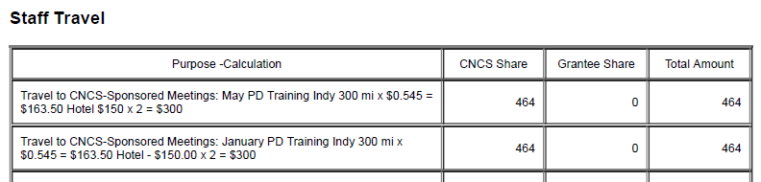
Itemized Example

Slide 59
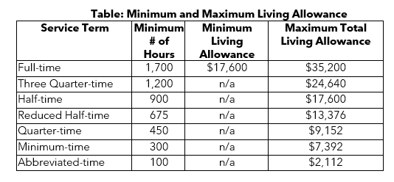
Maximum Cost Per MSY Updates
Calculated by taking total CNCS portion/number of MSY
MSY = 1 FT Member (1700)
$150,000 CNCS share/20 full time members = $7,500/MSY
TIP: Build budget based around this restriction and move backwards!

Slide 60

Match Requirement:
Serve Indiana suggests new programs stay at 24%

Slide 61
Member Benefits Guidelines
Required for Full Time from Grantee:
Living Allowance
Health Care
Can provide to less than full time if non-federal
FICA
Covered by CNCS:
Loan forbearance and interest accrual
Education Award
Child Care Assistance
**Indiana regulation: Do not included unemployment insurance on grant or include members in organizational expenses

Slide 62
Living Allowance Updates

Slide 63
Admin Costs Options
Options:
CNCS Fixed Percentage Method
Federally approved indirect cost rate
10 percent de minimis rate
All methods must be applied consistently across federal awards.
Fixed Percentage Method Calculation:
([Section I] + [Section II] x 0.0526) x (0.20) = Commission Share
([Section I] + [Section II] x 0.0526) x (0.80) = Subgrantee Share

Slide 64
SI Budget Requirements
Staff travel: 3 in person 1-day trainings in Indianapolis (required) and 1 Midwest conference (optional)
Member travel: Camp AmeriCorps (optional)
Staff and member training: Consult SI handbook, SI will send out clarification if not included
Evaluation: SI will review
Other operating costs: CHC $75 and OnCorps $55/month (required), $100 IADA (required)
Member cost section: Did not include unemployment

Slide 65
Commonly Missed Budget Items
Staff travel/Member to CNCS-sponsored technical assistance meetings
Explaining source of funds in full
Staff included in the narrative are not included in the budget
FICA/Healthcare incorrect.
Mileage should not exceed federal mileage rate unless justified
Member gear not included in budget
Evaluation cost too low
Background check
Living allowance not within minimum/maximum amount
Unemployment insurance included in budget
Math errors or no documentation of calculation

Slide 66
Submission & Review Process

Slide 67
DUNS & EIN
Applications must include a DUNS number and an Employer Identification Number.
The DUNS number does not replace an Employer Identification Number.
Applicants must register with the SAM and maintain an active SAM registration until the application process is complete and, if a grant is awarded, throughout the life of the award.
SAM registration must be renewed annually.
Complete at least 2 weeks before submitting!

Slide 68
When is the application due?
Fall Due Dates: New Applicants
October 3^{rd:} Notice of Intent to Apply via email
November 1st: Application Due via eGrants
*Additional clarification and notification dates available in NOFO/Application Instructions

Slide 69
Serve Indiana Review
November:
Staff and external reviews
Staff scoring/compilation
Clarifications may be communicated
December 2022: SI Commission Meeting
Decisions communicated within 3 business days (clarifications)
January 2023: Serve Indiana submission to CNCS (Competitive)
TBD: CNCS Competitive decision & formula clarifications
TBD: CNCS & Serve Indiana decisions communicated
June 2023: Orientation for the 2023-2024 PY

Slide 70
Questions? Comments?
ckellogggillenwater@serveindiana.gov
317-220-1659

