Slide 1
Creating a Service Opportunity Listing in eGrants
Notes:
Creating a Service Opportunity Listing in eGrants

Slide 2
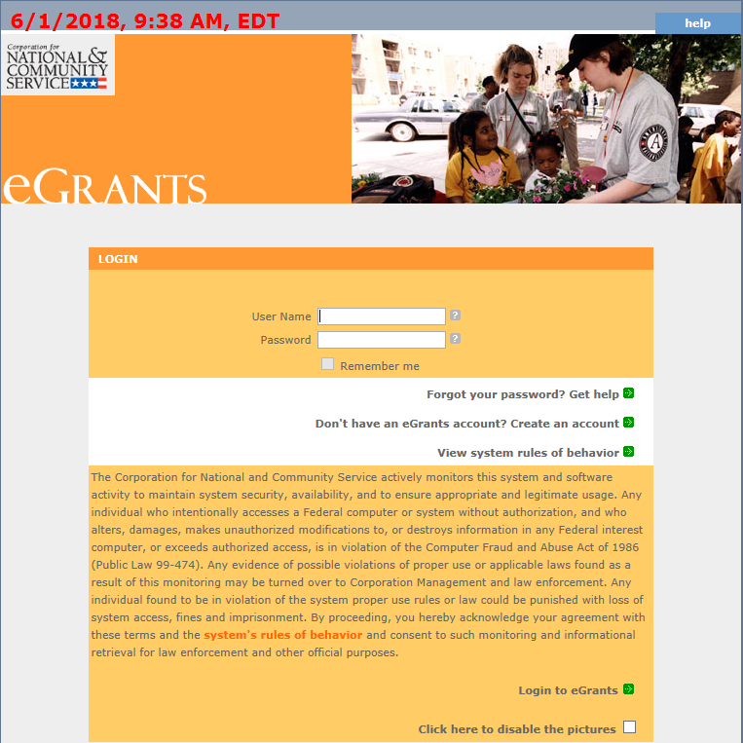
Login to eGrants
Enter in User Name and Password
Then click Login to eGrants
Notes:
Enter in User Name and Password in the eGrants portal. Then click Login to eGrants.

Slide 3
Login to Portal Home
Click on the Portal Home link under View My AmeriCorps Portal
Notes:
Login to Portal Home by clicking on the Portal Home link located under View My AmeriCorps Portal heading.

Slide 4
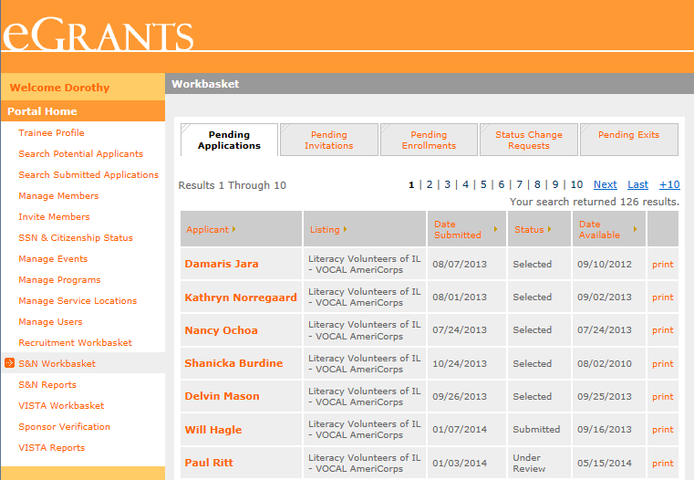
Navigate to Recruitment Workbasket
Click on the Recruitment Workbasket from Portal Home menu
Notes:
Navigate to Recruitment Workbasket by clicking on the Recruitment Workbasket title from Portal Home menu.

Slide 5
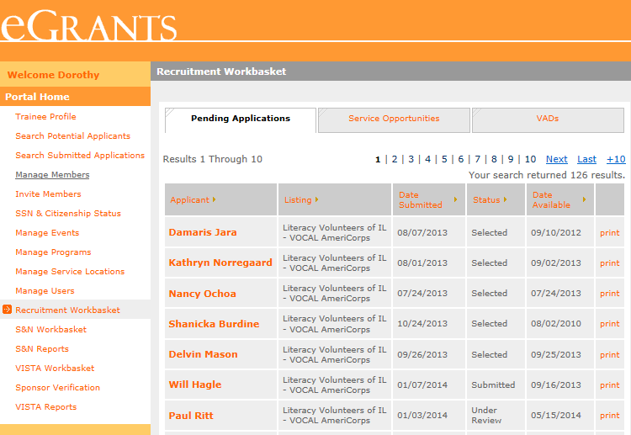
Navigate to Service Opportunities
Click on Service Opportunities from the top tab selection
Notes:
Navigate to Service Opportunities by clicking on Service Opportunities tab from the top menu tab selections.

Slide 6
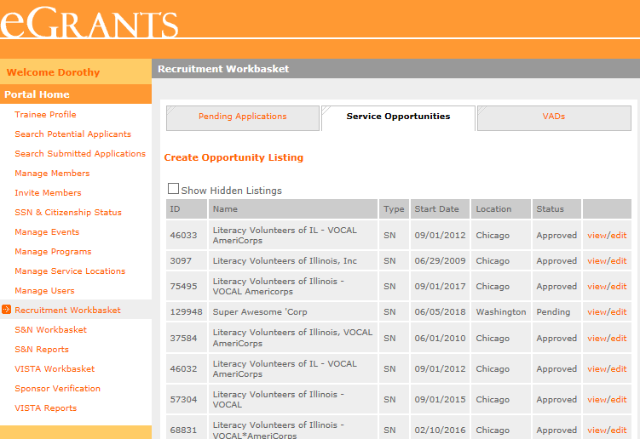
Navigate to Create Opportunity Listing
To create a new Service Opportunity Listing, click on Create Opportunity Listings at the top of the page
To modify an existing Service Opportunity Listing, click Edit on the desired listing
Notes:
Navigate to Create Opportunity Listing. To create a new Service Opportunity Listing, click on Create Opportunity Listings at the top of the page, located under Pending Applications. To modify an existing Service Opportunity Listing, click Edit next to the desired listing.

Slide 7
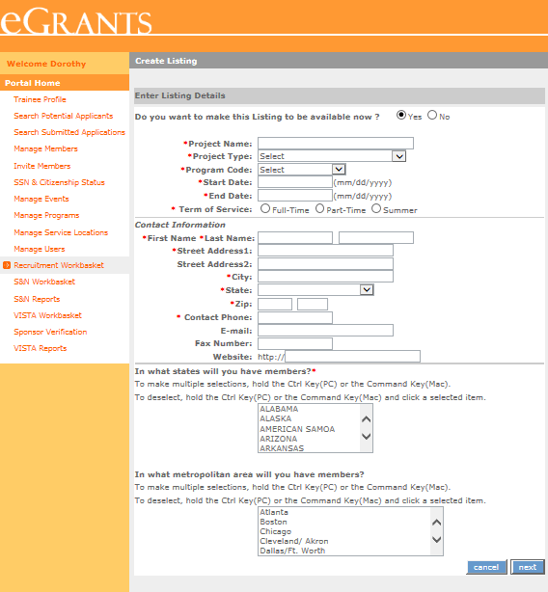
Input Information – Page 1
Input the following required information, as indicated by a red asterisk* or by CNCS policy:
Project Name
Project Type
Program Code
Start and End Dates
Term of Service
Contact Information
State(s) or Territories of service
Optional information:
Listing availability (default “Yes”)
Metropolitan areas
Click Next
Note: Information cannot be saved until final submission
Notes:
Begin inputting Service Opportunity Listing information.
Input the following required information, as indicated by a red asterisk or by CNCS policy:
Project Name
Project Type
Program Code
Start and End Dates
Term of Service
Contact Information
State(s) or Territories of service
Optional information:
Listing availability (default “Yes”)
Metropolitan areas
Click Next
Note: Information cannot be saved until final submission.

Slide 8
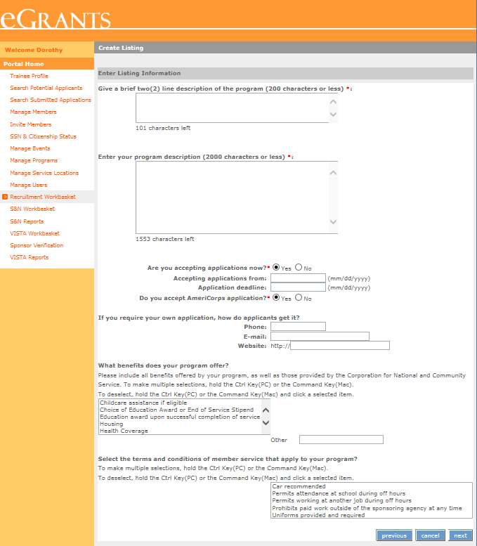
Input Information – Page 2
Input the following required information, as indicated by a red asterisk*or by CNCS policy:
Two line description headline
Program description
Accepting applications (Yes/No)
Application deadlines
Alternate applications (Yes/No)
Member benefits
Optional information:
Alternate application information
Terms and conditions
Click Next
Notes:
Input the following required information, as indicated by a red asterisk or by CNCS policy:
Two line description headline
Program description
Accepting applications (Yes/No)
Application deadlines
Alternate applications (Yes/No)
Member benefits
Optional information:
Alternate application information
Terms and conditions
Click Next

Slide 9
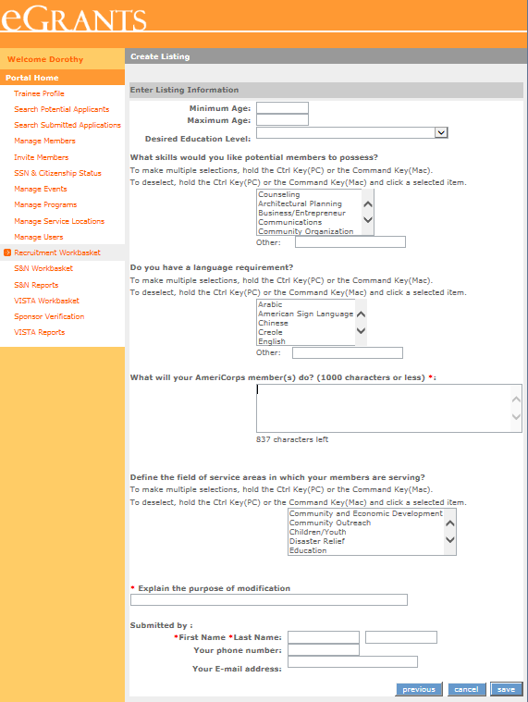
Input Information – Page 3
Input the following required information, as indicated by a red asterisk*or by CNCS policy:
Minimum Age
Maximum Age
Member activities
Modification comment – if editing a listing
Submitter name
Optional information:
Desired education level
Member skills
Language requirement
Service areas
Submitter contact information
Click Save to submit to CNCS
Notes:
Input the following required information, as indicated by a red asterisk*or by CNCS policy:
Minimum Age
Maximum Age
Member activities
Modification comment – if editing a listing
Submitter name
Optional information:
Desired education level
Member skills
Language requirement
Service areas
Submitter contact information
Click Save to submit to CNCS

Slide 10
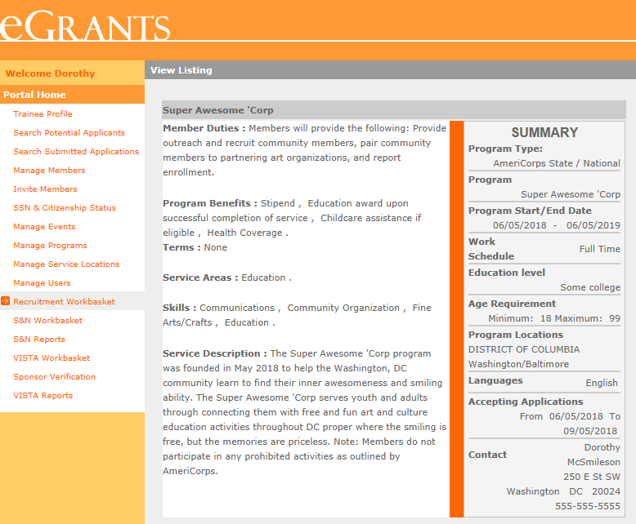
View Service Opportunity Listing
After clicking Save, the screen will display your newly submitted Service Opportunity Listing
Review the Service Opportunity Listing and if changes are required, navigate back to the Service Opportunities in the Recruitment Workbasket to edit
Notes:
After clicking Save, the screen will display your newly submitted Service Opportunity Listing. Review the Service Opportunity Listing and if changes are required, navigate back to the Service Opportunities in the Recruitment Workbasket to edit.

Slide 11
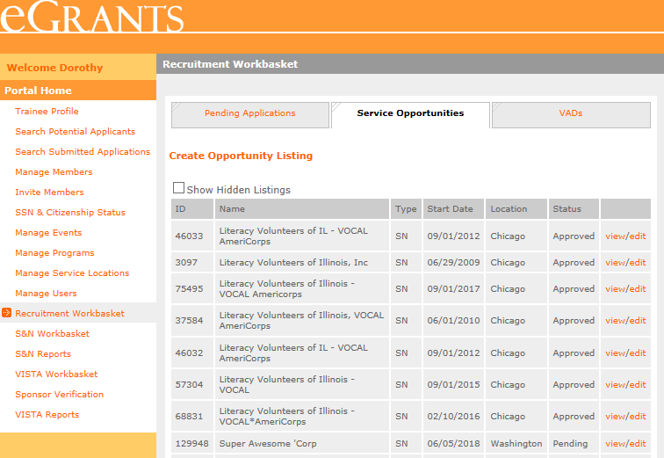
View Submission Status
Service Opportunity Listings Status:
Pending – awaiting to be viewed by CNCS
Approved – viewed by CNCS and approved submission. Listing is now viewable, if indicated by submitter
Denied – viewed by CNCS and disapproved submission. Listing needs to be edited and resubmitted
Note: Every time a listing is edited, it is resubmitted with a new timestamp and listings are reviewed chronologically by CNCS. If you do not wish to edit and adjust the timestamp, select view.
Notes:
Service Opportunity Listings Status:
Pending – awaiting to be viewed by CNCS
Approved – viewed by CNCS and approved submission. Listing is now viewable, if indicated by submitter
Denied – viewed by CNCS and disapproved submission. Listing needs to be edited and resubmitted
Note: Every time a listing is edited, it is resubmitted with a new timestamp and listings are reviewed chronologically by CNCS. If you do not wish to edit and adjust the timestamp, select view.

Slide 12
Resources
Resources for drafting compliant Service Opportunity Listings are available at:
https://www.nationalservice.gov/resources/americorps/member-assignment-listings
Notes:
Resources for drafting compliant Service Opportunity Listings are available at:
https://www.nationalservice.gov/resources/americorps/member-assignment-listings

