Slide 1
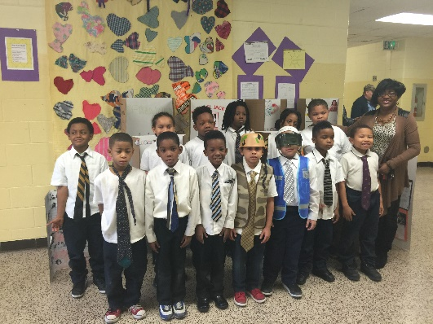
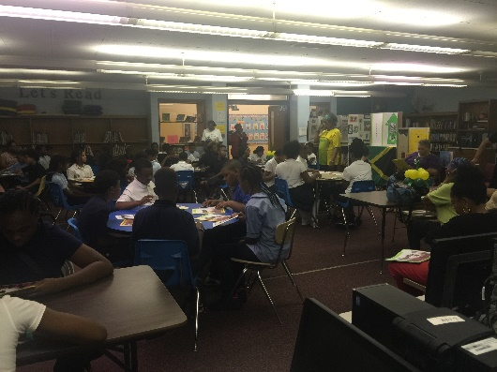
Turning Around Our School—Phase I
Beveridge Elementary School
Gary Community School Corporation

Slide 2
Beveridge Elementary School--
  School Vision:
Beveridge Elementary School provides a uniform, safe, and orderly environment that
produces educated, productive, and responsible citizens.
  School Mission:
  To provide all students with a high-quality education in a safe and orderly learning environment which will ensure the acquisition of knowledge, skills, and values necessary to be productive and responsible citizens in a global and technological society.

Slide 3
Beveridge Elementary School--
Introduction to School
  K-6 school, 417 students in 2016-2017
  93% Free, Reduced Lunch
  7% Special Needs
  School attendance boundaries have dramatically enlarged based on closures over past few years
  Schools merged into Beveridge over past few years were also persistently low-achieving
  Staffed with several long-term assignment substitutes in key grades in 2016-2017
  Located west of city’s midtown section
  Situated in once-thriving Tolle-Mann neighborhood
  Currently, many business storefronts and homes unoccupied

Slide 4
Beveridge Elementary School--
Most Current ISTEP+ Results:
Performance Domain:
  Passing rates in Language Arts and Math far below expectations
        Language Arts (10.4%) Math (5.8%)
  Overall, continued decline in Language Arts, Math
  Math has dropped to single digit passing rate
Growth Domain:
  Far below requirement to demonstrate acceleration

Slide 5
Beveridge Elementary School--
The School-Based Goals and Objectives:
Goal 1: By Spring 2018, Beveridge Elementary students in grades 3-6 will achieve an increase in language arts performance by 20% as measured by ISTEP+.
Objective 1: To increase student knowledge of Indiana Academic Standards by targeting specific learning outcomes in E/LA by teaching a 90-minute block that will allow for targeted instruction in reading comprehension

Slide 6
Beveridge Elementary School--
The School-Based Goals and Objectives:
Goal 2: By Spring 2018, Beveridge Elementary students in grades 3-6 will achieve an increase in mathematics performance by 15% as measured by ISTEP+.
Objective 2a: To increase student knowledge of Indiana Academic Math Standards by improving instruction in the math block that has been increased from 60-90 minutes and by extending the instructional time 3 hours/week for targeted math instruction
Objective 2b: To improve teacher attendance
Objective 2c: To recruit certified teachers to replace substitutes in long term assignments

Slide 7
Beveridge Elementary School--
The School-Based Goals and Objectives:
Goal 3: By Spring 2018, Beveridge Elementary students in grades 4-6 will achieve an increase in mathematics growth performance by 10% and an increase in language arts growth by 15% as measured by ISTEP+.
Objective 3: To increase test performance on ISTEP+ in E/LA and Math by increasing opportunities for enrichment and maintenance of instruction through targeted instruction during Success Periods

Slide 8
Beveridge Elementary School--
The School-Based Goals and Objectives
Goal 4: By Spring 2018, Beveridge Elementary School students will maintain a 96% or higher attendance rate.
Objective 4: To increase student attendance by recognizing perfect and improved attendance as well as communicating with families to resolve issues contributing to chronic absences

Slide 9
Intensive Intervention Strategy—Extended Day
  Extended Day
    Purpose: To provide more time for personalized learning for each child
    This strategy will be implemented school-wide
      Three days per week, two instructional hours per day
    This strategy alone adds an additional day’s worth of focused instructional time per week
    Math and Language Arts instruction will be at the center of the extended day
    The District is exploring partnering with local universities’ Education majors to provide core instructional supports during the extended day.

Slide 10
Beveridge Elementary School--
Professional Development
District-Level
The textbook representative will train teachers in using the core materials for reading and math.
Teachers will be trained in PIVOT to assess student learning and disaggregate data.
The principal mentor will train teachers and principals in the 8-Step Instructional Process: Plan, Do, Check, Act.

Slide 11
Beveridge Elementary School--
Professional Development
School/Grade Level
Teachers will learn to unpack standards by grade levels.
Teachers will learn how to scaffold instruction in E/LA and Math.
Teachers will be trained in effective lesson design.
Teachers will be trained in disaggregating data and analyzing data.
Teachers will be trained in cultural competency.

Slide 12
Beveridge Elementary School--
Professional Development
Job-Embedded:
Train a primary and intermediate teacher to develop a demonstration classroom to model instruction utilizing the math and literacy framework.
Math and E/LA Coaches will be assigned to buildings and grade levels to help teachers implement instructional strategies.

