Slide 1

U.S. Army Cadet Command
Army JROTC
Program Overview
“Motivating young people to be better citizens”

Slide 2
Agenda
Program History
Program Overview
Instructor Status / Training
Manual Military Appreciation Day (MMAD) – 100th Anniversary
Conclusion

Slide 3
JROTC History
National Defense Act (as amended) of 1916 – Established the JROTC program and the National Defense Cadet Corps (NDCC)
  EMHS JROTC established 1917
1964 – Changed use of active duty instructors to retirees - opened program to other services
1973 – Authorized female participants
Today – Largest program within the Army; popular support and congressional endorsement
Notes:
Title 10 USC 2031 authorizes JROTC
Title 10 USC 4651(Arms, Tentage and Equipment: Educational institutions not maintaining units of ROTC) authorizes NDCC

Slide 4
Program Overview
JROTC Mission = To Motivate Young People To Be Better Citizens
The Goals
The Curriculum
Promote citizenship
Develop leadership
Teach to Communicate effectively
Improve physical fitness
Provide incentive to live drug-free
Strengthen positive self-motivation
Provide historical perspective of military service
Train to work as a team member
Inspire to graduate from High School
Citizenship in Action
Leadership Theory and Application
Foundation for Success
Wellness, Fitness, and First Aid
Geography, Map Skills and Environmental Awareness
Citizenship in American History and Government
Cadet Safety and Civilian Marksmanship Program (Optional)
Notes:
The mission of the JROTC program is simple yet awesome “to motivate young people to become better citizens” by focusing on American Values, Army Values, and Character Development.
We have over 300,000 JROTC cadets enrolled across the nation and world (DoD Schools) at 1,645 high school programs. These cadets beat their peers in the measured, evaluated categories shown on the lower left corner of the chart.
The JROTC program accomplishes its goals through innovative Curriculum that is-
Student centered learning
Latest instructional techniques
Multi-media
Supports 74 of the National Standards (all in PE/Health & Language Arts, most in Social Studies and some in Math & Science)
6 hours of college credit

Slide 5
JROTC Oversight
3rd BDE
7th BDE
116 JROTC
23,687 Cadets
307 Instructors
214 JROTC
34,050 Cadets
459 Instructors
8th BDE
156 JROTC
27,713 Cadets
347 Instructors
HQs USACC
FT Knox
2nd BDE
112 JROTC
16,048 Cadets
245 Instructors
HI
HI
4th BDE
330JROTC
54,054 Cadets
733 Instructors
5th BDE
313 JROTC
44,216 Cadets
735 Instructors
6th BDE
464JROTC
89,206 Cadets
1130 Instructors
JROTC Status
Programs: 1702
Instructors: ENL/OFF/WO
2430/1402/124
Number of Cadets: 314,000
5

Slide 6
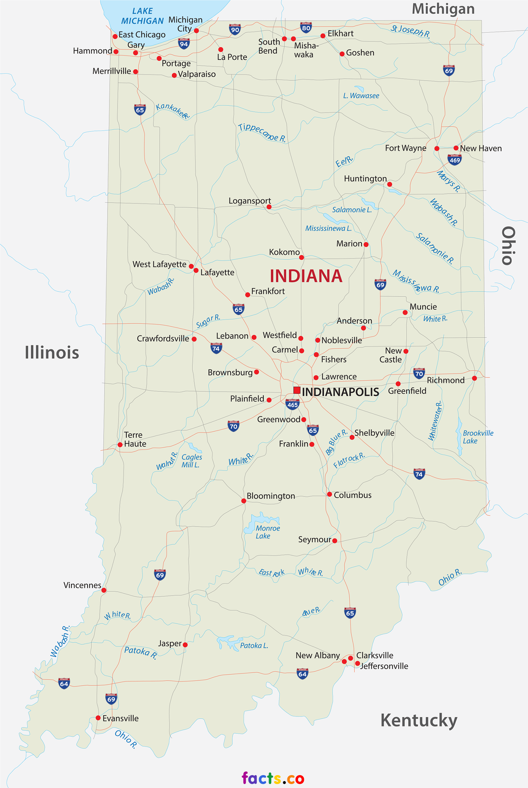
Indiana Army JROTC Programs
CRISPUS ATTACKUS HS | INDIANAPOLIS
ARSENAL TECH HS | INDIANAPOLIS
GEORGE WASHINGTON COMMUNITY HS | INDIANAPOLIS
JOHN MARSHALL COMMUNITY HS | INDIANAPOLIS
NORTHWEST HS | INDIANAPOLIS
BLACKFORD HS | HARTFORD CITY
CONCORDIA LUTHERAN HS | FORT WAYNE
EMMERICH MANUAL HS | INDIANAPOLIS
HAMMOND HS | HAMMOND
HOBART HS | HOBART
MARION HS | MARION
NORTH CENTRAL HS | INDIANAPOLIS
ROOSEVELT HS | GARY
SOUTH VIGO HS | TERRE HAUTE
THE HOWE SCHOOL | HOWE
THOMAS CARR HOWE COMMUNITY HS | INDIANAPOLIS
VINCENNES LINCOLN HS | VINCENNES
WARSAW HS | WARSAW
WEST SIDE HS | GARY
WH HARRISON HS | EVANSVILLE
6

Slide 7


JROTC Organizational Chart
MILITARY
CIVILIAN/SCHOOL
HQ USACC
CSUSA
Army JROTC
School Administrator
7th Brigade
EMHS JROTC
EMHS

Slide 8
What is provided
What the school must provide:
Credit for coursework
Classrooms (including desks/tables), office space (including desks, cabinets, etc), storage, telecommunications, and drill area
Partial instructor salaries
Like benefits for instructors and
students
Title 10, US Code
Section 2031;
DODI 1203.15;
AR 145-2;
CCR 145-2;
Contract
What the Army provides:
Educational/audiovisual materials
Classroom equipment
Student books, curriculum guides,
instructor materials
Unit support and maintenance funding
Uniforms and organizational
equipment
Special team equipment (Color Guard,
Drill Teams, Marksmanship Teams)
Partial instructor salary
reimbursement
What we don’t do:
Require a service obligation
Recruit for the Armed Forces
Conduct combat skills training

Slide 9
JROTC Instructor Status
  GENERAL REQUIREMENTS:
  Retired E-6 through O-6
  No record of military or civilian adverse actions
  Meet the retention medical fitness standards and weight standards of CCR 145-2:
    Meet height and weight standard; 30% male body fat and 36% female body fat
    No speech impediment
    No medical disqualifiers (i.e., heart disease, asthma, pace makers)
    VA disabilities > 30% require medical review
  Have an excellent record of military performance
  Have the mentality, personality, appearance and bearing to represent The Army well in the civilian community
  Have good moral character, instructional ability, and be able to challenge, motivate and influence young people in a positive manner
  Completion of initial qualification training, satisfactory interview, and be determined by Cadet Command to meet the criteria
Instructors
Certified
by the
Army
Hired and
employed by the
school
Instructor Pay – Cost Shared
  Monthly salary augmented by the government
  Integrated curriculum pay provided by school
  (coaching stipend)

Slide 10
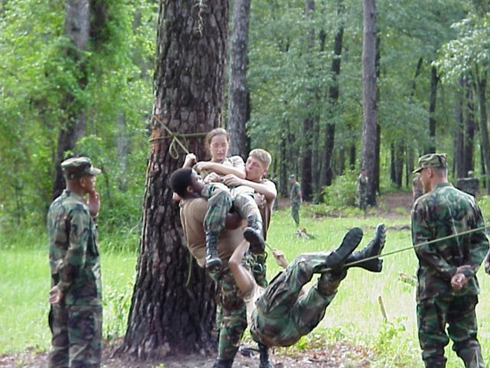
JROTC Cadet Leadership Challenge (“Summer Camp”)
Core
  Rappelling
  Leadership Reaction Course (LRC)
  Map Reading and Land Navigation
  Water Survival
  Awards/Graduation Ceremonies
Integrated
  Physical Fitness
  Leadership
  Drill and Ceremonies
  Personal Hygiene and Field Sanitation
  Organized Activities
Notes:
Note: Insert Colin Powell TODAY show video here.
Again, top half of slide shows where we are.
Bottom half of slide shows where are are going.
July 29, 1999 - Mr. Henry directed that we expand from current 1,370 units to 1,645.

Slide 11
SY 16-17 Program Demographics
Ethnic
Gender
Male 57
Caucasian 71
Female 44
Hispanic 13
African American 11
Asian 6
Enrollment Level
101 Cadets
LET 1 - 62
LET 2 – 24
LET 3 – 12
LET 4 – 3
LET level may not correlate to academic year … A senior could be a LET 1

Slide 12
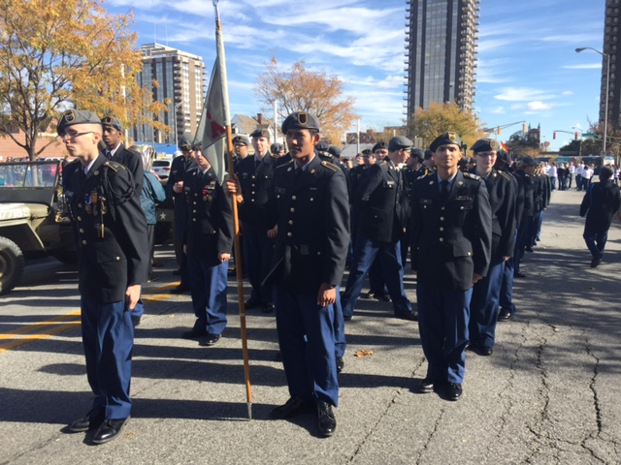
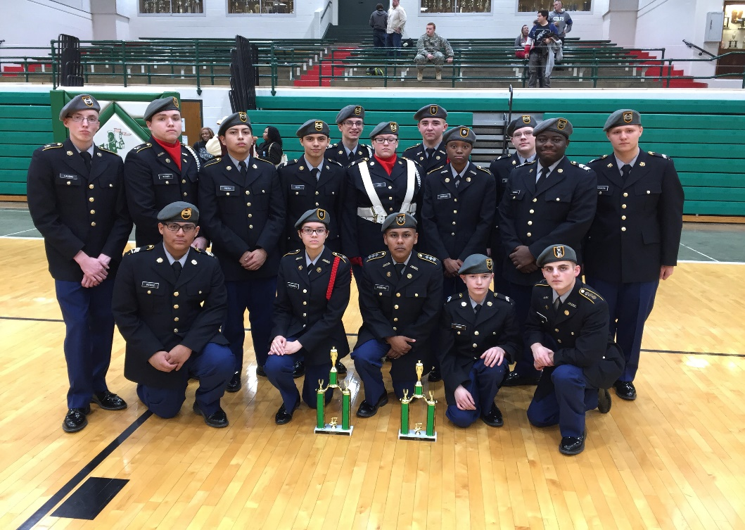
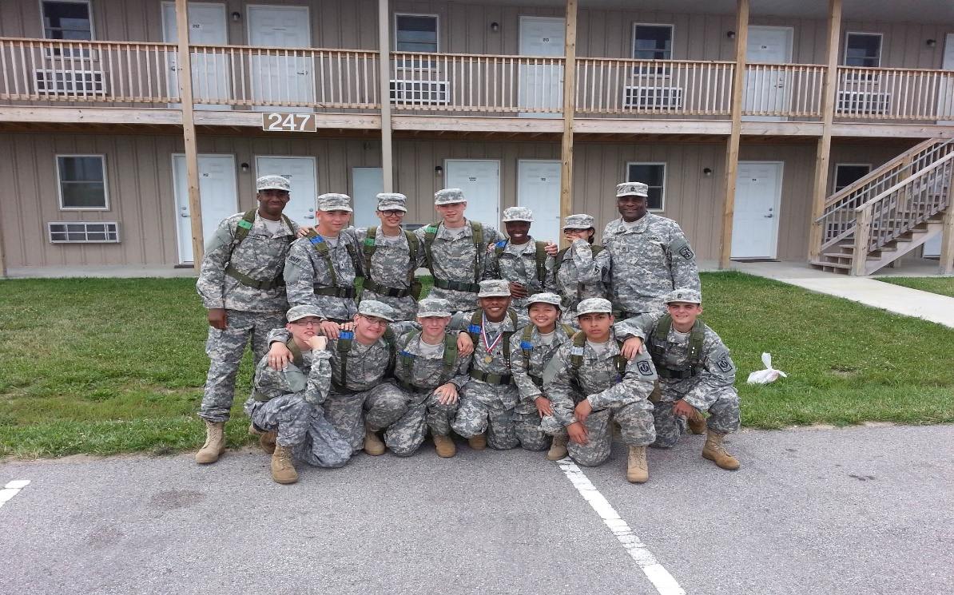
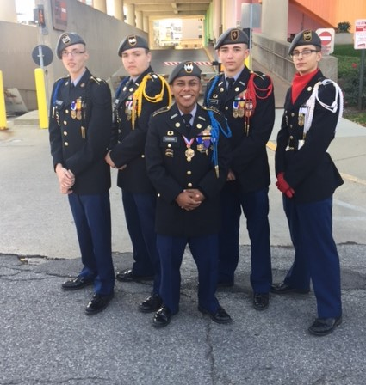
EMHS REDSKIN BATTALION JROTC

Slide 13
SERVICE LEARNING
JROTC
An active and experiential learning strategy where Cadets
have a direct impact on an identified need that motivates
them.
Connect our JROTC program to the local community
Challenge Cadets to develop new skills
Requires little or no money
Has a positive effect on all participants
Maximum participation by JROTC Cadets
Involve other school departments/clubs into the event

Slide 14
EMHS Military Appreciation Day Concept
JROTC
Concept: JROTC will host a military appreciation event that will recognize 100 years of JROTC at Emmerich Manual High School.
Detail: The event will occur at EMHS in the late afternoon. All activities will occur in the gymnasium with speakers opening the formal portion of the program. Following the speakers and presentations a meal will be served.
Ideas:
100th Anniversary of JROTC theme
Say the pledge of allegiance and Cadet creed
Military theme music performed by EMHS band
All Cadets in uniform
Speakers MG Carr (IN AG) Dr. B Ernest, Mr. Gordon Durnil
JROTC performance (Color Guard & IDR)
Recognition of individual Veterans, former Cadets, and EMHS Alumni (service crests)
-Meal (working out the details on the menu)
-Local media coverage
Choir to sing at beginning
Art Department dedicate a project

Slide 15

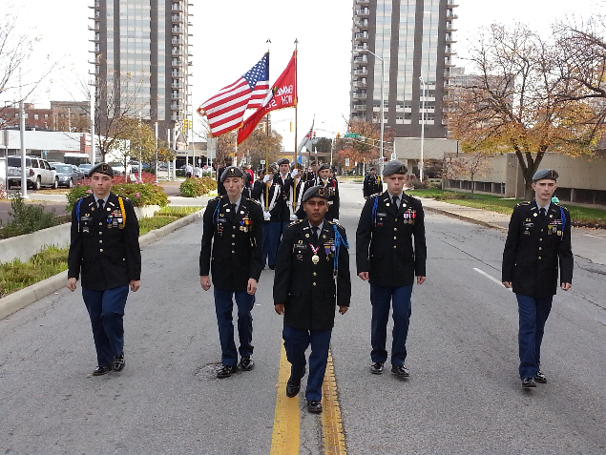
Manual Military Appreciation Day (MMAD)
Who: Former JROTC Cadets, Veterans, Active Duty service members, friends and
family of Veterans, Manual Alumni
What: Celebration, food provided, special speakers, JROTC presentations
Where: Emmerich Manual High School Gymnasium
(2405 Madison Avenue, Indianapolis, IN)
When: April 19, 2017 4:30 pm – 6:30 pm
Why: To celebrate 100 years of JROTC at Manual High School
Come Join The Fun!
Help Fund our project @ Donorschoose.org
PLEASE RSVP to EMHS JROTC @ 217-1983 ext. 235 (RSVP not required to attend)

Slide 16


