Slide 1
IREAD-3 Update

Slide 2
2013 Guidance

Slide 3
2011 Guidance

Slide 4
Statewide Readiness Test (SRT)

Slide 5
Goals of SRT
Ensure that student devices used for testing are correctly setup for testing
Test all the connections between student devices, the test content and Pearson servers
Verify that secure student “credentials” can be validated and test items are displayed and can be responded to, test navigation and tools work and that student responses are received and verified on the Pearson servers
Test the capacity of Pearson servers and software to handle high loads of logins and test item transactions
Detect local, setup, network or infrastructure issues well in advance of testing so there is time for analysis, support and correction of problems on either the Pearson or the school side

Slide 6
Statewide Readiness Test
Conducted January 19, 2017, 10:00 to 11:00 am
Over 250, 000 unique logins (students) to the Pearson System
At our peak volume, the Pearson system processed 15,000 logins a minute and was handling 115,000+ test transactions a minute
Over 1450 different “Test Administrators” managed student tests during the SRT
Makeup Date January 26th
7,000 unique logins – very low volumes similar results
To date 84.4% (1645/1948) of our online schools have conducted tests

Slide 7
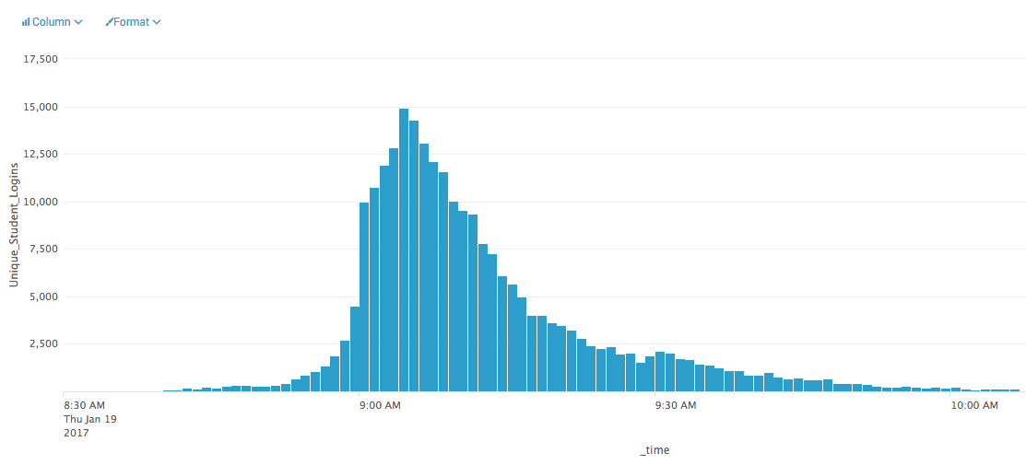
SRT Login Rate

Slide 8
Analysis
A “successful” test but in 5% of cases there were interruptions to testing – Error code is produced
Well below the rate from last year >15% but concerning
These errors fall into three categories:
Avoidable – issues in device setup
Out of date app
Attempting browser-based testing
Pressing CTRL/ALT/DEL
Screen savers or automatic updates
“Local” technology issues
Problems accessing proctor cache
Content filters issues
Unknown
Interruption occur but no error message is returned

Slide 9
Actions
We are publishing a top 10 avoidable errors document to address category 1 errors
We will also reinforce good practices in our trainings and webinars
Categories 2 and 3 are the main focus of Pearson’s efforts
Site visits have already begun
Based on SRT data and calls to help desk during and after SRT
Pearson is working to identify the source and create corrective steps for the unknown errors

