Slide 1
2018 State of the Child
State Board of Education
May 2, 2018

Slide 2
Why the state of the child?
We all benefit when the next generation is healthy, safe, well-educated and economically secure.
Provide information to better understand the whole story.
Spark discussions that lead to action.
Find ways to work together as a community so all youth can reach their full potential.
Notes:
Understanding the state of the child is essential.
We all benefit when the next generation is healthy, safe, well-educated and economically secure.
Today, we will provide information to better understand the whole story.
In our every day work, it can be easy to become hyper-focused on the data within our individual expertise or discipline.
The State of the Child will focus on five areas.
This will provide a comprehensive view of child well-being.
We hope today to sparks discussion that leads to action.
As you listen to the data, and there will be a lot of it, lean into what stirs and inspires you.
Finally, for the needle to move for children in our state it is going to take all of us collectively.
The State of the Child provides us a foundation to find ways to work together as a community so all youth can reach their full potential.

Slide 3
Families and Communities
Economics
Education
Health
Safety
Notes:
We will dive into five areas of child well-being.
- Share Indiana's National rankings
- Highlight successes
- Explore themes
- Spotlight a particular issues with an emphasis on solutions

Slide 4
Who are Hoosier Kids?
Child population | 1.5 million
Children in single-parent families | 34%
Children who are a race/ethnicity other than white, non-Hispanic | 26.6%
Children who speak a language other than English at home | 10.4%
Children in immigrant families | 12%
Sources: Easy Access to Juvenile Populations & American Community Survey
Notes:
With 1.5 million youth, Indiana has 15th largest child population nationally.
Over the past five years, 75 counties have seen a decrease in child population and 17 have seen an increase.
Most of the increase has been in urban and suburban counties, while rural counties see declining child populations.
2 in 3 children live in married couple families.
Child population is becoming more diverse.

Slide 5
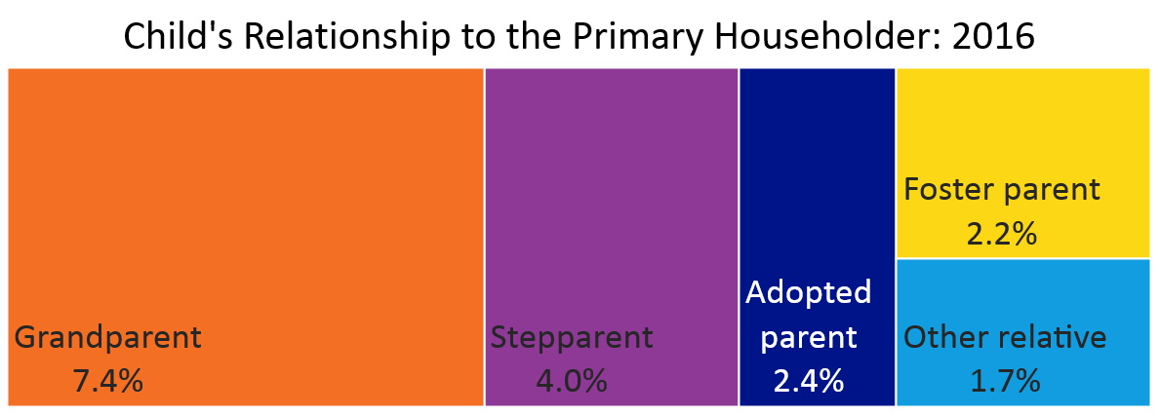
Hoosier youth are diverse in family structure
Source: American Community Survey
Notes:
18% of Indiana kids live with a primary householder other than a biological parent.

Slide 6
Recent successes and improvements set a foundation for continued growth.
Notes:
The highlights showcase growth, but there is still a lot of room for improvement. We are not a place where we can be satisfied.

Slide 7
Highlights
More Hoosier adults have a bachelor’s degree or higher | 26%
Indiana has the 9th highest rate of reading proficiency in 4th grade | 41%
Juvenile offense case filings have fallen 51.2% over the past decade | 17,230
The teen birth rate is at an all-time low | 23.5 per 1,000
Sources: American Community Survey, NAEP, Indiana Supreme Court, & Indiana State Department of Health
Notes:
In 2016, 25.6% of Hoosier adults have a Bachelor’s degree or higher, up from 23.9% in 2013
As measured by NAEP, 39% of Hoosier 8th graders were proficient in math, compared to 32% nationally.
Indiana’s teen birth rate is at the lowest level ever recorded, 23.5 births per 1,000 females ages 15-19. The teen birth rate has been falling steadily for the past decade.

Slide 8
Highlights
Fewer Hoosier children are living in poverty | 19.5%
More kids are being adopted from DCS | 1,812
More slots available in licensed child care | 20.5 per 100 children
More children have health insurance | 94.1%
Sources: American Community Survey, Indiana Department of Child Services, & Indiana Family and Social Services Administration
Notes:
In 2016, 19.5% of children live in poverty, down from 20.4% in 2015 and a recent peak of 22.6% in 2011.
In 2017, there were 1,812 adoptions through DCS, up from 1,038 in 2014.
In 2016, there are 20.5 slots in licensed child care for every 100 children ages 0-5, up from 19.9 in 2015 and 19.7 in 2012. However, 9 Indiana counties have no high quality program available.

Slide 9
Nationally, we excel in few, lag in most and need to improve in all.
Notes:
It is important for us to compare our state nationally.

Slide 10
National Rankings
KIDS COUNT Domains
Indiana Overall Family and Communities Economy Education Health | 28th 31st 19th 14th 35th
Source: Annie E. Casey Foundation
Notes:
Overall, Indiana ranks 28th for child well-being. We are right in the middle.
Rank: In 2017, Indiana is ranked 19th for overall economic well-being. This is a point improvement as we have increased from 24th in 2015.
Rank: In 2017, Indiana’s highest ranking i 14th in education, up from 23rd in 2016 and 36th five years ago (2012).

Slide 11
National Rankings
Highest 5 ​ |  | ​ | Lowest 5​
4th Grade Math Proficiency​ ​ 8th Grade Reading Proficiency ​ ​ 4th Grade Reading Proficiency High Housing Burdens​ ​ High School Graduation ​ ​ Secure Parental Employment​ ​ Child Food Insecurity​ ​ | 6th​ ​ 7th ​ ​ 9th 9th ​ ​ 12th ​ ​ 21st​ ​ 21st ​ |  | Child Maltreatment​ ​ Youth in Juvenile Detention​ ​ Infant Mortality​ ​ Child and Teen Deaths​ ​ Child Poverty​ ​ | 47th ​ ​ 43rd​ ​ 41st ​ ​ 37th​ ​ 31st​ ​
Source: KIDS COUNT Data Center
Notes:
Indiana’s highest rankings are in education and economic indicators.
HS graduation: After a steady increase from 2007-2012, graduation rates seemed to plateau around 89-90%. In 2017, they fell 2 percentage points from 89.1% to 87.2%
Indiana ranks 21st for child food insecurity with 19.1% of children good insecure. This varies by county. The range is 13% on the low end and is 24% on the high end.
Our lowest rankings are in safety and health indicators.
Child Maltreatment: physical abuse, sexual abuse, and neglect
For child abuse in neglect in 2016, there were 18.6 substantiated cases per 1,000 children, up from 17.1 in 2015, 16.2 in 2014, and 14.2 in 2013.
The Indiana child abuse and neglect hotline receives an average of one report every 2 minutes.
By the end of the state of the child experience today, there will be 45 new reported cases.

Slide 12
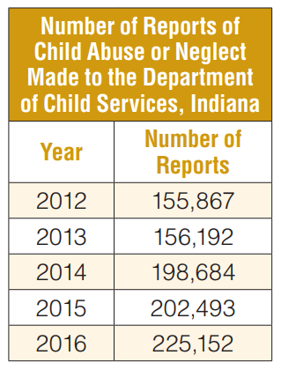
Child Maltreatment
Indiana’s child abuse and neglect rate has risen 52.5% over the past five years
The Indiana child abuse and neglect hotline receives an average of one report every 2 minutes
Source: Indiana Department of Child Services
Notes:
The Indiana child abuse and neglect hotline receives an average of one report every 2 minutes.
Dating violence: Hoosier students are more likely to experience dating violence than their peers nationally. 1 in 10 Indiana high school students (10.0%) have ever been physically forced to have sexual intercourse when they did not want to.
Bullied at School
Females Bullying – 22.5%
Males bullying – 14.8%
Cyber Bullying: 15.7% of Indiana high school students were electronically bullied in the past year
Cyber Female: 20.6%
Cyber Male: 11%

Slide 13
Clear disproportionate challenges and barriers exist for children by race, place, income and immigrant status.
Notes:
Disparities:
- Many areas where we see improvement, but it is slow
- Many areas are stagnant
- Clear declines do exist as well

Slide 14
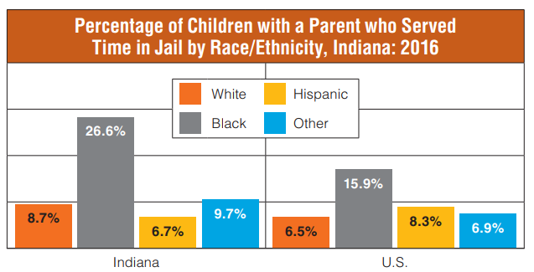
Parental Incarceration
Black Hoosier youth are 3 times as likely to experience parental incarceration as their white peers.
Source: National Survey of Children’s Health
Notes:
Black Hoosier youth are 3 times as likely to experience parental incarceration as their white peers.
More than 1 in 4 black children have experienced parental incarceration, compared to less than 1 in 10 for all other racial groups.
In comparison to national percentages, Indiana has a higher percentage of white, black and Other youth that have experienced parental incarceration.

Slide 15
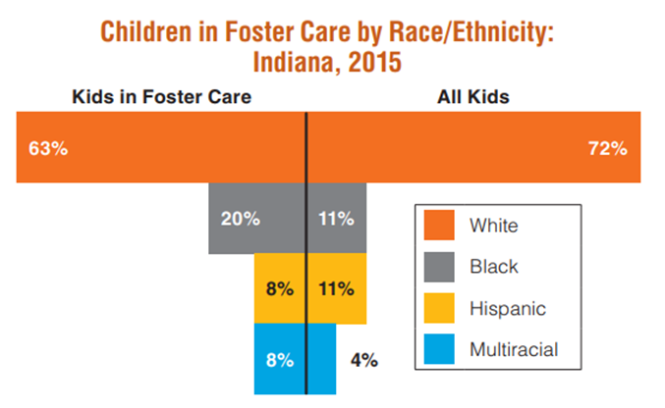
Foster Care
Source: Child Trends
Notes:
Challenges and barriers exist in foster care as well.
Black and multiracial children are disproportionately represented among kids in the foster care system.
Black children account for just 11% of the total child population, but 20% of kids in foster care are black.

Slide 16
Poverty
Source: American Community Survey
Notes:
Poverty has a massive impact.
Children who experience poverty are exposed to risks that may impair brain development and affect cognitive, social and emotional functioning.
These risks may lead to gaps in learning, knowledge and socio-emotional development
This can begin as early as infancy and get progressively wider over time.
1 in 5 Hoosier children (19.5%) live in poverty
Child poverty rates by county range from 4.9% in Hamilton county to 29.1% in Grant County.
Black Hoosier children are three times more likely to live in poverty than their white peers.
Children younger than age five are more likely to live in poverty (21.2%) than older children (18.9%).

Slide 17
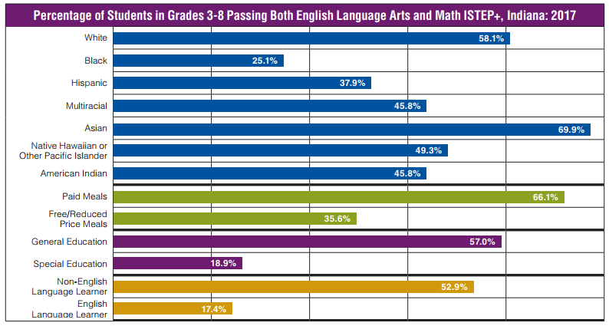
Achievement Gaps
Source: Indiana Department of Education
Notes:
For our state to reach its fullest potential, it is critical that educational success reach all children.
Education achievement gaps are pervasive and persistent across the education spectrum.
Vulnerable groups lag behind their peers in school readiness, reading, grades, educational attainment and graduation.
Groups most likely to be affected by achievement gaps include racial and ethnic minorities, low income students, English-language learners, and students with disabilities.
This particular figure shows the percentage of students in grades 3-8 passing both English Language Arts and Math ISTEP.
Nearly 45 percentage points separate black students and Asian students.
There is a gap of 30 percentage points between students that receive free/reduced meals and those that are paid meals.
38 points separate students with disabilities and general education.
17.4% of English learners passed both parts of ISTEP while 53% of Non-English Language Learners passed.

Slide 18
Education Gaps
Source: Indiana Department of Education
Notes:
In addition to performance, Disproportionality exists in educational systems such as special education programs, high ability programs and school discipline.
For example, children of color are significantly more likely to be identified for special education
and white students are 3 times more likely to be identified as high ability than their black peers.
Black students are 2.4 times more likely to receive in-school suspension, 4.6 times more likely to receive out-of-school suspension, and 2 times more likely to be expelled than their white peers.68

Slide 19
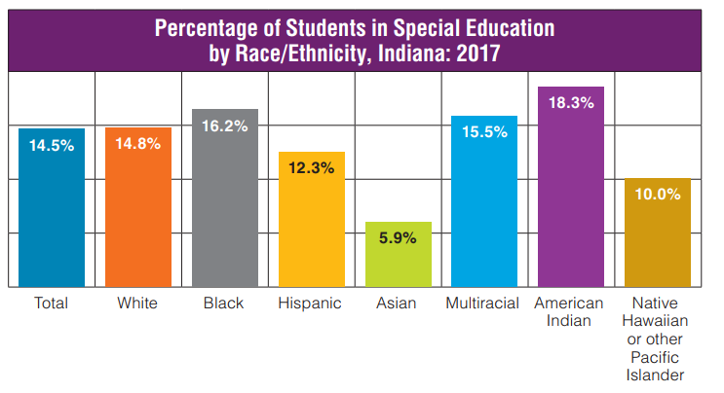
Indiana faces significant disparities in the students who are identified for special education and high ability programs
Source: Indiana Department of Education
Notes:
For our state to reach its full potential, it is critical that educational success reach all children.
Vulnerable groups lag behind their peers in terms of school readiness, reading, grades and educational attainment. Groups most likely to be affected by achievement gaps include racial and ethnic minorities, low income
students, English-language learners, and students with disabilities.

Slide 20
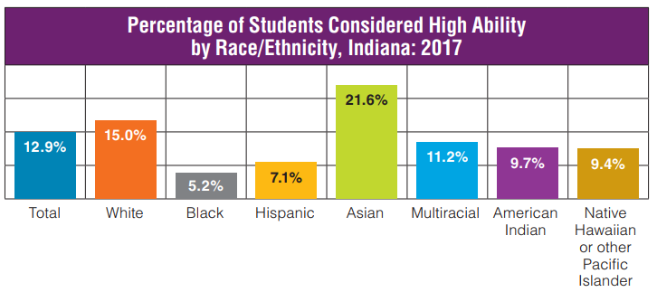
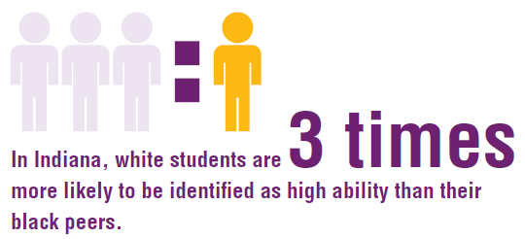
Indiana faces significant disparities in the students who are identified for special education and high ability programs
Source: Indiana Department of Education
Notes:
For our state to reach its full potential, it is critical that educational success reach all children.
Vulnerable groups lag behind their peers in terms of school readiness, reading, grades and educational attainment. Groups most likely to be affected by achievement gaps include racial and ethnic minorities, low income
students, English-language learners, and students with disabilities.

Slide 21
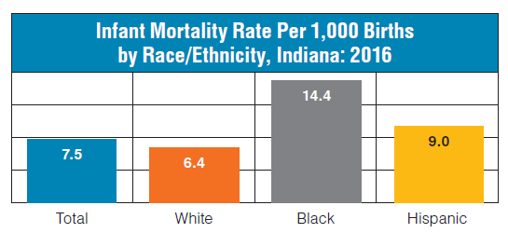
Infant Mortality
Black infants are more than twice as likely to die before their first birthday as white infants.
Source: Indiana State Department of Health
Notes:
A child’s first year of life is the most fragile.
In his 2018 State of the State address, Gov. Eric Holcomb set the goal for Indiana to become the best state in the Midwest for infant mortality rates by 2024, challenging us to work together to improve conditions for infants. The governor rightly labeled our current infant mortality rate as “unacceptable.” Indiana is ranked 41st nationally, with our babies being 24 percent more likely to die before their first birthday than infants nationally.
When you examine infant mortality by race, the disparities are clear.
Indiana’s black infants are twice as likely as white babies to die before their first birthday, with this disparity widening over the prior year.

Slide 22
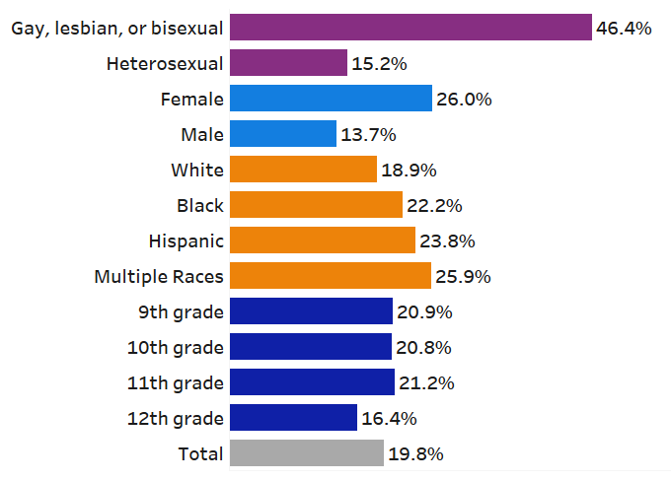
Youth Suicide
High School Students Who Seriously Considered Attempting Suicide in the Past Year, Indiana: 2015
Youth who identify as lesbian, gay, or bisexual are three times more likely to consider suicide and five times more likely to attempt suicide than their peers.
Females are twice as likely to consider suicide as males.
Source: Youth Risk Behavior Survey
Notes:
Disparities are also prevalent when it comes to youth suicide and sexual orientation.
Indiana ranks 3rd out of 36 states in the percentage of high school students who seriously considered attempting suicide.
1 in 5 Hoosier high school students seriously considered suicide in the past year.
Significant disparities exist.
LGB youth, females, and students of color are significantly more likely to struggle with suicidal ideation.
Nearly half of LGB students seriously considered suicide in the past year.

Slide 23
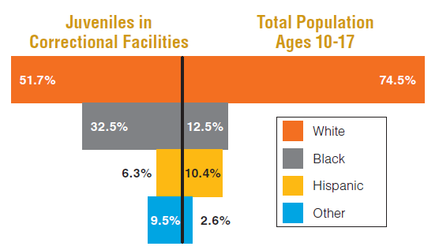
Juvenile Justice
Youth of color experience disproportionate contact with the juvenile justice system.
Source: Indiana Department of Correction & Easy Access to Juvenile Populations
Notes:
Juvenile Justice has important consequences for both youth and communities.
Did you know it costs an estimated $265 each to day to house a youth in confinement.
Youth of color experience disproportionate contact with the juvenile justice system.
Black youth account for 32.5% of youth confined, but just 12.5% of the total population of children ages 10-17.

Slide 24
Critical issues are impacting Hoosier kids.
Individuals, organizations, and leaders can be part of the solution.
Notes:
The data is clear; Clear disproportionate challenges and barriers exist for children by race, place, income and immigrant status.
highlights, national rankings and numerous data points across the five domains.
Now, we are going to take a deeper look and explore the data, impact and solutions on three key areas.
I would like to introduce you Katie Kincaid, Data & Research Manager. Katie is the primary author of the 2018 Indiana Kids COUNT Data Book and County profiles.
: Thank you, Charlie.

Slide 25
Notes:
The data is clear; Clear disproportionate challenges and barriers exist for children by race, place, income and immigrant status.
highlights, national rankings and numerous data points across the five domains.
Now, we are going to take a deeper look and explore the data, impact and solutions on three key areas.
I would like to introduce you Katie Kincaid, Data & Research Manager. Katie is the primary author of the 2018 Indiana Kids COUNT Data Book and County profiles.
: Thank you, Charlie.

Slide 26
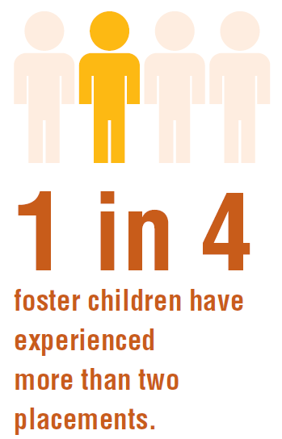
Indiana has seen a 58% increase in the number of children in foster care over the past five years.
What are the challenges for foster children?
Multiple placements
Separation from family
Waiting for adoption
Source: KIDS COUNT Data Center
Notes:
Children are placed in foster care when it’s not safe for them to remain at home, and placement in foster care is associated with many unique challenges for kids.
In some cases, foster kids may experience multiple placements before they’re reunited with parents or find a permanent family.
1 in 4 foster children experience more than two placements while in foster care. Children who move around from home to home may have difficulty maintaining important relationships with teachers, peers and friends – relationships we know are critical for children’s long-term development. Children who are older, a racial or ethnic minority, or have special needs are more likely to experience multiple placements.
Children in foster care experience separation from their family and familiar surroundings. When these separations are sudden, unexpected or prolonged, they can interfere with a child’s ability to adjust to their new everyday life and develop healthy coping strategies.
In some cases, Hoosier children spend significant amounts of time in foster care waiting to be adopted.
Of children in foster care waiting for adoption, more than 1 in 3 (37%) have been waiting three years or longer, and 1 in 8 (12%) have been waiting five years or longer.

Slide 27
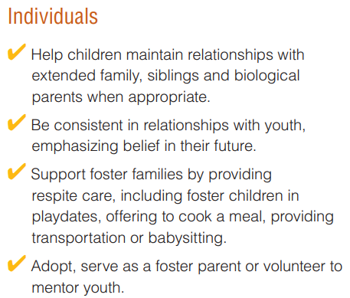
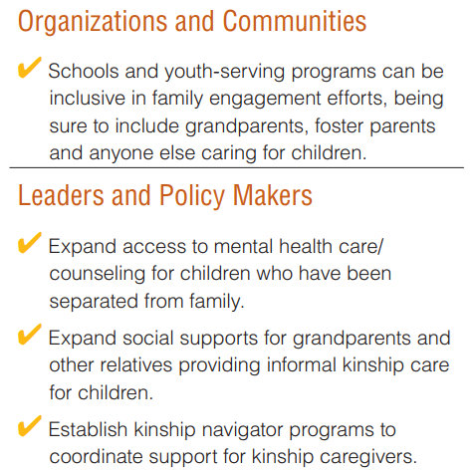
Foster Care Solutions
Notes:
When it comes to addressing these issues, individuals, organizations, communities, leaders, and policy makers are all part of the solution.
Inclusive family engagement practices – foster parents, kinship caregivers, grandparents
Mental health care for kids who have separated from family
Social supports for kinship caregivers – those grandparents and other relatives providing care for kids outside the formal foster care system

Slide 28
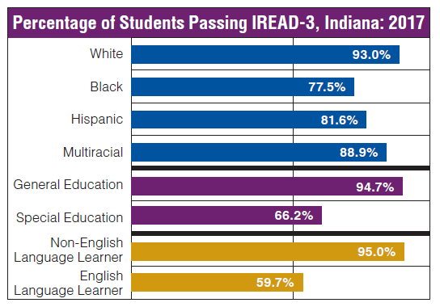
What factors contribute to achievement gaps?
Poverty
Parental factors
Community segregation
Teacher performance
Inequitable systems
Opportunity gaps
Source: Indiana Department of Education
Notes:
Poverty: Poverty can threaten children’s early development and limit access to high-quality learning environments
Parental factors: Parents’ educational attainment, community connections, and knowledge of the education system affect their children’s educational achievement
Community segregation: Segregation of communities by socioeconomic status and race leads to a concentration of factors associated with achievement gaps, such as less experienced teaching staff.
Teacher performance: Teachers are estimated to have a two to three times larger impact on achievement than any other school factor. Less
experienced teachers are more likely to teach in low income schools than more experienced teachers.

Slide 29
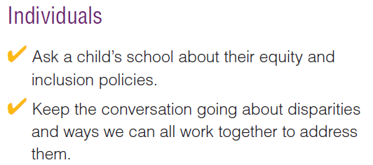
Achievement Gap Solutions
.

Slide 30
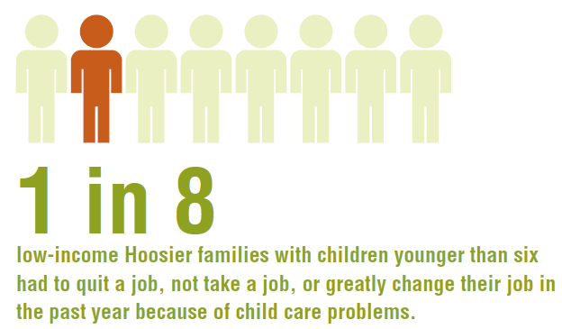
What are the challenges for parents?
Child care
Transportation
Access to social safety nets
Housing burdens
Source: National Survey of Children’s Health
Notes:
Low income Hoosier families are facing severe child care problems that interfere with employment.

Slide 31
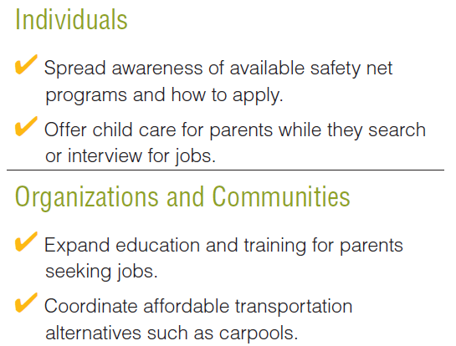
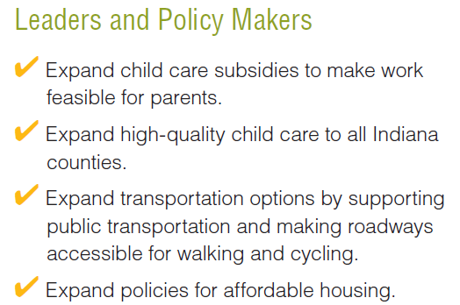
Barriers to Employment Solutions
Notes:
This issue again takes all of us working together to mitigate barriers to parental employment, but leaders and policy makers have a critical role.
Expand affordable transportation options and alternatives by supporting public transit and making roads accessible for walking and biking
Expand policies for affordable housing to alleviate housing burdens and support low-income working families

Slide 32
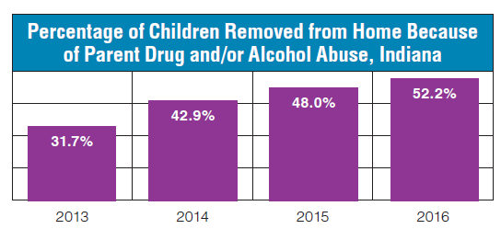
What is the impact on kids?
Prenatal exposure
Interference with parent-child relationships
Increased risk of child maltreatment
Substance abuse affects the whole family
Source: Indiana Department of Child Services
Notes:
Babies born to women who use opioids during pregnancy face greater risk of poor birth outcomes and may experience neonatal abstinence syndrome at birth.
Substance abuse can impair parents' awareness of and sensitivity to their child’s emotions, interfering with healthy parent-child attachment.
Children whose parents abuse opioids are more likely to experience abuse or neglect than other children. The time a parent invests in obtaining and using addictive substances can also take away from time with their child or interfere with adequate supervision of a child, contributing to neglect.
In households with parental substance abuse, resources may go towards drugs and alcohol instead of food or other household needs. In two-parent households where one parent does not use, children still may not receive adequate attention if the other parent must invest their time and energy in the parent with an addiction. Substance abuse can also strain relationships with others outside the immediate family, sometimes leading to estrangement from extended family and other social supports.

Slide 33
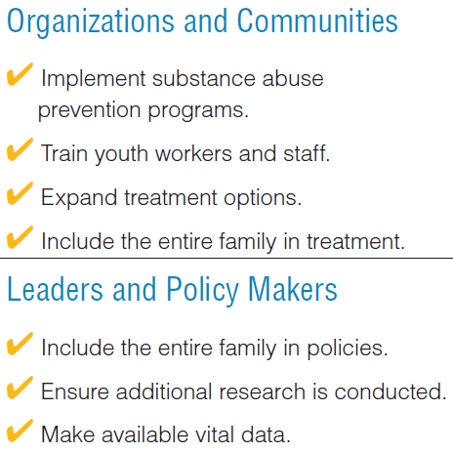
Opioid Epidemic Solutions
Notes:
Implement substance abuse and prevention programs
Include the entire family in policies
Ensure additional research is conducted
IYI plans to provide training, explore the power of mentoring.

Slide 34
What is the state of the child?
Indiana has a foundation for continued growth.
Nationally, we excel in few, lag in most and need to improve in all.
Clear disproportionate challenges and barriers exist.
Critical issues are impacting Hoosier kids.
Notes:
We dove into foster care, barriers to employment and opioids – three critical areas impacting youth. We’ve touched on specific solutions to each issue, but now it’s time to turn our attention to the immediate next steps, and the “now what” of how we can all advocate for child well-being in our state.

Slide 35
It's in all of our best interest to make sure each and every child is getting the support they need to reach their full potential.
Notes:
We have a call to action to take the data we have discussed today and go and make a difference.

Slide 36
Call to Action
Communicate the key data and solutions Promote access to your data and services Create collaborations to make a difference Maximize your presence and influence Learn more
Notes:
Ignite discussions focused on the data and solutions that lead to action

Slide 37
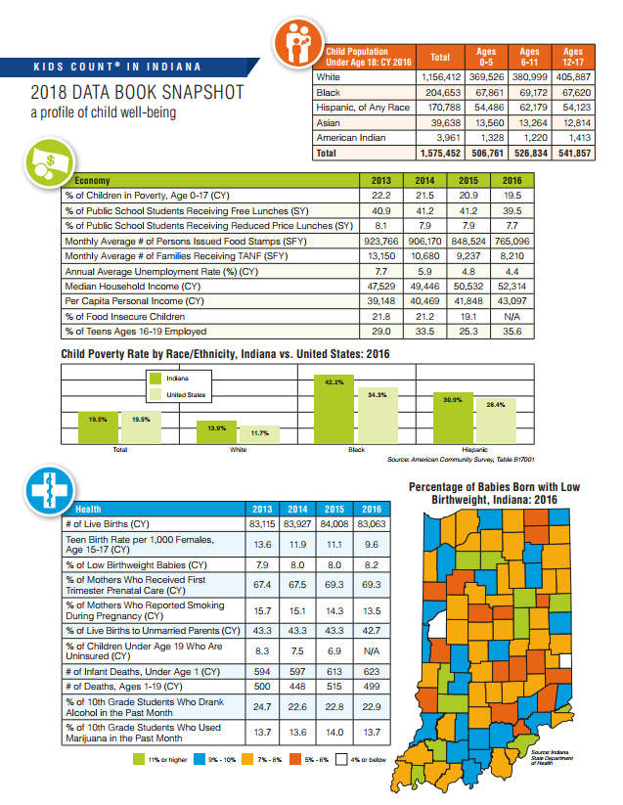
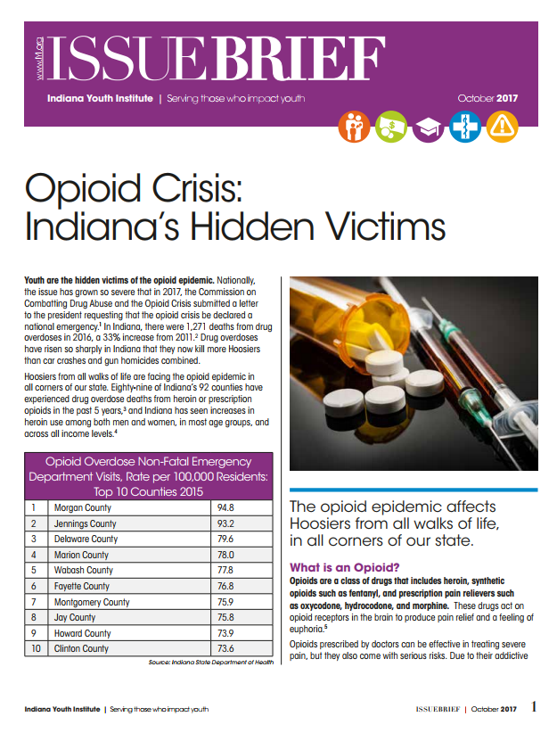
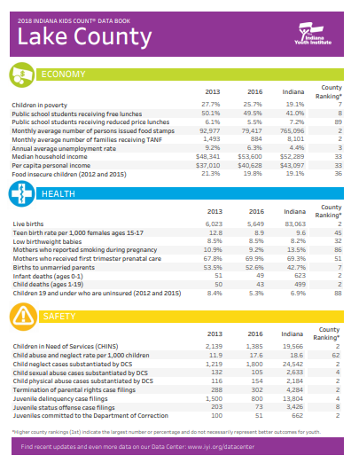
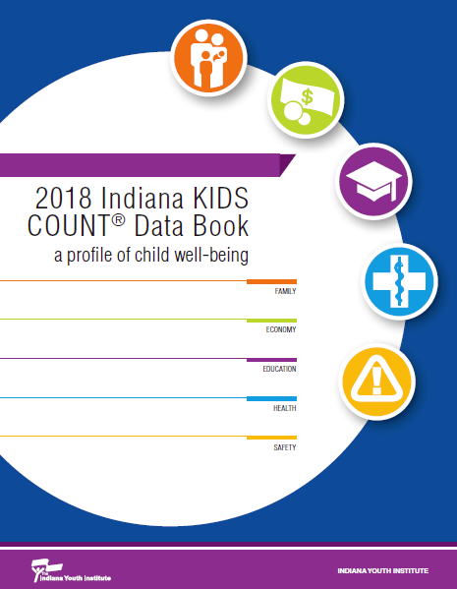
Resources and Contact
www.iyi.org/data - cgeier@iyi.org
Notes:
One tangible way to learn more is through IYI resources.

