Slide 1
Indiana ESEA
Flexibility Waiver

Slide 2
Background
-Indiana was a part of cohort 1
-Why cohort 1?
-USED Approval February 2012
-Approval through 2013-14 School Year
-USED issued option for one year extension to all SEAs

Slide 3
What Flexibility Provides for States
-The NCLB waiver primarily provides the state with flexibility across three dimensions:
1. States can utilize its own state accountability system-our A-F system-for purposes of both federal and state accountability, instead of using both the AYP system and also the A-F system;

Slide 4
2. Indiana has flexibility at the state level to allocate federal Title I funds to support out D and F schools
3. Schools have full flexibility at he local level to utilize Title 1 funds to improve academic performance
Note:
-AYP represents the annual academic performance targets in reading and math that the state, school districts and schools must reach to be considered on track for 100% proficiency
-Section 1111(b)(2)(F) of the ESEA Act of 1965, as amended by the Federal NCLB Act of 1002 requires each state to establish a timeline for adequate yearly process. The timeline must ensure that not later than the 2014-15 school year, all students will meet or exceed the state's standards for academic proficiency.

Slide 5
Goals of Flexibility as Outlined by USED
-will provide educators and State and local leaders with flexibility regarding specific requirements of the No Child Left Behind Act of 2001 (NCLB) in exchange for rigorous and comprehensive State-Developed plans designed to improve educational outcomes for all students, close achievement gaps, increase equity, and improve the quality of instruction.

Slide 6
Goals of Flexibility as Outlined by USED
-flexibility is intended to build on and support the significant State and local reform efforts already underway in critical areas such as transition to college-and career-ready standards and assessments; developing systems of differentiated recognition, accountability , and support; and evaluating and supporting teacher and principal effectiveness.

Slide 7
USED Monitoring of State Waivers
Desktop/On-Site Monitoring
Part A
Part B
Part C

Slide 8
Waiver Design
SEA Systems & Processes:
Monitoring
Technical Assistance
Data Collection & Use
Family & Community Engagement and Outreach
Principle 1- College and Career Ready Expectations for All Students
Principle 2- State Developed Differentiated Recognition, Accountability and Support
Principle 3-Supporing Effective Instruction and Leadership

Slide 9
Elements Meeting Expectation
SEA Systems & Processes
Data Collection & Use
Principle 1
Adopt English Language Proficiency Standards
Develop and Administer Alternate Assessments
Principle 2
Develop and Implement a State-Based System of Differentiated Recognition, Accountability, and Support
Reward Schools
Other Title I Schools
State and Local Report Cards

Slide 10
Elements Not Meeting Expectation
SEA Systems & Processes
Monitoring
Technical Assistance
Family & Community Engagement and Outreach
Principle 1
Transition to and Implement College-and Career-ready Standards
Develop and Administer High-Quality Assessments
Principle 2
Priority Schools
Focus Schools
Principle 3
Teacher Evaluation and Support Systems
Principal Evaluation and Support Systems

Slide 11
Full Approval | Conditional | High Risk | Waiver Revocation

Slide 12
Part B Monitoring Reflected…
Conditions being placed on Indiana’s Waiver based upon implementation since approval in February 2012-
August 21-22

Slide 13
Part B Monitoring Reflected…
From USED… “Part B monitoring aims to continue the collaborative relationship begun during the request approval process, provided ED with a deeper understanding of each SEAs goals and approaches to implementing flexibility…”

Slide 14
Part B Monitoring Next Steps…
“Indiana will have until 60 days from May, that is Monday, June 30, to submit its extension request for approval of Flexibility through the 2014-2015 school year, which will include its responses to the next steps.”

Slide 15
Part B Monitoring Next Steps
-Indiana as an assigned USED technical team
-USED technical team lead has been an ongoing collaborative partner with IDOE
-According to USED same team lead will act as our point person for planning calls, and for ongoing technical assistance on submitted amendment draft work

Slide 16
Timeline
5/14/14 Submit hierarchical call schedule to USED
5/16/14 - 6/6/14 Twice weekly USED Topic Specific Calls
Deadline of Draft on Topic to USED within 2 weeks of call
6/4/14 Formal Update Presentation to State Board of Education
6/20/14 Complete Body of Work Deadline for Final Edit to Superintendent of Public Instruction
6/25/14 Submission to USED

Slide 17
Response Options from USED
Option 1-Full Approval*
Option 2- Conditional
Option 3-High Risk Status
Option 3- Revocation

Slide 18
High Quality Plans
Principle 1
College and Career Ready Expectations for All Students

Slide 19

Transition to and Implement College-and Career ready Standards (1.B)

Slide 20
Waiver 2012 Commitments
Continued the transition to Common Core State Standards for all K-12 students statewide.
Provide technical assistance to educators of all students, including teachers of students with disabilities and English Learners, for the transition to Common Core State Standards by the end of the 2013-2014 school year.
Develop and administer annual, statewide, aligned high-quality assessments by 2014-2015. Indiana participated in an assessment consortium.

Slide 21
Waiver 2012 Commitments Completed
Continue the transition to Common Core State Standards for all K-12 students statewide.
  Completed delivery of online and live professional development for educators and administrators on the Common Core standards.
  Completed live and online technical assistance for Common Core Standards.
  Completed a curriculum map for Common Core Standards.
  Completed grade level resources for educators aligned to the Common Core Standards.

Slide 22
Waiver 2012 Commitments for English Learners
Adopt and transition to college and career-ready standards
Monitor the work of World-class Instructional Design and Assessment (WIDA) and use this to inform the revision of ELP standards
Develop and disseminate new English Language Proficiency (ELP) standards that are college and career ready.
Utilize WIDA standards
Develop and internal stakeholder group that will review the WIDA standards
Develop an internal/external work group to review/revise/and propose changes to the WIDA work
Roll out the revised ELP standards providing WebEX and potential regional workshops
Revise as appropriate with the involvement and support of key stakeholders, Work Group, and Advisory Group

Slide 23
Waiver 2012 Commitments for English Learners
Provide technical assistance to educators of all students , including teachers of students with disabilities and English Learners, for the transition to Common Core State Standards by the end of the 2013-2014 school year.
  Support English learner and content teachers in in the transition to new ELP standards
  Provide professional development for teachers of English learners to prepare teachers to teach them
  Recruit and onboard a strong Coordinator of EL
Develop and administer annual, statewide, aligned high-quality assessments by 2014-2015

Slide 24
2012 Waiver Commitments Completed for English Learners
Adopt and transition to college and career ready standards
Work began in November 2012 with a white paper submitted to IDOE from INTESOL recommending moving forward with WIDA.
An internal key stakeholder group was created with representatives from the Office of English Learning and Migrant education, college and career readiness, and content area specialists. The purpose of this group is to review the work done by the external workgroups and the external advisory group.
External work group complete an alignment study for each grade span to ensure all current Indiana English language proficiency standards were covered. Three groups met to complete this work on July 19th, 23rd, and 25th 2013. This group had representatives from around the state from K-12 teachers, instructional coaches, administrators, and higher education professionals.
The internal key stakeholder group met on July 29th 2013 to discuss the information from the external work groups and make a recommendation to move forward.

Slide 25
2012 Waiver Commitments Completed for English Learners
Adopt and transition to college and career-ready standards - 2
The external advisory group was developed to review the work done by the external work groups and dissect public comment. This group was comprised of K-12 district administrators, high education professionals, and educators.
The proposed WIDA standards were posted for public comment on August 19th through September 19, 2013. This information was disseminated through DOE Dialogue, INTESOL leadership group listserv, and the Title III and NESP Learning Connection community.
The comments received spanned from educators to administrators and parents. The overall score for the standards was a 4.43 out of a possible 5 points.
The internal key stakeholder group met on September 23, 2013 to discuss the public comments and make a recommendation for moving forward. The group unanimously suggested to move forward with the adoption of the WIDA ELD standards.
The standards were adopted in October 2013.

Slide 26
2012 Waiver Commitments Completed for English Learners
Provide technical assistance to educators of all students, including English Learners
  October 3rd held a northern region Title III Directors meeting and reviewed ESEA flexibility waiver requirements and the new CCR ELD standards transition in Logansport.
  October 4th presented in Chesterton, IN and reviewed ESEA flexibility waiver requirements and the new CCR ELD standards transition.
  October 11th presented at Christel House Academy in Indianapolis and reviewed ESEA flexibility waiver requirements and the new CCR ELD standards transition.
  EL and Migrant Education Coordinator and El Specialist attended the WIDA conference on October 17-19th to gather plans for technical assistance surrounding the new implementation.
  October 30th presented to INTESOL Leadership group and reviewed ESEA flexibility waiver requirements and the new CCR ELD standards transition.

Slide 27
2012 Waiver Commitments Completed for English Learners
Provide technical assistance to educators of all students, including English Learners - 2
November 1st presented at Central Indiana Education Service Center and reviewed ESEA flexibility waiver requirements and the new CCR ELD standards transition.
November 13th presented at East Central Education Service Center and reviewed ESEA flexibility waiver requirements and the new CCR ELD standards transition.
November 8th held a southern region Title III Directors meeting and reviewed ESEA flexibility waiver requirements and the new CCR ELD standards transition in Columbus.
November 19th presented at Muncie Community Schools and reviewed ESEA flexibility waiver requirements and the new CCR ELD standards transition.
December 4th-5th WIDA ELD standards were reviewed at the EL Academy professional development session with over 15 school districts.
December 11th held EL Leadership group meeting and discussed WIDA ELD standards transition as well was ESEA flexibility waiver requirements.
December 16th, IDOE met with WIDS professional development department to plan statewide training.
Presented a WIDA overview in MSD of Wayne Township in January 13th to EL and classroom teachers.

Slide 28
2012 Waiver Commitments Completed for English Learners
Provide technical assistance to educators of all students, including English Learners - 3
  January 15th presented at Breeman Public Schools,
  February 20th provided 2 breakout sessions at the Wabash Valley Conference regarding the WIDA standards,
  January 21st presented at Southern Indiana Education Center and reviewed ESEA flexibility waiver requirements and the new CCR ELD standards transition.
  February 7th and 21st presented at the Excel Center and reviewed ESEA flexibility waiver requirements and the new CCR ELD standards transition.
  February 28th presentation to INTESOL Leadership group from Jessee Markow on the transition to the WIDA ELD standards.
  March 11th presented at Tri-Central Community Schools and reviewed ESEA flexibility waiver requirements and the new CCR ELD standards transition.
  March 14th presented at Region 8 service center in Decatur, Indiana and reviewed ESEA flexibility waiver requirements and the new CCR ELD standards transition.
  March 31st announcement of WIDA standards training and resource guide with 5 locations around the state. (June 10th, June 12th, June 24th, June 27th, July 17th)

Slide 29
2012 Waiver Commitments Completed for English Learners
Provide technical assistance to educators of all students, including English Learners - 4
  April 29th added 2 additional WIDA standards training sessions (June 13th and July 16th) due to high demand.
  Currently exploring adding 3 more locations around the state in order to meet demand and ensure teachers are ready to utilize the newly adopted CCR ELA and Math standards in conjunction with WIDA. We currently have over 600 confirmed attendees for these events.
  April 30th presentation to INTESOL Leadership group about WIDA and the Indiana CCR standards (2014). Participants were guided through utilizing the new CCR standards (2014) to create lessons and objectives incorporating WIDA standards.
  All summer of eLearning standards presentations will include professional learning on college and career ready standards and English learners.

Slide 30
2012 Waiver Commitments Completed for English Learners
Develop and administer annual, statewide, aligned high-quality assessments
  Reviewed CCR assessment February 18, 2014 through current vendor CTB McGraw-Hill.
  Feb. 27th reviewed WIDA ACCESS assessment aligned to WIDA standards.
  Received draft approval from Attorney General to move forward with joining the WIDA consortium (not in violation of HEA 1427) in January and a final approval in May.
  Met with the finance department to review and allocate funds to adopt a new CCR assessment for English learners in April 2014.
  Coordinated with the Office of Student Assessment to determine next steps and contract requirements.
  The Office of Student Assessment is currently working with WIDA to complete a contract for the full implementation of a CCR assessment by the 2014-2015 school year.

Slide 31
Waiver 2012 Commitments for Students with Disabilities
Provide technical assistance to educators of all students , including teachers of students with disabilities and English Learners, for the transition to Common Core State Standards by the end of the 2013-2014 school year.
  (p.25) IDOE’s Office of Special Education has TA Centers focused on multiple areas of education benefitting students with disabilities. Three centers are able to incorporate into their current efforts training and professional development that will support and prepare teachers to educate students with disabilities to the CCSS.
  (p.25) Develop a guidance document for LEAs that addresses how to select, administer, and evaluate the use of accommodations for instruction and assessment of students with disabilities.

Slide 32
Waiver 2012 Commitments for Students with Disabilities
Provide technical assistance to educators of all students , including teachers of students with disabilities and English Learners, for the transition to Common Core State Standards by the end of the 2013-2014 school year.
  (p.27) Ensure that students who take the alternate assessment are being transitioned to college and career readiness.
  (p.27) IDOE is addressing the needs of students participating in Indiana’s modified assessment (IMAST) by providing the RtI model for supporting all students in high-quality Tier 1 instruction.

Slide 33
Waiver 2012 Commitments for Students with Disabilities
Provide technical assistance to educators of all students , including teachers of students with disabilities and English Learners, for the transition to Common Core State Standards by the end of the 2013-2014 school year.
  (p.25) For students who are participate in the alternate assessment, IDOE will: (a) provide guidance on how to assess and align grade level content for students with the most significant cognitive disabilities, (b) identify instructional activities and supports that relate to CCSS for this population of students, embedding communication, motor, and social skills into curriculum.

Slide 34
Waiver 2012 Commitments for Students with Disabilities
Provide technical assistance to educators of all students , including teachers of students with disabilities and English Learners, for the transition to Common Core State Standards by the end of the 2013-2014 school year.
  (p.35) Indiana participates in the General Supervision Enhancement (GSEG) Grant through the National Alternate Assessment Center which focuses on creating a new alternate assessment to replace Indiana’s current ISTAR alternate assessment. The National Center and State Collaborative (NCSC) grant http://www.ncscpartners.org/ is dedicated to providing substantive professional development on how to appropriately and effectively teach students with cognitive impairments. It centers on how to provide appropriate instruction in ELA and Math. The professional development will involve the curriculum, the standards of which will be the ‘core connectors’ to the CCSS.

Slide 35
Waiver 2012 Commitments for Students with Disabilities
Develop and administer annual, statewide, aligned high-quality assessments by 2014-2015.
  (p.26) IDOE will work collaboratively with parent advocacy groups (INSOURCE) and Effective Evaluations Resource Center to develop guidance for districts regarding the change in assessment options.

Slide 36
Waiver 2012 Commitments for Students with Disabilities
Develop and administer annual, statewide, aligned high-quality assessments by 2014-2015.
  (p.35) Indiana participates in the General Supervision Enhancement (GSEG) Grant through the National Alternate Assessment Center which focuses on creating a new alternate assessment to replace Indiana’s current ISTAR alternate assessment. The National Center and State Collaborative (NCSC) grant http://www.ncscpartners.org/ is dedicated to providing substantive professional development on how to appropriately and effectively teach students with cognitive impairments. It centers on how to provide appropriate instruction in ELA and Math. The professional development will involve the curriculum, the standards of which will be the ‘core connectors’ to the CCSS.

Slide 37
Waiver 2012 Commitments for Students with Disabilities Completed
Provide technical assistance to educators of all students , including teachers of students with disabilities and English Learners, for the transition to Common Core State Standards by the end of the 2013-2014 school year.
TA Centers
  Project SUCCESS, the newest of 7 Indiana Resource Networks, was specifically created to assist teachers of students with the most significant cognitive disabilities in the transition to CCR standards and to a new alternate assessment.

Slide 38
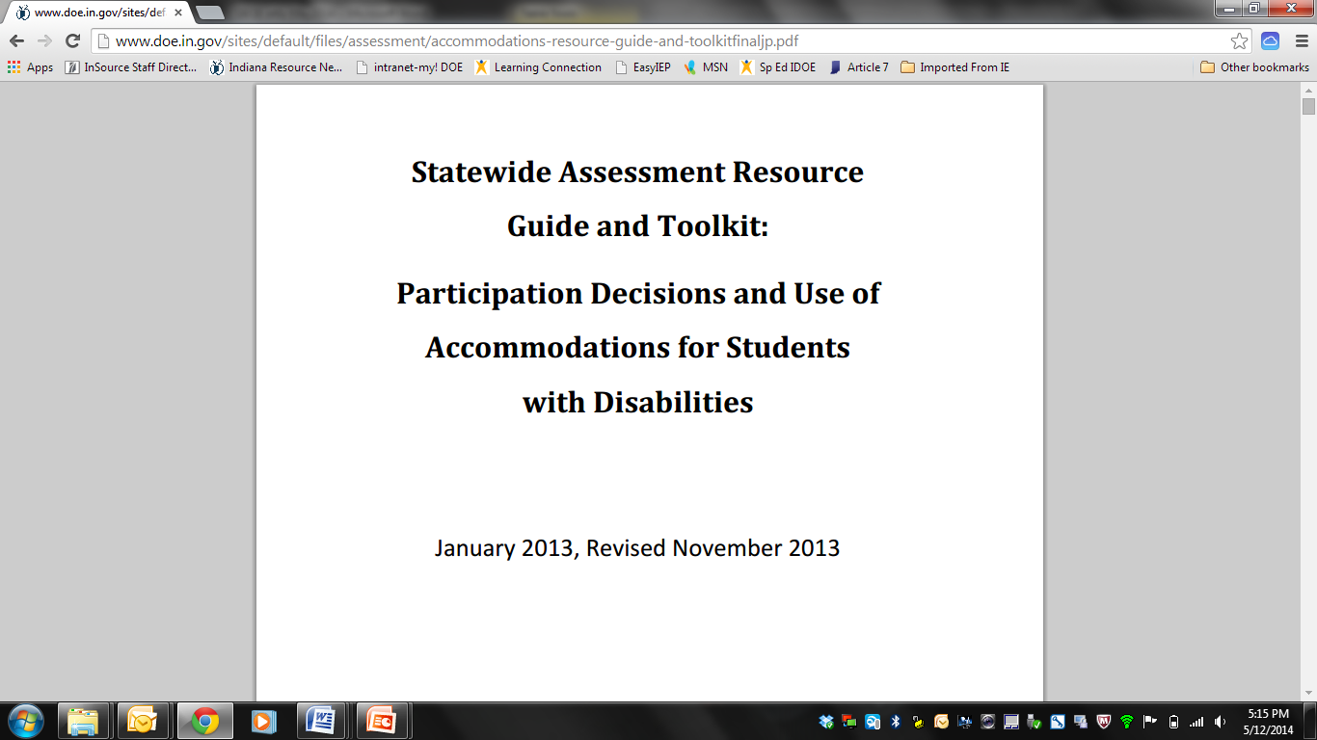
Waiver 2012 Commitments for Students with Disabilities Completed
Provide technical assistance to educators of all students , including teachers of students with disabilities and English Learners, for the transition to Common Core State Standards by the end of the 2013-2014 school year.
Accommodations for Instruction http://www.doe.in.gov/sites/default/files/assessment/accommodations-resource-guide-and-toolkitfinaljp.pdf

Slide 39
Waiver 2012 Commitments for Students with Disabilities Completed
Provide technical assistance to educators of all students , including teachers of students with disabilities and English Learners, for the transition to Common Core State Standards by the end of the 2013-2014 school year.
Transition to college and career readiness: ongoing TA/PD provided by IRNs: Indiana Secondary Transition Resource Center, Indiana IEP Resource Center, and Project SUCCESS

Slide 40
Waiver 2012 Commitments for Students with Disabilities Completed
Provide technical assistance to educators of all students , including teachers of students with disabilities and English Learners, for the transition to Common Core State Standards by the end of the 2013-2014 school year.
In addition to what was promised, in the spring of 2014 the Office of Student Assessment, Office of Special Education, and INSOURCE (parent resource center) collaborated on a series of webinars to assist teachers and parents in the transition away from Indiana Modified Assessment (IMAST): http://www.doe.in.gov/specialed. 3 of 5 are completed.

Slide 41
Waiver 2012 Commitments for Students with Disabilities Completed
Provide technical assistance to educators of all students , including teachers of students with disabilities and English Learners, for the transition to Common Core State Standards by the end of the 2013-2014 school year.
Guidance on how to align grade level content and identify instructional activities and supports - Project SUCCESS provides TA and PD using NCSC materials in a variety of formats. (ongoing)

Slide 42
Waiver 2012 Commitments for Students with Disabilities Completed
Provide technical assistance to educators of all students , including teachers of students with disabilities and English Learners, for the transition to Common Core State Standards by the end of the 2013-2014 school year.
Project SUCCESS provides TA and PD using National Center and State Collaborative (NCSC) materials in a variety of formats. (ongoing)

Slide 43
Waiver 2012 Commitments for Students with Disabilities Completed
Develop and administer annual, statewide, aligned high-quality assessments by 2014-2015.
Guidance for and by parent advocacy groups about the change in assessment options.
Accommodations for Instruction http://www.doe.in.gov/sites/default/files/assessment/accommodations-resource-guide-and-toolkitfinaljp.pdf

Slide 44
Waiver 2012 Commitments for Students with Disabilities Completed
Develop and administer annual, statewide, aligned high-quality assessments by 2014-2015.
Creating a new alternate assessment to replace Indiana’s current ISTAR alternate assessment.
  Indiana is piloting the NCSC Alternate Assessment for ELA and Math (May 2014) and writing (fall 2014)

Slide 45
Waiver 2012 Commitments Completed Regarding Communication about the Waiver to
Parents & Diverse Stakeholders
English Language learners, and other diverse stakeholders understand the implications of the SEA’s ESEA flexibility plan for LEAs, schools, teachers, and students. The following activities have been completed:
Included in Migrant Parent Advisory Councils at three events in spring of 2014
Presented at conferences and included the importance and essential information of the ESEA Flexibility Waiver that should be communicate to stakeholders
Provided PD to district leaders at the INTESOL leadership group on communicating the ESEA Flexibility to parents
Included a “Flexibility Corner” with essential information to share with parents and stakeholders
Parent stakeholder groups will begin in Fall 2014

Slide 46
Waiver 2012 Commitments Completed Regarding Communication about the Waiver to
Parents & Diverse Stakeholders, Cont’d
Planned INTESOL conference to include opportunities for ESEA Flexibility information.
Title I presented a New Title I Program Administrator Meeting in September 2013
Slides providing a brief overview of Indiana’s ESEA Flexibility Waiver included an brief history of Indiana’s approval process, alignment between state and federal accountability system, and Indiana’s categories of school improvement (including Focus, Priority, and Focus-Targeted)

Slide 47
Waiver 2012 Commitments Regarding Communication about the Waiver to
Parents & Diverse Stakeholders, Cont’d
Shared information with the Indiana Council of Administrators of Special Education (ICASE) on the transition to the new Indiana Academic Standards and the new aligned assessment, and transition away from IMAST to ISTEP
Shared information with the State Advisory Council (SAC - ARC is a member)
Housed an IN*SOURCE parent advocate with IDOE’s Office of Special Education to share information about transition to the new Indiana Academic Standards and aligned assessment
Created IMAST transition webinar in cooperation with IN*SOURCE

Slide 48
Next Steps for Standards Monitoring
IDOE’s Office of Accreditation will continue the collection of principal and superintendent assurances that locally developed curriculum and instruction is aligned to the new standards (2014).
A cross department team created to support and monitor statewide implementation of the new Indiana Academic Standards with focus on differentiated LEA implementation needs.

Slide 49
Next Steps for Implementing the new Indiana Academic Standards
IDOE will release a correlation (aka crosswalk) side-by-side document to indicate the similarities and differences between standards currently in use and the newly adopted college and career ready (CCR) standards (2014). This document will allow corporations and schools to align their curriculum and instruction to the new standards.
IDOE will issue assessment guidance to help corporations and schools focus their locally developed curriculum and instruction for future assessment. This will allow them to identify key CCR standards to target their curriculum and instruction.
IDOE will create teacher resource guides for the new CCR standards, which will include a glossary of terms, a comprehensive text complexity rubric (with quantitative, qualitative and task analysis criteria) for corporations and schools to use in the local development of reading lists.
IDOE will launch online communities of practice to create a peer to peer network of support in sharing resources, best practices, and tips in aligning locally developed curriculum to the new CCR standards.

Slide 50
Next Steps for Implementing the new Indiana Academic Standards, Cont’d
During the summer months and the beginning of the 2014-2015 school year, IDOE staff will deliver online and live professional development for educators and administrators on the new CCR standards.

Slide 51
Next Steps for Assessing the New Indiana Academic Standards
By mid- June, IDOE will submit the blueprint to USED for the College and Career Readiness Transition Assessment (CCRTA) to be offered in conjunction with ISTEP+ for the spring of 2014-2015. This will allow for exposure to TE items and the new Indiana Academic Standards.
During the summer months of 2014, IDOE will work with the State Board of Education Assessment Subcommittee to develop the required procurement paperwork to identify
and select the next vendor to create the new aligned assessment.
Request for Information (RFI) out in for public review now.
Request for Proposals (RFP) to be developed this summer based on feedback from RFI respondents.

Slide 52
Next Steps for English Learners
Provide technical assistance and supports to educators of ELs for the transition to CCR standards in the 2013-2014 school year and beyond and adopt CCR assessment for English learners.
Development of Indiana specific Model Performance Indicators (MPIs) and WIDA implementation guide.
Indiana Academic Standards and WIDA alignment webinars.
Train the Trainer Workshops.
Translated parent resources and communication.
Assessment and data analysis.
Monitor through on-site and desktop monitoring.
WIDA standards and assessment assurances will be included in Title III and NESP applications.
Continue meeting with all established stakeholder and work groups.

Slide 53
Next Steps for Students with Disabilities
TA Centers
  Project SUCCESS, the newest IRN, was specifically created to assist teachers of students with the most significant cognitive disabilities in the transition to CCR standards and to a new alternate assessment.
  We partner with IN*SOURCE, a parent advocacy group, and the remaining 5 IRNs on numerous projects to develop resource documents on standards and assessments.
  Additionally, ongoing TA/PD provided by IRNs: Indiana Secondary Transition Resource Center, Indiana IEP Resource Center, and Project SUCCESS

Slide 54
Next Steps for Students with Disabilities
Project SUCCESS provides TA and PD using NCSC materials in a variety of formats. (ongoing)
Final 2 IMAST transition webinars (standards based IEP goals and Universal Design for Learning) will be completed with the help of 2 resource centers (IEP Resource Center and PATINS (Promoting Achievement through Technology and Instruction for all Students) by the fall of 2014
Indiana is piloting the NCSC Alternate Assessment for ELA and Math (May 2014) and writing (fall 2014)

Slide 55
High Quality Plans
Principle 2
State Developed Differentiated Recognition, Accountability and Support

Slide 56
Priority Schools
(2.D)

Slide 57
Waiver 2012
Effect change in priority schools by ensuring that each LEA with 1 or more priority schools implements meaningful interventions aligned with the turnaround principles for 3 years.
IDOE school improvement planning tools used to select interventions for non-SIG priority schools must accurately reflect the turnaround principles.
Training materials for IDOE and LEA staff must accurately and consistently define the turnaround principles.

Slide 58
Waiver 2012
School improvement planning tools & monitoring reports must be sufficiently aligned to facilitate evaluation of concurrent implementation of all turnaround principles in non-SIG priority schools.
Must provide evidence that each non-SIG priority school superintendent reviewed the performance of the priority school principal & made a determination regarding whether to keep or replace the principal based on the ability to lead the turnaround effort and data to support a past track record of student achievement success.

Slide 59
Next Steps Outlined in Monitoring
Begin full implementation of interventions in non-SIG priority schools in the 2014-15 school year, including a high quality plan to adjust its school improvement planning and monitoring process by:
describing the ESEA flexibility turnaround principles within related tools, documents, training materials and other supports
align planning and monitoring tools to facilitate the determination that each school is implementing all ESEA flexibility turnaround principles for three years

Slide 60
Designed in Consultation with USED since Monitoring
(Work Complete and Amendment Impetus)
Created a monitoring rubric and process to provide schools with feedback on the implementation of the 8 turnaround principles.

Slide 61
The 8 Turnaround Principles
School Leadership: Ensuring that the principal has the ability to lead the turnaround effort;
School Climate and Culture: Establishing school environments with a climate conducive to learning and a culture of high expectations;
Effective Instruction: Ensuring teachers utilize research-based effective instruction to meet the needs of all students;
Curriculum, Assessment, and Intervention System: Ensuring teachers have the foundational documents and instructional materials needed to teach to the rigorous college and career ready standards that have been adopted;
Effective Staffing Practices: Developing the skills to better recruit, retain and develop effective teachers;
Enabling the Effective Use of Data: Ensuring school-wide use of data focused on improving teaching and learning, as well as climate and culture;
Effective Use of Time: Redesigning time to better meet student needs and increase teacher collaboration focused on improving teaching and learning; and
Effective Family and Community Engagement: Increasing academically focused family and community engagement.

Slide 62
Indicators for Turnaround Principle 1: Ensuring Strong Leadership
Quality School Review Rubric Indicators SCHOOL LEADERSHIP
TURNAROUND PRINCIPLE 1: Ensure that the principal has the ability to lead the turnaround effort.
INDICATORS
1.1 The principal uses data to establish a coherent vision that is understood and supported by the entire school community
1.2 The principal develops and promotes a coherent strategy and plan for implementing the school vision, which includes clear measurable goals, aligned strategies and a plan for monitoring progress and driving continuous improvement.
1.3 The principal uses data to work collaboratively with staff to maintain a safe, orderly and equitable learning environment.
1.4 The principal communicates high expectations to staff, students and families, and supports students to achieve them.
1.5 The principal ensures that a rigorous and coherent standards-based curriculum and aligned assessment system are implemented with fidelity.
1.6 The principal ensures that classroom level instruction is adjusted based on formative and summative results from aligned assessments.
1.7 The principal uses informal and formal observation data and on-going student learning outcome data to monitor and improve school-wide instructional practices and ensure the achievement of learning goals for all students (including SWD and ELLs).
1.8 The principal ensures that the schedule is intentionally aligned with the school improvement plan in order to meet the agreed upon school level learning goals.
1.9 The principal effectively employs staffing practices (recruitment and selection, assignment, shared leadership, job-embedded professional development, observations with meaningful instructional feedback, evaluation, tenure review) in order to continuously improve instructional and meet student learning goals.
1.10 The principal uses data and research-based best practices to work with staff to increase academically-focused family and community engagement.

Slide 63
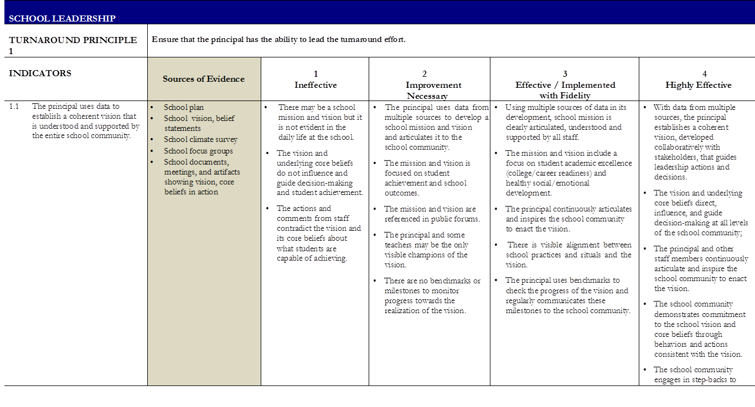
Monitoring Rubric for Priority Schools

Slide 64
Designed in Consultation with USED since Monitoring
(Work Complete and Amendment Impetus)
Created a Student Achievement Plan to supplement the School Improvement Plan for all Focus and Priority Schools.

Slide 66
IDOE
Assisted
LEAs
In
Identifying
SMART Goals
Driven by Data

Slide 67
DATA

Slide 68
Root Cause Analysis Priority Area for Improvement – PAI #____
Using the provided 2012-2013 student data on the school’s A-F Report Card, identify a PAI based on low levels of student proficiency or growth, low graduation rates, or low College and Career Readiness indicators (*You should have two or three PAI’s in total*).
PAI Focus | (Select One) ___Student Proficiency (Pass Rate) ___Student Growth ___Graduation Rate ___College and Career Readiness
Subject | (Select One) ___Math ___English/Language Arts ___English 10 ___Algebra I
Grade(s)
Subgroup or Improvement Focus | (Select One) ___Bottom 25% (Elementary and Middle School only) ___Top 75% (Elementary and Middle School only) ___Improvement from 8th to 10th Grade (High School only) ___Improvement from 10th to 12th Grade (High School only)
Description of PAI – What Do We Notice as THE PROBLEM? (For example, “Data shows an overall negative trend in English/Language Arts performance over the past 4 years. In order to earn above a ‘D’ for this subject area, student proficiency will have to increase 13%. Increasing the performance of all students in grades 3 through 8 will also increase the overall performance of the bottom 25%”)
Root Cause of PAI – The Most Important WHY? (For example, “In 2010, our school discontinued an English/Language Arts Intervention program and redirected it towards the purchase of technology. Although we have been able to use technology to enrich learning, our students’ proficiency in E/LA has decreased since the end of the intervention program. The absence of the intervention program is the only major change in our E/LA program since the scores started to decline. Thus, we believe that the root cause of PAI 1 is the absence of an effective E/LA intervention program.”

Slide 71
Intervention | PAI Addressed | 1 2 3 | Driver | Name/Title
 | Provide a brief description of your intervention
 | Evidence – What evidence will you utilize to show success for the intervention?
Action Steps – Provide specific action steps to implement the intervention |  |  |  |  | Target Date | Status
Intervention | PAI Addressed | 1 2 3 | Driver | Name/Title
 | Provide a brief description of your intervention
 | Evidence – What evidence will you utilize to show success for the intervention?
Action Steps – Provide specific action steps to implement the intervention |  |  |  |  | Target Date | Status
Priority Schools completed this Student Achievement Plan template for each of the 8 Turnaround Principles.

Slide 72
Designed in Consultation with USED since Monitoring
(Work Complete and Amendment Impetus)
Created a system to monitor the implementation of interventions with fidelity in all Priority Schools for three years.

Slide 73
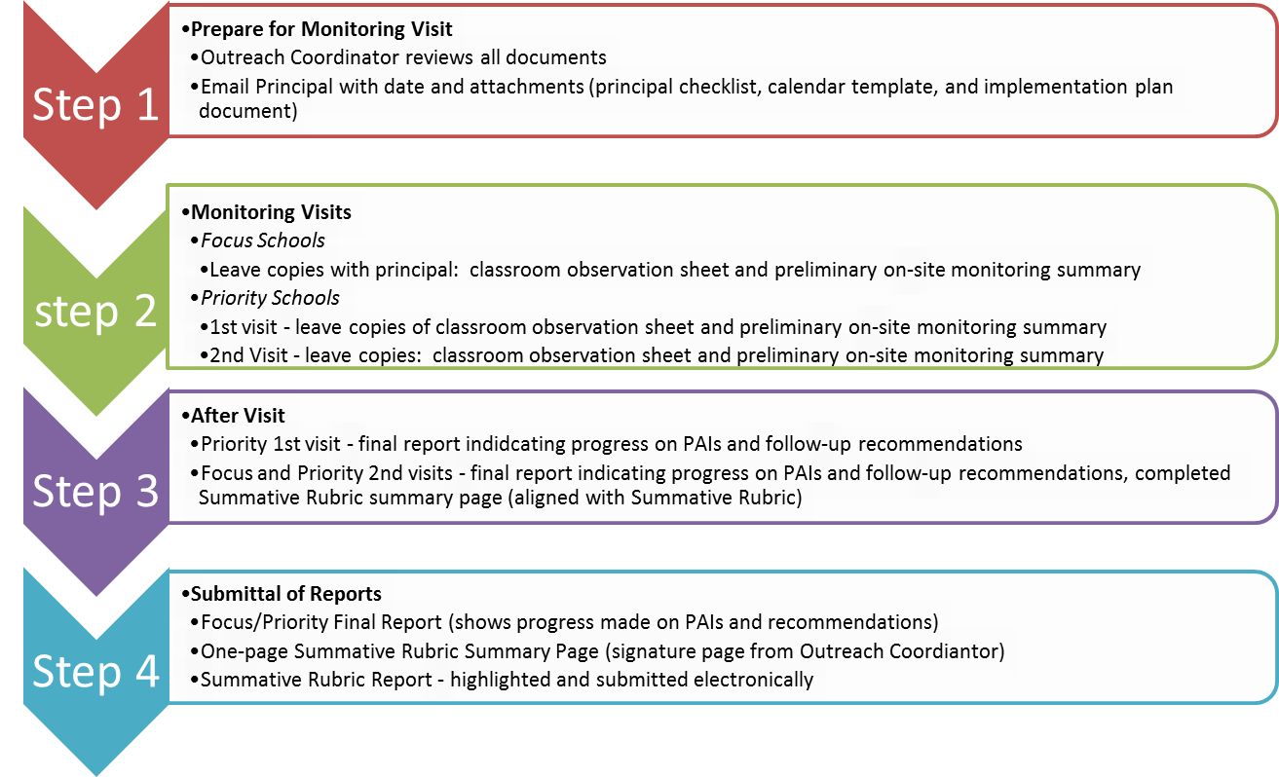
Outreach Coordinator Monitoring Protocol

Slide 74
On-Site Monitoring: Classroom Observation Form
Characteristic |  |  | Rating |  |  |  |  | Evidence
Classroom Environment safety order visible and invisible structures academic atmosphere student-centeredness peer support purposeful/practical space arrangement student-work displays |  |  | Low High
 |  |  | 1 |  | 2 | 3 | 4
Classroom Culture high expectations achievement rigor relationships respect tolerance collaboration urgency |  |  | Low High
 |  |  | 1 |  | 2 | 3 | 4
Behavior Management efficiency effectiveness respect rules and routines consistency compliance |  |  | Low High
 |  |  | 1 |  | 2 | 3 | 4
Instructional Execution objective-driven knowledge or skill development levels of connections being made rigor differentiation student practice scaffolding concepts pacing progress charting higher order thinking students interests and backgrounds |  |  | Low High
 |  |  | 1 |  | 2 | 3 | 4
Engagement compliance level “on-task” students’ personal interest level making relevant connections |  |  | Low High
 |  |  | 1 |  | 2 | 3 | 4
1 - Very little or no evidence observed that the practice presently exists | 2 - Some evidence observed, but there are a number of practices needing improvement or opportunities for strengthening |  |  |  |  |  |  | 3 -Much evidence observed, but there are a few practices that could be strengthened |  | 4 – Much evidence observed and it would be difficult to find ways to improve
Additional Comments:
Beginning Time: ________________ Ending Time: ________________ |  | Number of Students in classroom |  |  |  |  |  | School
Observer |  |  |  | Date |  |  |  | Room # | Teacher

Slide 75
Preliminary On-Site Monitoring Summary
Turnaround Principle | Rating | Evidence
TURNAROUND PRINCIPLE 1: School Leadership | 1 Ineffective 2 Improvement Necessary 3 Effective/Implemented with Fidelity 4 Highly Effective
TURNAROUND PRINCIPLE 2: School Climate and Culture | 1 Ineffective 2 Improvement Necessary 3 Effective/Implemented with Fidelity 4 Highly Effective
TURNAROUND PRINCIPLE 3: Effective Instruction | 1 Ineffective 2 Improvement Necessary 3 Effective/Implemented with Fidelity 4 Highly Effective
TURNAROUND PRINCIPLE 4: Curriculum, Assessment & Intervention System | 1 Ineffective 2 Improvement Necessary 3 Effective/Implemented with Fidelity 4 Highly Effective

Slide 76
TURNAROUND PRINCIPLE 5: Effective Staffing Practices | 1 Ineffective 2 Improvement Necessary 3 Effective/Implemented with Fidelity 4 Highly Effective
TURNAROUND PRINCIPLE 6: Enabling the Effective Use of Data | 1 Ineffective 2 Improvement Necessary 3 Effective/Implemented with Fidelity 4 Highly Effective
TURNAROUND PRINCIPLE 7: Effective Use of Time | 1 Ineffective 2 Improvement Necessary 3 Effective/Implemented with Fidelity 4 Highly Effective
TURNAROUND PRINCIPLE 8: Effective Family and Community Engagement | 1 Ineffective 2 Improvement Necessary 3 Effective/Implemented with Fidelity 4 Highly Effective
Additional Comments:

Slide 79
Summative Rubric Summary
School Name ____________________________________________________________ Corporation #___________ School # _________
Date of Visit _________________________ Outreach Coordinator Name: ___________________________________________________
Turnaround Principle | Ineffective | Improvement Necessary | Effective/Implemented with Fidelity | Highly Effective
School Leadership
School Climate & Culture
Effective Instruction
Curriculum, Assessment & Intervention System
Effective Staffing Practices
Enabling the Effective Use of Data
Effective Use of Time
Effective Family & Community Engagement
As a result of the Outreach Division of School Improvement monitoring visit, the above named school is found to be performing at the indicated level. N/A indicates that the focus school has not identified that principle as a focus in their plan. Priority schools are evaluated in all eight (8) areas. Summary page should be submitted to Assistant Superintendent of Outreach no later than June 15.
Outreach Coordinator Signature _______________________________________________________ Date ___________________________

Slide 80
Designed in Consultation with USED since Monitoring
(Work Complete and Amendment Impetus)
Created documents and process to ensure strong leadership in all Priority Schools.

Slide 84
Ensuring Strong Leadership Principal Evaluation and Superintendent Verification. Principals must be evaluated as effective on all indicators to successfully meet the foundational requirements of being able to lead the turnaround work. The Superintendent Verification is Due by February 28, 2014 to the Indiana Department of Education.

Slide 85
Superintendent’s submitted by February 28, the following rubric and evidence. The IDOE responded on April 15, 2014 to the submittal with a yes or no (we still need more evidence) letter. IDOE will respond by May 15 to the additional evidence.
Indicators of Principal Evaluation | Sources of Possible Evidence | Evidence Provided | Evaluation of Evidence
1.1 The principal uses data to establish a coherent vision that is understood and supported by the entire school community. | • School plan • School vision, belief statements • School climate survey • School focus groups • School documents, meetings, and artifacts showing vision, core beliefs in action | Please list the evidence you are attaching to meet the EFFECTIVE level of proficiency for each indicator on the left: | To be Completed by IDOE The evidence provided meets the criteria for an Effective Rating. ______Yes ______No
1.2 The principal develops and promotes a coherent strategy and plan for implementing the school vision, which includes clear measurable goals, aligned strategies and a plan for monitoring progress and driving continuous improvement. | • School Improvement Plan • School vision and mission statements • School climate survey • School focus groups • Evidence of monitoring of action plan goals frequently and continuously • Administrative Walk Through Data • Formative Achievement Data |  | To be Completed by IDOE The evidence provided meets the criteria for an Effective Rating. ______Yes ______No
1.3 The principal uses data to work collaboratively with staff to maintain a safe, orderly and equitable learning environment. | • Administrative Walkthrough Data – student engagement indicator • School climate survey • School focus group • School Discipline Plan • School Faculty/Student Handbook • Individual Teacher Observations/Evaluations • Master & Bell Schedules |  | To be Completed by IDOE The evidence provided meets the criteria for an Effective Rating. ______Yes ______No

Slide 86
Superintendent Verification Form

Slide 89
INDICATOR 1.1: Principal uses data to establish a coherent vision that is understood & supported by the entire school community
LEA must demonstrate all identifiers to prove effectiveness of principal
IDENTIFIER | DEMONSTRATED | NOT DEMONSTRATED
Using multiple sources of data in its development, school mission is clearly articulated, understood & supported by all staff
The mission & vision include a focus on student academic excellence (college/career readiness) & healthy social/emotional development
The principal continuously articulates & inspires the school community to enact the vision
There is visible alignment between school practices & rituals & the vision
The principal uses benchmarks to check the progress of the vision & regularly communicates these milestones to the school community
TOTAL
DETERMINATION (circle one) | Effective Ineffective

Slide 90
Response from IDOE to school leadership:
Approved

Slide 91
Response from IDOE to school leadership:
Not Approved

Slide 92
Response from IDOE to school leadership following resubmittal:
Not Approved

Slide 93
Designed in Consultation with USED since Monitoring
(Work Complete and Amendment Impetus)
Provided technical assistance to schools and shared expectations for Focus and Priority Schools and how schools would be monitored.
  December 2013: 6 Regional Meetings for all Focus and Priority School Leadership Teams (Central Indianapolis, West Indianapolis, Elkhart, Merrillville, Bedford, and Evansville) Partnered with the M.A. Rooney Foundation and provided data analysis tools.

Slide 95
Excerpt from Memo sent on December 2, 2013, to Principals and Superintendents of Focus and Priority Schools

Slide 96
Next Steps Designed in Consultation with USED since Monitoring
(Work Outlined to be Complete and Amendment Impetus)
Best Practice Interventions will be provided to schools within each Turnaround Principle to guide selection. (This process was initiated in March and needs to be completed.)
All documents will be reviewed this summer for potential revisions.
Further conversations are needed around the concept of “implemented with fidelity vs. achieving results”

Slide 97
Focus Schools
(2.E)

Slide 98
Waiver 2012
Ensure that each LEA implements interventions in focus schools based on reviews of the specific academic needs of the school and its students
implement a school improvement process of sufficient quality to ensure that interventions selected to address reasons for identification of focus schools are implemented
LEA and IDOE accountability plans and implementation status reports adequately align with each other

Slide 99
Next Steps Outlined in Monitoring
As part of its ESEA flexibility extension request, IDOE will submit a high-quality plan for adjusting and aligning its SIP and monitoring processes to facilitate the determination of whether its focus schools are implementing those interventions selected based on the performance of its lowest-performing ESEA subgroups.

Slide 100
Designed in Consultation with USED since Monitoring
(Work Complete and Amendment Impetus)
Created a Student Achievement Plan, monitoring tools, and technical assistance to inform the selection of the appropriate intervention for Focus Schools, determined by data, to support the lowest performing subgroups.

Slide 103
Monitoring the work…In addition to reviewing the data and Student Achievement Plan alignment, Outreach Coordinators visit Focus Schools once in the Spring 2014 and provide school leaders with a summative report based on the onsite visit and evidence submitted.

Slide 104
Next Steps Designed in Consultation with USED since Monitoring
(Work Outlined to be Complete and Amendment Impetus)
On-going continuous improvement and review of the process during the summer of 2014.

Slide 105
Summary of IDOE’s Intentional Action since the USDE August Monitoring Visit:
The Outreach Division of School Improvement was created by Superintendent Ritz in the summer of 2013 to provide 13 field staff to directly support and monitor our struggling schools around the state.
Since its inception, the division has created a Student Achievement Plan, a rubric, monitoring tools, and a process to ensure that Indiana schools are implementing the 8 Turnaround Principles with fidelity.
The Outreach Coordinators have monitored the 98 Focus Schools and 203 Priority Schools and have completed over 500 onsite visits to assist Indiana’s struggling schools. The schools have been given specific and intentional feedback on each of the 8 Turnaround Principles.
.

Slide 106
Summary of IDOE’s Intentional Action since the USDE August Monitoring Visit:
Schools have been given technical assistance and professional development to assist them with data analysis, intervention strategies, student engagement practices, and many other best academic practices.
All Focus and Priority School leaders will receive a summative monitoring report by the end of the school year to inform decisions for the next school year.
Outreach Coordinators have served on Work Councils and participated in many community organizations to provide connections to schools and align our work to community resources.
An intentional process was implemented to ensure that all Priority Schools have strong leadership and an intentionally placed leader for the 2014-15 school year.
.

Slide 107
Summary of IDOE’s Intentional Action since the USDE August Monitoring Visit:
By the end of May we will have conducted 7 School Quality Reviews for our Year 4 schools to assist the State Board of Education with their technical assistance to schools and to identify first priorities for the 14-15 School Improvement Plans. The School Quality Reviews are aligned to the 8 Turnaround Principles.
A partnership with AdvancED was created to give our Priority Schools a rigorous and comprehensive tool to use for School Improvement Planning. This work is aligned to the 8 Turnaround Principles.
IDOE renewed its contract with Mass Insight to provide technical assistance to the SEA on Turnaround work.
.

Slide 108
Next Steps Outlined in Monitoring
Begin full implementation of interventions in non-SIG priority schools in the 2014-15 school year, including a high quality plan to adjust its school improvement planning and monitoring process by:
describing the ESEA flexibility turnaround principles within related tools, documents, training materials and other supports
align planning and monitoring tools to facilitate the determination that each school is implementing all ESEA flexibility turnaround principles for three years

Slide 109
Next Steps Outlined in Monitoring
As part of its ESEA flexibility extension request, IDOE will submit a high-quality plan for adjusting and aligning its SIP and monitoring processes to facilitate the determination of whether its focus schools are implementing those interventions selected based on the performance of its lowest-performing ESEA subgroups.

Slide 110
Teacher and Principal Evaluation and Support Systems (3.B)

Slide 111
Waiver 2012
Develop training modules and support documents for teacher and principal evaluation systems
Ensure effective implementation of teacher and principal evaluation systems
Principal evaluations should tie to LEA personnel decisions (mirror the requirements for teacher evaluations to inform personnel decisions)
Regional Education Service Centers (ESCs) provide PD to districts throughout the state
School districts will outline a clear process for review and refinement of evaluation systems

Slide 112
Next Steps Outlined in Monitoring Report
Reduce the weight of student growth in the State evaluation model for teacher evaluations based on the 2012-2013 school year data only
Provide monitoring and technical assistance supports around teacher and principal evaluation systems beginning in the 2014-2015 school year
Develop high quality plan for how it will ensure that its principal evaluation results will be used to inform personnel decisions based on the 2015-2016 ratings

Slide 113
Designed in Consultation with USED since Monitoring
(Work Complete and Amendment Impetus)
Staff Performance Evaluation Data annual reporting
  249 districts and 1993 schools reported certified employee final evaluation data for the 2012-13 evaluation year per IC 20-28-11.5-9
  LEA aggregate evaluation data available on IDOE website by school, district and teacher prep program per IC 20-28-11.5-9
  Alignment of teacher evaluation data to A-F school accountability grading transparent
Teacher and Principal Evaluation Monitoring
  13 Outreach specialists monitored over 200 principal evaluations which included implementing teacher evaluation systems and informed LEA personnel decisions in Priority Schools

Slide 114
Designed in Consultation with USED since Monitoring
(Work Complete and Amendment Impetus)
  Districts annually submit Accreditation Legal Standard 12-- Evaluation Plan with assurance that the LEA evaluation plan is statutorily compliant with IC 20-28-11.5. Plans are posted on the IDOE website
  IDOE reviewed over 200 LEA compensation plans linked to compliant evaluation plans for compliance with IC 20-28-9-1.5; these plans are posted on IDOE website; review required annually
  IDOE surveyed LEAs in fall 2013 on evaluation plan implementation with over 700 educators responding. Results are being used to guide development of technical assistance and guidance documents for 2014-15.

Slide 115
Designed in Consultation with USED since Monitoring
(Work Complete and Amendment Impetus)
  IDOE began working with the IU Center for Education and Lifelong Learning in 2011 on the Indiana Teacher Appraisal and Support System (INTASS) tool when the state evaluation model was first implemented. IDOE has a representative on the INTASS advisory board.
  INTASS is a tool for LEAs to assess the effectiveness of their evaluation system and to identify opportunities for improving their evaluation plans and implementation; INTASS tool is currently being piloted; will be ready for LEA use in 2014-15 school year.
  New principal licensure exam (effective 2/2014) is aligned to RISE 2.0 Principal Effectiveness Rubric

Slide 116
Next Steps Designed in Consultation with USED since Monitoring (Work Outlined to be Complete and Amendment Impetus)
  Priority schools will be targeted to receive technical assistance to develop more Highly Effective teachers and principals in partnership with IDOE Outreach staff
  IDOE will offer competitive grant opportunities for schools to retain and develop Highly Effective educators.
  IDOE will augment guidance materials for creating SLOs for SPED and EL in collaboration with IDOE EL and SPED staff
  IDOE will identify resources to assist LEAs to develop SLOs in non-state tested subjects, such as the Northern IN Assessment and Evaluation Consortium

Slide 117
Next Steps Designed in Consultation with USED since Monitoring (Work Outlined to be Complete and Amendment Impetus)
  Partner with Outreach Coordinators and IASP “Schools to Watch” to match leaders in high performing middle schools as mentors to leaders struggling with instructional leadership and effective staff support
  IDOE will continue to partner with the IU Center for Education and Lifelong Learning and the INTASS advisory board in the development of online modules for evaluator training using best practices, projected to be available by the 2015-16 school year

Slide 118
Next Steps Designed in Consultation with USED since Monitoring (Work Outlined to be Complete and Amendment Impetus)
  IDOE will provide feedback to LEAs based on onsite monitoring of implementation of teacher and principal evaluation systems to inform professional development and identify best practices to be shared across districts in the state
  Educator Effectiveness staff will monitor districts in each region that reported high percentages of N/A (staff not evaluated)
  Continue IDOE’s partnership with Great Lakes Comprehensive Center (GLCC) to assess and refine IDOE’s monitoring process and provide LEAs with enhanced technical assistance
  Outreach Coordinators will continue to monitor Focus and Priority Schools teacher and principal evaluation systems through Turnaround Principles

Slide 119
Next Steps Designed in Consultation with USED since Monitoring (Work Outlined to be Complete and Amendment Impetus)
●Amend the ESEA Waiver request to reflect the current version of the state evaluation model (RISE 2.0)
●Amend the ESEA Waiver request to reflect the modification of the weighting of student growth and achievement data in the summative evaluation component of the state evaluation model for the 2012-13 school year only (RISE 2.5) due to state testing disruptions that compromised public confidence in the data; reflect that weighting percentages have returned to the levels in RISE 2.0 for 2013-14 and onward

Slide 120
Next Steps Designed in Consultation with USED since Monitoring (Work Outlined to be Complete and Amendment Impetus)
●Collaborate with IASP, IAPSS and IDOE Outreach to identify, develop and deliver needed technical assistance to support principal evaluation systems through web ex, video, conferences, ESC personnel, etc.
● Collaborate with Outreach to support LEA personnel decisions that ensure strong leadership in Priority schools by analyzing evaluation ratings and student achievement results relative to Priority school principals’ performance.

Slide 121
Expectations from USED
-Receive Waiver Amendments/High Quality Plans no later than
June 30, 2014
-3 Documents Required
1. Chart of amendments
2. Amendments/High Quality Plans
3. Red Line Copy Linking Amendments/High Quality Plans to Waiver of 2012

Slide 122
Expectations of Indiana Department of Education
Full Approval of Waiver through June 30, 2015

