Slide 1

Smith Academy for Excellence
a Grace College Charter School
Smith Academy for Excellence
ADDRESS
725 West Washington Boulevard Fort Wayne, IN 46802
TELEPHONE
(260) 579-6939
WEBSITE
http://www.fwsafe.com/
Grades Served: | 2-10
Year Opened: | 2012
Final Year in Contract: | 2017-2018 (7 year charter)
Total Enrollment: | 85 students
School Leaders: | Thomas Smith Corey Smith Cameron Smith

Slide 2
Enrollment Data
2013-2014 Academic Year
Enrollment by Grade
Grade 3 | 1
Grade 4 | 4
Grade 5 | 6
Grade 6 | 6
Grade 7 | 19
Grade 8 | 24
Grade 9 | 11
Grade 10 | 14
Ethnicity
Black | 59 | 69.4%
Hispanic | 7 | 8.2%
Multiracial | 11 | 12.9%
White | 8 | 9.4%
English Language Learners
Non-ELL | 83 | 97.6%
ELL | 2 | 2.4%
Total | 85
Meal Plan
Free | 65 | 76.5%
Reduced Price | 7 | 8.2%
Paid | 13 | 15.3%
Special Education
General Education | 74 | 87.1%
Special Education | 11 | 12.9%

Slide 3
Attendance Rates
2013-2014 Academic Year

Slide 4
ISTEP Results
2013-2014 Academic Year

Slide 5
End Of Course Assessments
2013-2014 Academic Year

Slide 6
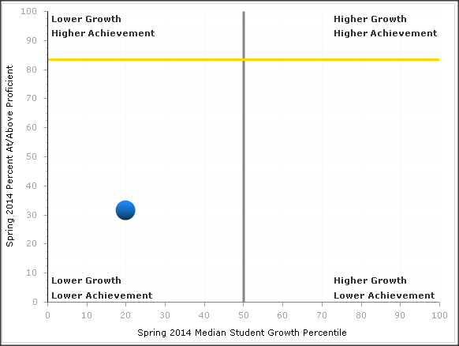
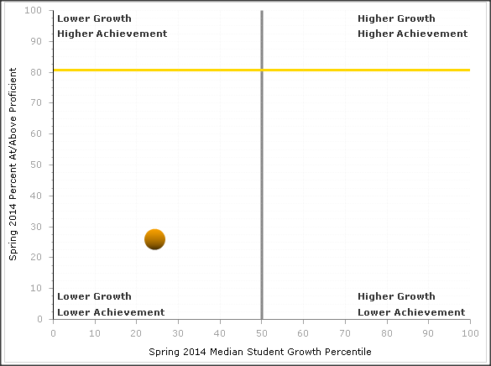
Student Growth and Improvement
2013-2014 Academic Year
Mathematics
Students Enrolled | 85
Students Tested | 47
Pass Percent | 31.9%
Median Growth | 19.5
English Language Arts
Students Enrolled | 85
Students Tested | 46
Pass Percent | 26.1%
Median Growth | 24.0

Slide 7
Graduation and Expulsion Rates
2013-2014 Academic Year
Graduation Rate
0% Because S.A.F.E. only enrolled students in third through eleventh grade, no students concluded their high school careers.
Expulsion Rate
4 students 5%

Slide 8
Authorizer Action
by Grace College Office of Charter
Administrative Fees Collected
School ID | School Name | Basic Tuition Support | Monthly Basic Tuition Support | % Charged | Yearly Administrative Fee
0242 | Smith Academy for Excellence | $617,161.00 | $51,430.08 | 3% | $18,514.83
Use of Fees Collected
The fees collected were used to cover the expenses associated with legal consultants , charter school memberships (including dues and license fees), and travel expenses.

Slide 9
Status of Authorizer’s Charter Schools
2013-2014 Academic Year
Status of Schools
Approved but not yet open | None
Open and Operating | Smith Academy for Excellence (2012)
Closed or having a charter that was not renewed | None

Slide 10
Decision Making Body
for the Grace College Office of Charter
Application Review Committee
Dr. William Katip | Grace College President
Dr. Jim Swanson | Vice President for Academic and Student Services
Mr. Tom Dunn | Vice President for Strategic Initiatives and Planning
Dr. Laurie Owen | Dean, Grace College School of Education
Board of Directors
Dr. Ronald Manahan Rev. Dan Allan Ms. Brook Avey Mr. William Burke Dr. John Carini Rev. Kip Cone Dr. James Custer Mrs. Stefanie Gross Mr. John Haller Mr. Charles Kreider | Mr. Lamarr Lark, Sr. Rev. John McIntosh Mrs. Janet Minnix Rev. Jesús Muñoz Mr. Scott Silveus Dr. John F. Smith Mr. Robert Vitoux Rev. Michael Yoder Rev. Nathan Zakahi Ms. Janine Zeltwanger
Mr. Denny Duncan | Vice President for Strategic Initiatives and Planning

Slide 11
Contact Information
at Grace College:
Denny Duncan | duncandl@grace.edu
Dr. William Katip | katipwj@grace.edu
at Smith Academy for Excellence:
Mr. Thomas Smith | thomas@fwsafe.com
Mr. Corey Smith | corey@fwsafe.com
Mr. Cameron Smith | cameron@fwsafe.com

Slide 12
Compliance
Grace College Charter Schools uses the Accountability System developed by the Indiana Charter School Board, 2012

