Slide 1
State Board of Education Hearing Hoosier Academy Virtual Charter School September 7, 2016 Robert A. Marra, Executive Director Office of Charter Schools

Slide 2
Hoosier Academy Virtual Charter School External Plans and Evaluations
IDOE Monitoring Feedback Report April 2015
BSU Renewal Application October 2015
IDOE Priority Visit Summary Report November 2015
School Improvement Plan submitted to IDOE February 2016
AdvancED Reaccreditation March 2016
IDOE School Improvement Report April 2016
Academic Plan for FY 2016-17 to K12
INTASS Plan Under Development

Slide 3
Guiding Principles
School Leadership: Ensure that the principal has the ability to lead the turnaround effect.
School Climate and Culture: Established a school environment that supports the social, emotional, and learning needs of all students.
Effective Instruction: Ensure that teachers utilize research-based, rigorous and effective instruction to meet the needs of all students and aligned with State Standards
Curriculum, Assessment & Intervention Systems: Ensure that teachers have the foundational documents and instructional materials needed to teach to the rigorous college and career ready state standards.
Effective Staffing Practices: Develop skills to better recruit, retain and develop effective teachers.
Enabling the Effective Use of Data: Ensure the school-wide use of data focused on improving teaching and learning.
Effective Use of Time: Redesign time to better meet student and teacher learning needs and increase teacher collaboration focusing on improving teaching and learning.
Effective Family and Community Engagement: Increase academically focused family and community and engagement.

Slide 4
Hoosier Academies Virtual School IDOE Monitoring Feedback Report - April 2015 (See Attachment 1, Page 2)
First Priorities to Intentionally in Address in School Improvement Plan:
Hoosier Academy Virtual Charter School is on pace with Priority Areas of Improvement 1, 2 and 3.
Hoosier Academies Virtual School IDOE School Improvement Report - April 2016
(See Attachment 2)
IDOE scores Hoosier Academy Virtual Charter School a level 3-Effective/ Implemented with Fidelity on all eight Turnaround Principles.

Slide 5
IDOE Priority Visit Summary Report November 2015 2015-16 Student Achievement Plan See Attachment 3, Page 4
Powerful Practices
Amazing LEADERSHIP!!!!
Great staff of dedicated teachers!!!!
Team teaching/collaboration
Opportunities for Improvement
High student mobility could lead to creating a school within a school
Providing support for teachers so that they can worry about teaching and not tracking family mobility, truancy, or other non-teaching related items.
Next Steps and/or Commitments
Incorporate a robust high ability protocol within classroom instruction~ how to meet the needs of all learners.
Hoosier Academies will work on being very intentional about student placements; creating a school within a school model

Slide 6
BSU Renewal Application/IDOE School Improvement Plan (See Attachment 4) (One Plan)
Hoosier Academy Virtual Charter School used the AdvancED ASSIST process to submit both its BSU Renewal Application and its IDOE School Improvement Plan.

Slide 7
AdvancED Reaccreditation March 2016 (See Attachment 5, page 27)
 | External Review IEQ Score | AdvancED Network Average
Overall Score | 273.78 | 278.34
Teaching and Learning Impact | 254.78 | 268.94
Leadership Capacity | 311.54 | 292.64
Resource Utilization | 260.71 | 283.23
Hoosier Academy Virtual Charter School has been accredited by AdvancED/NCA CASI through June 30, 2021. (See Attachment 6)

Slide 8
Demonstration of Sufficient Progress
Both the April 2015 and April 2016 IDOE Reports score Hoosier Academy Virtual Charter School a level 3-Effective/ Implemented with Fidelity on all eight Turnaround Principles.
AdvancED granted Hoosier Academy Virtual Charter Schools re-accreditation from July 1, 2016 through June 30, 2021.
INTASS: Indiana Teacher Appraisal and Support System – Dr. Cassandra M. Cole, Director, Center for Education and Lifelong Learning, Indiana University.

Slide 9
Academic Plan for FY 2016-17 to K12 See Attachment 7
The Academic Plan is a framework of standards and guidelines designed to support schools in the development, implementation and execution of a comprehensive school-based Academic Plan, organized according to seven guiding standards: instruction, assessment, staffing, observation and feedback, data-driven instruction, culture, and professional development. Each standard and the supporting guidelines codifies effective virtual school practices and resources, and establishes a common language and expectations.

Slide 10
OCS Renewal Process
Ball State University Office of Charter Schools evaluated the school’s data through the Performance Frameworks and OCS Policies:
Academic Performance Framework
Organizational Performance Framework
Financial Performance Framework
Policy Regarding Organizer Governance
Policies on Contract with Education Service Providers
Practices, Policies and Procedures for the Monitoring and Renewal of Charter Schools

Slide 11
Hoosier Academies Credit Deficiency Data 11/18/2015
 | 10th Grade | 11th Grade | 12th Grade
Sufficient | 92 | 231 | 111
1-2 Credits Deficient | 24 | 31 | 16
3-5 Credits Deficient | 43 | 45 | 20
6+ Credits Deficient | 404 | 252 | 131

Slide 12
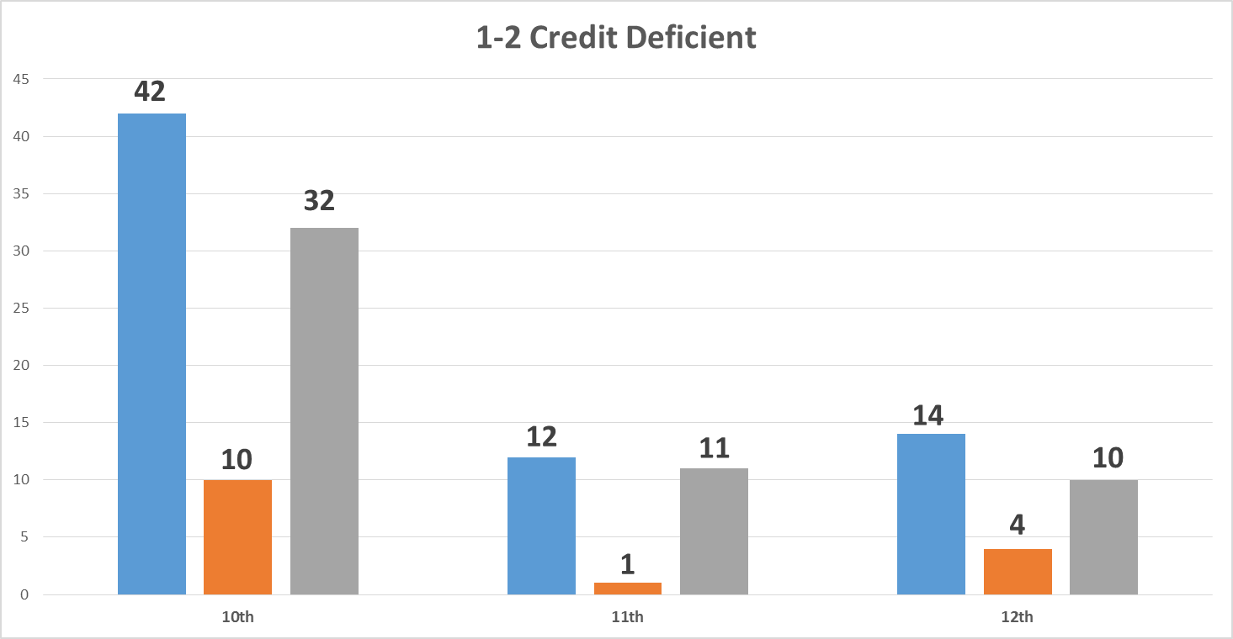
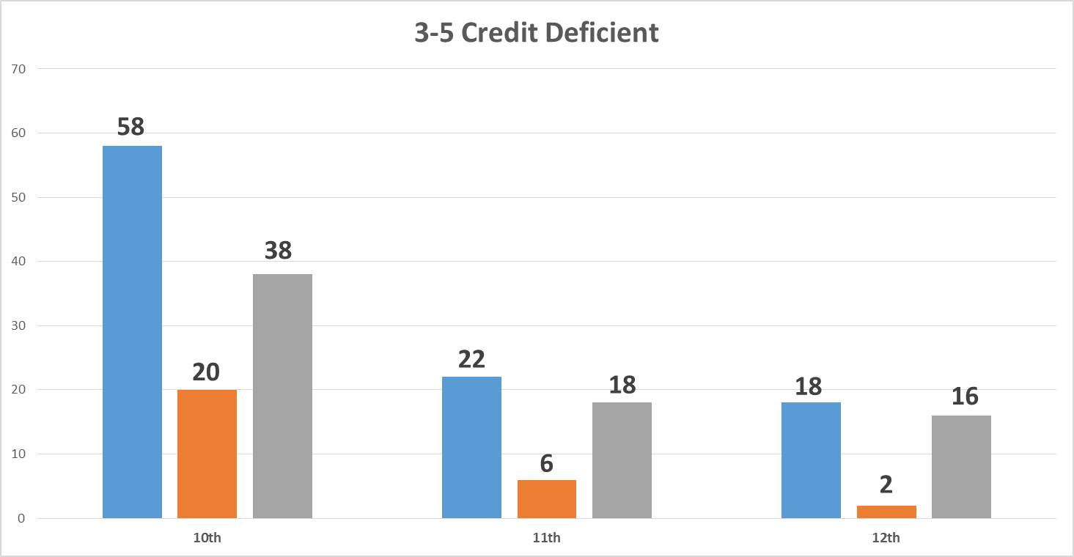
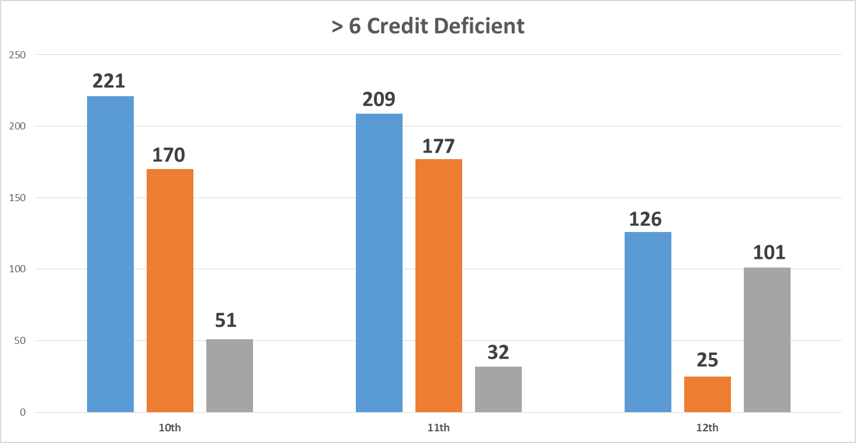
Credit Deficiency
Students enroll at Hoosier Academy Virtual School deficient in credits. The graphs below highlight the credit deficiency for 10th, 11th, and 12th grade students enrolled as of August 23, 2016. The primary focus of all school personnel is to ensure all students are provided opportunities to progress toward graduation and postsecondary success.
Total Enrollment at Hoosier Academy Virtual School:
Grades 10th - 12th = 1142 students
Total number of students lacking credit: 722 students
Percent of students in grades 10-12 who are credit deficient:
6% of the total 10-12 grade population is 1-2 credits deficient; of these students, 22% are new to Hoosier Virtual.
9% of the total 10-12 grade population is 3-5 credits deficient; of these students, 29% are new to Hoosier Virtual.
49% of the total 10-12 grade population is 6 or more credits deficient, of these students, 67% are new to Hoosier Virtual.
As of August 23, 2016

Slide 13
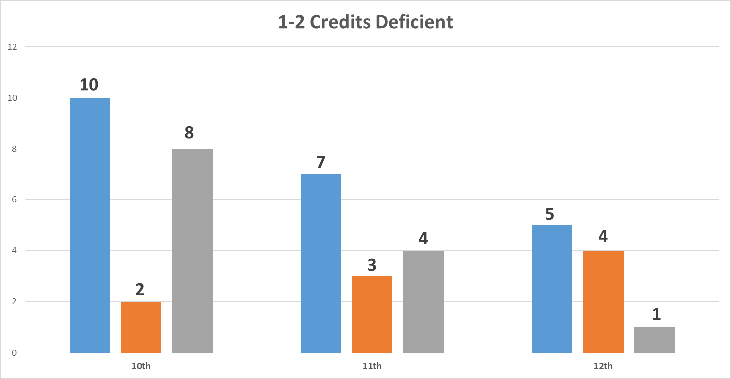
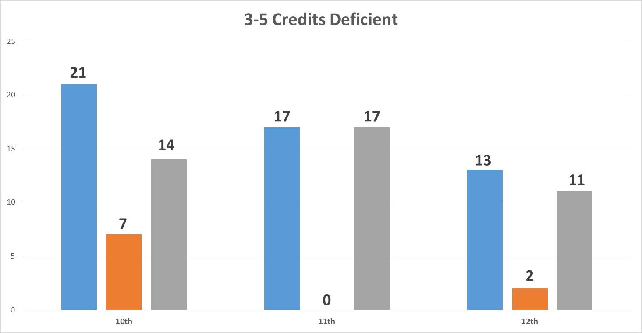
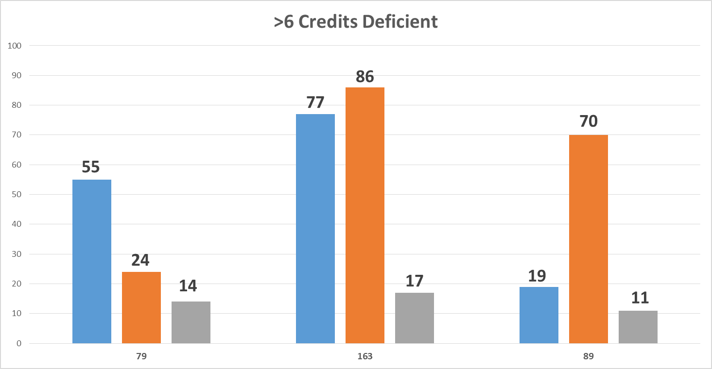
Credit Deficiency
Hoosier Academies enrolls students at all grade levels who are skill and/or credit deficient and have come to Hoosier Academies performing significantly below state grade level expectations. While this is occurring at all grade levels, its strongest impact is in grades 7-12. The Insight School instructional and wrap around model is specifically designed to provide additional supports and a unique learning environment for students who have traditionally struggled.
Total Enrollment at Insight School of Indiana:
Grades 10th -12th = 423
Total number of students lacking credit: 404
Percent of students in grades 10-12 who are credit deficient:
5% of the total 10-12 grade population is 1-2 credits deficient
12% of the total 10-12 grade population is 3-5 credits deficient
78% of the total 10-12 grade population is >6 credits deficient
As of August 23, 2016

Slide 14
Length of Student Enrollment
5434 students were enrolled at Hoosier Academies throughout the 15-16 SY – 4400 at any one time due to the school cap
61% of students enrolled had been enrolled for less than one year
19% of students had been enrolled for one year
Of students enrolled for less than a year:
27% of students were enrolled for two months or less
58% of students were enrolled for six months or less
20% of the student population at Hoosier Academies in the 15-16 SY had been enrolled there two years or more.

Slide 15
Hoosier Virtual Charter School
Reregistration comparison from SY15/16 to SY16/17
Reregistration Rate - Hoosier Virtual - as of 8/17/2016
 | All Students | K-5 | Middle School | High School
Total | 69.2% | 73.0% | 72.9% | 69.2%
Reregistration Rate - Hoosier Virtual - as of 8/19/2015
 | All Students | K-5 | Middle School | High School
Total | 67.1% | 71.2% | 69.4% | 66.3%
**The average is weighted based on the size of the student body.
Hoosier Virtual School’s reenrollment rates have improved from SY 14/15.
Nearly 70% of students who finished with Hoosier Virtual in May 2016 have chosen to re-enrolled at the school for the SY16/17.

Slide 16
2015-16 Enrollment and Demographic Information
 | # | %
Total Enrollment | 3861
Ethnicity/Race
White | 2999 | 77.7%
Black | 399 | 10.3%
Hispanic | 249 | 6.4%
Asian | 21 | 0.5%
Native American | 21 | 0.5%
Multiracial | 166 | 4.3%
Native Hawaiian or Other Pacific Islander | 2 | 0.1%
Other | 0 | 0
Special Populations
Students with IEPs | 519 | 13.40%
English Language Learners | 27 | 0.70%
Eligible for Free Lunch | 789 | 20.40%
Eligible for Reduced Lunch | 161 | 4.20%

Slide 17
SY 15-16 Hoosier Student Heat Map

Slide 18
OCS 2016 Renewal Decision
Based upon the academic, financial and organizational performance of Hoosier Academy – Indianapolis, OCS made the following renewal decision:
Hoosier Academies Virtual Charter School was granted a two year charter renewal
Renewal application on October 1, 2017
Only data points from the 2015-16 and 2016-17 school year will be available, upon which to base its renewal decision.
Insight School of Indiana, a virtual alternative charter school, 7-12, was granted a 3-year charter. See Attachment 8.
Combined enrollment for both schools capped at 4,000.

Slide 19
Post Renewal Actions
Following the renewal decision, OCS met with the school leader and Board to discuss the renewal decisions. In response,
Hoosier Academy has updated and revised its operations to ensure the school is operationally sound.
It has lowered the teacher/student ration in the virtual school from 300/1 to 229/1. In addition to becoming an INTASS school, Hoosier Academy Virtual Charter School has revised its teacher evaluations and begun coaching its teachers.
It has created a Family Academy Support Team. See Attachment 9, Page 4.
The Board has carefully reviewed its budget and had discussions with its Educational Management Organization to carefully review it’s Management Agreement.

Slide 20
Attachments
IDOE Monitoring Feedback Report April 2015
IDOE School Improvement Report April 2016
IDOE Priority Visit Summary Report November 2015 including 2015-2016 Student Achievement Plan submitted IDOE
School Improvement Plan submitted to IDOE
Hoosier Virtual AdvancED Reaccreditation Site Visit Report March 2016
AdvancED Letter of Accreditation
Hoosier Academic Plan SY16-17 submitted to K12
PowerPoint Introducing Insight School of Indiana - A Hoosier Academies Network School for Grades 7-12
Students First Services 2016-17, Hoosier Virtual Academy

