Slide 1
State Board of Education Hearing
January 11, 2017
Robert A. Marra, Executive Director
Office of Charter Schools

Slide 2
What Is Charter School Authorizing?
Maintain
high standards
Federal law
State law
BSU contract
Protect
student and public interests
Compliance
PRODUCE
high quality
education
Uphold
school
autonomy
BSU Policies and Practices

Slide 3
OCS Engaged In The National/State Debate
Surrounding Quality Charter School Authorizing
2013 Indiana General Assembly Session
OCS collaborated with Indiana authorizers to help pass H.B. 1338 - Quality Authorizing Legislation
IC 20-24-2.2-1.5
Authorizer; adoption of standards
Sec. 1.5. All approved authorizers shall adopt standards of quality charter school authorizing, as defined by a nationally recognized organization with expertise in charter school authorizing.
As added by P.L.280-2013, SEC.12.

Slide 4
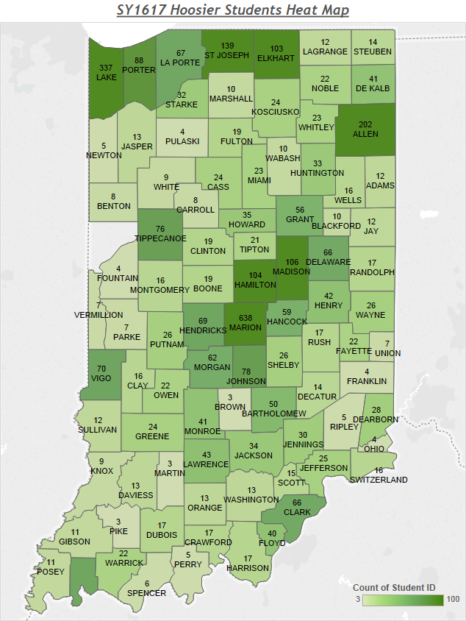
SY 16-17 Hoosier Student Heat Map

Slide 5
Overall Effect of Newly-Enrolled Students
A large number of the new students who attend Hoosier Academy enroll on day one already credit deficient
The majority of seniors are enrolling behind expected graduation timelines.

Slide 6
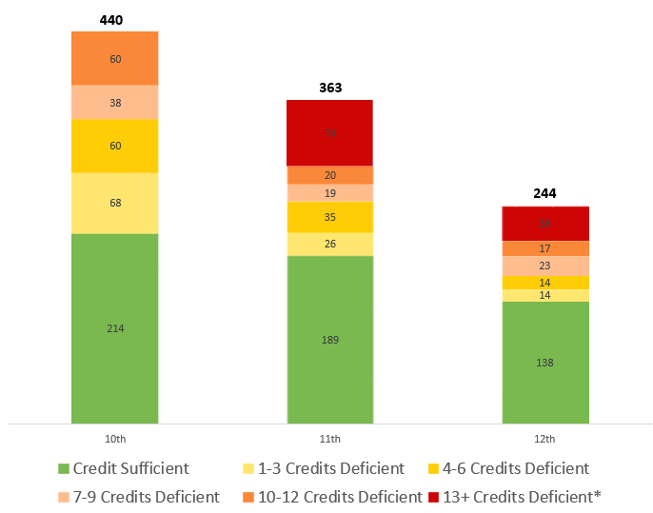
Effect of Enrollment Trends at Hoosier Academy
In Fall 2016, 48% (506 out of 1047) of enrolled students in grades 10-12 were credit deficient.
*Includes students that do not yet have records from prior schools

Slide 7
Credit Deficiency Enrollment Trends
Total % Deficient
% of New students that are Deficient
1-2 Credit Deficient
6% of the total 10-12 grade population
22% of these students are new
3-5 Credit Deficient
9% of the total 10-12 grade
29% of these students are new
6 or More Credit Deficient
49% of the total 10-12 grade population
67% of these students are new
See full data set in appendix

Slide 8
Graduation Rates
SY | Cohort N | Actual 12 and 12+ Grade Enrollment N | Total Graduate N | State Graduation Rate | Graduation Rate Based Upon Enrollment
12-13 | 53 | 16 | 14 | 26.40% | 88%
13-14 | 227 | 78 | 39 | 17.20% | 50%
14-15 | 401 | 140 | 86 | 21.40% | 61%
15-16 | 558 | 298 | 122 | 22.68% | 41%

Slide 9
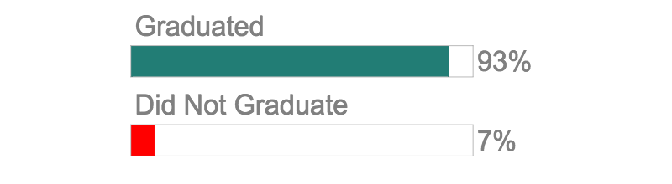
Demonstration of Successfully Graduating Students
Hoosier Academy successfully graduates students who start the year on track during the Fall of their Senior Year
2015-16 12th Grade Enrollment | 273
Started On Track for Graduation | 14
Graduated | 13
Did Not Graduate | 1

Slide 10

Demonstration of Successfully Graduating Students
Expected Graduation 2017
Expected Graduation 2018
Expected Graduation 2019
69%
136 students
25%
49 students
6%
11 students
Based on credit-status at the beginning of Fall 2016, Hoosier Academy expects to graduate 69% (136 of 196) of currently enrolled Class of 2017 students.

Slide 11
H.B. 1338 Quality Authorizing Legislation
  IC 20-24-2.2-3
If an authorizer fails to take action against a poor performing charter school, the State Board of Education may take one of the following actions:
  Transfer authorization to another authorizer.
  Order closure of the charter school at the end of the current school year. A charter school that is closed by the state board under this section may not be granted a charter by any other authorizer.
  Order the reduction of any administrative fee collected.
  Suspend the authorizer’s authority to authorize new charter schools.

Slide 12
Creation of Transformation Zones
IC 20-31-9.5-9.5
Sec. 9.5. (a) The governing body of a school that has been placed in the lowest two (2) categories or designations may submit a plan to the state board to create a transformation zone within the school corporation. A plan may be developed with the assistance of the department.
  (b) The state board shall grant the designation as a transformation zone unless the state board concludes that the submitted plan does not substantially meet the criteria set forth in this section. All plans must be submitted to the state board not later than April 15, 2016, or April 15 each year thereafter. All plans must be approved or denied by the state board not later than July 1 of the first year of implementation.
  (c) Each plan must include the following information:
    (1) An organizational chart that demonstrates that the leader of the transformation zone reports directly to the school corporation's superintendent.
    (2) A description of the innovations the school corporation will implement, which may include:
      (A) innovations in school staffing;
      (B) curriculum and nonmandated assessments;
      (C) class scheduling;
      (D) the length of the school day or year;
      (E) the use of financial and other resources;
      (F) teacher recruitment, employment, and compensation; and
      (G) other innovations.

Slide 13
Hoosier Academy Virtual Charter School
External Plans and Evaluations
IDOE Monitoring Feedback Report April 2015
BSU Renewal Application October 2015
IDOE Priority Visit Summary Report November 2015
School Improvement Plan submitted to IDOE February 2016
AdvancED Reaccreditation March 2016
IDOE School Improvement Report April 2016
Academic Plan for FY 2016-17 to K12
INTASS Plan Under Development
IDOE On-Site Monitoring Report November 2016

Slide 14
Approach to Oversight and Improvement
Consolidated six distinct school improvement plans to one comprehensive plan
Ball State holds Hoosier Academy accountable for progress against the plan
Ball State report on specific progress measures beginning February
Focus on:
  Further Development of College and Career areas of AP, Dual Credit, CTE, and Industry Certification
  Improve progress toward graduation and graduation rate
  Reduce withdrawal rate
  Align and pacing instruction
  Respond to student-level data

Slide 15
Hoosier Academies Virtual Charter School – 2-year Conditional Renewal
2015-16 | Baseline Data Points
2016-17 Current Contract | 1st year of Conditional Renewal / 2016-17 Academic Data will be used for 2017 Renewal Review and Decision 2017 Renewal Review also includes Governance and Financial Audits
2017-18 Current Contract | Final year of Conditional Renewal

Slide 16
2016-17 Indiana Assessment Windows
Name of Assessment | Window Begins | Window Ends
Indiana Statewide Testing of Educational Progress Plus (ISTEP+ ) Grades 3-8, and 10
ISTEP+ Part 1 – Paper/pencil and Online (Applied Skills) | February 27, 2017 | March 10, 2017
ISTEP+ Part 2 – Paper/pencil* (Multiple-Choice & Gridded-Response Items) ISTEP+ Part 2 – Online (Multiple-Choice & Technology-Enhanced Items) | April 17, 2017 | May 5, 2017
Indiana Reading And Evaluation Determination-3 (IREAD-3)
IREAD-3 (Spring) | March 13, 2017 | March 17, 2017
IREAD-3 (Summer) – Online | May 30, 2017 | July 21, 2017
IREAD-3 (Summer) – Paper/pencil (as needed) | June 5, 2017 | July 21, 2017
ISTEP+ End of Course Assessments (ECAs) Algebra I, English 10
ECAs (Winter) | December 5, 2016 | December 16, 2016
ECAs (Spring) | April 24, 2017 | May 26, 2017
ECAs (Summer) | August 21, 2017 | September 1, 2017

Slide 17
Timeline for Renewal
The external review team will be working with the school regarding the renewal process | March - August 2017
Letter of Intent to Renew and Renewal Application Due to OCS | October 1, 2017
External review team will conduct on-site visit | August – November 2017
Renewal Decisions | On or before January 15, 2018
Final Decision following any Appeal and subsequent Reconsideration Hearing | March 1, 2018

Slide 18
External Review Team
External Review Team will consist of individuals with expertise in:
online learning
assessments
learning coach component
charter school governance and financial management
curriculum and programming development and implementation
authorizing online schools, i.e., a staff member from another authorizer that has an online school in its portfolio

