Slide 1
Lincoln Community School
May 2017

Slide 2
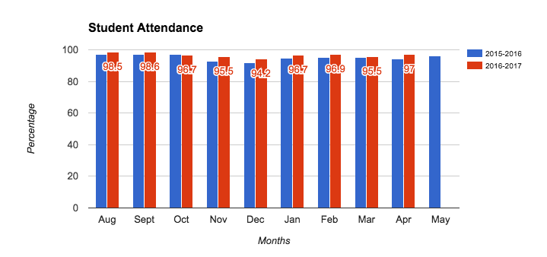
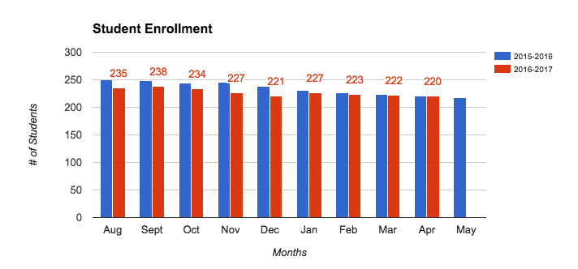
Data Dashboard Summary - Student Attendance, Enrollment

Slide 3
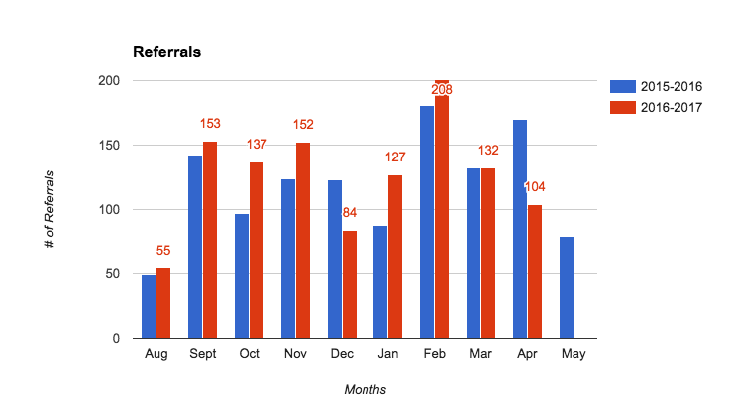
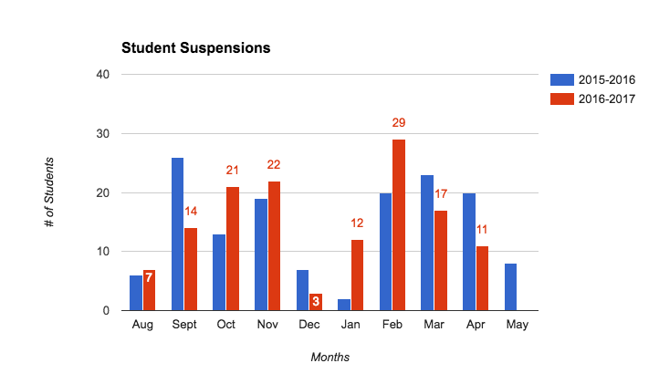
Data Dashboard Summary - Behavior
Improved difference of
15.4
referrals per day!

Slide 4
Data Dashboard Summary - ELA Student Performance (First Year NWEA)
Highlight: Spring IREAD pass rates improved 16%

Slide 5
Data Dashboard Summary - Math Student Performance (First Year NWEA)

Slide 6
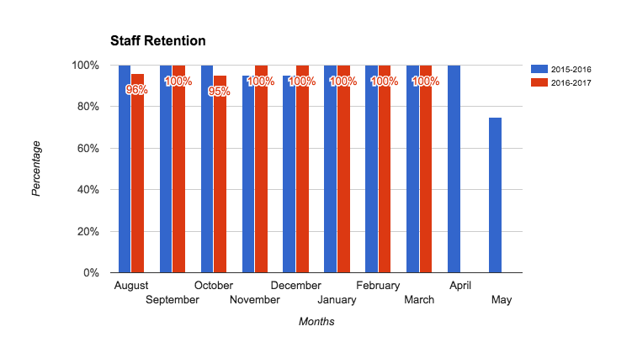
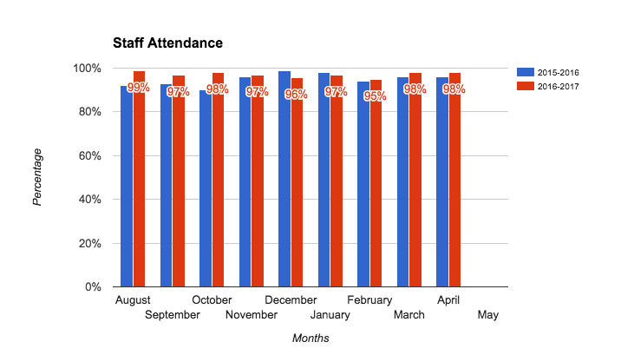
Data Dashboard Summary - Staff Retention, Staff Attendance

Slide 7
Data Dashboard Summary - Professional Development
Assessment
PLC Guiding Question #2
How do we know they have learned it?
Content
PLC Guiding Question #1
What do we want students to know or be able to do?
Reflect & Refine
PLC Guiding Questions 3 & 4
How will I respond to students’ learning needs?
Lesson Planning/ Instructional Delivery
Guiding Question
How do I plan to get them there?

Slide 8
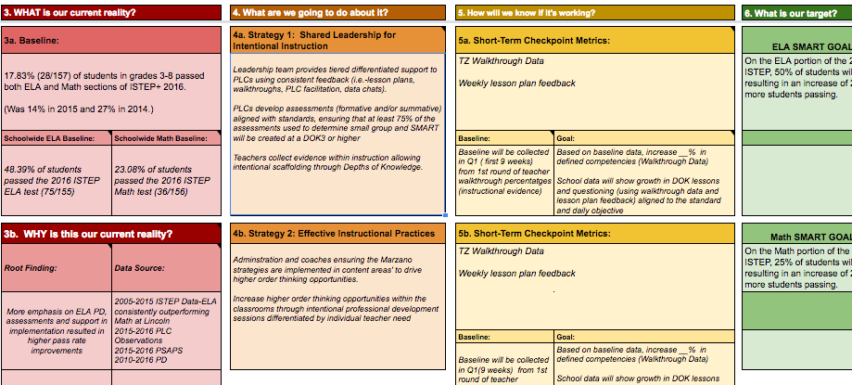
Goal Update - Effective turnaround school leadership
Goal: Creation and execution of a data-driven, research-based school improvement plan with monthly cycles of monitoring for school improvement.
Intervention: EVSC Office of Transformational Support (OTS) embedded within Lincoln School providing differentiated support to increase skill, capacity, and remove barriers of improvement. School improvement development, action planning, and monitoring are facilitated by the OTS.

Slide 9
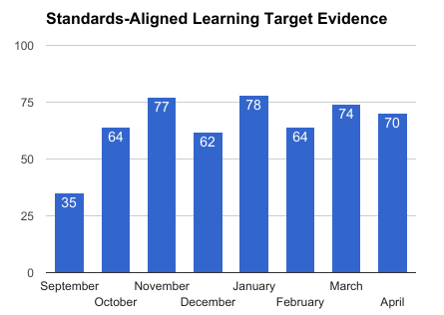
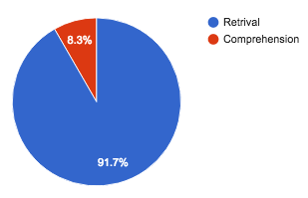
Goal Update - Effective Instruction that meets the needs of all students and is aligned with state standards
Goal: PLC work of unpacking standards and writing aligned assessments transfers to teacher practice of more cognitively complex learning tasks.
Intervention: Weekly lesson plan feedback and learning walks to monitor evidence of transfer to teacher practice. Teachers not meeting goals are provided differentiated support per teacher need to improve outcomes.
Cognitive complexity of learning tasks observed
September
(Baseline)
April
(Current Reality)

Slide 10
Goal Update - Using data to differentiate instruction and provide interventions
Goal: NWEA data utilized in all grades K-8 to drive Tier I small group instruction for remediation, enrichment and Tier II interventions.
Intervention: NWEA and intervention training paired with cyclical teacher training and support provided by district data coach and school-based instructional coaches.

Slide 11
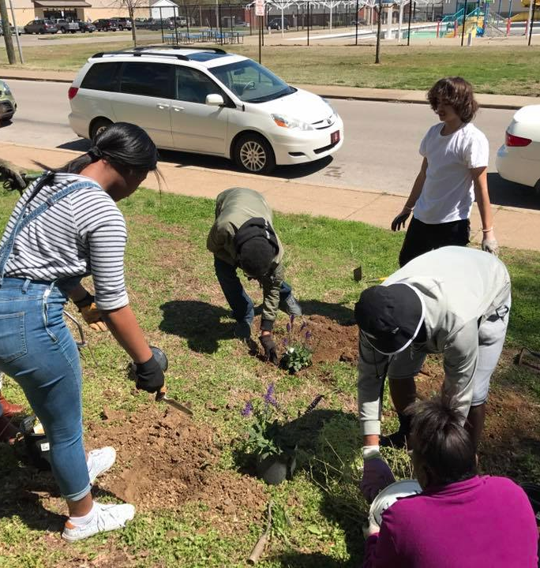
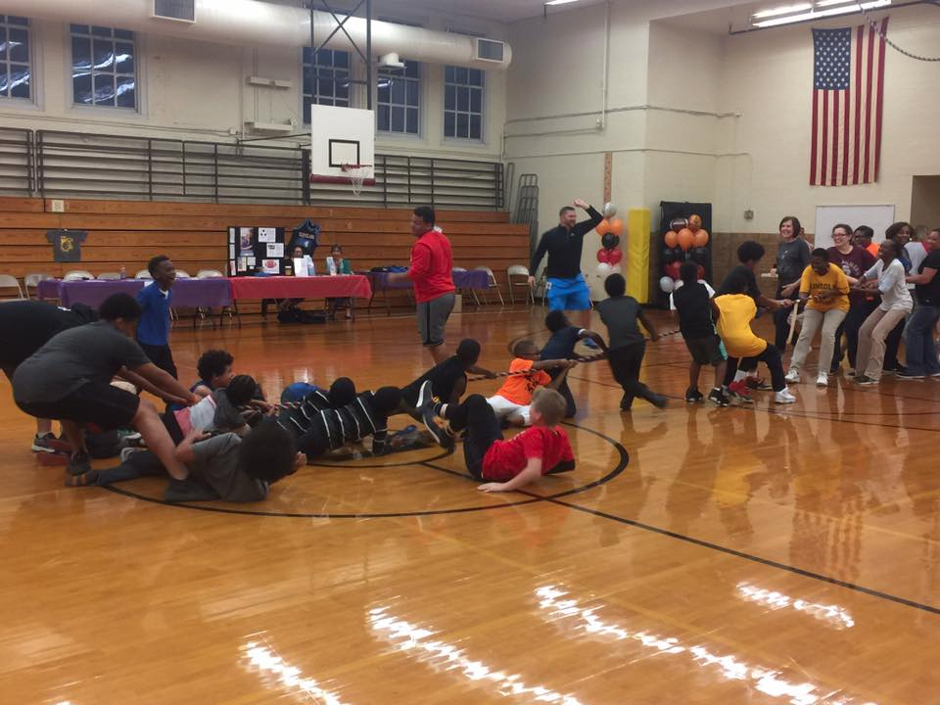
Community and Stakeholder Input and Engagement

Slide 12
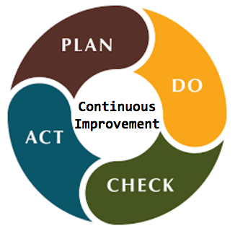
Next Steps

Slide 13
Next Steps
Reassess root causes to refresh school improvement plan for 2017-18 utilizing progress monitoring data
Finalize systems and protocols for seamless launch this fall
PLC assessment protocols
Student work analysis protocols
Tighten internal coaching cycle procedures driven by classroom evidence and teacher collaboration

