Slide 2
Internal Lead Partner Proposal
Indianapolis Public Schools – Dr. Lewis D. Ferebee, Superintendent
State Board of Education
May 14, 2014

Slide 3
Overview
Indianapolis Public Schools (IPS) Transformation
Internal Lead Partner (ILP)
Department of Innovation & Transformation
Comparison & Implementation Data
IPS Transformation Model

Slide 4
Overview
IPS Model/8 Step Crosswalk
IPS Model/Lead Partner Comparison
IPS Model Investment & Expansion Costs
Scope of Work
IPS Monitoring Updates
Appendix

Slide 5
IPS Transformation Academic Division
Hired Transformational Leader
Created IPS Transformation Model
Created Department of Innovation & Transformation

Slide 6
ILP – Department of Innovation & Transformation
Deliver consistent instructional message
Build internal capacity of educators
Increase sustainability
Reduce cost by utilizing existing district resources

Slide 7
District Comparison Data
Guilford County Schools
126 Schools
72,388 Students
59.41% Free/Reduced Lunch
GCS Enrichment Region
9 Schools
6,226 Students
86.81 % Free/Reduced Lunch
Indianapolis Public Schools
60 Schools
30,000 Students
77% Free/Reduced Lunch
IPS Priority Schools
11 Schools
5,949 Students
83.2% Free/Reduced Lunch

Slide 8
Implementation Data
Guilford County Schools – Enrichment Region
Overall Composites % | 2008 – 2009 | 2009 – 2010 | 2010 – 2011 | 2011 - 2012 | Overall Improvement
Elementary School
Bessemer | 51.0 | 53.4 | 60.3 | 56.3 | 5.3
Montlieu | 40.1 | 57.3 | 60.7 | 72.1 | 32.0
Wiley | 40.1 | 41.4 | 52.0 | 70.7 | 30.6
Middle School
Hairston | 43.9 | 54.9 | 51.2 | 55.6 | 11.7
Jackson | 48.9 | 57.6 | 56.7 | 59.5 | 10.6
Welborn | 57.1 | 60.2 | 64.7 | 66.1 | 9.0
High School
Andrews | 47.5 | 52.1 | 57.8 | 64.6 | 17.1
Dudley | 41.6 | 57.5 | 60.3 | 63.6 | 22.0
Smith | 41.2 | 57.7 | 54.9 | 68.4 | 27.2

Slide 9
Implementation Data
Guilford County Schools – Enrichment Region
Graduation Rate (%) | 2008 – 2009 | 2009 – 2010 | 2010 – 2011 | 2011 - 2012 | 2012 - 2013 | Overall Improvement
High School
Andrews | 66.8 | 77.0 | 80.1 | 87.6 | 86.9 | 20.1
Dudley | 78.2 | 81.0 | 80.8 | 85.6 | 86.1 | 7.9
Smith | 73.3 | 80.1 | 81.2 | 84.5 | 74.0 | 0.7
Enrichment Region | 73.7 | 79.6 | 80.7 | 85.8 | 81.9 | 8.2

Slide 10
IPS Priority School Selection
Washington Irving 14 | Joyce Kilmer 69
Elder W. Diggs 42 | George H. Fisher 93
Riverside 44 | Francis Scott Key 103
James Russell Lowell 51 | Northwest Jr. HS 625
Ralph Waldo Emerson 58 | John Marshall Jr. HS 626
Clarence Farrington 61
Schools selected were labeled an F in 2012 & 2013 with negative or no growth within the A-F model.

Slide 11
IPS Transformation Model
Staffing
Central Services
School-based
Instructional & Support Strategies
Student Behavior Model
Monitoring Systems
Staff Morale
Culturally Responsive
Weekly
Monthly
Quarterly
Instructional Framework
Climate
Professional Learning Communities (PLC)
Formative Assessment
Professional Learning
Recruitment/Hiring
Supplemental Instructional Time/Opportunities

Slide 12
IPS Transformation Model
Staffing
Central Services
2 English Language Arts (ELA) Coaches
2 Math Coaches
Graduation Coach
School-based
Math Coach
ELA Coach

Slide 13
IPS Transformation Model
Instructional & Support StrategiesFramework
Instructional Framework
Professional Learning Communities
Formative Assessment
Professional Learning
Mastery Learning Training
Protocols
Development & Usage Training
Coaching Framework
Leadership Excellence
Foundational & Content Specific

Slide 14
IPS Transformation Model
Climate
Student Behavior
National Model Selection
Training & Implementation
Staff Morale
Climate Survey Creation
Survey Results Usage
Culturally Responsive
Training & Implementation

Slide 15
IPS Transformation Model
Monitoring Systems
Weekly
PLC Protocol
Coach Support
Quarterly
Culturally Responsive Benchmarks
Revised Pacing
Instructional Audit
Formative Assessments
Common Walkthrough Document
Corrective Instruction Plans
SIP/SAP Reviews

Slide 16
Turnaround Principles/ IPS Model
Turnaround Principles
Effective leaders and teachers
Recruitment of highly effective central office and building leaders
Hiring instructional coaches to scaffold teacher effectiveness
Increased time for teaching and learning
Building in enrichment and intervention instructional time
Providing afterschool and supplemental learning opportunities
Rigorous, aligned and responsive instruction
Use of data for continuous improvement
Offering multiple opportunities for formative assessments
Safe school environment with family and community engagement
Creating revised pacing to include strategic and corrective instruction
Facilitating usage of national behavior model
Providing professional development and a systemic instructional framework
Providing instructional support for usage of data within classroom setting
Promoting culturally responsive goal setting and benchmarks for success
IPS Transformation Model
Source: U.S. Department of Education- School Turnaround Overview 2011

Slide 17
ILP & ELP Common Practices
Develop School Leaders
Scholastic
TNTP
Voyager
IPS

Slide 18
IPS Model / 8 Step Crosswalk
IPS Transformation Model | The 8-Step Process
Staffing District Coaches Building Coaches | Step 1 - Data Disaggregation Step 2 - Instructional Calendars Step 3 - Instructional Focus
Instructional & Support Strategies Mastery Learning PLC Training & Protocols Strategic Professional Development | Step 1 - Data Disaggregation Step 2 - Instructional Calendars Step 3 - Instructional Focus Step 5 - Tutorials Step 6 - Enrichment

Slide 19
IPS Model / 8 Step Crosswalk
IPS Transformation Model | The 8-Step Process
Climate National Behavior Model Climate Survey | Step 1 - Data Disaggregation Step 8 - Monitoring
Monitoring Systems Walkthrough Documents Instructional Audit PLC Protocols Coach Support Culturally Responsive Benchmarks Quarterly Formative Assessments | Step 1 - Data Disaggregation Step 2 - Instructional Calendars Step 3 - Instructional Focus Step 4 - Assessment Step 7 - Maintenance Step 8 - Monitoring

Slide 20
IPS Model/Lead Partner Comparison
Feature | IPS | TNTP | Voyager | Scholastic
Rise Training (Administration) | X | X
Gradual Release Model | X |  |  | X
Online Tools | X |  |  | X
PLC Training | X |  |  | X
Leadership Training | X | X | X | X
Year Long PD Plan | X |  |  | X
Instructional Coaching | X |  |  | X
Revised Pacing | X
Data Analysis and Applications | X |  | X

Slide 21
IPS Model/Lead Partner Comparison
Feature | IPS | TNTP | Voyager | Scholastic
Student Materials (Read 180 & Math 180) |  |  |  | X
Teacher Materials (Read 180 & Math 180) |  |  |  | X
Internal Building Coaches | X
Culturally Responsive Goal Setting | X
Diagnostic Formative Assessment | X
Support Instructional Leadership Team | X |  | X
Assessment of School Needs | X |  | X
New Teacher Support | X |  | X

Slide 22
IPS Model Investment
General Fund
Priority Elementary Principals extended to 12 months $97,746
Title I
Summer Teaching & Learning Institute $94,630
Title 2A
One 12-month High School Assistant Principal at each school $42,770
All Priority High Schools will receive a Behavior Specialist $216,492
Literacy Coach Positions $818,928
Parent Involvement Educator Positions $512,809
Assistant Principals for each Priority Elementary School $588,988
Director & 6 Instructional Coaches $633,600
Year-Long Professional Development $240,000
General Fund Total: $945,996
Title I Total: $1,426,367
$100,000
Title 2A Total: $873,600
IPS Investment Total: $3,245,923

Slide 23
IPS Model Expansion Cost
District Coaches
2 ELA Coaches
2 Math Coaches
Building Coaches
3 Graduation Coaches
3 Math Coaches
Professional Development
Initial Support
3 ELA Coaches
Ongoing Support
District Coaches Total: $300,000
Building Coaches Total: $500,000
$100,000
Professional Development Total: $100,000
Total: $900,000

Slide 24
Scope of Work
Phase One:
Foundational Support
Pre-assess instructional competencies and deficits
Phase Two:
Initial Support
Conduct Summer Teaching and Learning Institute
Train district coaches on coaching cycle and PLC protocols
Phase Three:
Ongoing Support
Train building level coaches on coaching cycle and instructional focuses
Review historical data
Train district coaches on instructional framework
Train principals and building level coaches on instructional framework
Create framework for content-specific training
Develop content for leadership excellence sessions
Develop SIP/SAP plans to include strategic instruction and climate SMART goals
Provide content-specific training for teachers and leadership excellence sessions for principals
Facilitate coaching support within schools
Monitor usage of walkthrough documents
Conduct quarterly audits of revised pacing guide usage, corrective instruction plans, SIP/SAP plans and culturally responsive benchmarks
June-July 2014
June-September 2014
Sept. 2014-June 2015
Purpose
Provide the support needed to assist George Washington, John Marshall, and Broad Ripple achieve academic success
Product
Increased academic achievement

Slide 25
Project Plan
Year One: 2014-15
Timeline 2014 | Descriptions | Resources
June | Conduct instructional audit to identify instructional strengths &weaknesses trending across content areas & grade-levels Analyze the following data trends from the last three years: Graduation Rate, ECA Scores, ISTEP Results | Director of Innovation & Transformation Building instructional coaches District instructional coaches School administration
June 23-27 | Train coaches & principals on mastery learning Conduct strategic training on instructional coaching & facilitating professional learning communities
July 21-25 | Train principals on mastery learning

Slide 26
Project Plan Continued
Timeline 2014-15 | Descriptions | Resources
August – September | Construct a framework for content-specific training based on the beginning of year data points Support school leadership teams in crafting SIPs & SAPs that align with instruction & climate data trends | Director of Innovation & Transformation Building instructional coaches District instructional coaches School administration
September – June | Conduct embedded coaching with building coaches & teachers through PLCs & classroom support visits
Quarterly | Deliver leadership excellence sessions & content-specific training for teachers & school administration Analyze results of support tools & goals created by schools for improvement

Slide 27
Program Evaluation
Continue, Expand
or Sunset?
Monitor & Adjust to Improve
Year 1
Continuous Improvement Cycle:
Plan, Do, Check, Act
CIP
Decision Process
Year 3
Year 2
Monitor & Adjust to Stabilize

Slide 28
IPS Monitoring Updates
Quarterly
(State Board Presentations)
Qualitative Data:
*Overview of action steps taken
*Summary of results and implications by school
*SIP adjustment plans developed based upon student data results
*Next steps to provide additional support and increase results
Quantitative Data:
*Acuity results
*Formative assessment results
Monthly
(Check-ups with IDOE and State Board Reports)
Qualitative Data:
*Snapshots of professional development implications
*Principal and teacher performance trend data
*Next steps for additional support and progress
Quantitative Data:
*Formative assessment results by school

Slide 29
Questions

Slide 30
Appendix

Slide 31
District Coaches
Facilitate monthly content specific training for building coaches
Support building level coaches in developing plans for instruction
Guide building level coaches in modeling/co-teaching
Recommend instructional strategies for improvement

Slide 32
Building Coaches
Ensure instructional alignment
Facilitate Mastery Learning Instructional Framework
Develop teachers’ knowledge of content and best practices
Facilitate professional learning community meetings

Slide 33
Mastery Learning Cycle
Indicator-Based Instruction
Formative Assessment
Corrective Instruction
Formative Assessment
Remediation & Enrichment
Notes:
T
Components of Master Learning Cycle
Do not use clip art in your presentations.

Slide 34
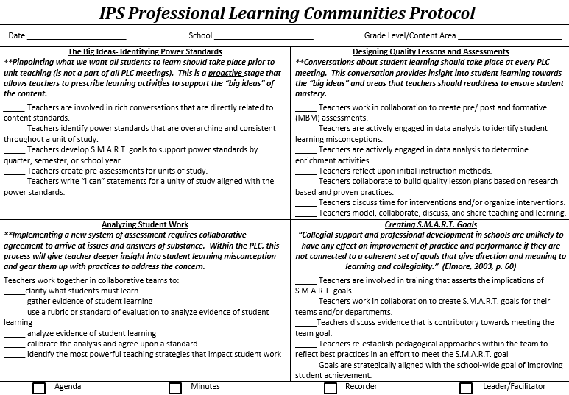
IPS PLC Protocols

Slide 35
Strategic PD Plan
Mode of Support | Who’s Training? | What?
Recipe for Learner Success PLC’s | *District Coaches *Building Level Coaches | *Conduct Weekly PLC’s in which teachers are trained and coached in the usage of three instructional focus areas. *Focus Areas: Tools of Engagement, Teacher Directed- Explicit Dialogue, Student Products *Teachers will develop lessons utilizing the recipe. *Instructional Coaches and Director will provide feedback on lesson creation and lesson delivery.
Applied Skills Planning Sessions | *Building Level Coaches | *Teachers will gather the standards in which 70% or more of students were not proficient. *Teachers will select an instructional strategy to reteach each standard. *Teachers will model the teaching of the skill with the strategy during the meeting. *Instructional Coaches and teacher will give feedback to each other.
Co-teaching Day | *Building Level Coaches | *7th/8th Grade ELA-Math Teachers will conduct a co-teaching experience with a pre-selected instructional coach. *The coach and teacher will collaborate on the instructional delivery.

Slide 36
Leadership Excellence
Cultural
Relevancy
Discipline with Dignity
Instructional
Framework
Mastery Learning
Organizational
Optimization
Poverty Training
Culturally Responsive Education
Gradual Release / Direct Instruction
Instructional Best Practice / Balanced Literacy / PLCs
Data Driven Instruction
Leveraging Partner Relationships
Maximizing Resources (Financial & Human Capital)
Mission & Vision Communication
Marketing and Branding
Motivation, Resilience, & Grit

Slide 37
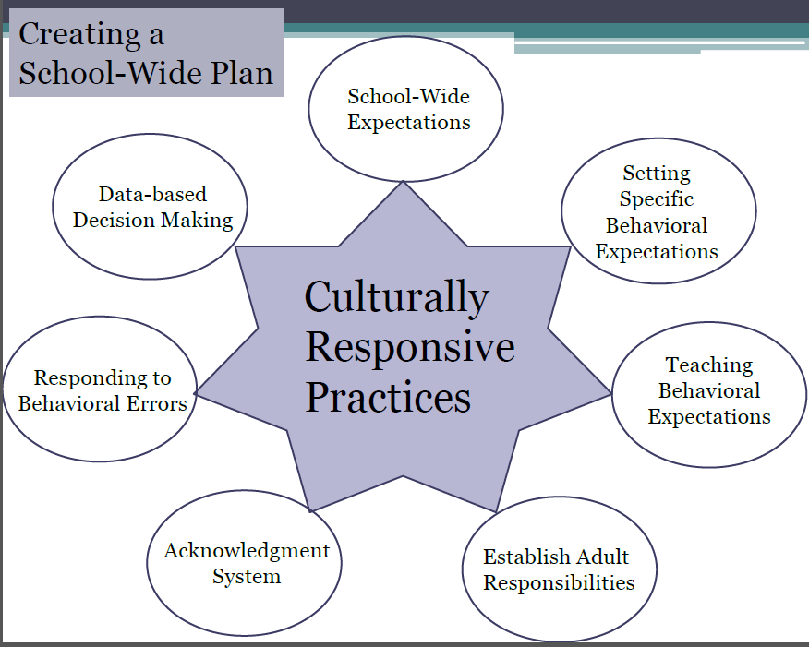
National Behavior Model
Schools will follow national model to create school-wide plans
Sourced from PBIS Indiana http://www.indiana.edu/~pbisin/uploads/files/77.pdf

Slide 38
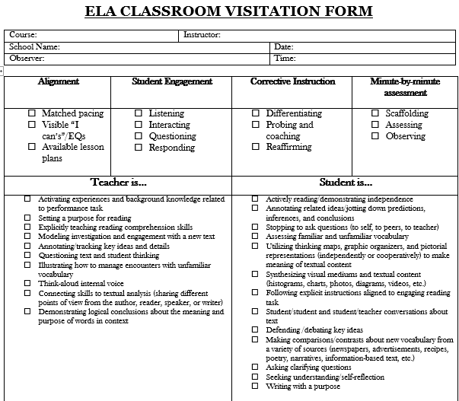
Walkthrough Document

Slide 39
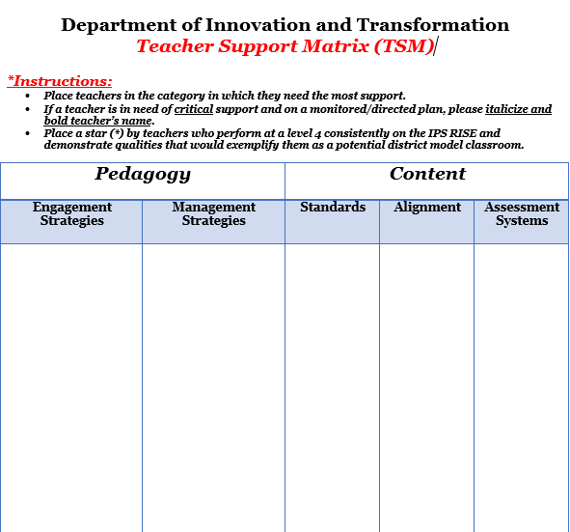
Instructional Audit
Audit Focus Areas:
Pedagogy
*Teaching Practices
Content
*Facilitation of a specific subject-area
DIT Coaches will conduct walkthroughs to analyze the effectiveness of teachers in each area.

Slide 40
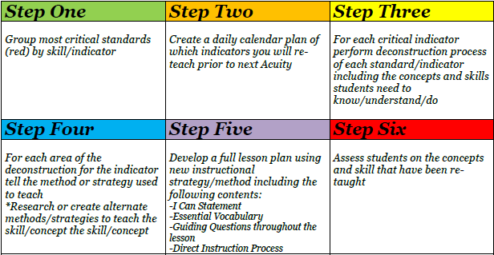
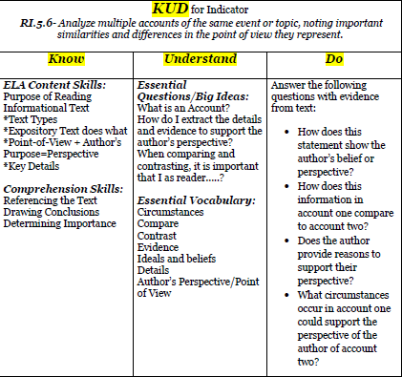
Corrective Instruction Tools
Corrective Instruction Action Steps
Step 3- Deconstruction of Standards

Slide 41
Assessment Calendar
Acuity A
Acuity B
Acuity C
Diagnostic A
Diagnostic B
Diagnostic C
Sep 22
Nov 3
Dec 1
Feb 2
Mar 9
Apr 13

