Slide 1
Virtual Charter Schools in Indiana Hoosier Academy and Insight SCHOOL OF INDIANA
August 1, 2018

Slide 2
Discussion Topics For Hoosier Virtual Academy and INSIGHT SCHOOL OF INDIANA
Enrollment Trends and Information
Withdrawal Trends and Information
Impact of New Engagement Law
State and School Assessment

Slide 3
Reasons Parents Choose Indiana Virtual Charter Schools
Several of the most popular reasons for choosing a virtual charter school relate to non-academic reasons, like safety and needing a temporary alternative.
Flexibility and teacher support are high priorities for all families.
The blue highlights show the top 5 reasons for each school’s grade band
REASON FOR ENROLLING | Hoosier VA MS | Hoosier VA HS | ISIN HS
Support of highly qualified, experienced teachers for each subject | 81% | 75% | 77%
Flexible scheduling/pacing (ability for this student to learn at his/her own pace) | 78% | 79% | 72%
Quality of curriculum | 83% | 74% | 65%
Reputation of [School Name]/K12-powered school | 71% | 64% | 64%
Dissatisfied with the academic instruction at his/her school | 57% | 44% | 59%
Ability to earn both High School and college credit on some courses through arrangements with colleges/universities | 43% | 56% | 56%
Ability to take career related course(s)/curriculum | 46% | 55% | 53%
Free tuition | 75% | 79% | 72%
Because [School Name] is a public school with recognition and backing of the state |  | 75% | 70%
My student has special needs | 43% | 48% | 47%
Variety of course levels available, including Honors and AP |  | 69% | 61%
Desired a higher level of safety and security for my student | 77% | 70% | 59%
Variety of electives available |  | 70% | 49%
Thought this would be a good way for my student to catch up academically | 50% | 43% | 71%
I thought this would be a good way for my student to be prepared for college |  | 59% | 51%
Needed a temporary alternative | 24% | 34% | 43%
Wanted to oversee/be more involved in my child’s education | 87%
My student is gifted and needed a more challenging academic program | 35% | 25% | 27%
Meets state required school standards | 83%
K12 is the kind of research-based, rigorous education I wanted for my child | 78%

Slide 4
When Do Students Enroll in Virtual Charter Schools?
As expected, there is a large new enrollment spike in the final weeks of August
There is another expected bump in enrollment in January for a second semester start
On average, 4 out of 10 students who enroll, start after October 1 of each year.
Enrollment Window | % of Total Enrollment
August & September | 59%
October - December | 14%
January-February | 20%
March-July | 7%
4

Slide 5
Overall Effect of Newly-Enrolled Students Hoosier Virtual Academy
A large number of the new students who attend Hoosier Virtual Academy
enroll on day one already credit deficient.*
The majority of seniors are enrolling behind expected graduation timelines.
*Hoosier Academy had very few new enrollees in the last two years due to enrollment caps and prospective school closure.

Slide 6
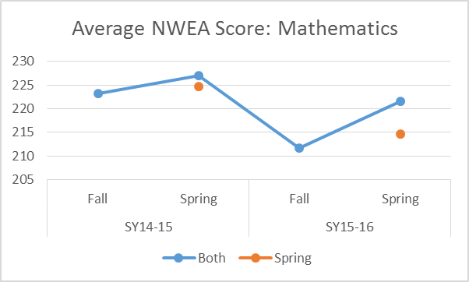
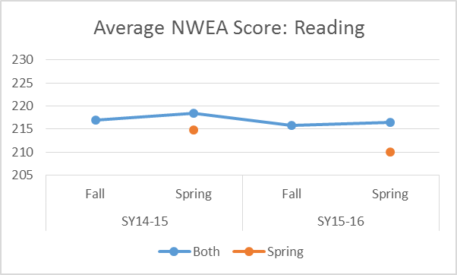
Effects and Characteristics of Late-Enrollees at Hoosier Virtual Academy (15-16 SY)*
The later in the school year students enroll, the lower they perform on the spring NWEA assessment.
Students who only have a spring NWEA score (late enrollees), usually score lower than students who have both a Fall and Spring score.
*Hoosier Academy had very few new enrollees in the last two years due to enrollment caps and prospective school closure.

Slide 7
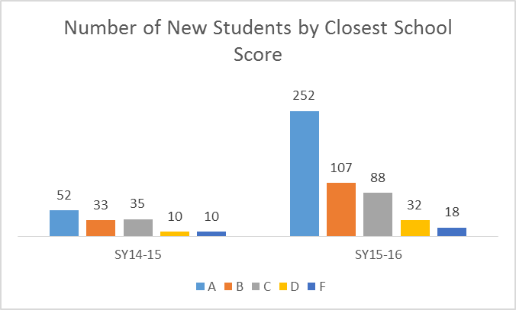
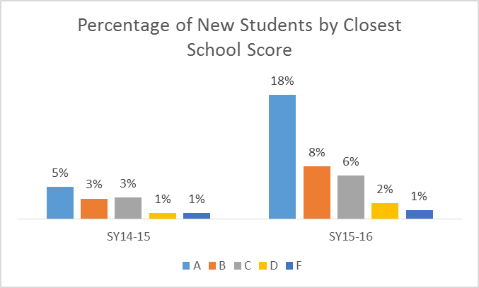
Where Did Late Enrollees Previously Attend School? (Before Enrolling at Hoosier Virtual Academy)
In the 2015-2016* school year, lower performing students from the highest performing schools enrolled in Hoosier Academy after the previous second funding count day and before the state testing window.
The number of late enrollees grew by 350 percent from SY14-15 to SY15-16.
*Hoosier Academy had very few new enrollees in the last two years due to enrollment caps and prospective school closure.

Slide 8
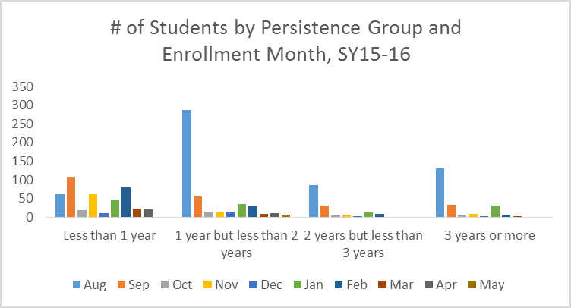
Student Persistence by Enrollment Month at Hoosier Virtual Academy
The majority of students enrolled longer than 1 year started school before the first semester, with another sizable group starting at the semester break.

Slide 9
Where Did Virtual Charter School Students Previously Attend School?
The largest percentage, and an increasing percentage, of virtual charter school students previously attended a public school.
Previous School Type | 2008 | 2009 | 2010 | 2011 | 2012 | 2013 | 2014 | 2015 | 2016 | 2017 | 2018 | Grand Total
Public school | 37.8% | 56.6% | 60.3% | 69.5% | 71.1% | 75.5% | 77.8% | 75.2% | 75.9% | 78.9% | 84.4% | 73.4%
Not in school/Other | 2.7% | 3.3% | 3.5% | 4.8% | 24.8% | 23.1% | 10.5% | 4.4% | 4.7% | 4.4% | 1.2% | 12.6%
Home school | 41.8% | 25.6% | 20.0% | 16.1% | 2.3% | 0.9% | 6.2% | 10.7% | 10.7% | 7.5% | 3.5% | 7.9%
Private school | 7.7% | 5.6% | 6.2% | 3.9% | 0.7% | 0.1% | 2.6% | 3.8% | 4.1% | 3.9% | 1.2% | 2.6%
Charter school | 6.5% | 5.8% | 8.2% | 3.3% | 0.8% | 0.2% | 1.4% | 4.3% | 3.3% | 4.1% | 6.9% | 2.4%
None | 0.2% | 0.0% | 0.0% | 1.4% | 0.1% | 0.0% | 1.0% | 0.6% | 0.1% | 0.1% | 0.0% | 0.4%
Virtual School | 0.0% | 0.0% | 0.2% | 0.0% | 0.1% | 0.1% | 0.2% | 0.5% | 0.8% | 0.8% | 2.3% | 0.3%
Out-of-State | 0.0% | 0.0% | 0.0% | 0.0% | 0.1% | 0.0% | 0.2% | 0.5% | 0.3% | 0.3% | 0.6% | 0.2%
Part-time public school/home school | 1.2% | 1.0% | 1.7% | 0.9% | 0.1% | 0.0% | 0.0% | 0.0% | 0.0% | 0.0% | 0.0% | 0.2%
Preschool | 2.0% | 1.9% | 0.0% | 0.0% | 0.0% | 0.0% | 0.0% | 0.0% | 0.1% | 0.0% | 0.0% | 0.1%
District School | 0.0% | 0.2% | 0.0% | 0.0% | 0.0% | 0.0% | 0.0% | 0.0% | 0.0% | 0.1% | 0.0% | 0.0%
Private School - Parochial | 0.0% | 0.0% | 0.0% | 0.0% | 0.0% | 0.0% | 0.0% | 0.0% | 0.0% | 0.0% | 0.0% | 0.0%
Private School - Independent | 0.0% | 0.0% | 0.0% | 0.0% | 0.0% | 0.0% | 0.0% | 0.0% | 0.0% | 0.0% | 0.0% | 0.0%
Parochial school | 0.0% | 0.0% | 0.0% | 0.0% | 0.0% | 0.0% | 0.0% | 0.0% | 0.0% | 0.0% | 0.0% | 0.0%
9

Slide 10
Parent-Initiated Withdrawal Reasons 2008-2018
The main reason for parent-initiated withdrawals is “Student Needs Structure of B&M (Brick and Mortar)” followed by ”Don’t like Online Model”
Top 25 Most Used Parent WD Reasons | Jan | Feb | Mar | Apr | May | Jun | Jul | Aug | Sep | Oct | Nov | Dec | Grand Total
Student Needs Structure of B&M | 394 | 221 | 195 | 140 | 137 | 13 | 157 | 714 | 204 | 196 | 173 | 134 | 2678
Program: Don't like Online Model | 251 | 337 | 157 | 119 | 234 | 3 | 43 | 56 | 214 | 387 | 282 | 389 | 2472
Curriculum/Material | 263 | 146 | 110 | 91 | 92 | 11 | 35 | 266 | 183 | 117 | 96 | 116 | 1526
Records request received | 165 | 90 | 61 | 37 | 73 | 7 | 16 | 461 | 170 | 136 | 115 | 156 | 1487
Transferring to another Full-time Online program* | 218 | 33 | 19 | 8 | 10 | 689 | 179 | 151 | 84 | 33 | 41 | 18 | 1483
Moving out of area served by school | 71 | 96 | 74 | 58 | 58 | 21 | 15 | 86 | 73 | 75 | 48 | 70 | 745
Accepted into a Preferred School | 40 | 24 | 14 | 5 | 113 | 16 | 27 | 230 | 104 | 77 | 34 | 13 | 697
Too much time commitment for the learning coach | 44 | 24 | 15 | 11 | 3 | 0 | 5 | 122 | 70 | 36 | 26 | 22 | 378
Student not motivated to complete work in this environment | 29 | 82 | 38 | 32 | 20 | 5 | 0 | 29 | 32 | 27 | 31 | 38 | 363
Learning coach no longer available | 41 | 28 | 19 | 10 | 6 | 16 | 5 | 88 | 40 | 27 | 32 | 22 | 334
Family left message with the office | 7 | 3 |  |  | 93 | 4 | 6 | 163 | 25 | 8 | 7 | 4 | 320
Workload | 16 | 5 | 4 | 8 | 2 | 27 |  | 154 | 14 | 5 | 10 | 15 | 260
Student Unavailable | 17 | 23 | 51 | 27 | 12 |  |  |  | 2 |  | 33 | 4 | 169
Health issues in the family | 19 | 24 | 14 | 12 | 8 | 1 | 3 | 26 | 16 | 18 | 13 | 8 | 162
Lack of socialization | 23 | 8 | 6 | 7 | 3 | 1 | 4 | 34 | 15 | 19 | 16 | 16 | 152
Number of required live Class Connect sessions | 7 | 8 | 5 | 3 | 2 |  | 1 | 38 | 29 | 11 | 11 | 17 | 132
Technical issues | 9 | 14 | 5 | 8 | 5 | 2 | 1 | 18 | 11 | 9 | 15 | 15 | 112
Pace of program is too fast for the student | 8 | 9 | 6 | 5 | 1 | 1 |  | 13 | 20 | 12 | 16 | 3 | 94
Economic Hardship | 18 | 4 | 3 | 1 | 4 | 1 | 2 | 18 | 4 | 5 | 8 | 7 | 75
Objects to public school requirements | 5 | 5 | 5 | 4 | 2 | 0 | 1 | 13 | 11 | 14 | 4 | 1 | 65
Student wants to get GED | 6 | 11 | 9 | 8 | 8 | 1 | 1 | 5 | 2 | 7 | 1 | 5 | 64
Time Commitment/Organization/Skills | 9 | 5 | 4 | 3 | 2 | 4 | 3 | 3 | 5 | 11 | 2 | 1 | 52
General Dissatisfaction with School | 3 | 4 | 6 |  | 2 |  |  |  | 13 | 7 | 7 |  | 42
Lack of start-up support | 7 | 3 | 2 | 1 |  |  | 1 | 3 | 5 | 4 | 2 | 3 | 31
Student Ran Away | 3 | 1 | 4 | 3 | 8 | 1 | 3 | 2 | 3 | 1 |  | 1 | 30
10

Slide 11
School Initiated Withdrawals Withdrawal Reasons (2008-2018)
The adoption and implementation of a policy related to the state’s new engagement law is the most common reason for school-initiated withdrawals at Insight.
Withdrawal reasons for Hoosier Virtual Academy may be skewed due to the school’s pending closure.
Hoosier Virtual Academy (2008-2018) | % of WD Reason
Not Registering | 40.43%
Attendance/Progress Policy | 20.72%
Status Unknown | 16.8%
Expelled | 11.72%
Truancy – Unknown | 5.11%
Undecided | 3.92%
Administrative Transfer between partner schools | 1.47%
Undefined | 0.20%
Compliancy requirements not met | 0.03%
Insight School of Indiana | % of WD Reason
Attendance issue withdrawal | 46.38%
Status Unknown | 30.00%
Not Registering | 18.97%
Administrative transfer between school group campus | 3.28%
Undecided | 1.38%
11

Slide 12
Students Transferring to Another Full Time Virtual School
In 2018, the number of students transferring to another virtual charter school climbed to 643 in large part due to Hoosier Virtual Academy’s pending closure.
 | Transferred in 2018
Enrolled 2014 | 117
Enrolled 2015 | 136
Enrolled 2016 | 271
Enrolled 2017 | 97
Enrolled 2018 | 22
Grand Total | 643
12

Slide 13
Teacher Instructional Session Attendance Insight School of Indiana
Insight increased its attendance in live teacher-led instructional sessions by more than 100 percent in middle school and more than 200 percent in high school.
Much of the increase in attendance is attributable to the new engagement law and the related school policy.
Insight School of Indiana Teacher-Led Instruction
 | Middle School | High School
SY16-17 | 24% | 12%
SY17-18 | 51% | 42%
Percent Different | 109% | 232%

Slide 14
Overall Course Passing Rate Insight School of Indiana
Insight increased its course passing rates across all grade levels by 9 to 97 percent during the 2017-18 school year.
Much of the increased passing rate is attributable to the engagement law and the related school policy.
Insight School of Indiana Course Passing Rates
Grade: | SY16-17 | SY17-18 | Percent Difference
7th | 42.5% | 72.6% | 70.8
8th | 41.6% | 82.0% | 97.1
9th | 55.1% | 60.0% | 8.9
10th | 34.0% | 58.1% | 70.9
11th | 34.0% | 44.5% | 30.9
12th | 33.5% | 37.5% | 11.9
Overall Passing Rate | 40.10% | 59.1% | 47.4

Slide 15
Assessment 2017-18
Creating a culture of measurement across the schools
20-24 state testing sites in close proximity to students’ residences
99 percent of students completed state assessments for Insight
97 percent of students completed state assessments for Hoosier Virtual Academy
80 percent of students participated in school-based interim assessments
Students participated in an average of 1.5 hours per week of Ascend and Mindplay

